Slide 1
Interactive Visualization of Standardized CDISC-SEND-Formatted Toxicology Study Data Using R Shiny
R/Pharma
Kevin Snyder, Ph.D.
FDA Center for Drug Evaluation and Research, Office Of New Drugs
Silver Spring, MD
August 22, 2019

Slide 2
Disclaimer
This presentation reflects the views of the author and should not be construed to represent FDA’s views or policies.

Slide 3
Introduction
The FDA has recently mandated that electronic CDISC-SEND datasets be submitted along with new toxicology study reports for study types that can be modelled in SEND, e.g. repeat-dose toxicology, carcinogenicity.
Widespread use of the SEND data standard has created an opportunity for the collaborative development of open source software solutions to analyze and visualize nonclinical toxicology study data.

Slide 4
Standard for Exchange of Nonclinical Data (SEND)
SEND is a data standard created by the Clinical Data Interchange Standards Consortium (CDISC) to enable collection and presentation of nonclinical data in a consistent format, i.e. SAS Transport Files (.xpt).
In December 2014, the FDA finalized a binding guidance requiring that certain clinical and nonclinical studies be submitted with standardized electronic data, formatted in accordance with the standards recognized in FDA Data Standards Catalog, which currently includes SEND versions 3.0 and 3.1.
For INDs/NDAs, repeat-dose and carcinogenicity studies initiated after December 17, 2017/2016 are required to be submitted with SENDv3.0 datasets.

Slide 5
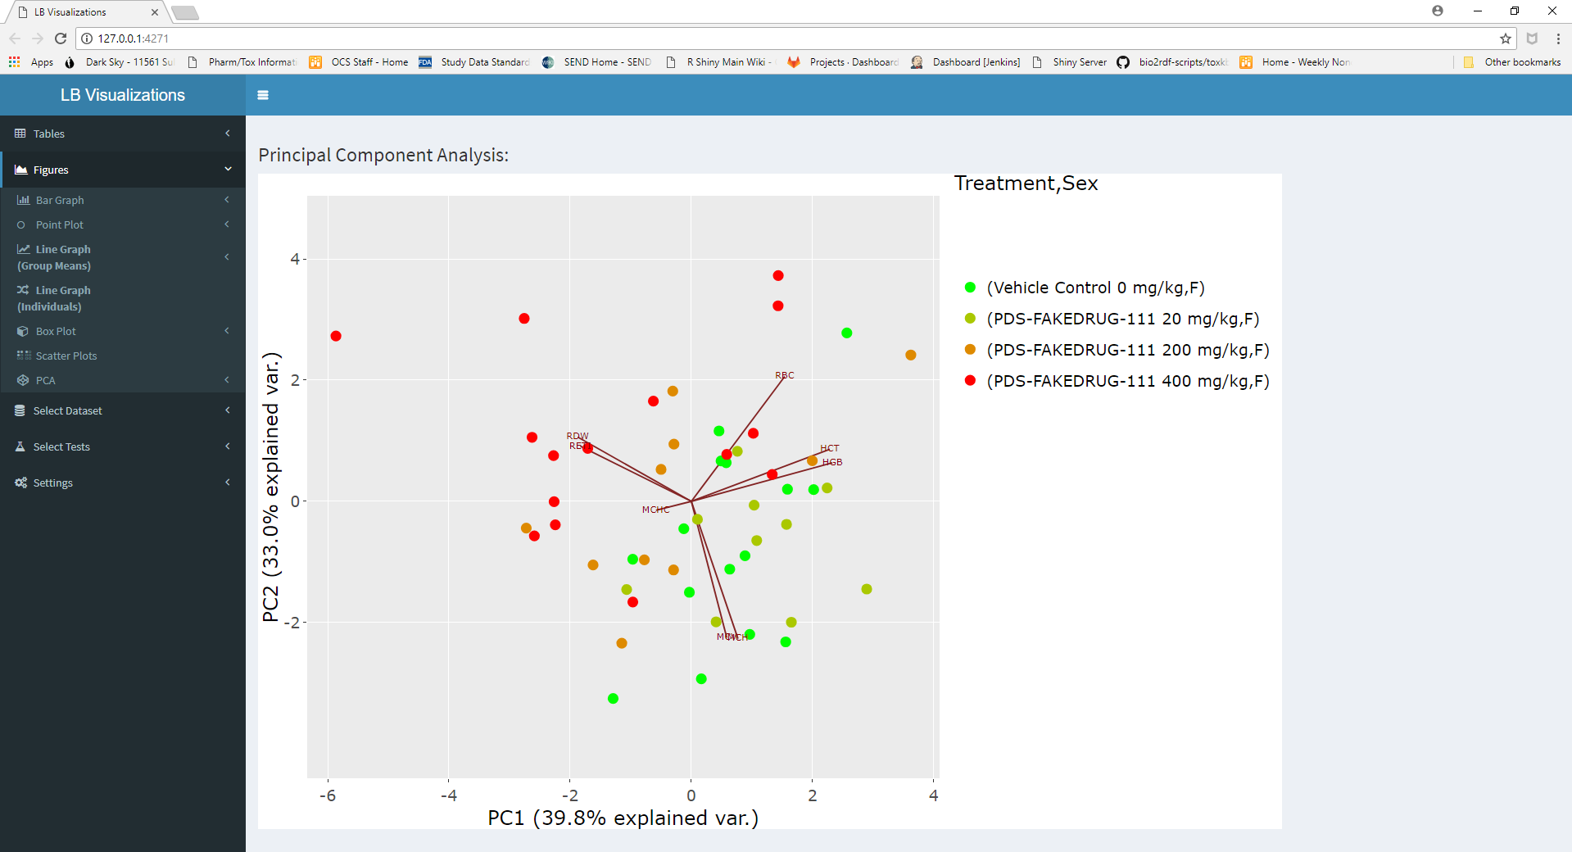
Advantages of SEND-Formatted Toxicology Study Data
Open source software can be collaboratively developed and used across organizations:

Slide 6
Collaborative Development of Open Source Web-Based R Shiny Applications via PhUSE
Shiny is an R package developed by RStudio to enable R programmers to easily build interactive web applications (https://shiny.rstudio.com).
The Pharmaceutical Users Software Exchange (PhUSE) Nonclinical Scripts Working Group has used R Shiny to develop and share several SEND-related applications.
Example: An R Shiny App has been developed to visualize laboratory test results (e.g. clinical chemistry, hematology) collected during a nonclinical toxicology study and encoded in SEND via the LB domain.

Slide 7
Traditional Static Tabular Representation of Toxicology Study Data
(NTP Toxicity Report Series, 2017)

Slide 8
Shortcomings of Static Tabular Representation of Toxicology Study Data
Difficult to integrate analysis across several independent variables:
e.g., test, treatment, sex, day
Difficult to assess treatment effects in individual subjects.
Impossible to assess correlation of treatment effects across tests.
Difficult to assess relative changes via data transformations:
e.g., percent change from control, change from baseline

Slide 9
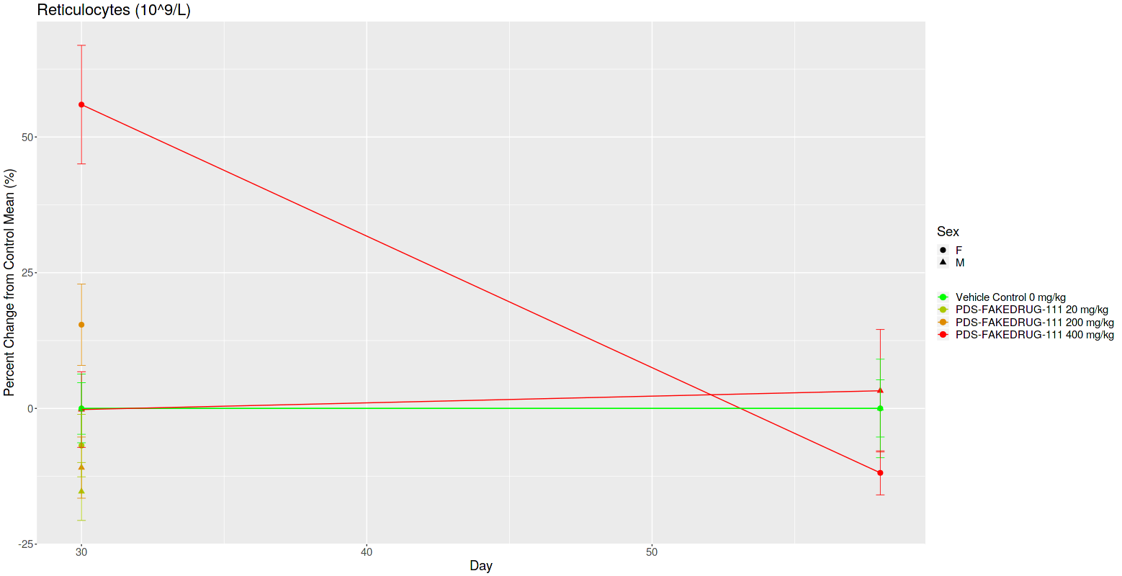
Advantages of SEND-Formatted Toxicology Study Data
Treatment effects can be observed simultaneously across multiple independent variables, e.g. sex and day:

Slide 10
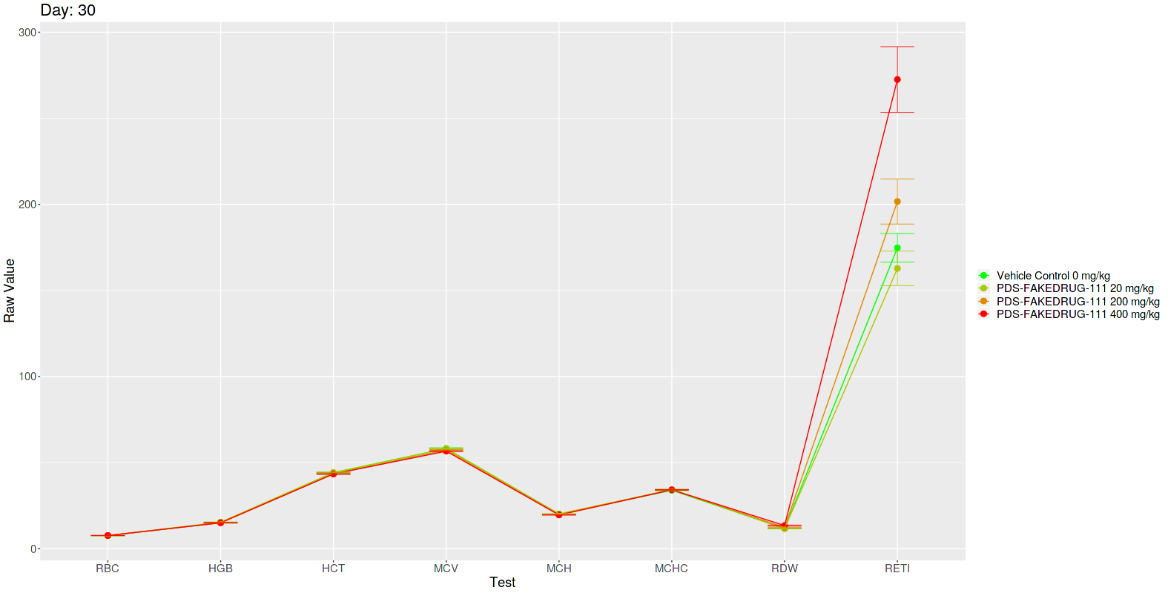
Advantages of SEND-Formatted Toxicology Study Data
Data can be transformed (e.g. z-score) to simultaneously assess treatment effects across several tests with vastly different scales.
Un-Transformed → Transformed

Slide 11
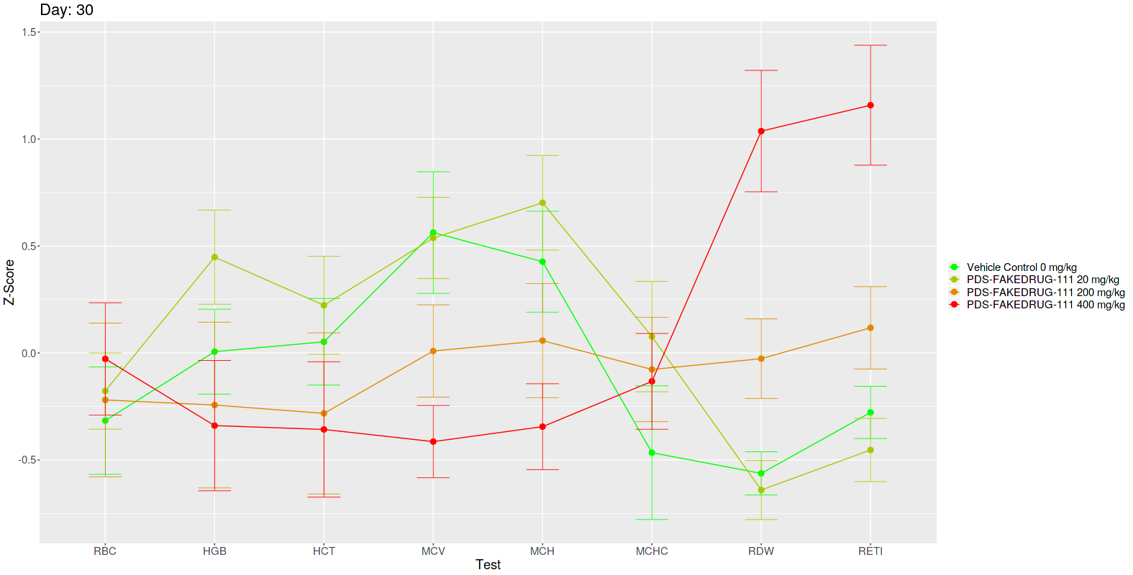
Advantages of SEND-Formatted Toxicology Study Data
Data can be transformed (e.g. z-score) to simultaneously assess treatment effects across several tests with vastly different scales.
Un-Transformed → Transformed

Slide 12
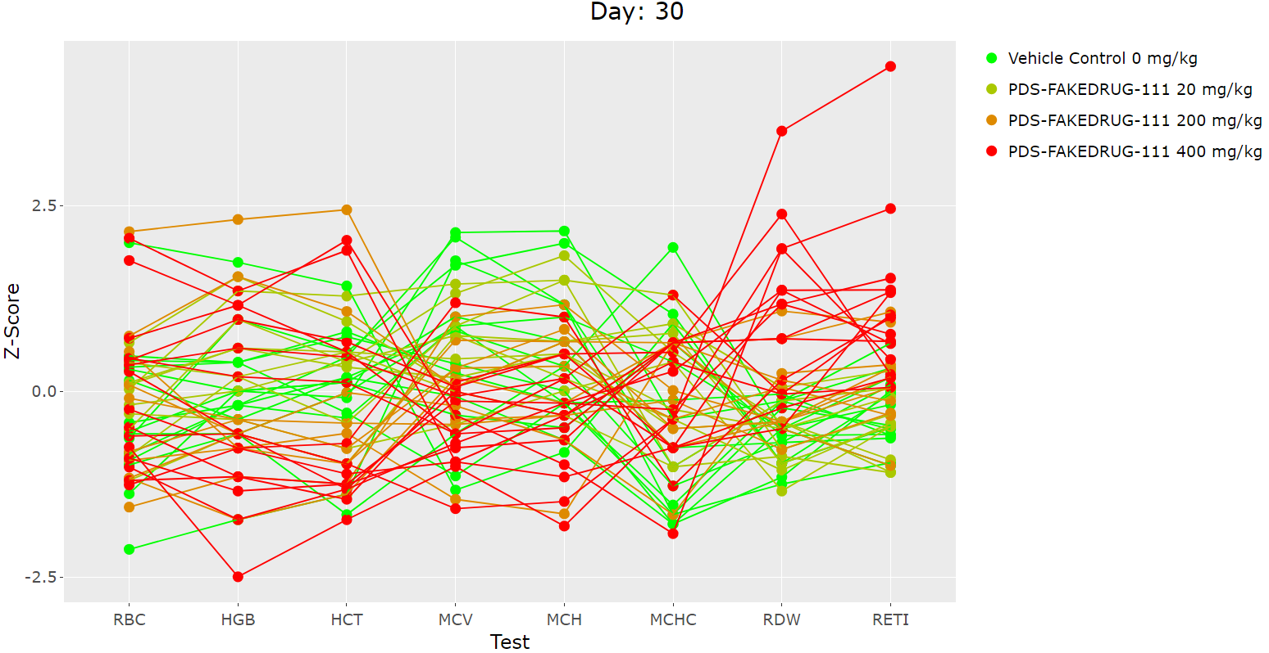
Advantages of SEND-Formatted Toxicology Study Data
Evaluate individual subject results simultaneously across tests:

Slide 13
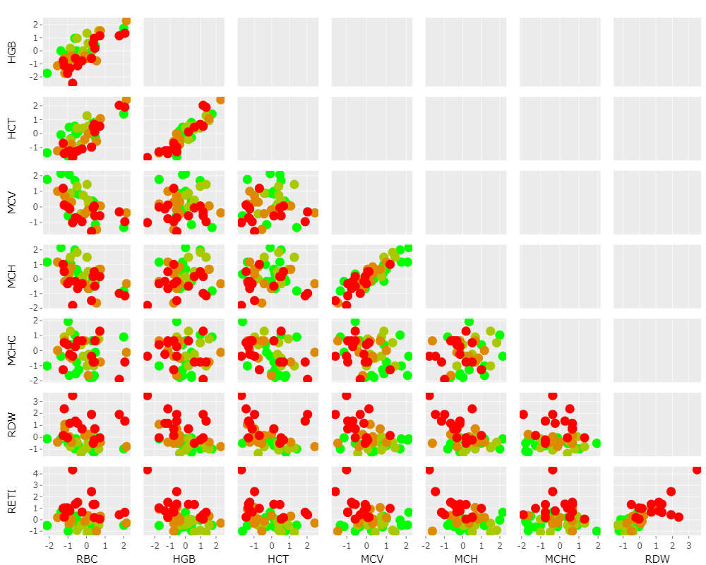
Advantages of SEND-Formatted Toxicology Study Data
Evaluate correlations among test results:

Slide 14
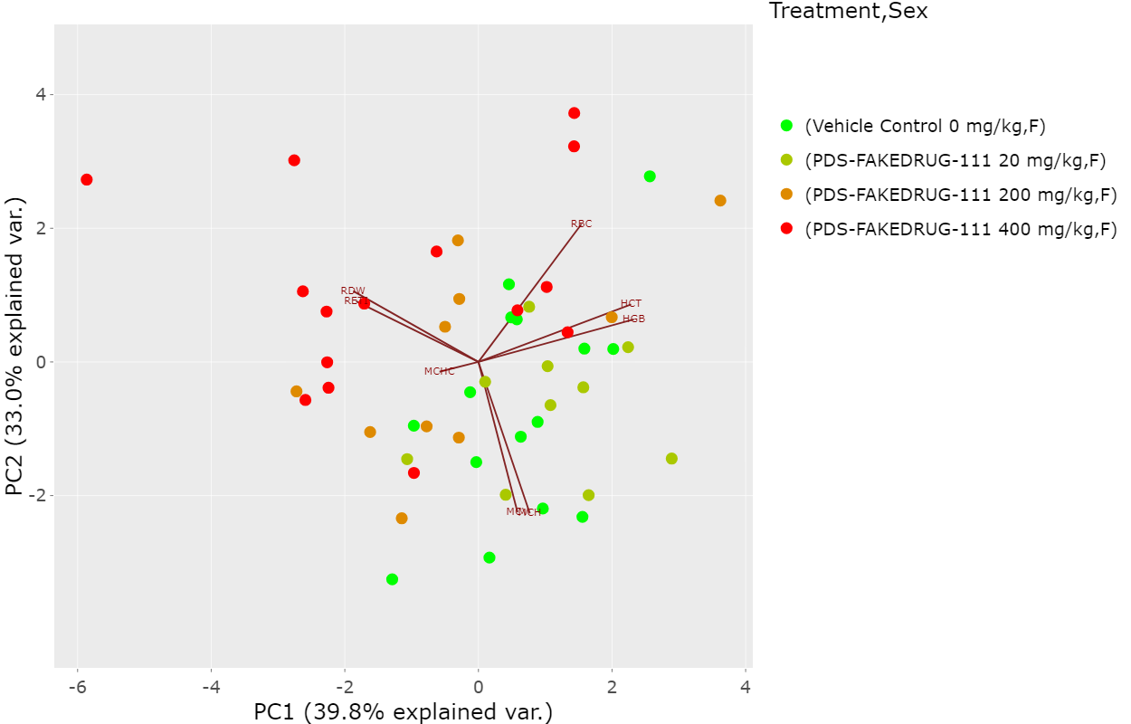
Advantages of SEND-Formatted Toxicology Study Data
Employ dimensionality reduction techniques, e.g., principal component analysis (PCA), to evaluate the differences in individuals across a set of test results.

Slide 15
Application Details
The application was developed in collaboration with the Pharmaceutical Users Software Exchange (PhUSE) Nonclinical Scripts Working Group.
The R Shiny web application is currently hosted on a public R Shiny server provided by RStudio (https://www.shinyapps.io).
https://phuse-nonclinical-scripts.shinyapps.io/LBapp
The source code for the R Shiny application is available on GitHub:
https://github.com/phuse-org/phuse-scripts/tree/master/contributed/Nonclinical/R/LBapp

Slide 16
Interested in Collaborating?
Contact the co-leaders of the PhUSE Nonclinical Scripts Project:
Kevin Snyder: kevin.snyder@fda.hhs.gov
Bill Houser: william.houser@bms.com
We are always looking to welcome new team members!

Slide 17
Software Demonstration
https://phuse-nonclinical-scripts.shinyapps.io/LBapp

