Slide 1

Making sure you are in the right conference …
2019 COPSS (The Committee of Presidents of Statistical Societies) Award
“统计学诺贝尔奖”被授予给那位改变了R语言的人

Slide 2
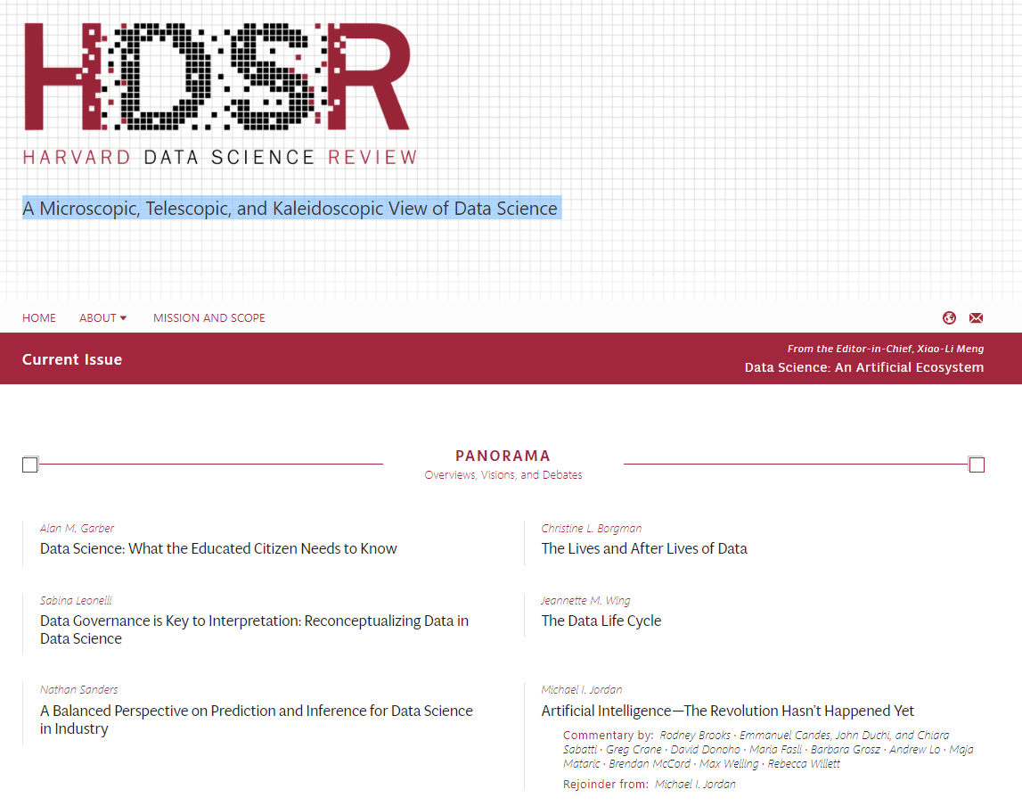

Slide 3

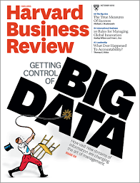
HDSR
The Digital Platform for Scholarship, Learning, and Impact of Data Science
A Premier Research Journal
A Popular Magazine
A Leading Education Publication

Slide 4
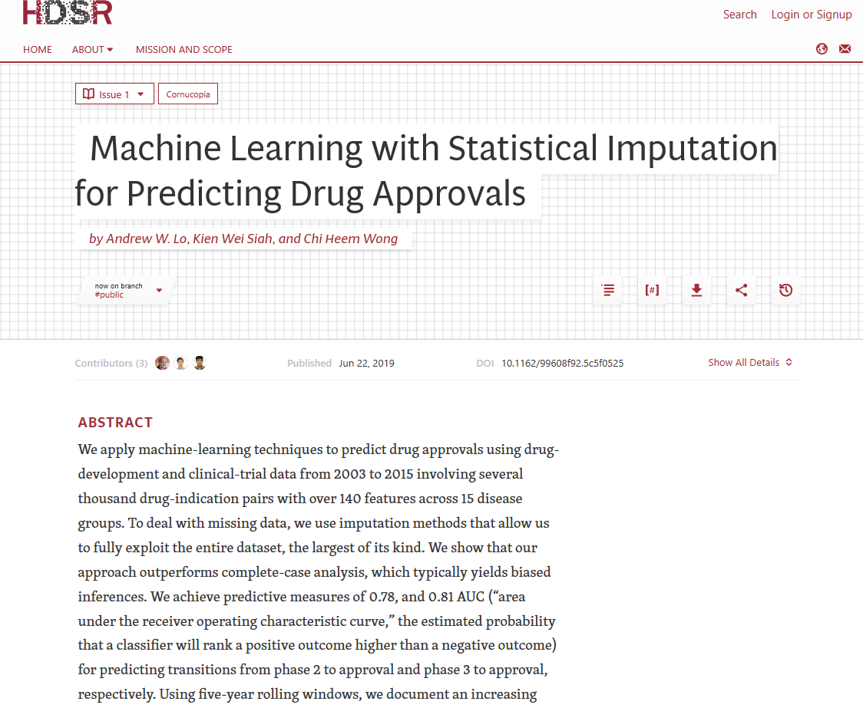

https://www.youtube.com/watch?v=AzELyaVf0v8&t=12s

Slide 5
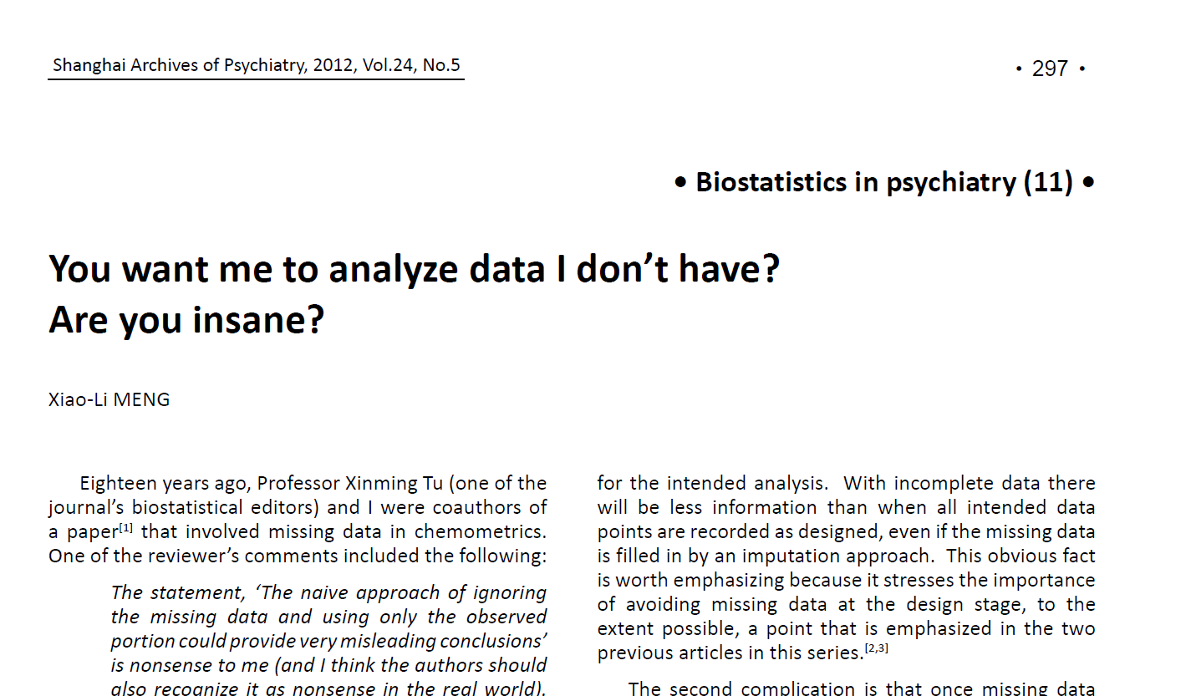

Slide 6

3 Complications
Inapplicability of standard methods and software
Reduced sample size and information
Data distortion due to selection/nonresponse bias
3 Common Mistakes
Drop any subject with missing values (complete case analysis)
Fill in missing values by some guesses (e.g., averages)
Analyze the imputed data as if they were real
3 Questions to ask
Why are data missing?
Do the missing data really make any difference?
Have I done the best that I could to handle the missing data?
3 Classes of Methods
Nonparametric: Reweighting
Parametric: modelling and EM-like fitting
Imputation: Multiple imputation

Slide 7
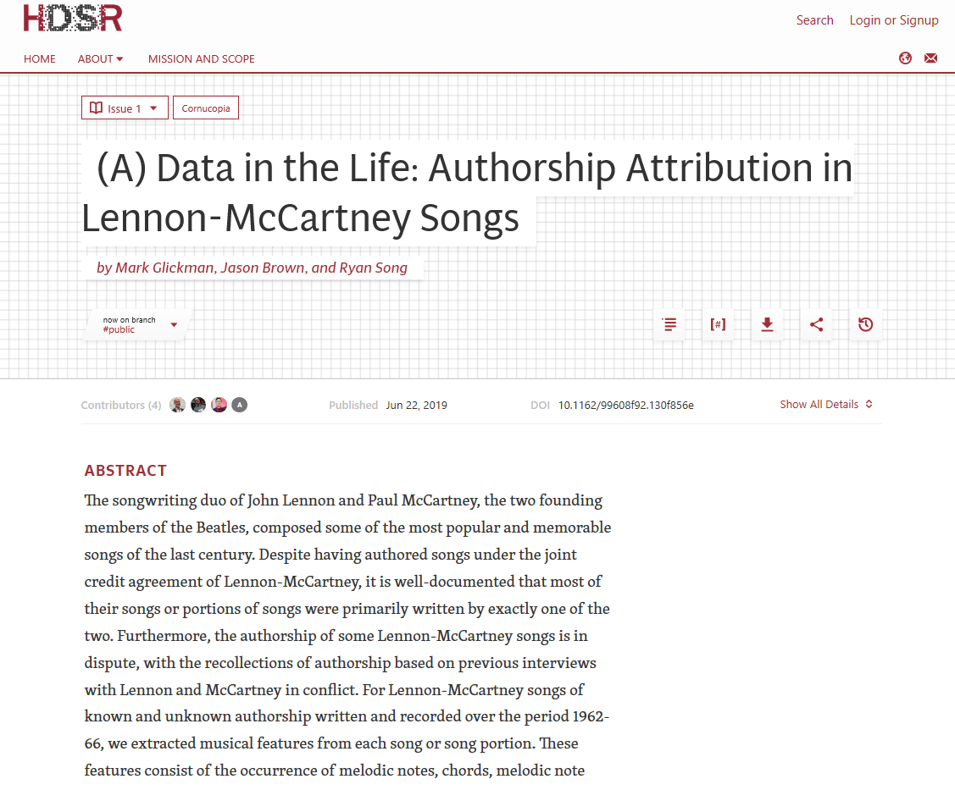


Slide 8
