Slide 1

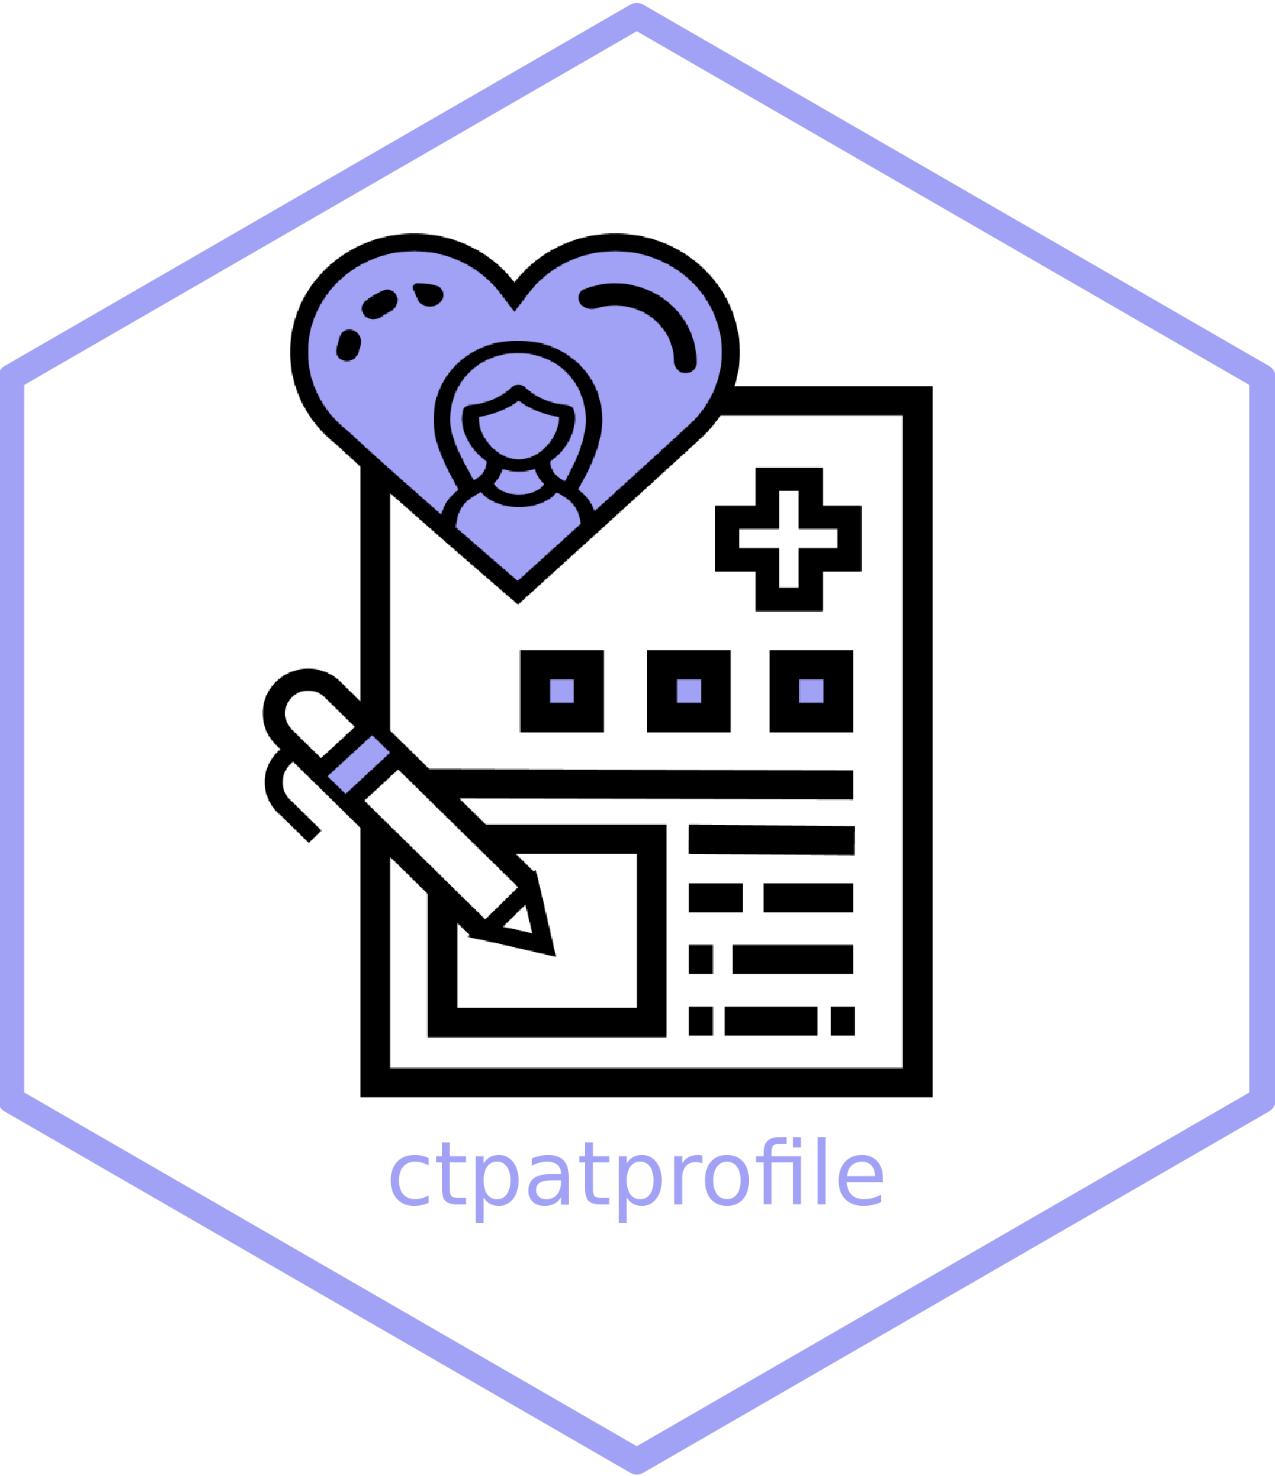
EDC to Patient Profiles
A Biotech {ctpatprofile} Story
Preston Burns
Maya Gans
Nathan Kosiba

Slide 2
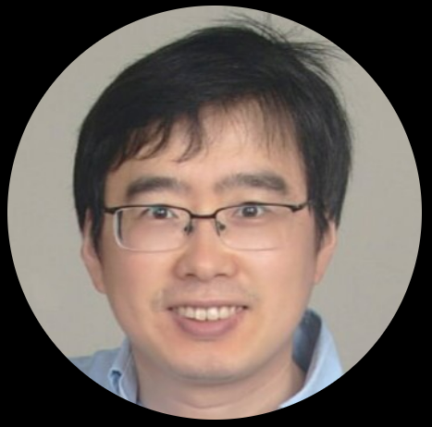
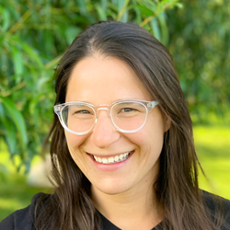

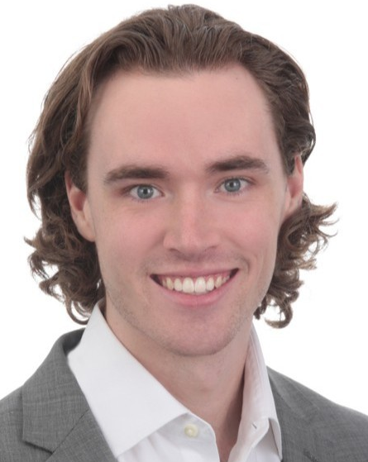
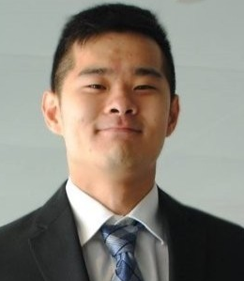
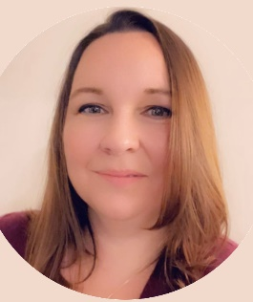
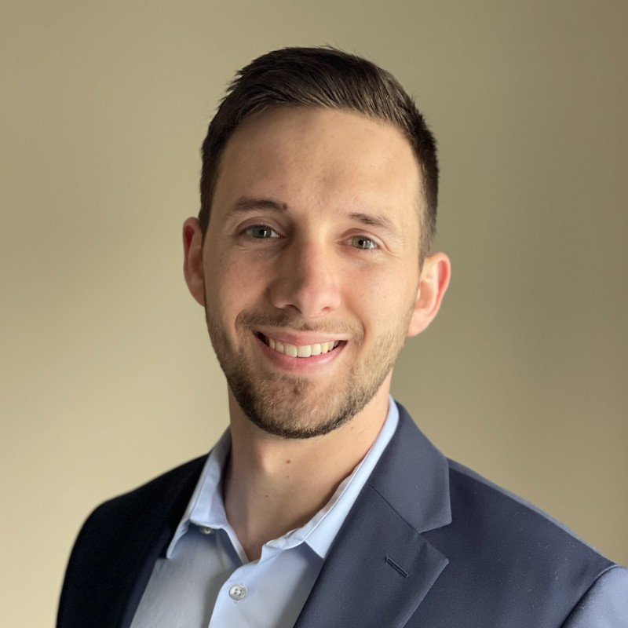

Acknowledgements
Sarepta Data Scientists
PV
Mansi Bhatt
Ijeoma Emenike
Mark Vivien
Ewa Wilk-Durakiewicz
Tricia O’donnell
Emanuel Palatinsky
Joy Haugh
Clinical development
Larry Orogun
Darko Stevanovic
Fernanda Leal-Pardinas
IT
Joseph Nash (Davis)
Rama Taraka
Kathleen Stenson
IDEA-R Leader
Biometrics
Ariful Islam
Jing Li
Nina Garfinkel
Preston Burns
Xiao Ni
Eli Miller (Atorus)
Jiwan Heo (Atorus)
Kent Ritchie (Atorus)
Kirsty Lauderdale (Atorus)
Maya Gans (Atorus)
Mike Stackhouse (Atorus)
Nathan Kosiba (Davis)
Data Management
John Mullin
Keryn Corcoran
Karina Vera
Xiao Ni
Maya Gans
^{Atorus}
Nathan Kosiba
^{Davis}
Kent Ritchie
^{Atorus}
Jiwan Heo
^{Atorus}
Kirsty Lauderdale
^{Atorus}
Preston Burns

Slide 3
AGENDA
Patient Profile: No Good Choices
ctpatprofile: R Shiny + Raw Data Pipeline
Design Principles
Intuitive User Interfaces
Flexible YAML Application Configuration
Enabling Communication
Parallel PDF Generation
Tomorrow: One-Stop Shop

Slide 4
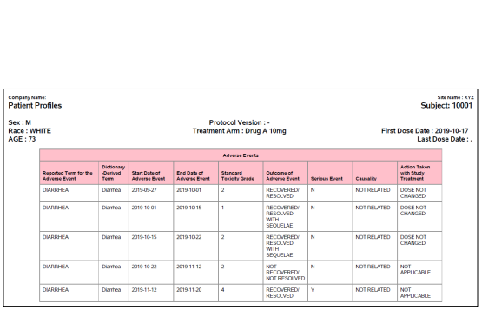
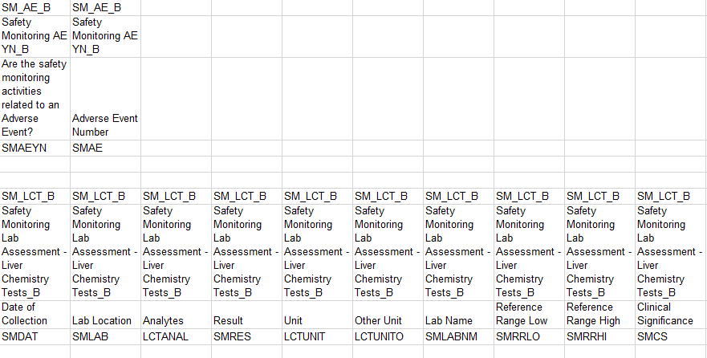



Rare Disease Biotech with Complex Safety Rules:
Patient Profiles Very Important
Historical Options:
Expensive and requires cdisc derivations
(internal + external vendors)
Laborious, error-prone, or static
(internal prog/DM)
No Good Choices
ctpatprofile
Design Principles
Intuitive UI
YAML Configuration
Communication
Parallelized PDF

Slide 5


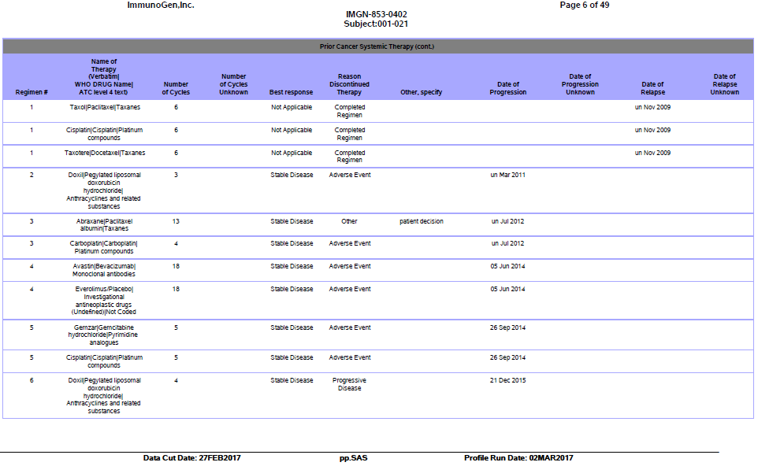


ctpatprofile: R Shiny + Raw Data Pipeline
Choose Patient
View/Export Patient Profile
Export and replace domain/variable configuration (when needed)
Select/Sort variables (if needed)
Replace data cut in BOX (if needed)
Select/Sort domains (if needed)
PV/DM Workflow
Printable Patient Profile PDF
End-to-end self-service, e.g. DM refresh data in Box and export PDF patient profiles on demand
Dynamically query patients on the fly
Eliminate patient-to-patient manual repetitive work through automation in Shiny
No Good Choices
ctpatprofile
Design Principles
Intuitive UI
YAML Configuration
Communication
Parallelized PDF
Notes:
Power back to user – run on demand

Slide 6


Design Principles
Built as an application framework​
Extensible feature list​
Modular design​
Designed to be used for many studies​
No Good Choices
ctpatprofile
Design Principles
Intuitive UI
YAML Configuration
Communication
Parallelized PDF

Slide 7
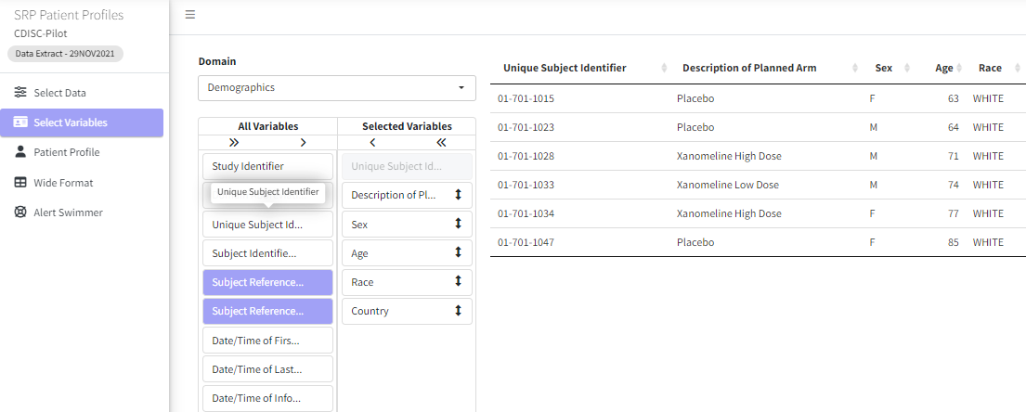
User Interface
Interactively switch between variable names and labels
Tooltips
Click and Drag to reorder
Interactive example listing
Minimalist button design
Easily switch between domains
1
A Variable Selection Example
2
4
6
5
3
2
4
3
3
1
5
6
No Good Choices
ctpatprofile
Design Principles
Intuitive UI
YAML Configuration
Communication
Parallelized PDF

Slide 8
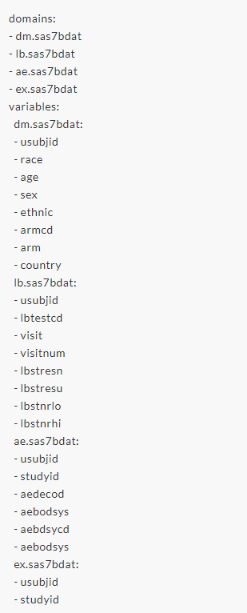
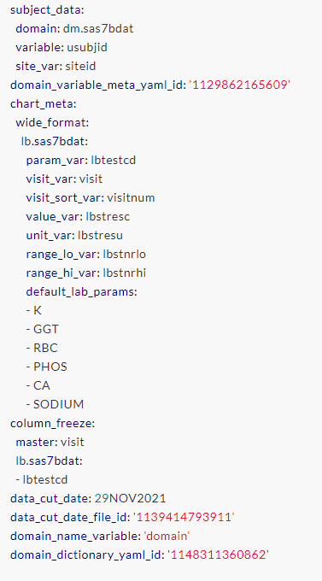

Application Configuration
Domain & Variable
Config
Study Config
App Config
No Good Choices
ctpatprofile
Design Principles
Intuitive UI
YAML Configuration
Communication
Parallelized PDF

Slide 9
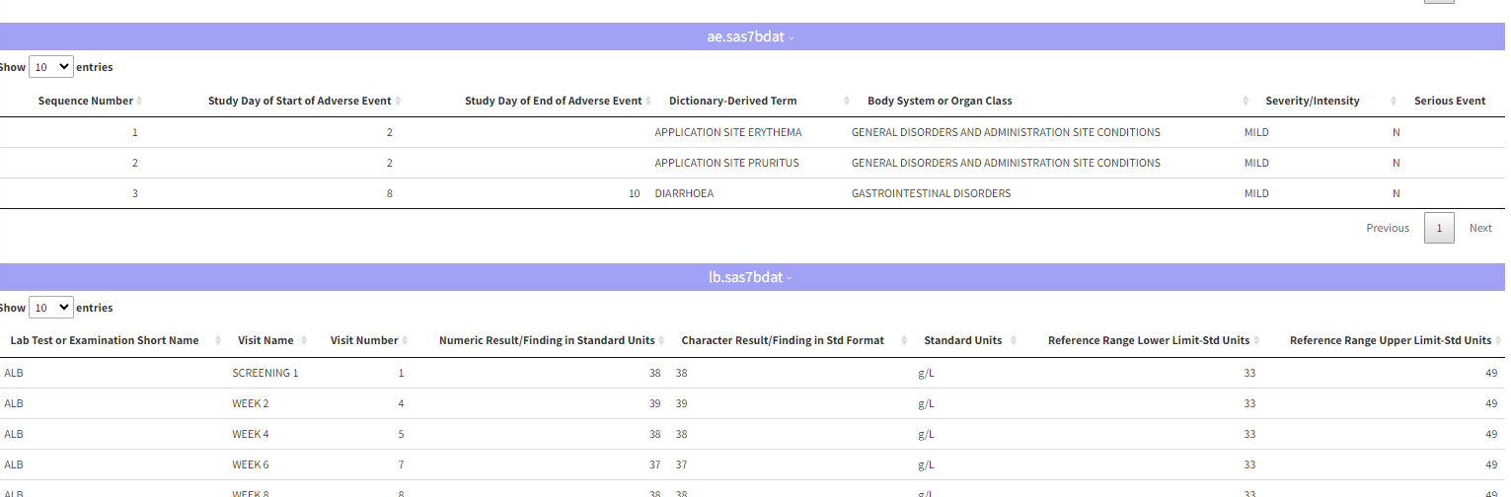
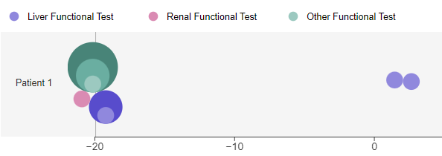
Application Configuration
Study Config
Domain & Variable Config
Listing
Alert Swimmer
No Good Choices
ctpatprofile
Design Principles
Intuitive UI
YAML Configuration
Communication
Parallelized PDF

Slide 10
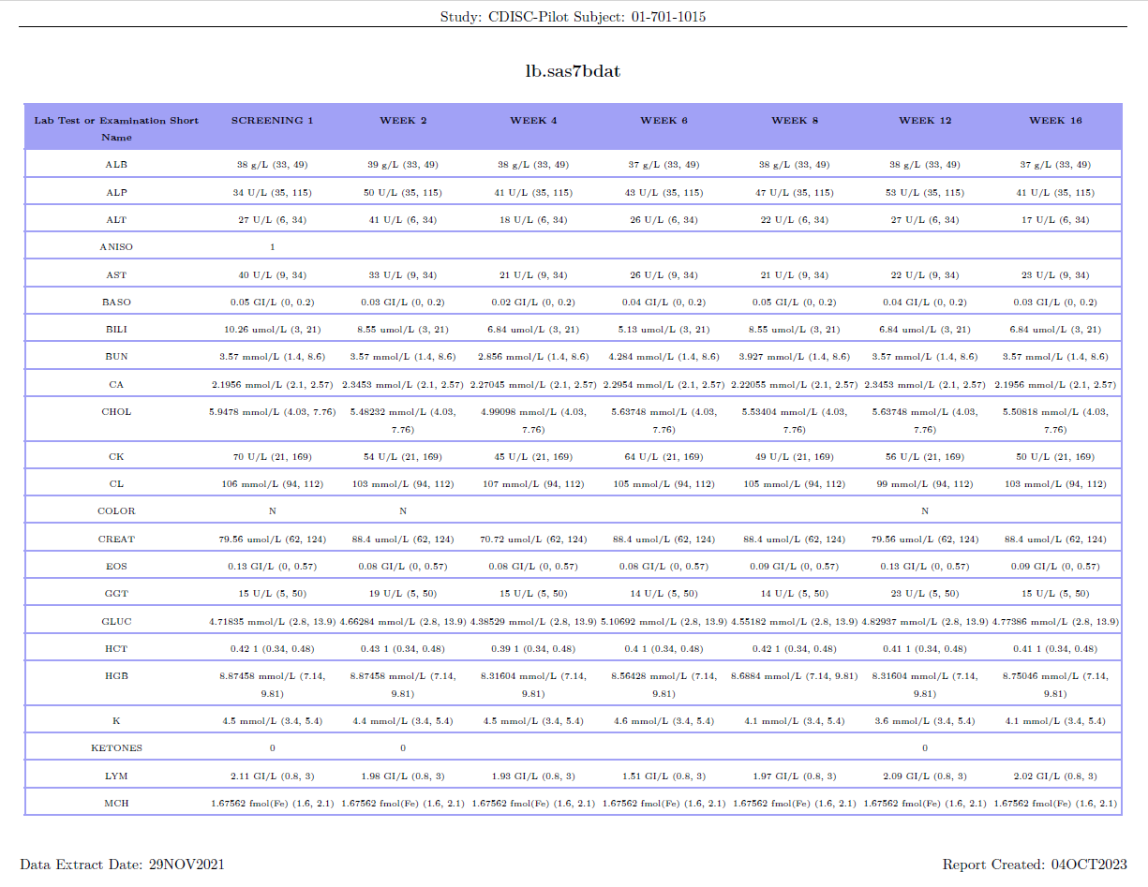
Communication
Export to flat files:
Fit-for-purpose
XLSX for wide format
PDF for patient profiles
Maintain Features (e.g. coloring)
Sharing with non-app users
Archiving results
Upload to downstream systems
No Good Choices
ctpatprofile
Design Principles
Intuitive UI
YAML Configuration
Communication
Parallelized PDF

Slide 11


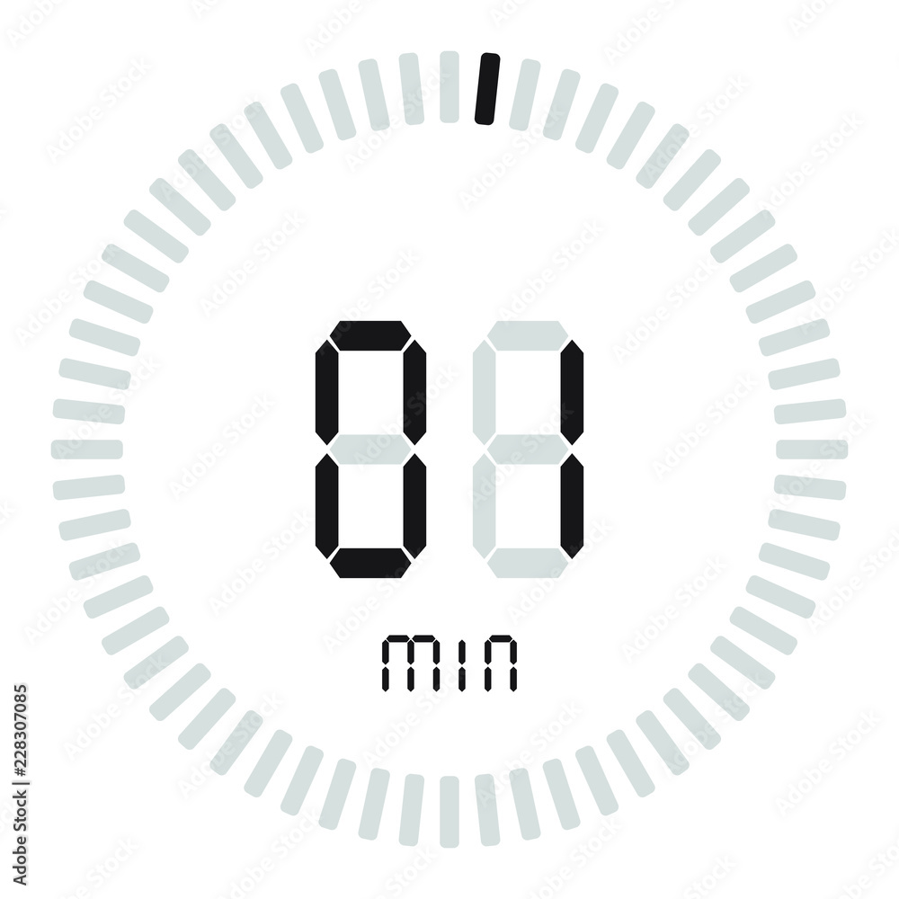
Parallel PDF Generation
Problem
Lessons Learned
{knitr} parallelization is not easy
Separate chunks into isolated spaces
Solution
Lessons Learned
20+ domains
70-page PDFs
Sequential Processing
Generate small PDFs
Stack large PDF
Parallelize Processing
Parallelized {knit}ting
Process Isolation
Insistent Processing
No Good Choices
ctpatprofile
Design Principles
Intuitive UI
YAML Configuration
Communication
Parallelized PDF

Slide 12
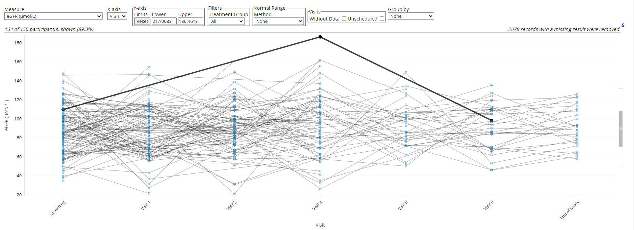
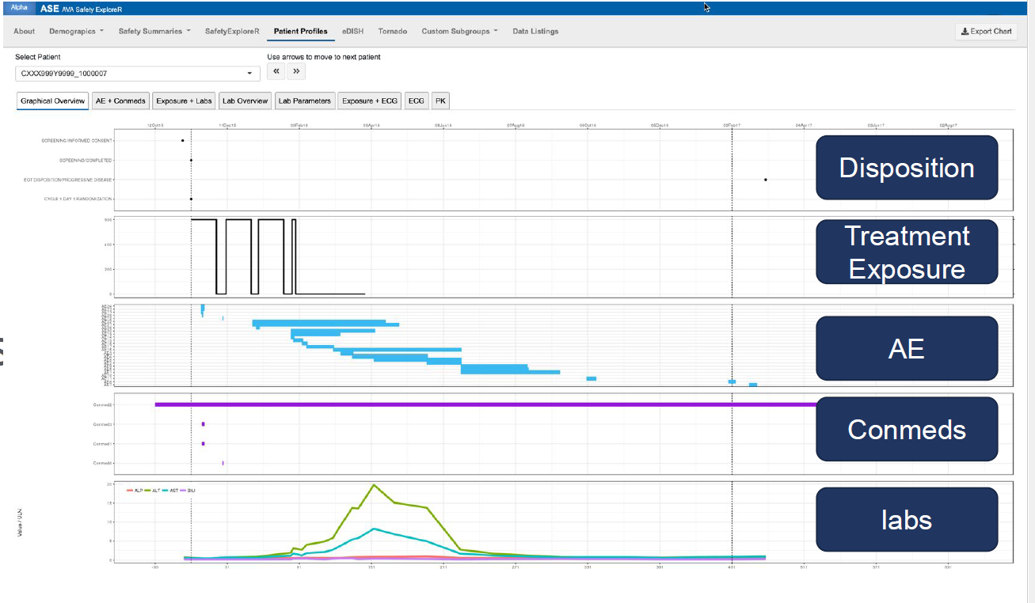
Tomorrow: One-Stop Shop {ctpatprofile}
1*
2
3
*https://github.com/SafetyGraphics/safetyGraphics

Slide 13
Thank you
Questions?
PrBurns@Sarepta.com

