Slide 1

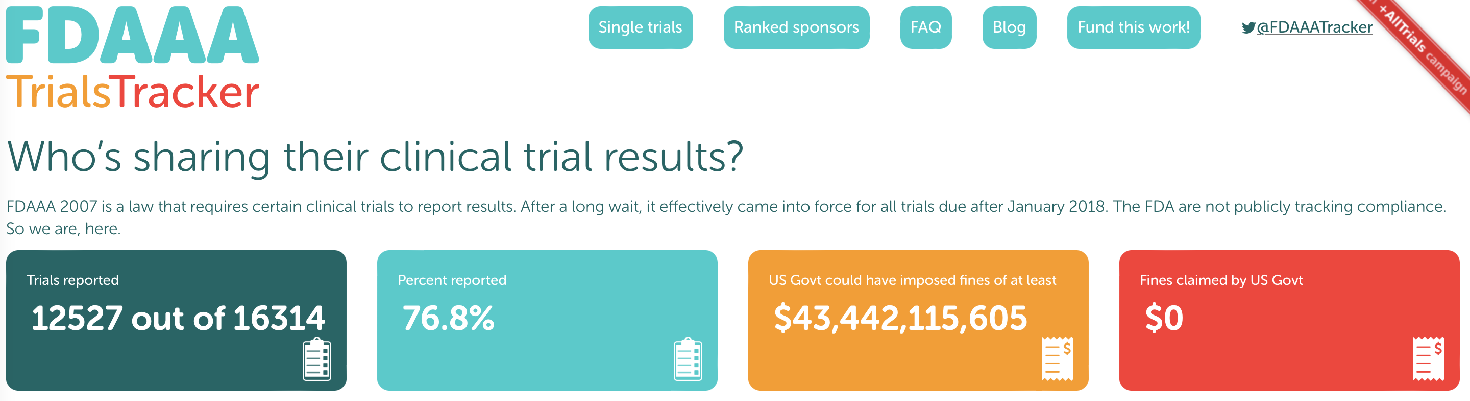
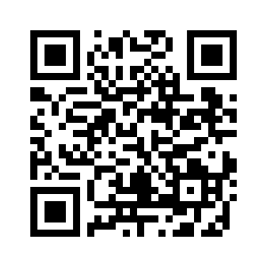
Section 801 of the Food and Drug Administration Amendments Act of 2007 (FDAAA 801)
Final Rule for Clinical Trials Registration and Results Information Submission
Applicable Clinical Trials (ACT) registered within 21 days of enrollment of first participant
Results submitted no later than 1 year after ACT primary completion date
Non-compliance could result in loss of all funding for an institution
Work supported by Yale Clinical and Translational Science Award CTSA UL1TR001863

Slide 2

The Dashboard was created because…
Ctgov PRS provides information, but it can be overwhelming…
How do I determine the activity in my institution’s PRS?
How do I plan for and communicate with study teams about future required actions?
Where can I get all of the information needed to do administrative tasks like mail merges?
How can I determine how many NIH studies are in the system?
When will results be due?

Slide 3

Things we use the Dashboard for…
Prospective 3-month dataset download
Studies with required annual updates due
Studies with results due
Primary results
All study results
ACT/NIH are defined
Data elements can be used with mail merges
Required fields are included in the download

Slide 4

Things we use the Dashboard for…
Dataset of Review Actions
Allows us to…
Capture all Ctgov Team record approvals
Determine how many studies registered
Initial Release
Determine how many results were submitted
Initial Results Release

Slide 5

Things we use the Dashboard for…
Track the successful submission of records
Registration
Accepted and made public with 2 or fewer tries (first try)
Graphic displays that can be included in reports
Line graphs of trends of various metrics
Registration
Avg days to register
Avg number of submissions before approval
% success on “first try”
Avg days to publish (Ctgov)

Slide 6

Things we use the Dashboard for…
Track the successful submission of records
Results
Accepted and made public with 2 or fewer tries (first try)
Graphic displays that can be included in reports
Line graphs of trends of various metrics
Registration
Avg days to publish results
Avg number of submissions before approval
% success on “first try”
Avg days to publish (Ctgov)

Slide 7
Things we use the Dashboard for…
Graphic displays can be customized to ‘sub-groups’
Study type
Study phase
Intervention type
ACT (y/n)
NIH (y/n)
All ‘toggles’ can be used in different combinations
E.g. NIH Interventional studies w behavioral interventions
Graphic displays can be customized by date range and shown in different aggregations (e.g. 1, 3 or 6 months)

