Slide 1
Good Practices for Creating Reproducible Content from Shiny Apps
Mike K Smith
Samir Parmar
Natalia Andriychuk
For R / Pharma
October 2023
The views, thoughts, and opinions expressed by the presenter are solely that of the presenter and do not reflect the views, opinions, policies, or position of Pfizer.

Slide 2
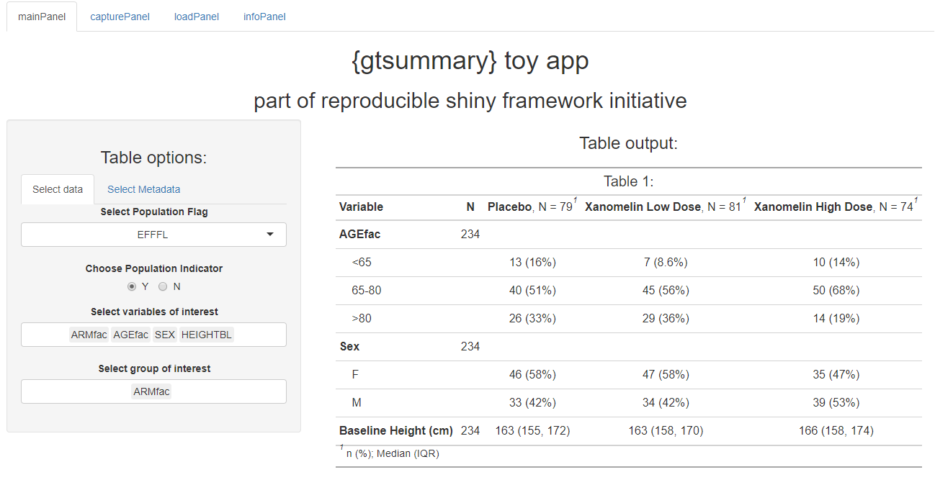
You’ve produced a table in your Shiny app, and you want to use it in a project deliverable. Now what?

Slide 3

If you said “Copy to clipboard and paste”…

Slide 4
Production code needs to conform to business QC processes…

Slide 5
… so how do you “validate” a Shiny app?

Slide 6

Supervised Low risk - Do we even bother to validate these?
Scope of use of your Shiny app:

Slide 7

Unsupervised Potentially higher risk - test and document functions
Scope of use of your Shiny app:

Slide 8

Critical for patient safety or regulatory submission HIGH risk – Full validation
Scope of use of your Shiny app:

Slide 9

It’s hard to retrofit reproducibility in a Shiny app

Slide 10

Is your Production environment the same as your Shiny server environment?

Slide 11
How do you capture and “replay” the user choices / selections?

Slide 12
Demo

Slide 13
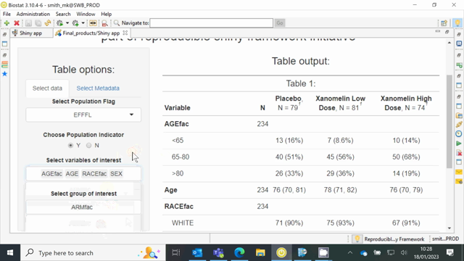

Slide 14
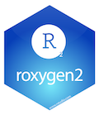

Use R Functions for the Shiny App
Develop functions in R, which can be tested and documented
Functions used in creation of the output can be reused across Shiny apps
Tan Ho: DIY Pest Control: Effectively Debugging Shiny Apps – Move logic that doesn’t NEED Shiny to functions
Notes:
These functions can be used within R scripts or as part of Shiny app code. Effectively the Shiny app becomes a user interface for the R functions. We can demonstrate that the functions used external to the Shiny app produce exactly the same content as when used within the app. Function can be used external to these allowing colleagues to build a library of useful functionality (possibly in an R package). They can be verified and QCed upstream of the use in a specific protocol or use case.
Each function must have a unit test created using {testthat}. Unit tests are needed to ensure that code features are working as intended and that bug fixes or dependency changes do not introduce new errors. The overall application should be tested using {shinytest2}.

Slide 15
Externalise the user inputs
Write to file
Inputs as arguments to the functions in template script
YAML format: easy to read and write in R
Notes:
Capture input choices. Text file so can easily track changes. Also useful to reconstitute app state, but this does need to be done carefully for more complex apps. Different from Shiny bookmarking.

Slide 16

Capture exports
Serve as key for comparison
Tables, figures, etc. saved as R object (.Rds)
Individually and more generally
Notes:
Could be a ggplot2 object or a gt object. This will be useful for later comparison in the template script. You can externalize the reactives individually within a list object or by using a more general function to export all possible reactives that are passed through render_* functions.

Slide 17

Write a template script
Uses the SAME functions as Shiny to get the “production” output (table / figure)
Uses YAML parameters (Shiny reactive snapshot) as inputs
Easy to check / QC
Doesn’t depend on Shiny, Posit / RStudio Connect – can be run in batch on HPC platform.

Slide 18
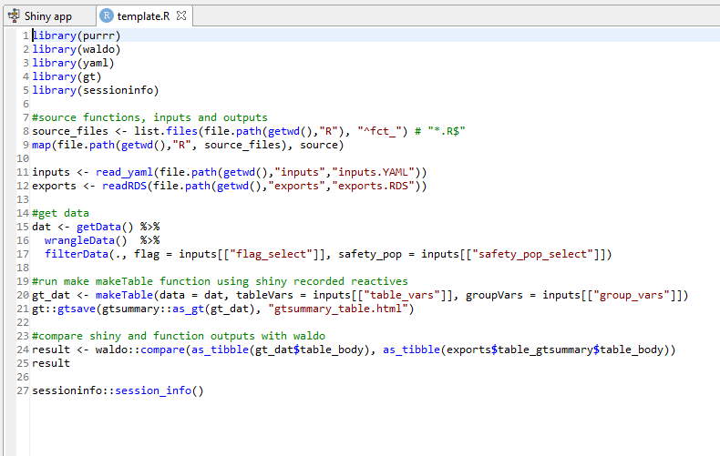
Template
Notes:
This is written by the Shiny developer to mirror the functionality in the Shiny app. Note that in this case, for this app, it’s pretty simple. In this script, we source the functions we created for the app. We used the fct_ prefix for file names of each function and include numbers in the file names indicating the call order of the functions. Then we read the input and exports objects we previously saved. Then we run the pipeline and get the final object which in this case is a gt table object. Finally, we compare exported objects from the Shiny app to the object in this run.

Slide 19
Use your preferred production environment
Version control repository
Secure, audit trail
Access to HPC for production run
Access to project metadata and audit trail information
Automation (if available)
Notes:
The automation step uses our prod environment to create a "recipe" for the run which includes the R functions, template, inputs YAML file, and other components. This recipe can be run on our HPC but leverages the template script to do a comparison then queries project metdatadata and generate a QC report.

Slide 20
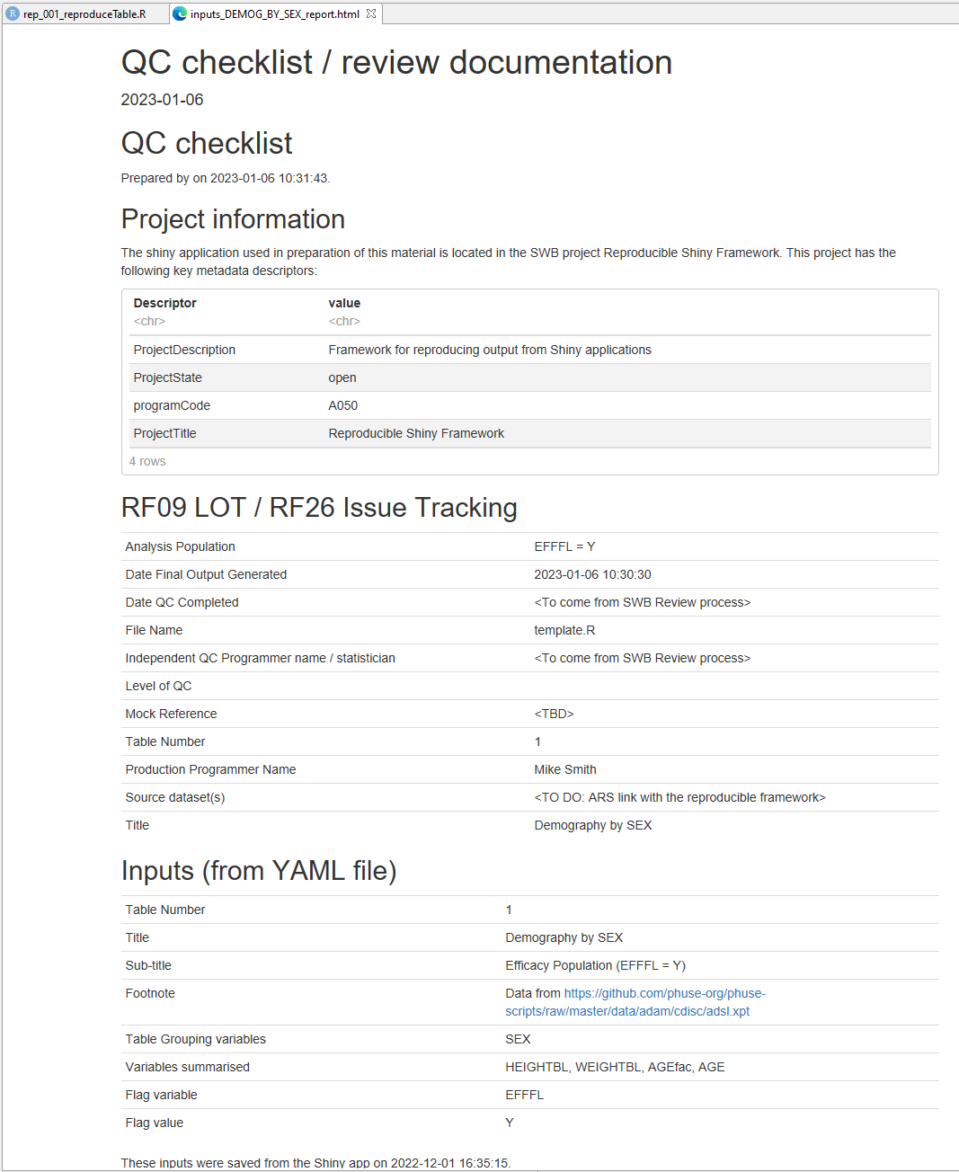
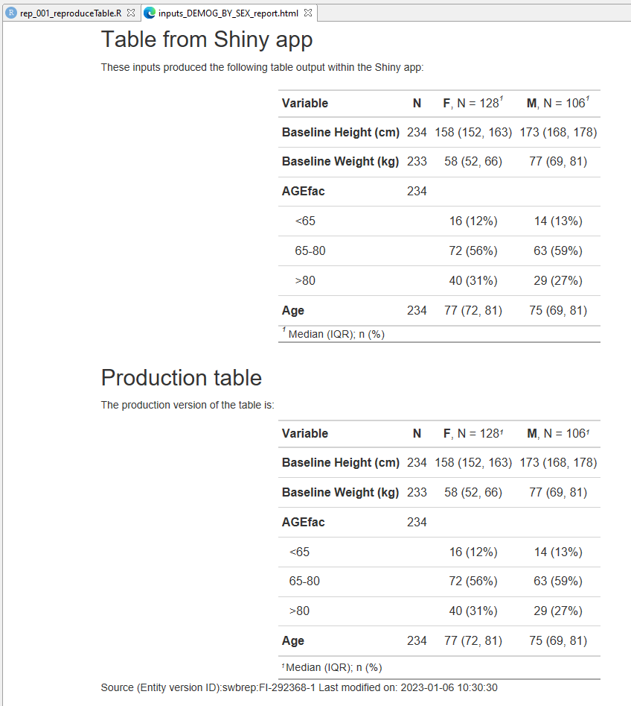
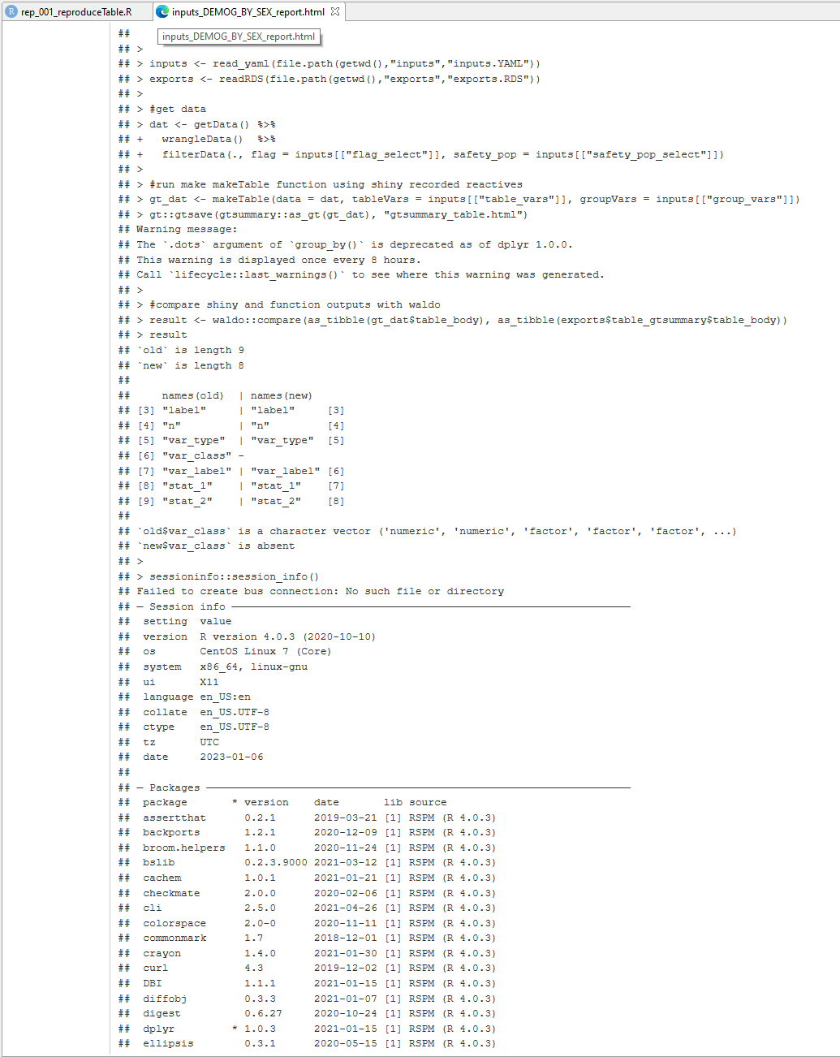
QC "checklist" / reference report
Notes:
This QC report contains information fields needed for compliant output, locations of files, outputs, input YAML file, template script, production output .lst file, production environment information.

Slide 21
What are the benefits?
Shiny can be part of team discussion to derive, review, and refine output specification in real time
Cuts down on QC overhead in place of double programming
App development is simpler and easier to QC / check
Integration with and automation in prod environment has enormous benefits
Notes:
Cuts down on the time between specification and final output.
Can “snapshot” things seen in Shiny exploration and reproduce in the long term
2. Or at least, shifts some of the QC upstream to reviewing functions and functionality.
{testthat} cases demonstrate that the code does work as expected and fails gracefully.
{waldo} ensures that output matches exactly what was seen in the app
3. App leans on functions, which are already tested and proven.
Can reuse functions in future apps – modularity.
4. Automation of task setup, execution, metadata capture: as though I had “point and clicked” my way around SWB.
Long term reproducibility with our production environment.
Capture of metadata and automated report generation

Slide 22
Thank you!
Notes:
Again, thank you so much for having us.

