Slide 1
Introducing openstatsware and the R Package {mmrm}
R/Pharma 2023 Conference Ya Wang on behalf of the working group

Slide 2
Outline
Introducing the Working Group
R Package mmrm

Slide 3
Introducing the Working Group

Slide 4

openstatsware
Official working group of the American Statistical Association (ASA) Biopharmaceutical Section
Formed on 19 August 2022
Cross-industry collaboration (38 members from 28 organizations)
Full name: Software Engineering Working Group
Short name: openstatsware
Homepage: rconsortium.github.io/asa-biop-swe-wg

Slide 5
Working Group Objectives
Primary
Engineer R packages that implement important statistical methods
to fill in gaps in the open-source statistical software landscape
focusing on what is needed for biopharmaceutical applications
Secondary
Develop and disseminate best practices for engineering high-quality open-source statistical software
By actively doing the statistical engineering work together, we align on best practices and can communicate these to others

Slide 6
Workstreams in R Package Development
Mixed Models for Repeated Measures (MMRM) 🌎
Develop mmrm R package for frequentist inference in MMRM (CRAN)
Bayesian MMRM 🌎
Develop brms.mmrm R package for Bayesian inference in MMRM (CRAN)
Health Technology Assessment 🌎
Develop open-source R tools to support HTA dossier submission across various countries
Particularly topics with unmet needs in R implementation and/or related to EUnetHTA

Slide 7
Best Practices Dissemination
Workshop “Good Software Engineering Practice for R Packages” on world tour 🌎
to teach hands-on skills and tools to engineer reliable R packages
5 events so far at Basel, Shanghai, San José, Rockville, and Montreal
Youtube video series “Statistical Software Engineering 101” 🌎
to introduce tips and tricks for good statistical software engineering practices
2 videos so far

Slide 8
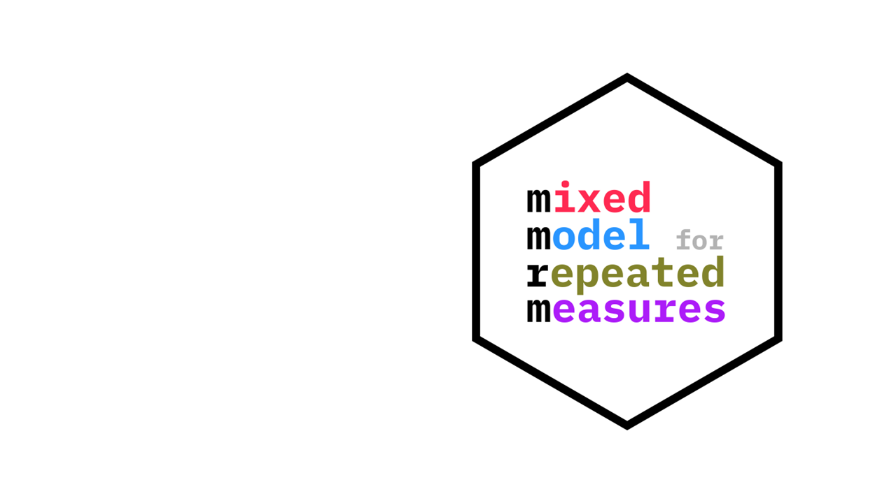
R Package mmrm 🌎

Slide 9
Motivation
MMRM is a popular choice for analyzing longitudinal continuous outcomes in randomized clinical trials
No great R package
Initially thought that the MMRM problem was solved by using lme4 with lmerTest, learned that this approach failed on large data sets (slow, did not converge)
nlme does not give Satterthwaite adjusted degrees of freedom, has convergence issues, and with emmeans it is only approximate
Next we tried to extend glmmTMB to calculate Satterthwaite adjusted degrees of freedom, but it did not work

Slide 10
Idea
We only want to fit a fixed effects model with a structured covariance matrix for each subject
The idea is then to use the Template Model Builder (TMB) directly - as it is also underlying glmmTMB - but code the exact model we want
We do this by implementing the log-likelihood in C++ using the TMB provided libraries

Slide 11
Advantages of TMB
Fast C++ framework for defining objective functions (Rcpp would have been alternative interface)
Automatic differentiation of the log-likelihood as a function of the variance parameters
We get the gradient and Hessian exactly and without additional coding
This can be used from the R side with the TMB interface and plugged into optimizers

Slide 12
Why It’s Not Just Another Package
Ongoing maintenance and support from the pharmaceutical industry
5 companies being involved in the development, on track to become standard package
Development using best practices as show case for high quality package
Thorough unit and integration tests (also comparing with SAS results) to ensure accurate results

Slide 13
Features of mmrm
Linear model for dependent observations within independent subjects
Covariance structures for the dependent observations:
Unstructured, Toeplitz, AR1, compound symmetry, ante-dependence, spatial exponential
Allows group specific covariance estimates and weights
REML or ML estimation, using multiple optimizers if needed
emmeans interface for least square means
tidymodels for easy model fitting
Satterthwaite and Kenward-Roger adjustments
Robust sandwich estimator for covariance

Slide 14
Comparison with Other Software
We have run comparison analyses with other R packages, namely nlme, glmmTMB and lme4
Also compared with SAS PROC GLIMMIX
Highlights
mmrm has faster convergence time
mmrm provides closest results to PROC GLIMMIX
Detailed results at the online comparison vignette

Slide 15

Q&A
Check out mmrm workshop recording 🌎:
From The Statistical Method To The R Package - The mmrm Example

