Slide 1


Slide 2
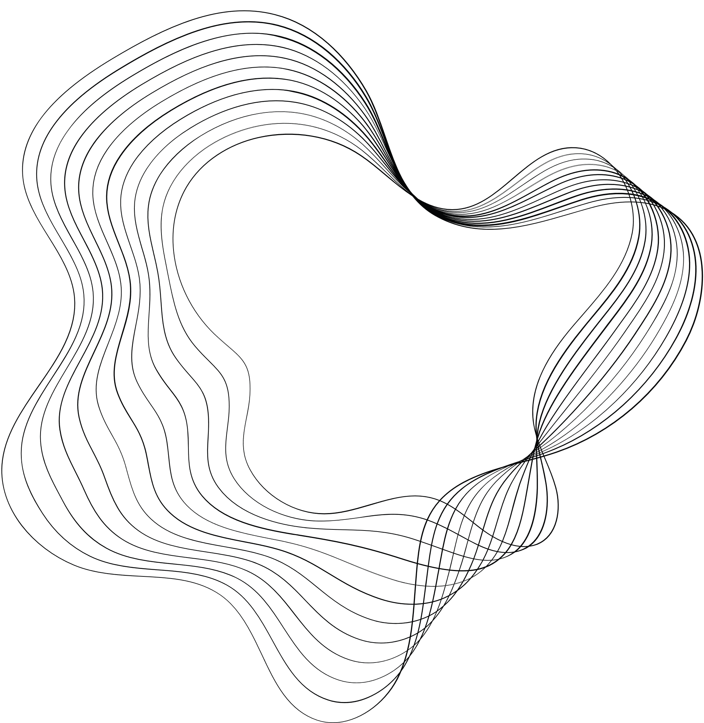
E-Commerce Product Delivery Prediction
In the current fast-paced e-commerce environment, it is essential to ensure that products are delivered on time in order to maintain consumer satisfaction and trust. This project concentrates on an international e-commerce company that specialises in electronic products.
The objective is to employ machine learning in predicting whether products will arrive at consumers on time.
The company can optimise logistics operations, establish realistic customer expectations, and identify critical factors that impact delivery performance by developing rigorous models for product delivery timeliness.
Presented By: Rinitha Rajan

Slide 3

CONTENT
01
INTRODUCTION
02
DATA OVERVIEW
03
EXPLORATORY DATA ANALYSIS
04
DATA PREPROCESSING
05
MODEL SELECTION AND TRAINING
06
MODEL EVALUATION
07
COMPARISON OF MODEL PERFORMANCES

Slide 4



INTRODUCTION
E-commerce has changed how consumers shop by providing convenience and an extensive choice. However, timeliness of product delivery is a major component that influences customer satisfaction.
It entails analyzing a variety of elements, including shipping methods, warehouse locations, product attributes, and customer behavior, to determine if a product will arrive on time.
By leveraging machine learning algorithms, companies can process vast amounts of data to identify patterns that influence delivery times.
Accurate predictions allow companies to optimize their logistics, set realistic delivery expectations, and proactively address potential delays.

Slide 5
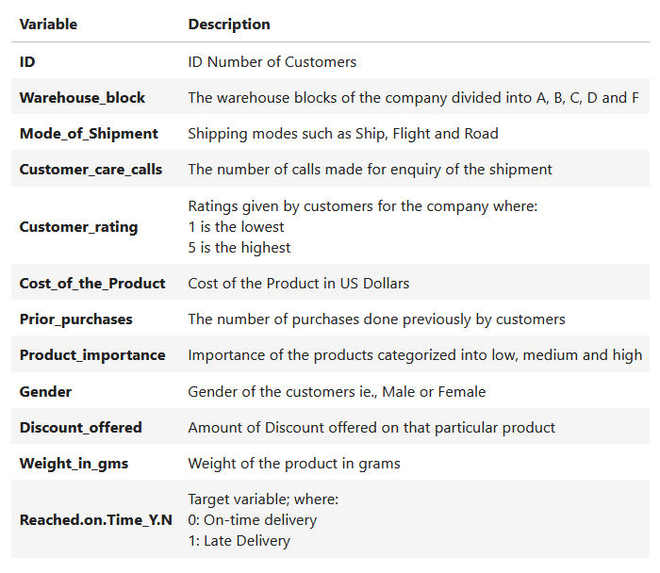
DATA OVERVIEW
ROWS
10999
E_Commerce.csv
COLUMNS
12
Features/Columns
'ID', 'Customer_care_calls', 'Cost_of_the_Product', 'Prior_purchases', 'Discount_offered', 'Weight_in_gms'
Numerical Information
X
Categorical Information
‘Warehouse_block’, 'Mode_of_Shipment', 'Customer_rating', 'Product_importance', 'Gender',
Y
Target
'Reached.on.Time_Y.N'

Slide 6


EXPLORATORY DATA ANALYSIS
Exploratory Data Analysis (EDA) helped us understand the data structure, find patterns, identify trends, and gain valuable insights from the dataset.
From EDA, we analyzed the distribution of each feature and checked the correlation between the features.
Using visuals helped us clearly observe the data, understand the relationship between the features, and identify factors that play a vital role in predicting whether a product is delivered on time.
The dataset is clean, as there are no NULL values, but we identified some duplicate values and outliers.
We reviewed our data columns and found columns (e.g., Customer_rating) to be numerical in terms of data type but categorical in terms of meaning. To ensure proper analysis, we converted these columns to categorical data types.
We applied univariate and bivariate analysis approaches to gain insights into individual characteristics of the data and how each feature relates to our main goal: predicting the target variable, Reached.on.Time_Y.N.

Slide 7
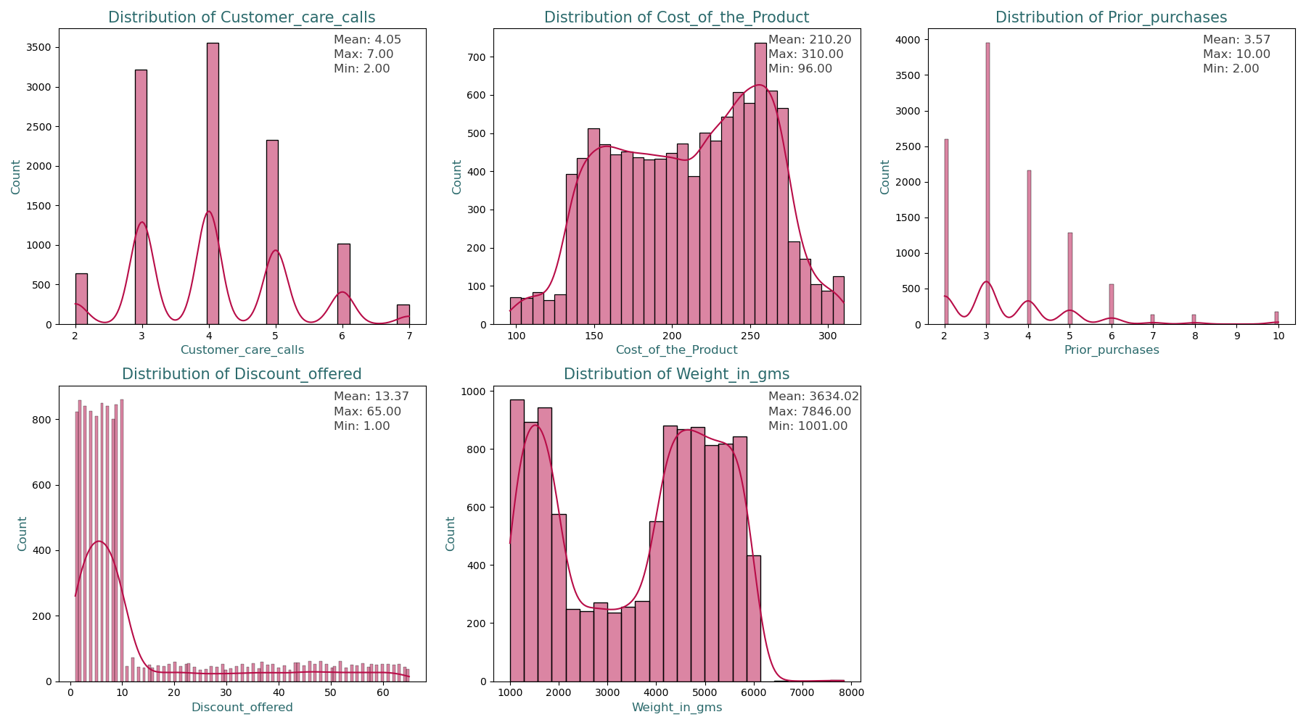
DISTRIBUTION OF NUMERICAL VARIABLES
Customer_care_calls: Most customers tend to make a moderate number of calls (3-6), with very few making only 2 calls or as many as 7 calls. This suggests that customer issues or inquiries typically require multiple interactions.
Cost_of_the_product: There are two main clusters of products, one in the lower cost range and another in the higher cost range. This might indicate the presence of distinct product categories (e.g., budget and premium).
Prior_purchases: Most customers have made between 2 to 4 prior purchases, indicating that this is a common range of loyalty or repeat buying behavior. Few customers have made a very high number of prior purchases.
Discount_offered: Most products are offered with relatively low discounts, and only a small fraction of products receive substantial discounts. This might suggest that high discounts are used sparingly, possibly for clearance or promotional items.
Weight_in_gms: There are two main clusters of products by weight, which may correspond to different categories of products (e.g., light vs. heavy goods). The bimodal distribution suggests a clear separation in product types based on weight.

Slide 8
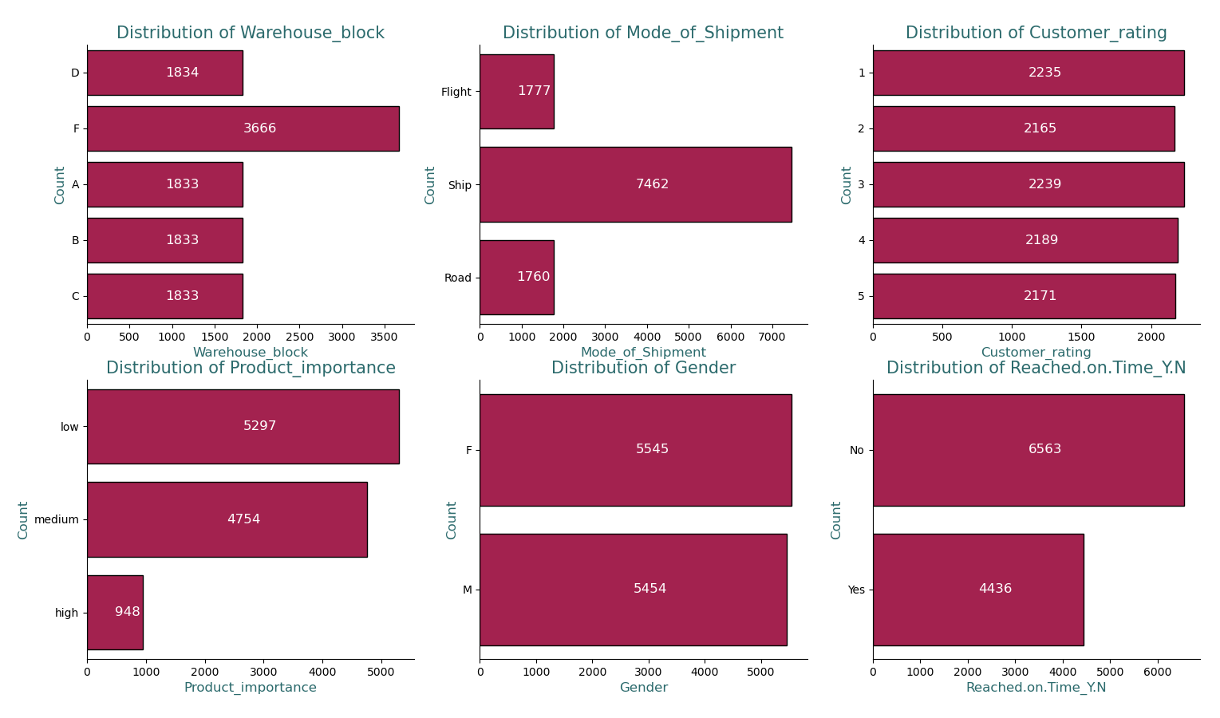
DISTRIBUTION OF CATEGORICAL VARIABLES
Warehouse_block: Most of the orders placed by customers are being stored and shipped from block F.
Mode_of_Shipment: This could mean that the customers prefers their shimpments arriving on water rather than air or on road.
Customer_rating: The customers seems to have equally varying opinions on the company and its service.
Product_importance: Most customers seem to order products of low importance with a very few orders with being high importance.
Gender: Both the gender seem to order equally with the number of female customers (F) being very slightly larger.

Slide 9
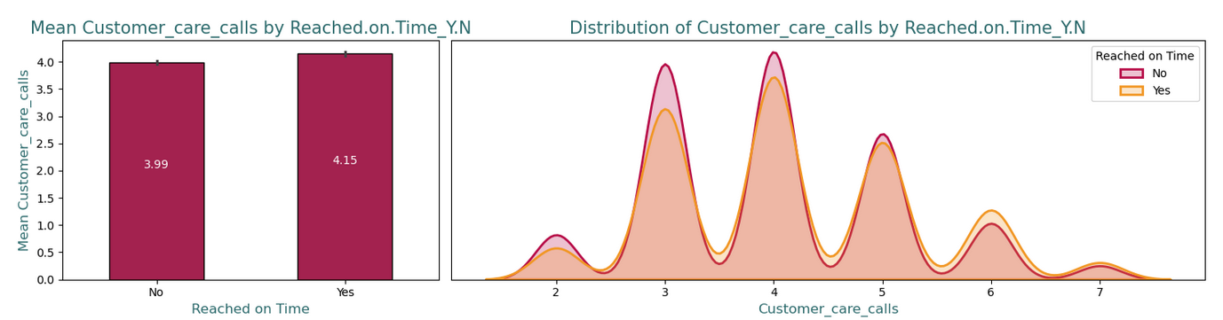
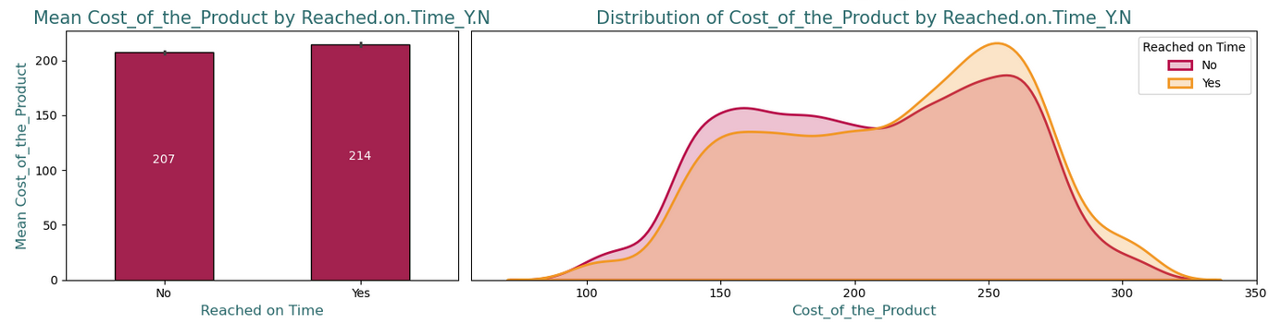
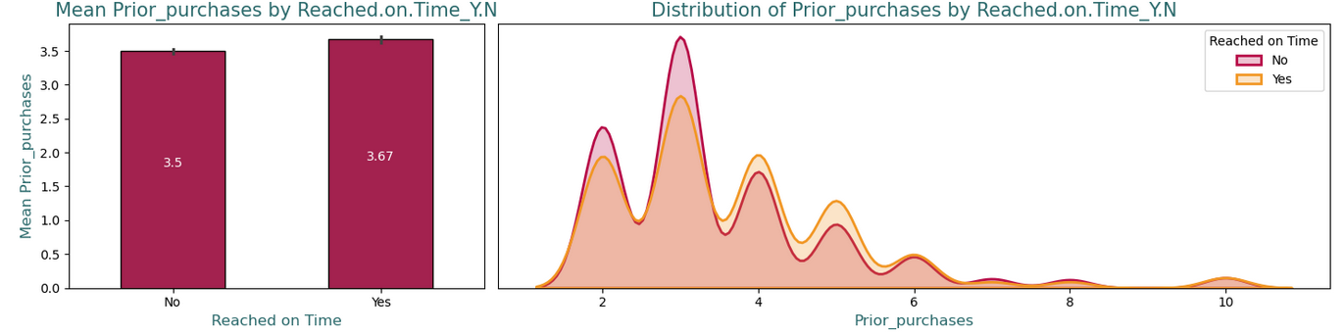
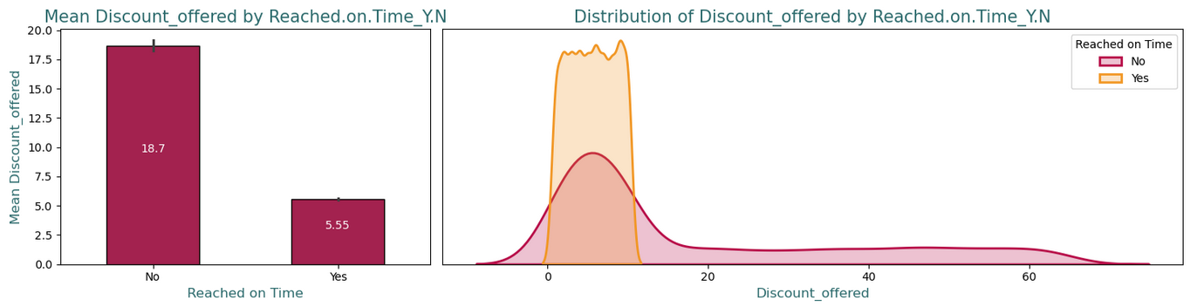
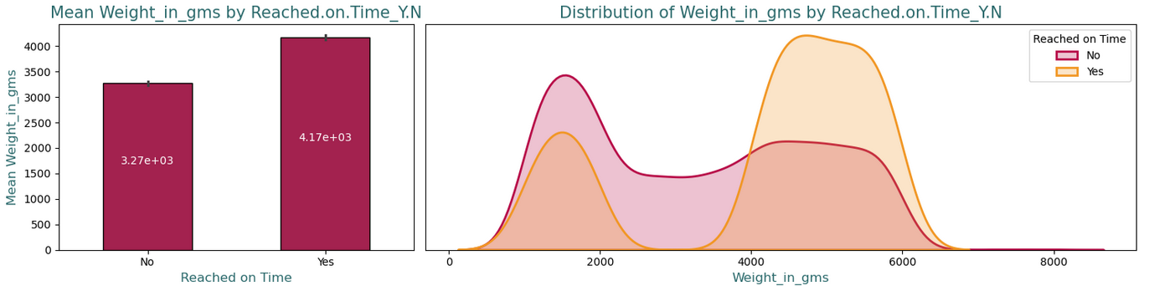
NUMERICAL VARIABLES VS TARGET
Warehouse_block: Most of the orders placed by customers are being stored and shipped from block F.
Mode_of_Shipment: This could mean that the customers prefers their shimpments arriving on water rather than air or on road.
Customer_rating: The customers seems to have equally varying opinions on the company and its service.
Product_importance: Most customers seem to order products of low importance with a very few orders with being high importance.
Gender: Both the gender seem to order equally with the number of female customers (F) being very slightly larger.

Slide 10
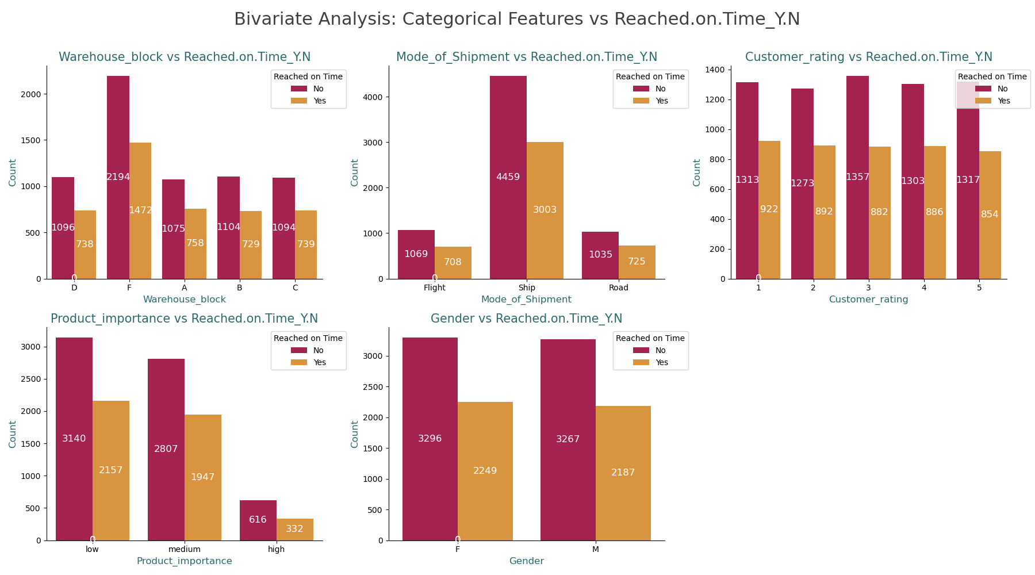
CATEGORICAL FEATURES VS TARGET
Warehouse_block: Block F has the highest delay rate, while Blocks A, B, C, and D have a more balanced distribution, with Block D showing the least delays.
Mode_of_Shipment: Shipments by Ship are the most delayed, while Flight and Road show fewer delays, with Road having the most on-time deliveries.
Customer_rating: Across all ratings (1-5), delays outnumber on-time deliveries, with no strong correlation between rating and on-time delivery.
Product_importance: Low and medium importance products face more delays, while high importance products, though fewer, have fewer delays.
Gender: Both Male and Female customers experience more delays than on-time deliveries, with gender having no significant impact on delivery timing.

Slide 11
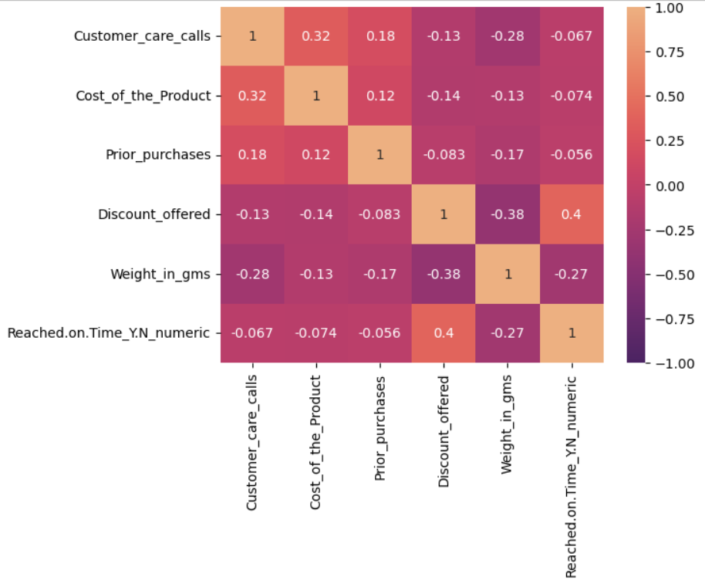
CORRELATION HEATMAP
Discount_offered: With on-time deliveries, there is a moderate correlation between higher discounts and the amount of discounts that are offered.
Weight_in_gms: Products that weigh less are more likely to experience a delay in delivery.
Customer_care_calls: It has been found that there is a weak correlation between the number of customer care calls and the number of delayed deliveries.
Cost_of_the_product: Products with a higher price tag are slightly more likely to experience delays than those with a lower price tag.
Prior_purchases: The delivery time is not significantly affected by the customers' previous purchase history.

Slide 12
DATA PREPROCESSING
Irrelevant Feature Removal:
Numerical Columns: ‘ID’ column has been dropped. On checking the numerical columns using VIF, ‘Customer_care_calls’ column has a multicollinearity problem and weaker correlation with the target, so it has been dropped as well.
Categorical Columns: `Warehouse_block`, `Mode_of_Shipment`, `Customer_rating` and `Gender` columns have been dropped since there was no significant association found from Chi-Square Analysis.
Missing Value and Duplicates: No missing values or duplicates found in the dataset.
Outliers Treatment: Checked outliers using IQR method for the continuous features and upon identifying outliers, followed two methods – removal and log-transformation.
Feature Extraction: Created two new classes of features – ‘Product Cost Class’ and ‘Prior Purchase Class’ from original columns with categories: low, medium and high.
Categorical Feature Encoding and Scaling: Applied one hot encoding to the categorical columns and scaled using StandardScaler().
FINAL DATA FOR MODELLING: There are three sets of data to compare:
Original Data
Data with Outliers Removed
Data with Log-Transformation

Slide 13
DATA PREPROCESSING
TRAIN-TEST SPLIT
We divided the data into training (80%) and testing (20%) sets.
Setting a random state ensures consistent results.
Feature importances are provided by the fitted attribute feature_importances_ where we use of a forest of trees to evaluate the importance of features on an artificial classification task.
Using this, we have filtered out the important feature on the original dataset and have derived two subsets – dataset with important features and the same dataset but with log-transformed numerical columns.
FEATURE IMPORTANCE USING RANDOM FOREST
FINAL DATASETS
FOR MODELLING
DATASET:
ORIGINAL DATASET (REFERENCE)
OUTLIERS REMOVED DATASET
LOG-TRANSFORMED DATASET
DATASET WITH FEATURE IMPORTANCES CONSIDERED:
ORIGINAL DATASET
LOG-TRANSFORMED DATASET

Slide 14
MODELS SELECTED
Random Forest: A robust ensemble learning technique that combines the results of multiple decision trees during training to make predictions. It is effective for both classification and regression tasks by averaging the results from various trees, which reduces the risk of overfitting and improves accuracy.
Decision Tree: A supervised learning algorithm that generates a model by recursively dividing the dataset into subsets based on the most significant feature values. In this process, a tree-like structure is formed, with each branch representing a decision rule and each leaf node representing a potential outcome or class designation.
Logistic Regression: A linear model that is employed to solve binary classification problems. It is capable of predicting outcomes such as pass/fail, yes/no, or 0/1 by applying the logistic function to a linear combination of the input features, thereby estimating the probability that a given input belongs to a specific class.
K-Nearest Neighbours (KNN): A straightforward, non-parametric algorithm that is employed for regression and classification. In the feature space, a data point is classified according to the majority class of its k-nearest neighbours, where "closeness" is typically determined by a distance metric such as Euclidean distance.

Slide 15
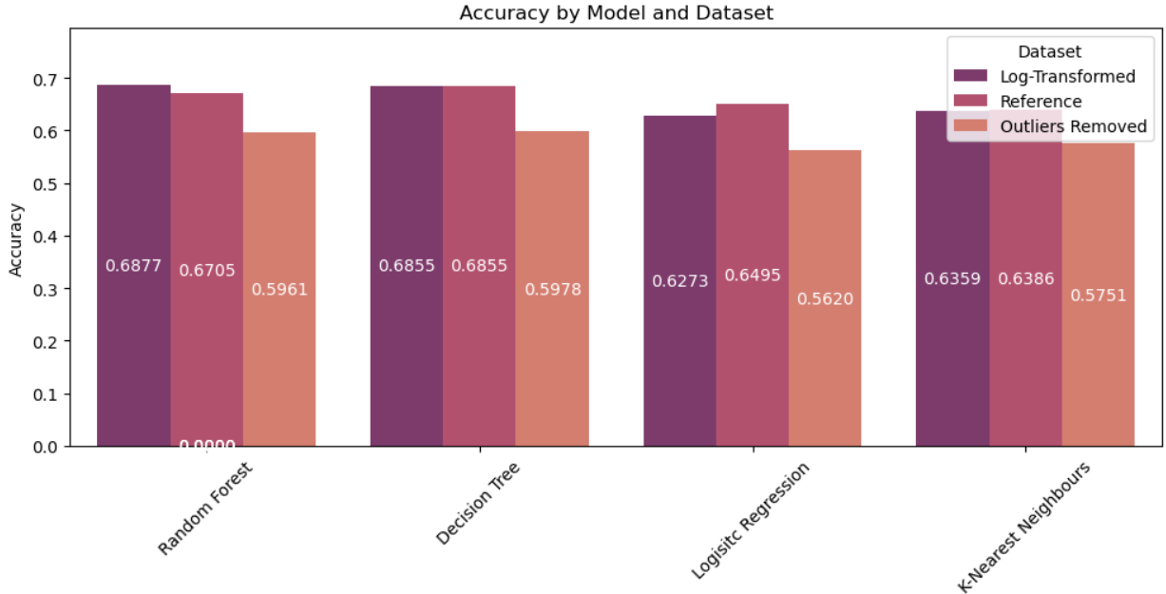
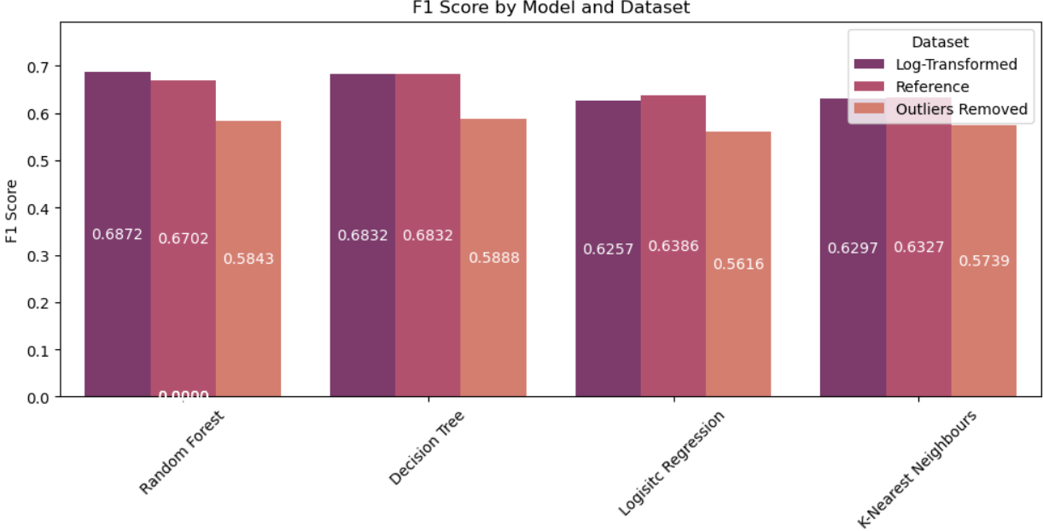
MODEL EVALUATION
Model | Accuracy | F1 Score | Dataset
Random Forest | 0.6877 | 0.6872 | Log-Transformed
Decision Tree | 0.6855 | 0.6832 | Log-Transformed
Logisitc Regression | 0.6273 | 0.6257 | Log-Transformed
K-Nearest Neighbours | 0.6359 | 0.6297 | Log-Transformed
Random Forest | 0.6705 | 0.6702 | Reference
Decision Tree | 0.6855 | 0.6832 | Reference
Logisitc Regression | 0.6495 | 0.6386 | Reference
K-Nearest Neighbours | 0.6386 | 0.6327 | Reference
Random Forest | 0.5961 | 0.5843 | Outliers Removed
Decision Tree | 0.5978 | 0.5888 | Outliers Removed
Logisitc Regression | 0.5620 | 0.5616 | Outliers Removed
K-Nearest Neighbours | 0.5751 | 0.5739 | Outliers Removed
Random Forest performs best in the log-transformed dataset with an accuracy of ~68.77% and an F1 score of ~68.72%. After feature extraction, its performance is slightly reduced compared to the original log-transformed dataset (~69.18% accuracy)..

Slide 16
MODEL EVALUATION
Random Forest performs best in the log-transformed dataset with an accuracy of ~68.77% and an F1 score of ~68.72%. After feature extraction, its performance is slightly reduced compared to the original log-transformed dataset (~69.18% accuracy).
Decision Tree maintains consistent performance across both the feature extraction and reference datasets, with accuracy around 68.55%, showing that it is not significantly affected by feature extraction.
Logistic Regression continues to underperform compared to other models, with accuracy around 62.73% in the log-transformed dataset and a slight decrease to 62.70% after feature extraction. It remains the weakest model overall.
K-Nearest Neighbors (KNN) shows a slight decline in performance after feature extraction, particularly in accuracy (from ~66.59% to ~63.59%).
Outliers Removed Dataset: All models show a significant drop in performance, indicating that the outliers might have had a meaningful impact on the data distribution and model predictions.

Slide 17
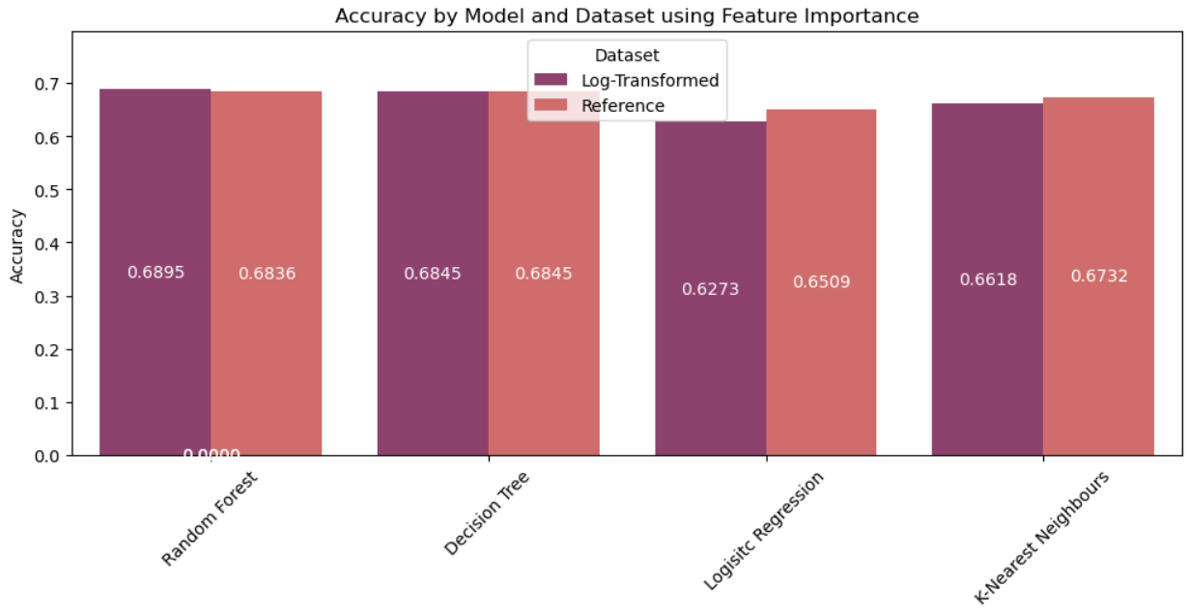

MODEL EVALUATION – AFTER FEATURE IMPORTANCE
From our previous models, we can tell that removing outliers significantly decrease model performances hence we have not removed the outliers for this analysis.
Model | Accuracy | F1 Score | Dataset
Random Forest | 0.6895 | 0.6869 | Log-Transformed
Decision Tree | 0.6845 | 0.6836 | Log-Transformed
Logisitc Regression | 0.6273 | 0.6257 | Log-Transformed
K-Nearest Neighbours | 0.6618 | 0.6569 | Log-Transformed
Random Forest | 0.6836 | 0.6835 | Reference
Decision Tree | 0.6845 | 0.6836 | Reference
Logisitc Regression | 0.6509 | 0.6397 | Reference
K-Nearest Neighbours | 0.6732 | 0.6680 | Reference
The Random Forest is the best-performing model, while Logistic Regression struggles the most with this data.
The log transformation slightly enhances model performance but does not drastically change the model rankings.

Slide 18
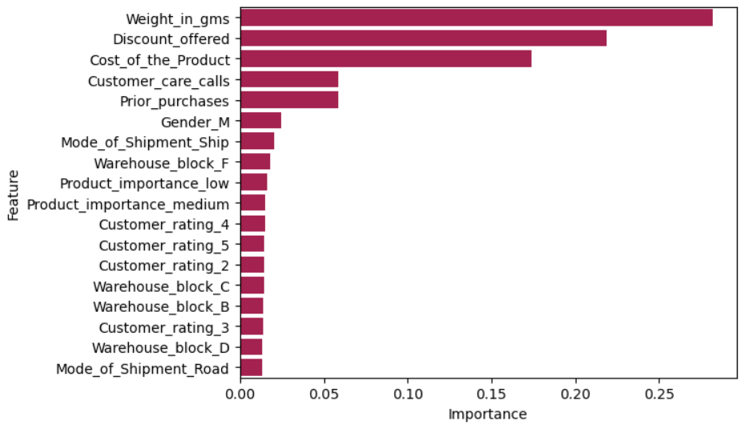
MODEL EVALUATION
AFTER FEATURE IMPORTANCE
The features selected are according to the given graph. The first five features namely, ‘Weight-in-gms’, ‘Discount_offered’, ‘Cost_of_the_Product’, ‘Customer_care_calls’ and ‘Prior_purchases’ are selected for the analysis.
Random Forest continues to outperform other models across all datasets, maintaining accuracy and F1 scores above 68%, both in the log-transformed and reference datasets. This highlights its robustness and ability to handle the data well, even after feature selection based on importance.
Decision Tree shows stable performance, similar to its results in the feature extraction dataset, indicating that it is relatively unaffected by both feature extraction and feature importance selection.
Logistic Regression improves slightly in the reference dataset (accuracy ~64.59%) but still lags behind other models. Feature importance did not significantly impact its performance.
K-Nearest Neighbors remains consistent with its performance, showing slightly better results in the log-transformed dataset compared to the feature extraction dataset, but still behind Random Forest and Decision Tree.

Slide 19
FINAL RESULTS AND CONCLUSION
Random Forest is consistently the best-performing model across different datasets and methods, demonstrating strong accuracy and F1 scores.
Feature Extraction and Feature Importance methods slightly affect model performance, with Random Forest and Decision Tree showing resilience, while Logistic Regression and KNN are more sensitive to these changes.
Outlier Removal has a negative impact on all models, suggesting that the removed outliers contained valuable information that influenced predictions.
FUTURE WORK
Advanced Imbalance Techniques: To increase model robustness and accuracy, implement and analyse advanced class imbalance approaches like SMOTE-ENN or cost-sensitive learning.
Feature Engineering and Selection: To improve model performance, investigate interaction terms and polynomial features and use more advanced feature selection approaches.
External Dataset Validation: Validate the models on external datasets or utilise nested cross-validation to guarantee that the findings generalise beyond this project's initial dataset.
LIMITATIONS
Model Sensitivity to Preprocessing: Log transformation and outlier removal affect model performance, which may limit consistency and generalisability.
Despite efforts to resolve class imbalance, model measurements may still favour the majority class, leading to deceptive model performance interpretations.
Limited Generalisation: The models have only been tested on a specific dataset, therefore the conclusions may not apply to other datasets or real-world circumstances.

Slide 20
Questions?

Slide 21
Thank You!

