Slide 1
HUMAN EVOLUTIONARY TRENDS
The evolutionary trends in hominins include
Adaptations for erect posture
Stance and locomotion
Relative size of the brain
Prognathism & dentition
Culture
An adaptation is any characteristic that helps an organism survive and reproduce in its natural environment

Slide 2
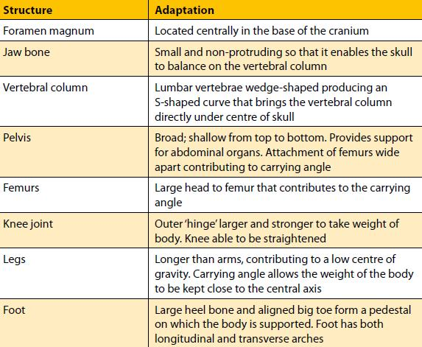
ADAPTATIONS FOR ERECT POSTURE

Slide 3
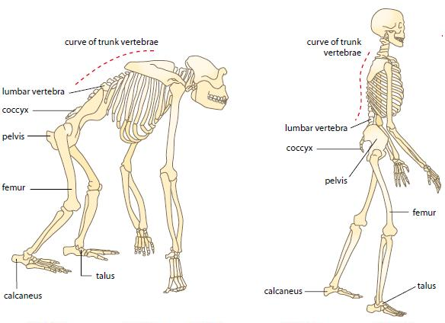

Slide 4
ADAPTATIONS FOR ERECT POSTURE
An adaptation is any characteristic that helps an organism survive and reproduce in its natural environment
The foramen magnum is the place where the spine inserts into the skull
The foramen magnum (big hole) is situated centrally at the base of the skull
In apes this structure is located towards the back of the skull and makes their head hang forward

Slide 5
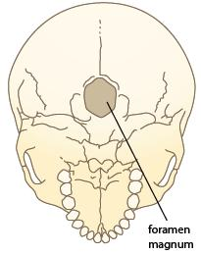
ADAPTATIONS FOR ERECT POSTURE

Slide 6
ADAPTATIONS FOR ERECT POSTURE
Apes have a protruding jaw whilst humans have a flatter face
The evolution of humans from apes has seen the protrusion of the jaw gradually reduce
This allows the skull to balance on the spine
The weight in front of the foramen magnum is the same as the weight behind
This helps with balance

Slide 7
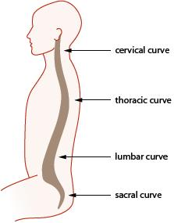
ADAPTATIONS FOR ERECT POSTURE
A curved spine allows the head to remain, balanced, over the pelvis
Humans have a double curvature of the spine
S shaped
All segments are curved

Slide 8
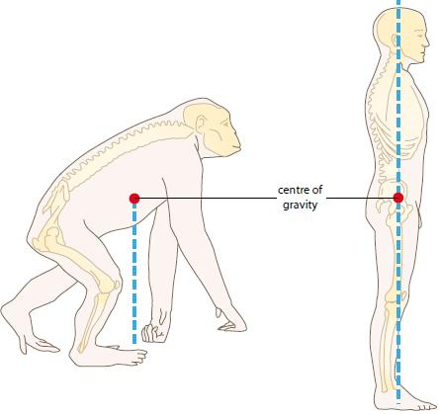
ADAPTATIONS FOR ERECT POSTURE
Whilst humans have an S shaped spine all other apes have a C shaped spine
This means that their centre of gravity is in front of their torso

Slide 9
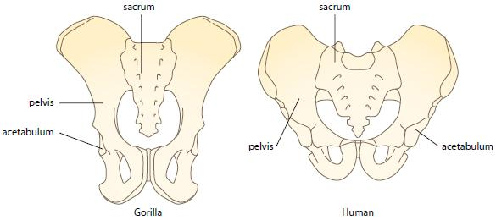
ADAPTATIONS FOR ERECT POSTURE

Slide 10
ADAPTATIONS FOR ERECT POSTURE
The pelvis in humans is bowl shaped to support the intestines and keeping them in line with the centre of gravity
The female pelvis is broader than that of the male to support the baby and aid in birth
A broad pelvis allows for the attachment of big gluteal muscles
The pelvis apes is flatter and the guts hang forward further pushing the centre of gravity forward

Slide 11
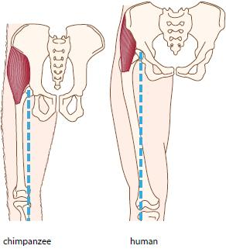
ADAPTATIONS FOR ERECT POSTURE

Slide 12
ADAPTATIONS FOR ERECT POSTURE
The femurs of the human slope inwards and keep the knees in line with the spine
This is called the carrying angle
It also ensures that the weight stays in line with the centre of gravity
When one foot is lifted the weight is supported by the other leg – striding gait
Apes have a straight femur and must sway to transfer the weight from side to side

Slide 13
ADAPTATIONS FOR ERECT POSTURE
The knee structure is such that there are 2 hinges separated by ligaments
The weight of the body tries to bend the knee backwards but the ligaments resist this and therefore no energy is required to support the body in a standing position

Slide 14
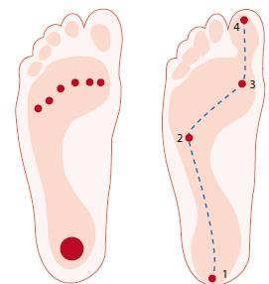
ADAPTATIONS FOR ERECT POSTURE
The foot is adapted for bipedal locomotion
The human foot is not prehensile, instead the big toe is used for thrust
Weight travels along the outside of the foot and out through the big toe

Slide 15
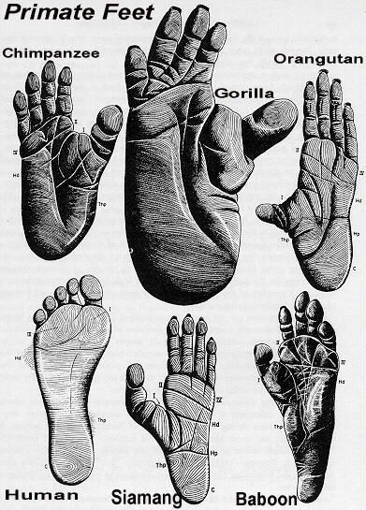

Slide 16
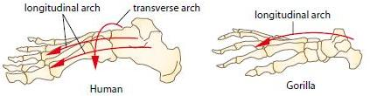
ADAPTATIONS FOR ERECT POSTURE
The human foot has two arches
The longitudinal and transverse
The transverse arch allows the inside middle of the foot to be lifted off the ground and so acts as a shock absorber
Apes have only a longitudinal arch and are said to be flat footed
Ask someone who is flat footed what running is like!

Slide 17
ADAPTATIONS FOR ERECT POSTURE
The centre of gravity is lower than that of apes
In humans the legs make up half the total height and thus the centre of gravity is low
In apes the legs only make up one third of their total height and so their centre of gravity is higher

Slide 18
ADAPTATIONS FOR ERECT POSTURE

Slide 20
ADAPTATIONS FOR STANCE & LOCOMOTION
Hominins walk bipedally
Australopithecus through to H. erectus and neanderthalensis also walked bipedally
One of the essential elements for maintaining upright stance is muscle tone
Muscle tone is the partial contraction of muscle where different fibres are recruited at different times to keep the overall level of contraction constant

Slide 21
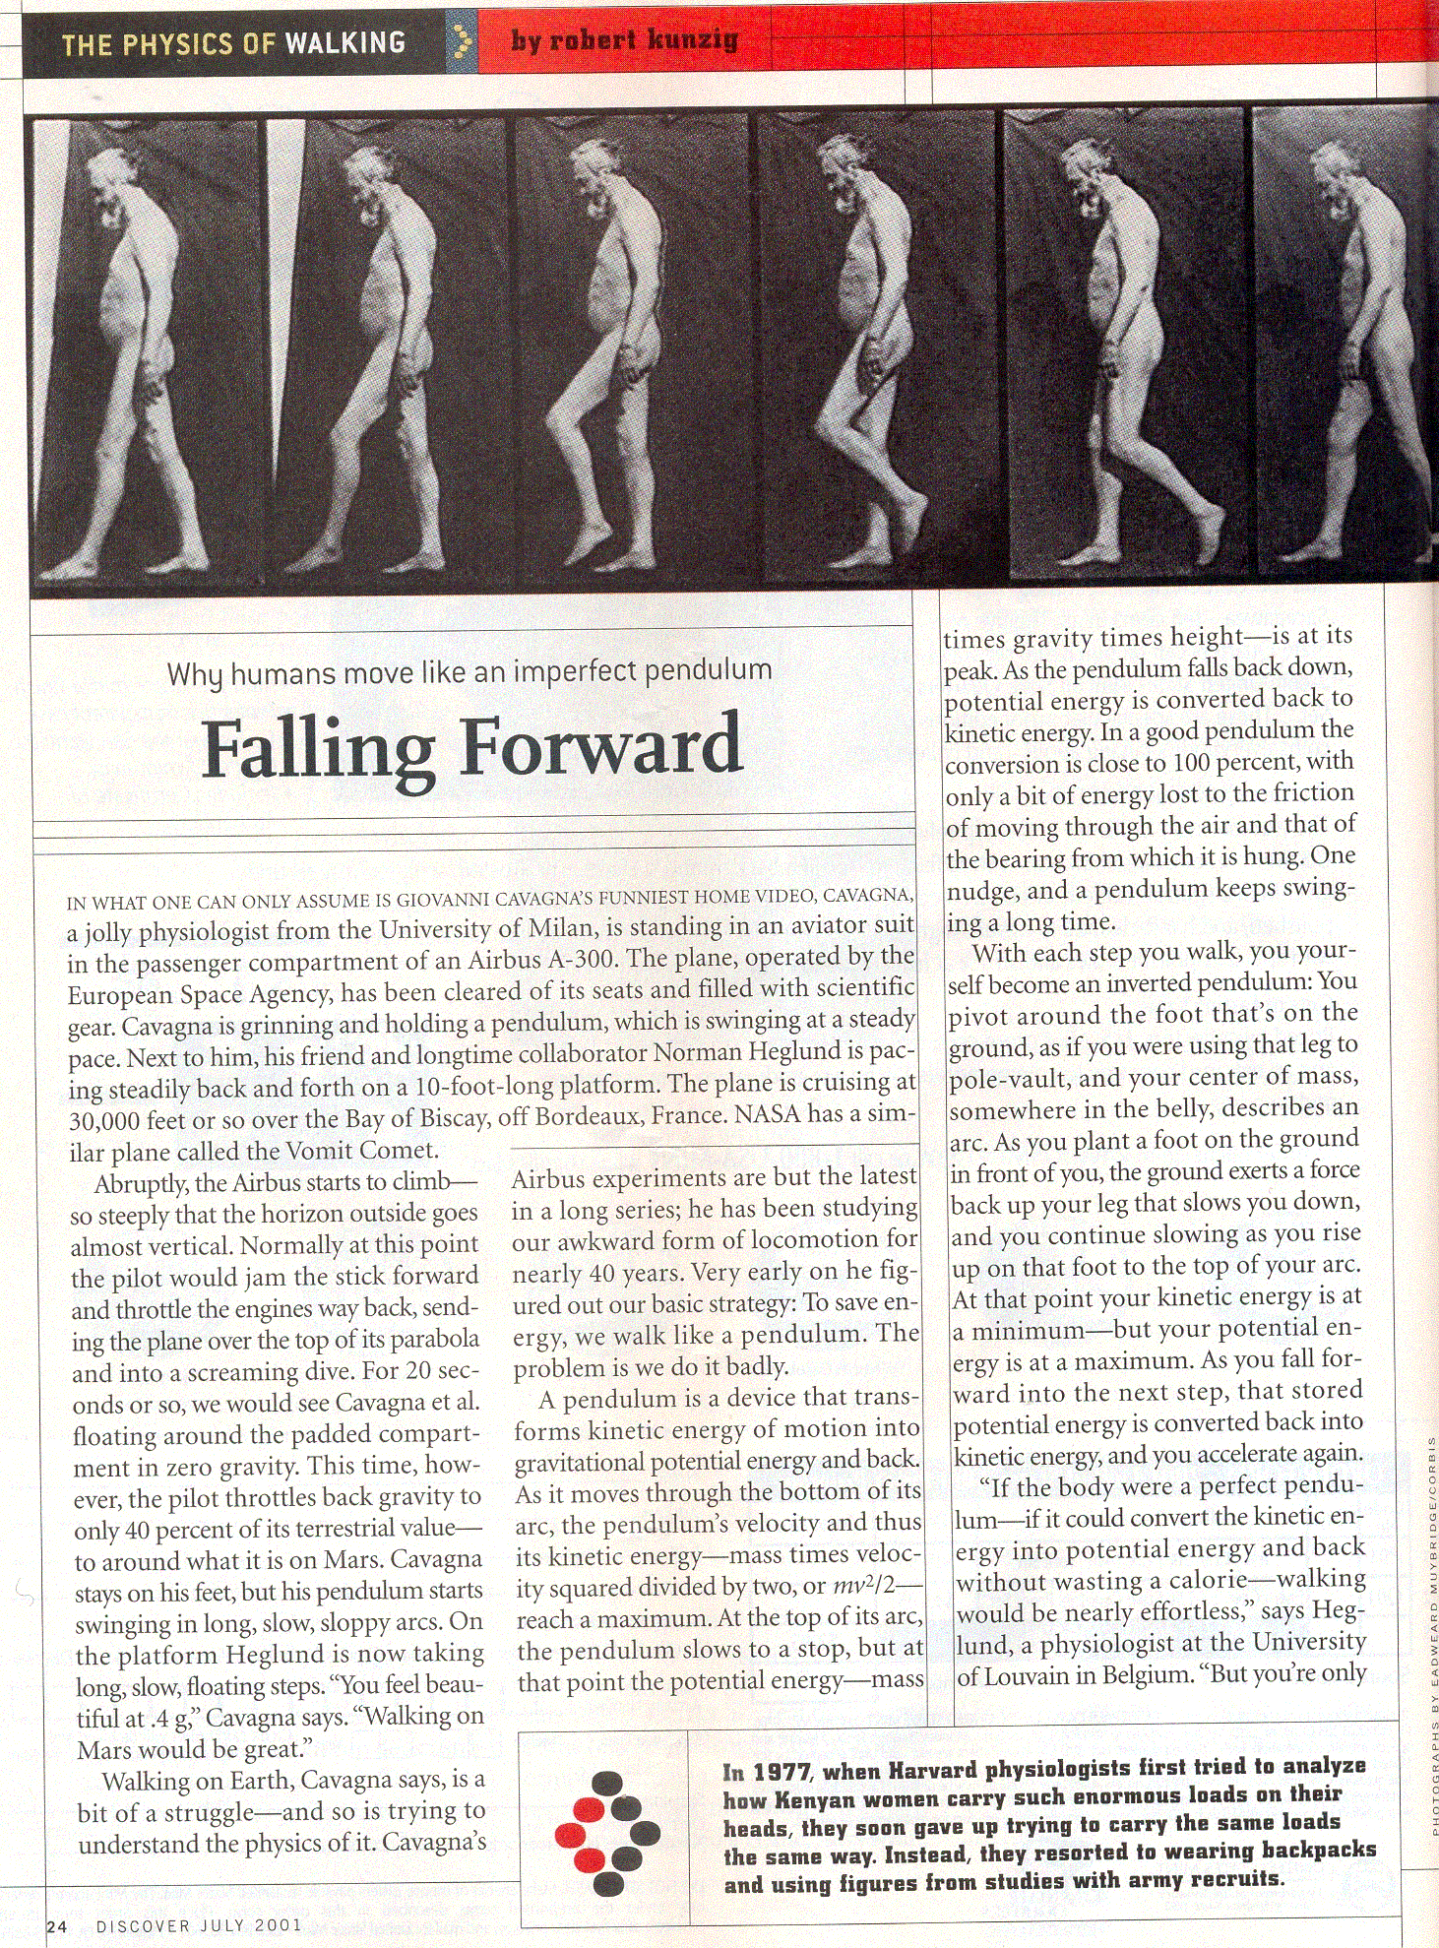
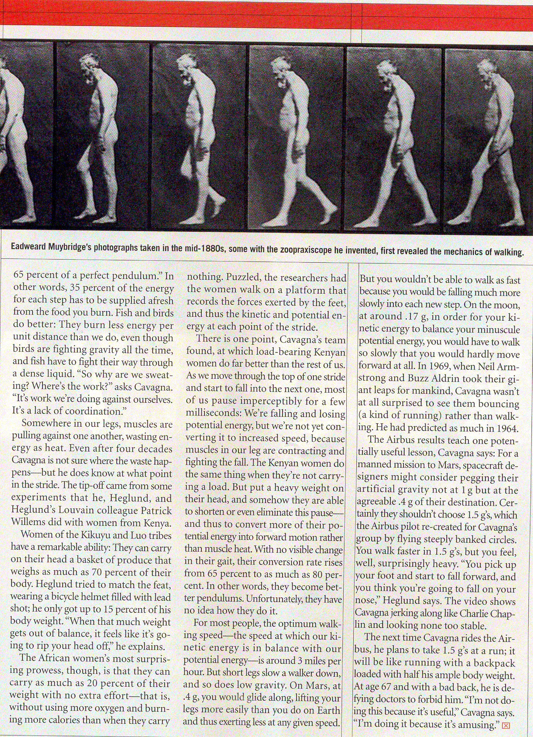
ADAPTATIONS FOR STANCE & LOCOMOTION
Muscle tone supports the body against gravity
Hominins use striding gait

Slide 22

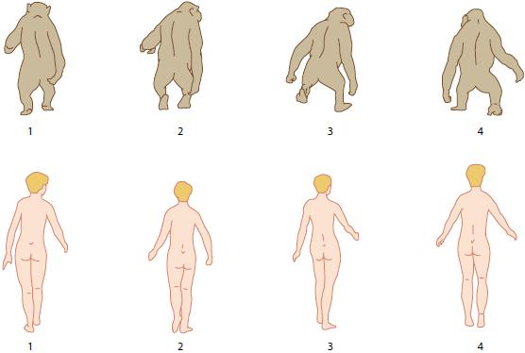
ADAPTATIONS FOR STANCE & LOCOMOTION
Can you explain the difference?

Slide 23
SIZE OF THE CEREBRAL CORTEX
The average human brain size is 1350cm³ but it does vary
Apes brains are only around 400-500cm³
Most of the difference is associated with the cerebrum
The outer portion is the cerebral cortex
In humans this section is over grown and over hangs the mid brain

Slide 24
SIZE OF THE CEREBRAL CORTEX
The convolutions in the cerebral cortex has greatly increased the surface area
The frontal lobe has had the greatest increase in surface area
In humans it makes up 47% but 33% in apes
The frontal lobe is used for planning, emotions etc
The larger brain requires a larger skull (cranium)
The volume of the skull is called cranial capacity
Cranial capacity has increased over time and can be measured with an endocast

Slide 25
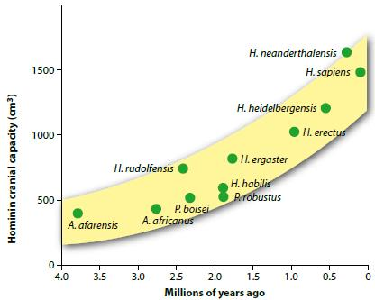
SIZE OF THE CEREBRAL CORTEX

Slide 26
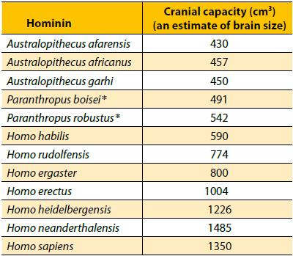
SIZE OF THE CEREBRAL CORTEX

Slide 27
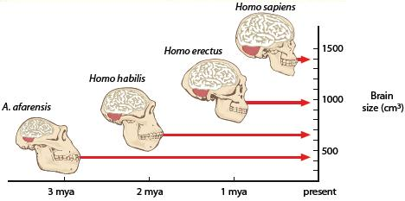
SIZE OF THE CEREBRAL CORTEX
The increase in brain size is thought to be as a result of increased protein in the diet

Slide 28
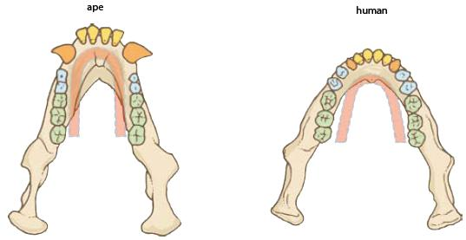
PROGNATHISM & DENTITION
Human dentition is very distinctive
The canine teeth do not project beyond the other teeth and interlock as they do in apes
The teeth in either row, dental arcade, are smaller and take up less room
The human jaw is parabolic and not U shaped as in apes

Slide 29
HUMAN EVOLUTIONARY TRENDS
As humans have evolved their faces have become flatter
The jaw does not jut out
Prognathism
Molar size has decreased with increased meat in the diet and many people are today born without wisdom teeth
Homo sapiens are the only hominin to have a chin
The forehead has also become flatter

Slide 30
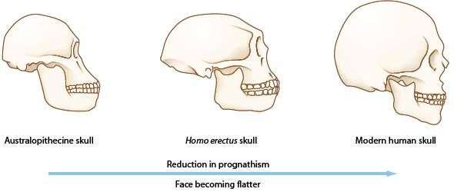
HUMAN EVOLUTIONARY TRENDS

Slide 31
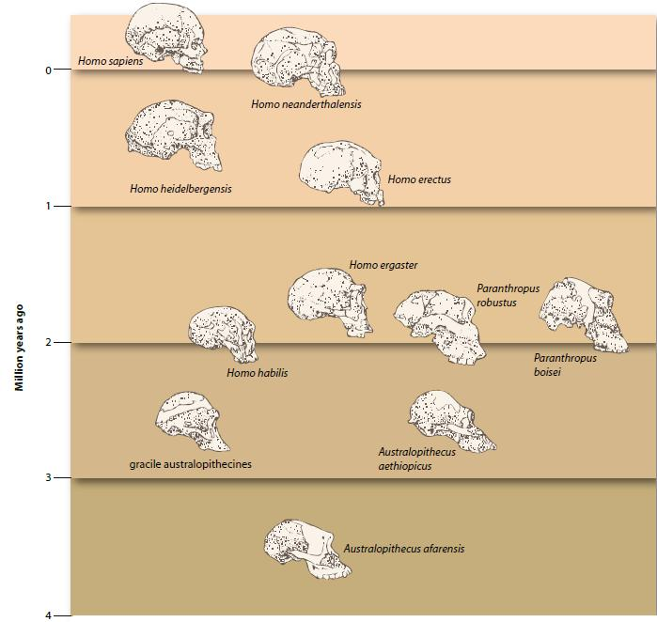

Slide 32
THE EFECT OF HOMININ EVOLUTION ON THE ENVIRONMENT
Working backwards in terms of natural selection, scientists believe they know what the environment was like for past hominins
Early hominins and chimpanzees evolved from the same ancestral species that lived in a woodland environment
These patches of forest were surrounded by grass 1m tall

Slide 33
THE EFECT OF HOMININ EVOLUTION ON THE ENVIRONMENT
Chimpanzees stayed in the trees whilst our ancestors travelled across the grassy plains
Bipedalism was born!!

Slide 34
THE EFECT OF HOMININ EVOLUTION ON THE ENVIRONMENT
Bipedalism has its advantages
Increased range of vision for predators
Increased size deters predators
Hands free for carrying tools etc
Higher reach for food (fruit)
Improved cooling of the body (↓SA:V for sun)
What effect would natural selection have on these?

Slide 35
Cultural evolution of hominins
Culture is any knowledge that is able to be passed down to the next generation
All hominin groups have had culture
The old would show the young
In time it was turned into speech then script

