Slide 1

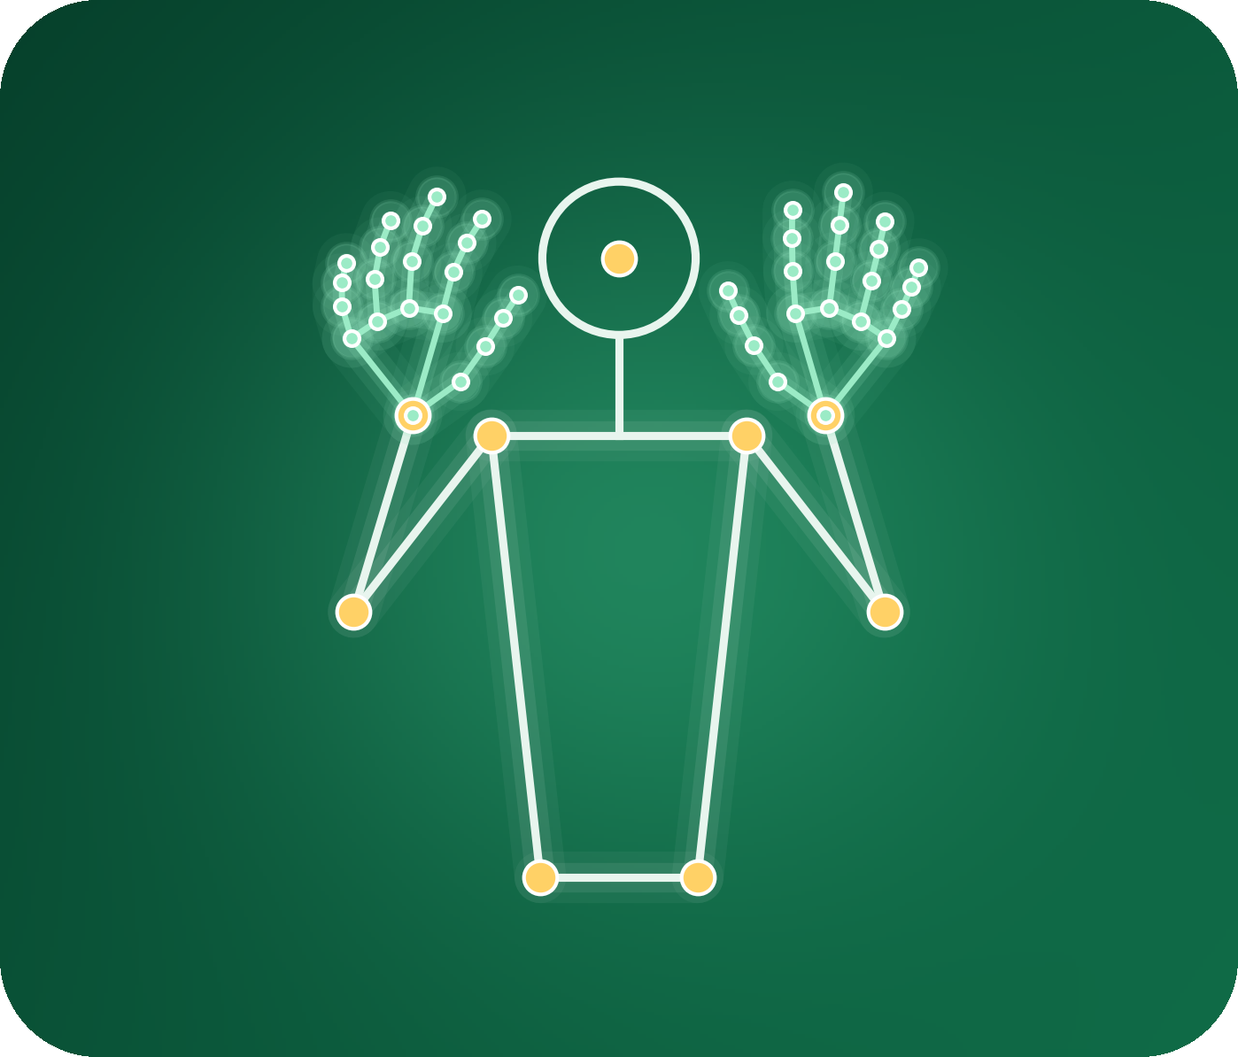
Khmer Sign Language
Word Recognition
Comparing LSTM, GRU and Transformer on landmark sequences
Presenter: [Your full name]
Course: Deep Learning
Lecturer: Mr. Soklong HIM
School: Kirirom Institute of Technology
Date: [Presentation date]
Student final project
Deep Learning
Notes:
Say your name. One sentence: I built a system that recognises 11 Khmer sign words and compared three neural networks on it.

Slide 2
Table of Contents
01
Problem and Approach
06
Learning Curves and Tuning
02
Dataset
07
Error Analysis
03
Model Architectures
08
Discussion
04
Experimental Setup
09
Limitations
05
Results
10
Conclusion and Next Steps
Student final project
Deep Learning
Notes:
Ten topics, about one minute each or less. You can delete this slide if you are short of time.

Slide 3
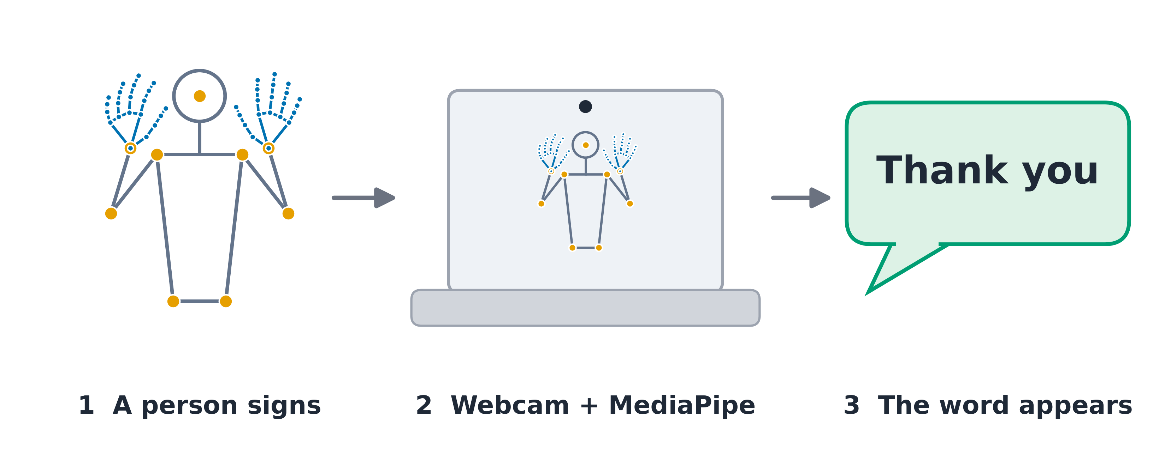
Problem and Approach
From a webcam clip to one of 11 Khmer sign words
What the system does
Input: a webcam clip, 90 frames × 258 landmark values (about 3 s)
Output: one of 11 words (multi-class sequence classification)
Why it matters
Khmer Sign Language has very little data or software; a webcam-only recogniser is a first step
The question
Which model reads the signs best: LSTM, GRU or Transformer?
Student final project
Deep Learning
Notes:
Explain input and output precisely. MediaPipe turns each frame into 258 numbers; it is a fixed, pretrained step shared by all three models. Only the sequence model is trained, from scratch, in PyTorch.

Slide 4
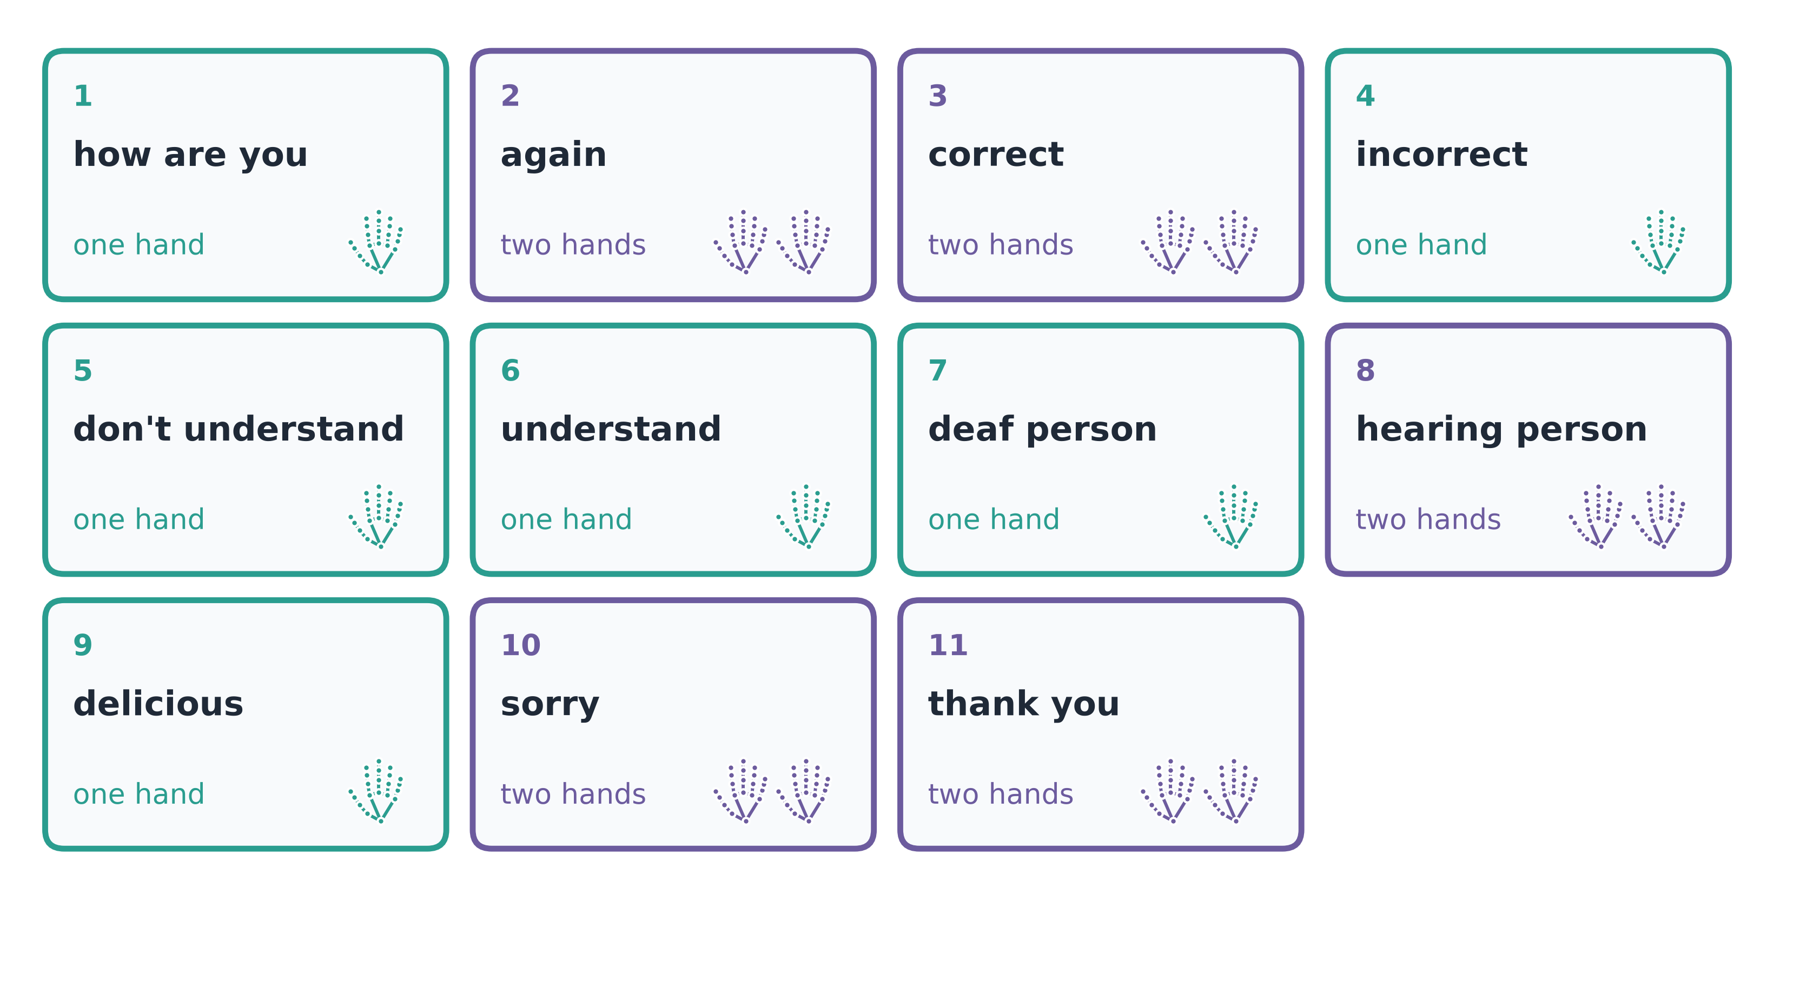
Dataset
Self-collected landmarks, 11 signs, fixed split
330
11
230 / 50 / 50
clips (30 per sign)
sign classes
train / validation / test
Notes
One signer, one webcam; balanced classes
Fixed, stratified split (seed 42), same for every model
Preprocessing: MediaPipe landmarks only; no augmentation
A hand the camera misses is stored as zeros
Student final project
Deep Learning
Notes:
Self-collected, so I describe it honestly: one person. Balanced, 30 clips per sign. Teal cards are one-handed signs, purple are two-handed. The test set is never used for any decision. [Add one line on recording conditions: sittings, lighting, camera.]

Slide 5
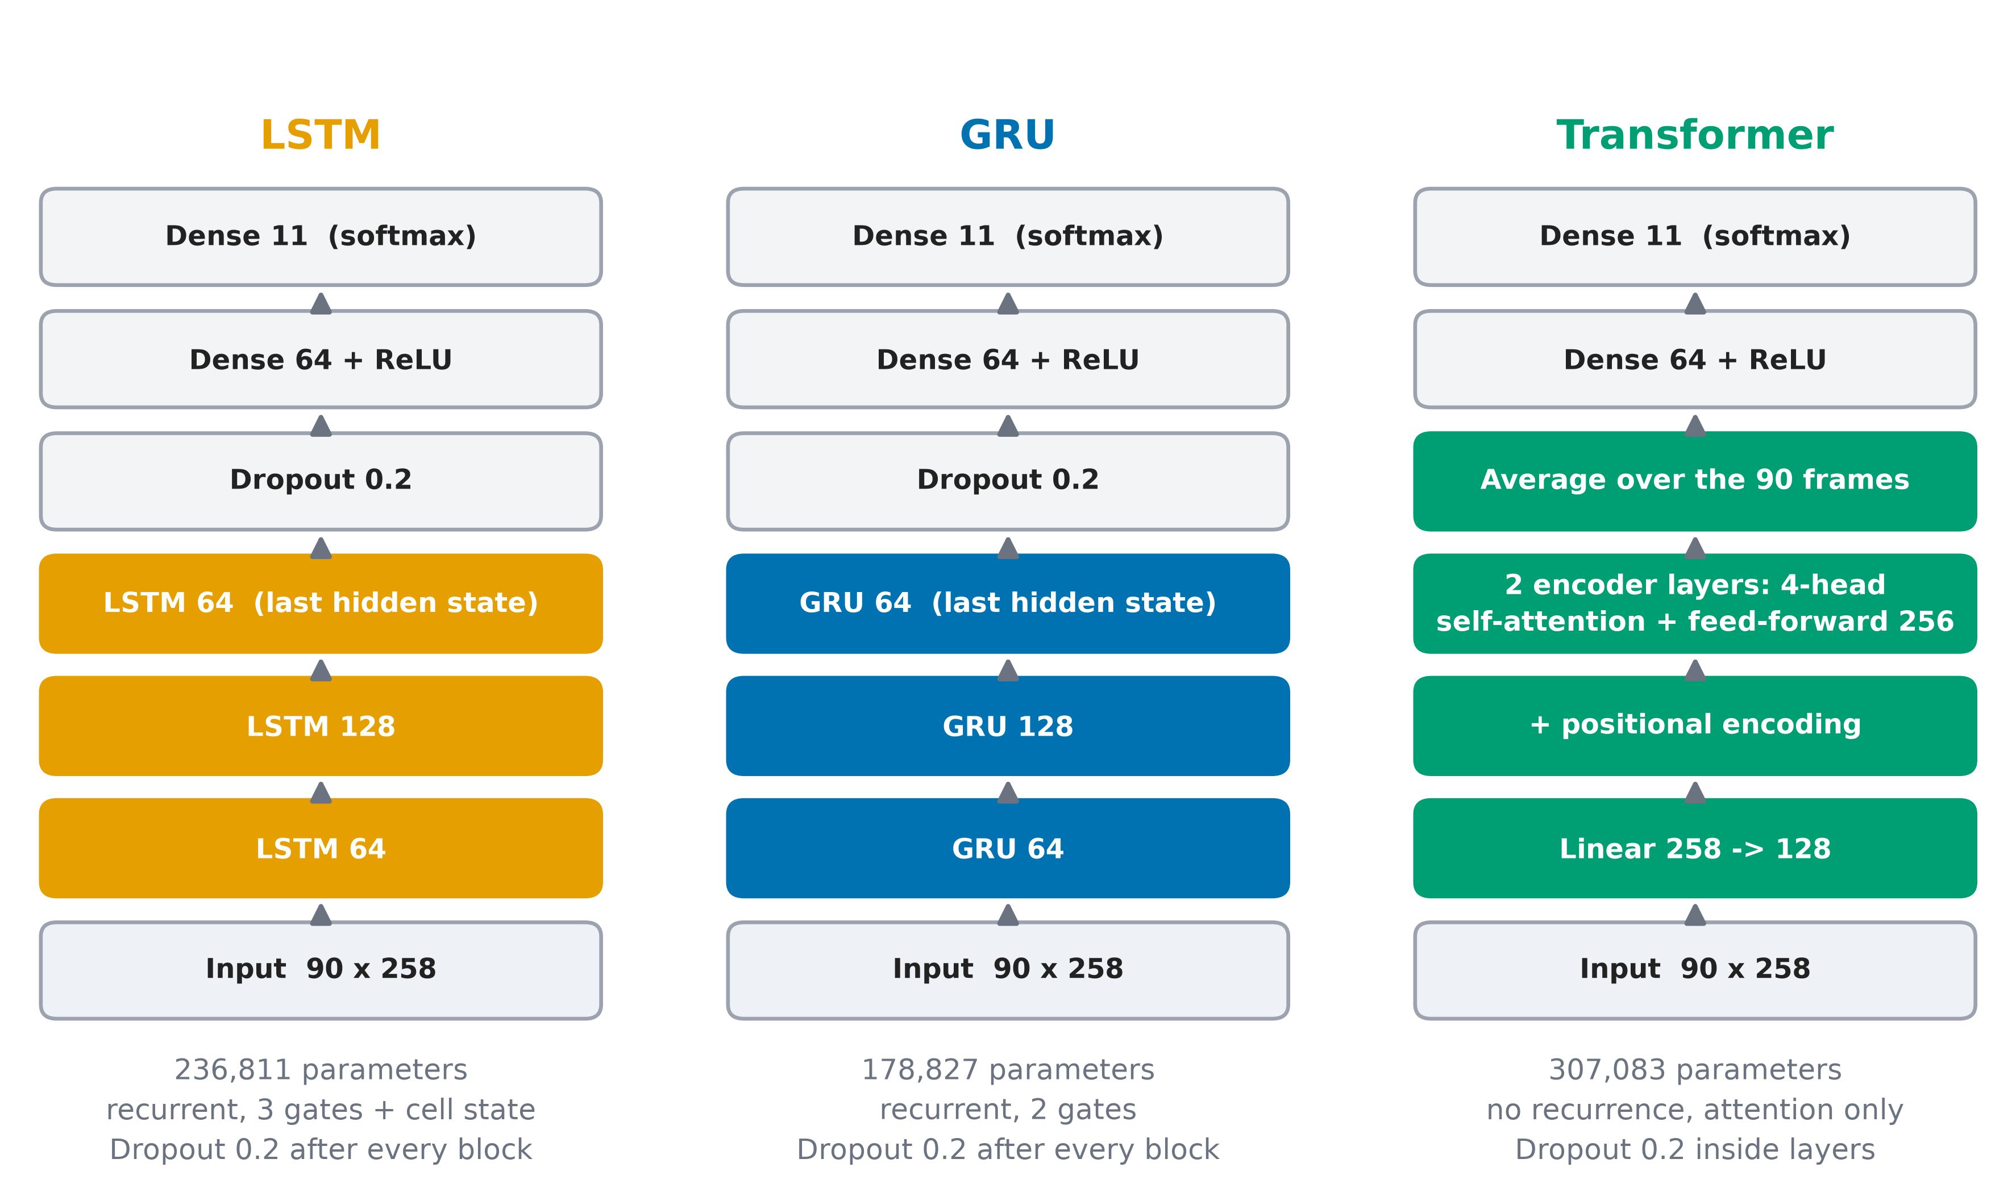
Model Architectures
Three networks compared on the same task
LSTM
Gated memory
GRU
Simpler gates
Transformer
Self-attention, no recurrence
Why these three
Sequence models from Sessions 07–08, all trained from scratch; only the architecture changes
Student final project
Deep Learning
Notes:
LSTM and GRU read the clip frame by frame and keep a memory. The Transformer lets every frame look at every other frame. GRU has about three quarters of the LSTM's parameters: 3 weight blocks instead of 4.

Slide 6
Experimental Setup
Same data, same metrics, same training recipe
Data and metrics
Tuning
230 / 50 / 50 split, same for every model
Accuracy (main), macro F1, confusion matrix
Learning rate {1e-3, 5e-4, 1e-4} × weight decay {0, 1e-4}
Chosen on validation accuracy
Training
Reproducibility and hardware
Cross-entropy loss, Adam, learning rate 1e-3, batch size 16
Early stopping (patience 25), dropout 0.2
Seed 42, torch.save checkpoints
Colab Tesla T4, 6–8 s per model, [PyTorch version]
Student final project
Deep Learning
Notes:
One sentence per block. The best epoch, chosen by validation accuracy, is what gets tested. Fill in the PyTorch version from the second cell of your Colab notebook.

Slide 7
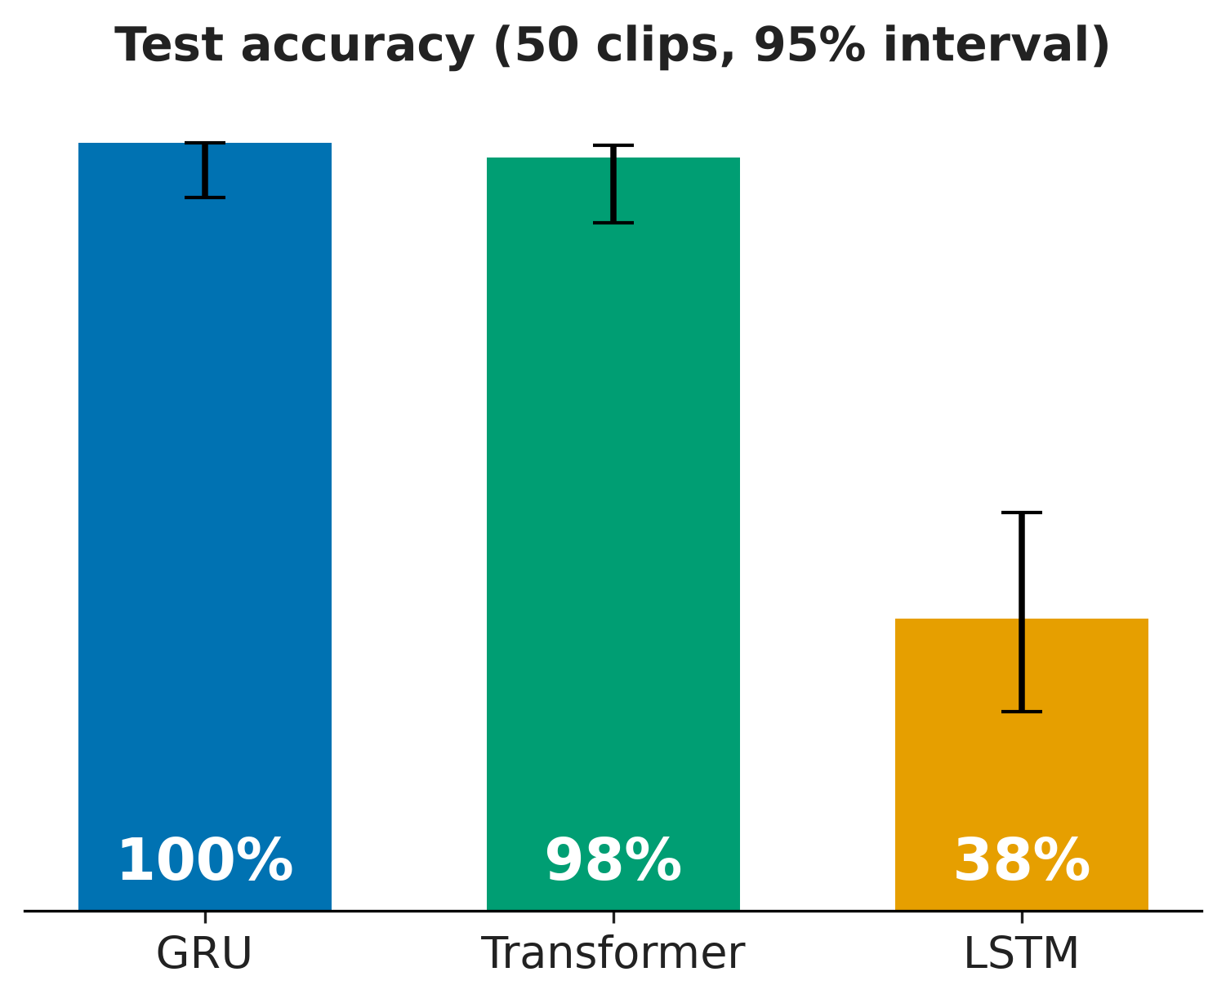
Results
Same 50 test clips for every model
Approach | Accuracy | Macro F1 | Parameters | Time
GRU | 100% | 1.00 | 178,827 | 5.8 s
Transformer | 98% | 0.98 | 307,083 | 8.1 s
LSTM | 38% | 0.31 | 236,811 | 6.7 s
Errors out of 50: GRU 0, Transformer 1, LSTM 31
95% intervals: GRU 93%–100%, Transformer 90%–100%. Not separable with 50 clips
Student final project
Deep Learning
Notes:
Same test set, same metrics for every model. Be clear that the gap between GRU and Transformer is one clip.

Slide 8
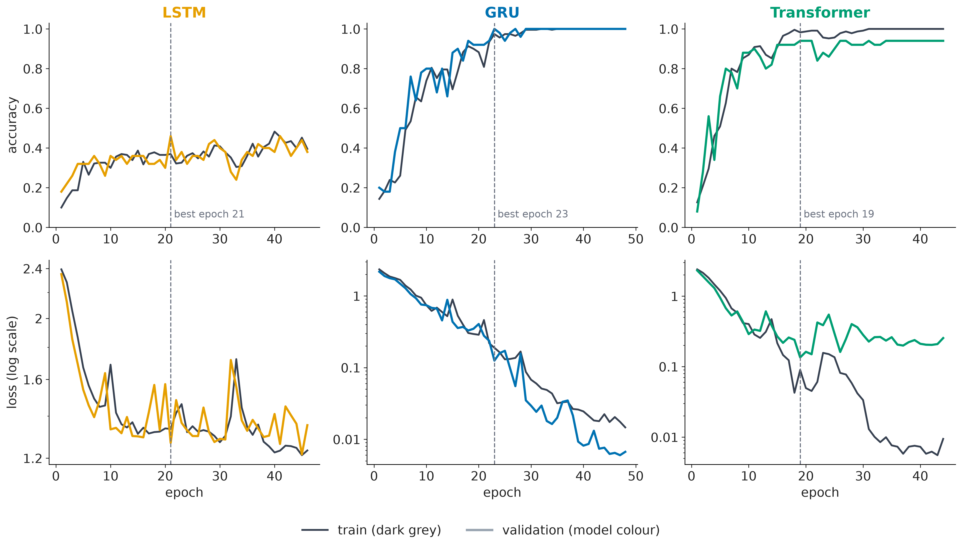
Learning Curves
Training vs validation, per model
LSTM
Underfits: training accuracy only 40%
GRU
Fits cleanly: no gap
Transformer
Slight overfit: validation loss rises after epoch 19
Student final project
Deep Learning
Notes:
Top row accuracy, bottom row loss on a log scale. In the Transformer's bottom panel the two lines separate: that is the overfitting signature from class. Early stopping kept the best epoch of each model.

Slide 9
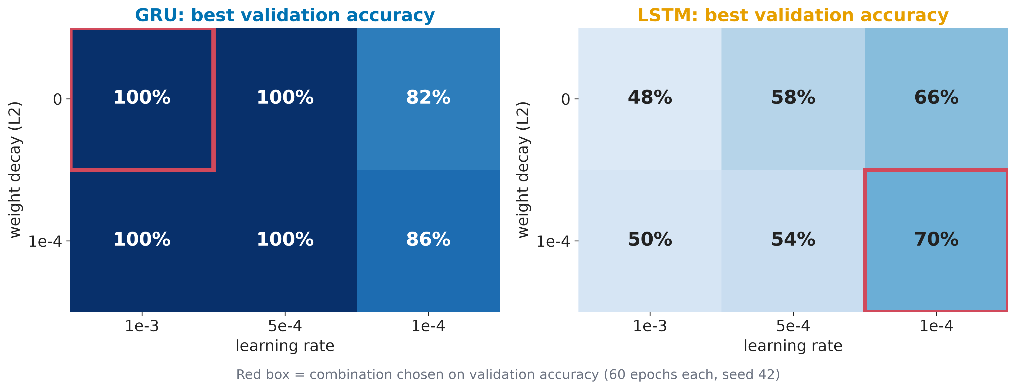
Hyperparameter Tuning
Learning rate × weight decay, chosen on validation
What we found
GRU: 4 of 6 settings reach 100%; learning rate 1e-4 is too slow (82%–86%)
LSTM: a lower learning rate lifts validation accuracy from 48% to 70%
The LSTM in the results uses the default rate; retraining it is future work
Student final project
Deep Learning
Notes:
Choices were made on validation accuracy only. Weight decay made no difference for the GRU. This also tells us the LSTM's weak result is partly a settings problem.

Slide 10
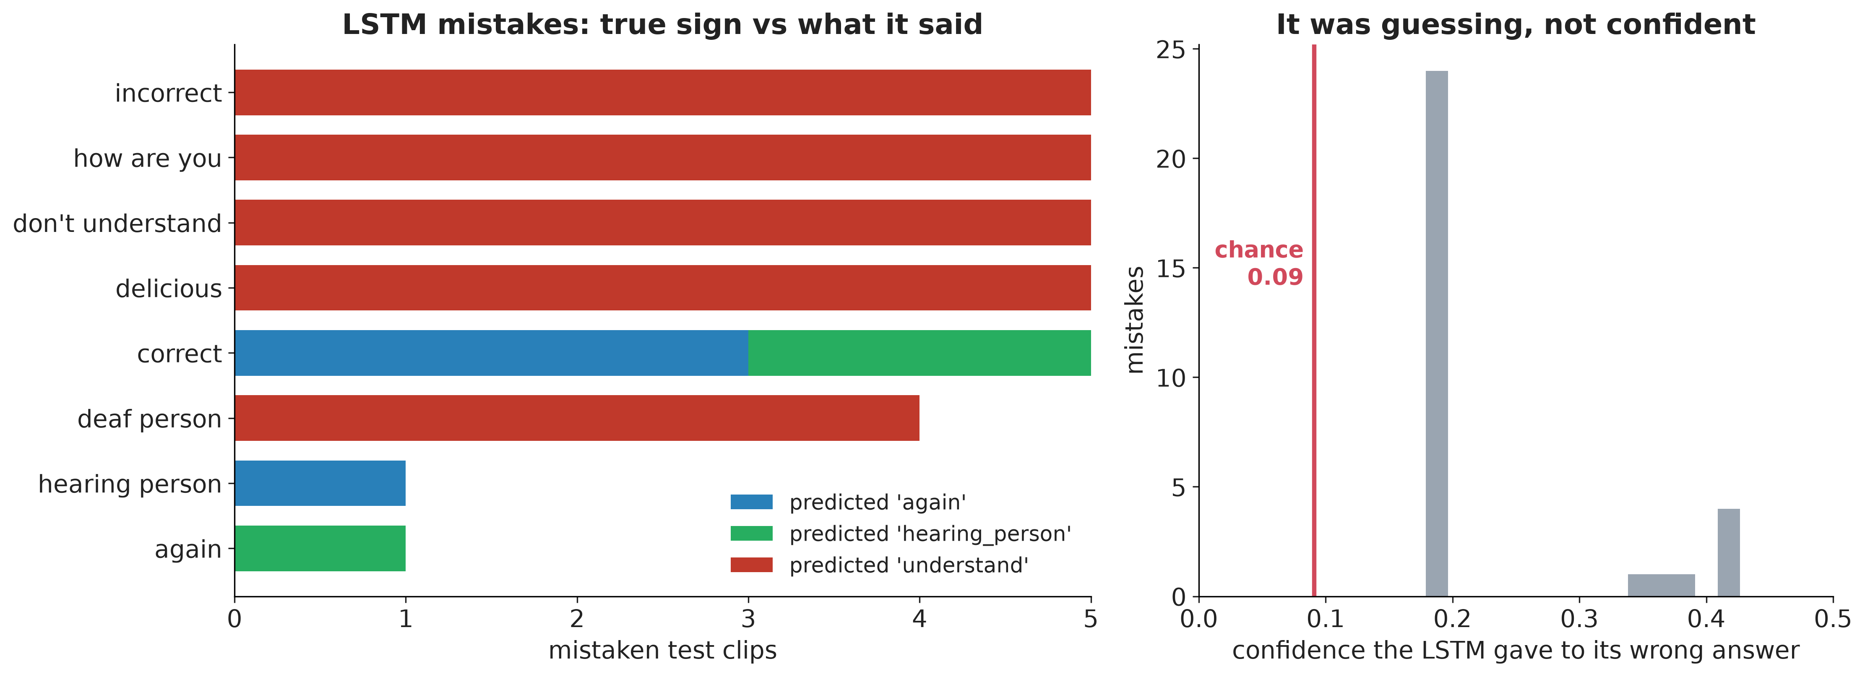
Error Analysis
What each model got wrong, and why
What went wrong
GRU: 0 errors
Transformer: 1 error (understand read as don't understand)
LSTM: 31 errors; 24 were “understand” at about 0.18 confidence (chance is 0.09)
All from one-handed signs: it learned which hands are present, not the movement
Student final project
Deep Learning
Notes:
The LSTM got sorry, thank you and understand fully right and collapsed the one-handed signs into one answer. Diagnosis: underfitting, not overfitting. I do not claim why the Transformer confused that one pair.

Slide 11
Why GRU Won, and a Caution
Explaining the results with course concepts
Why
Frame-order test
GRU beats LSTM: little data (230 clips) and 90 steps; fewer parameters, easier to optimise
Transformer is close: attention reaches every frame; the larger model overfits slightly
But the dataset is easy: a model with no sense of order also scores 100%
 | Normal order | Frames shuffled
GRU | 100% | 94%
Transformer | 98% | 93%
LSTM | 38% | 35%
No-order baseline | 100% | n/a
Shuffling the frames barely hurts, so the models rely on hand shape and position more than on movement.
Student final project
Deep Learning
Notes:
This is the most important slide for honesty. A logistic regression on the clip average, with no concept of time, scores 100% on the test set. So the scores do not prove the models learned movement. A harder test: signs that differ only in movement, or a second signer. Course terms: capacity, data size, regularisation, inductive bias.

Slide 12
Limitations
Honest limits of this study
Data and evaluation
Method
One signer, one room: no evidence for other people, cameras or lighting
Small data: 30 clips per sign; one test clip is worth 2 points
Easy dataset: frame order is barely used
Raw coordinates, and a missed hand becomes zeros: possible shortcuts
No augmentation
Live webcam accuracy not measured
Student final project
Deep Learning
Notes:
Read these straight; the rubric rewards limitations clearly identified. [If you ran a live test with predict.py, replace the last bullet with your tally.]

Slide 13
Conclusion and Next Steps
Key takeaways and prioritised future work
Conclusion
Next steps
GRU best (100%), Transformer 98%, LSTM 38%
Same data, split, seed and metrics for all three
Honest finding: an easy dataset, order barely used
Record a second signer
Add signs that differ only in movement
Augmentation and body-relative coordinates
Retrain the tuned LSTM; live accuracy test
Student final project
Deep Learning
Notes:
Three takeaways, then the next steps in priority order, then questions.

Slide 14
Thank you
Questions? · github.com/rinrin168/khmersignlanguage
Student final project
Deep Learning

Slide 15
Backup: Per-Sign Results
For questions only
Transformer
LSTM (recall per sign)
Recall 100% for every sign except: understand 75%
Precision below 100%: don't understand 83%
100%: sorry, thank you, understand
75%: again, hearing person
0%: correct, deaf person, delicious, don't understand, how are you, incorrect
Student final project
Deep Learning

Slide 16
Backup: Reproducibility and AI Use
For questions only
Code, data and results: github.com/rinrin168/khmersignlanguage
Seed 42 (Python, NumPy, PyTorch), fixed split from src/preprocess.py, torch.save checkpoints
MediaPipe Holistic (Google, Apache 2.0): fixed feature extractor, not trained by me
AI assistance: Claude (Anthropic) for drafting and debugging code, figures and the README; code and analysis checked by me [edit this line so it is true for you]
Student final project
Deep Learning

