Slide 1
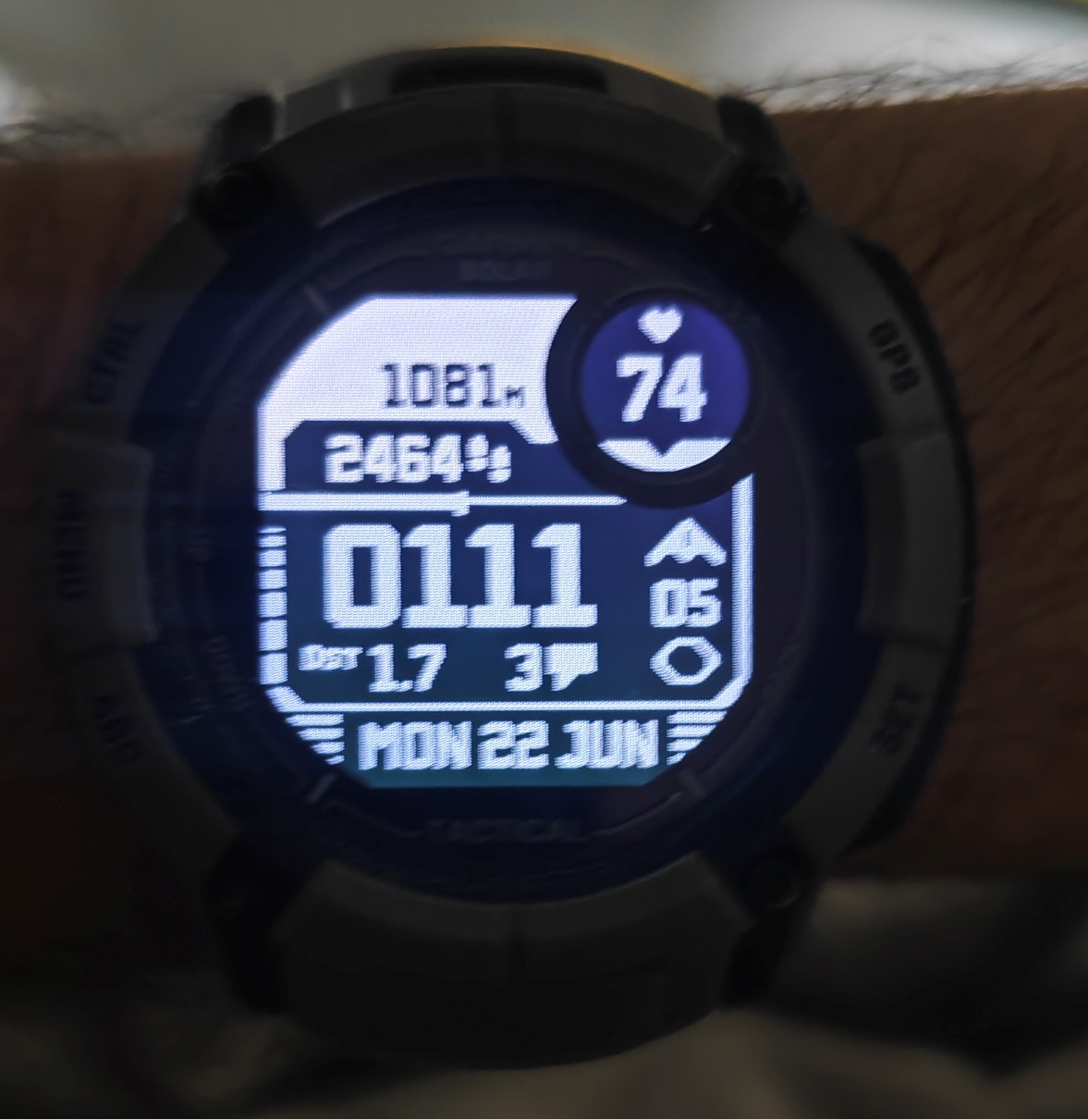
Stock line Graph
BPM
Stock 1m Price
HH:MM:SS
Steps
Altitude
Day Date Month

