Slide 1

Learning & Development

Slide 2
Learning & Development Overview Page
Learning & Development
Learning Platforms
L&D Resources
Leaders Corner
Professional Qualifications
Competencies Repository
Home - Workday
Coursera | Courses, Professional Certificates, and Degrees Online
LinkedIn Learning: Online Courses for Creative, Technology, Business Skills
Business Learning and Development
Functional Learning and Development
Group Learning and Development
Winning Performance Culture
Becoming a Line manager
Line Leader Toolkit for Goal Setting.pptx
2026 Learning Programmes
Past: People Development Week
Past: LEAD for Frontline
Itqan
Notes:
Note 1 – we have a separate slide explaining each learning platform
Note 2 – we have separate slides for each L&D resource

Slide 3
Coursera
What Coursera Offers?
Courses from top universities & companies. (Harvard, Google, IBM, Stanford, Wharton, and more.)
Professional certificates & micro‑credentials.
Hands‑on projects and practical assessments.
Learn anytime—mobile, desktop, on‑the‑go. (Employees can build new skills while still completing everyday tasks.)
Key Benefits for Employees
Personalized learning pathways aligned to career goals.
Earn industry‑recognized certificates from global partners.
Improve performance with flexible, structured learning.
Why It Matters?
Coursera empowers employees to stay future‑ready by building the technical, digital, and business skills needed in today’s evolving workplace.

Slide 4
LinkedIn Learning Hub
LinkedIn Learning is a digital learning platform offering employees on‑demand training in business, technology, leadership, and future‑skills:
Business: Leadership, HR, project management, communication.
Technology: Data analysis, software development, IT infrastructure.
Personal Development: Time management, emotional intelligence, productivity.
Personalized Learning Paths: Courses tailored to each employee’s role, skills, and career goals.
AI‑Powered Coaching: Role‑play difficult conversations and receive instant feedback to improve communication and leadership skills.
Future‑Ready Skills: Access to the latest courses in AI, digital skills, leadership, and business excellence.
Learn Anytime, Anywhere: Short videos and mobile access make learning flexible and convenient.
Career Growth & Engagement: Employees feel more supported, motivated, and prepared for new opportunities.
What You Get?
Thousands of expert‑led courses.
Bite-sized videos for fast learning.
Professional certificates.
Accessible anytime, on any device.
Key Benefits
Personalized learning paths.
AI-powered role play to sharpen communication.
Develop future-ready digital & AI skills.
Boost career growth and confidence.
Why It Matters?
LinkedIn Learning helps you build the skills you need to perform, grow, and succeed in a rapidly evolving workplace.
Using the Role Play feature in LinkedinLearning
👉Already have a license? [Access AI Features HERE]
👉Need a license? [Activate Yours HERE]
To activate the LinkedIn license, can refer to this page

Slide 5
Learning Resources - Group Learning and Development
Causal Learning – Home
Commercial Academy
Continuous Improvement
DE&I Learning Portal
Digital Skills@Shell
Energy Transition Learning Resources
Ethics & Compliance Learning
Knowledge Management: validated content & experts
Marketing Learning Hub
STAKEHOLDER SAVVY
Notes:
These links take you to complete pages / portals established by Shell Global with all the relevant learning materials

Slide 6
Learning Resources - Business Learning and Development
Asset Management
Shell Project Academy and Engineering Learning
Global Lubricants Learning Portal
Global Customer Operations Learning Portal
Low Carbon Solutions
Lubricants Supply Chain Learning Curriculum
Mobility & Convenience Learning Portal
Renewables and Energy Solutions
Safety
SEAM Knowledge Management, Learning & Talent – Home
T&S Learning

Slide 7
Learning Resources - Functional Learning and Development
CR Development Portal
Pages - Finance Learning Gateway
IDT Learning
Real Estate Competency Framework
Security Capability Development

Slide 8

2026 Learning Programmes – People Development Week
As an organisation, our role is to provide / offer all the tools and resources to enable the development process, otherwise, it is each individual’s responsibility.
Employees should by default love learning and exploring, rather than seeing learning / training as a tick box exercise
Our key messages will be around:
Learning starts from within
It is about YOU
You’ve got this
Just take the first step
Start from here…
Empower. Innovate. Elevate
Notes:
This is the logo and the key message (I will be sharing more information in the second batch)
The agenda and pillars of the week are in the next slides

Slide 9
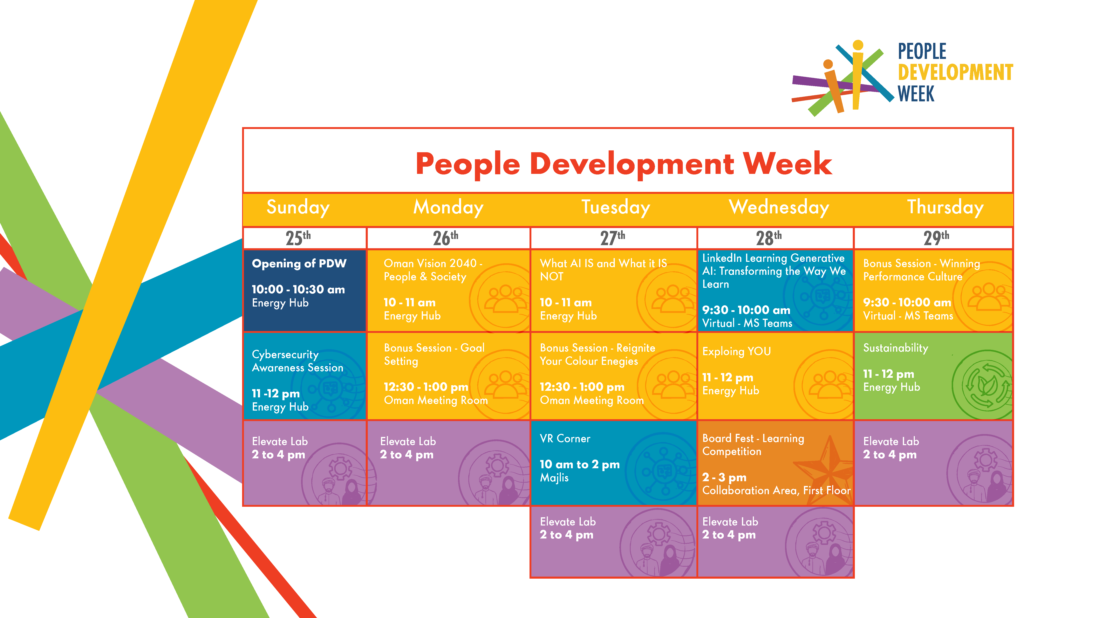
Notes:
Need to mention the interactive screens here

Slide 10

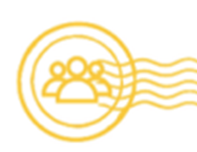

People Development Week Pillars
Digitalisation
Sustainability
People Excellence

