Slide 1
Easy Cook
Recipe Finder App
Presented by, Guided by,
Rinsha T Prof.Sheera Shamsu
Department of MCA Department of MCA

Slide 2
INTRODUCTION
Target Audience: Individuals with limited cooking skills or those who are often perplexed by the ingredients they have on hand.
Purpose: To help users easily discover recipes they can make with the ingredients they have.
Interface: Simple and intuitive, allowing users to input available ingredients.
Functionality: Provides tailored recipe suggestions that match the input ingredients.
Goal: To make meal preparation effortless and enjoyable.

Slide 3
Existing Problem
Limited Cooking Skills
Ingredient Confusion
Traditional Recipe Limitations
Unhealthy Eating Habits
Lack of Customization

Slide 4
Problem Solutions
Recipe Search functionalites:
Random recipe search
Search by ingredient input
Advanced filtering Options
->Cooking time
->Difficulty level
->Preffered cuisine
->Dietary restriction
User profile for Authentication and Advanced Search
Smart suggestion

Slide 5
Flutter
UI for Recipe Search and Login/Sign-up (Auth)
Methodology
Firebase Auth
(Login/Sign-up)
Spoonacular API
(Fetch Recipes)
Firestore DB
(User Preferences & Profile Info)
Spoonacular API (Random Search, Ingredient Search,Advanced Filters)

Slide 6
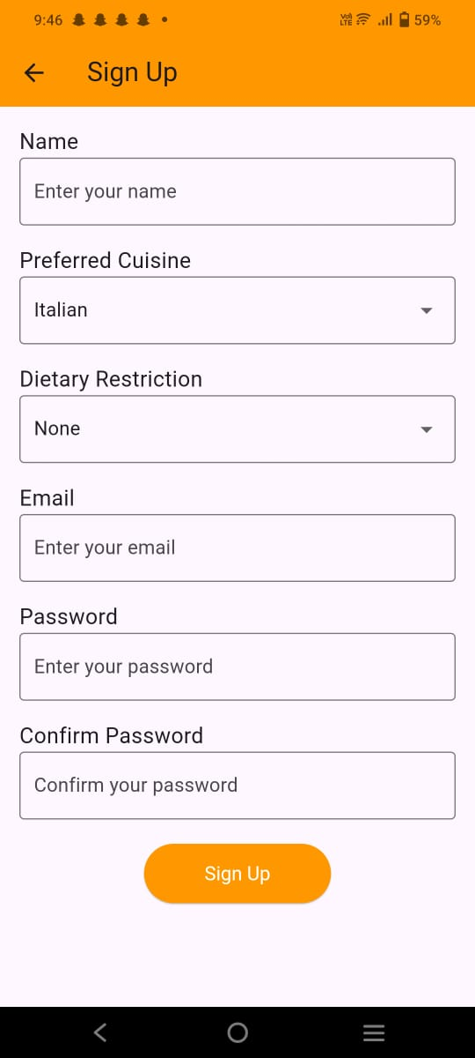
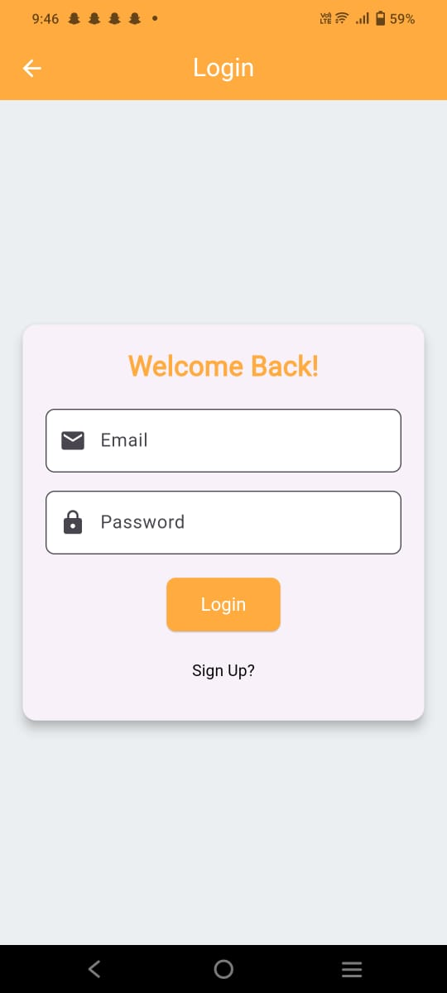
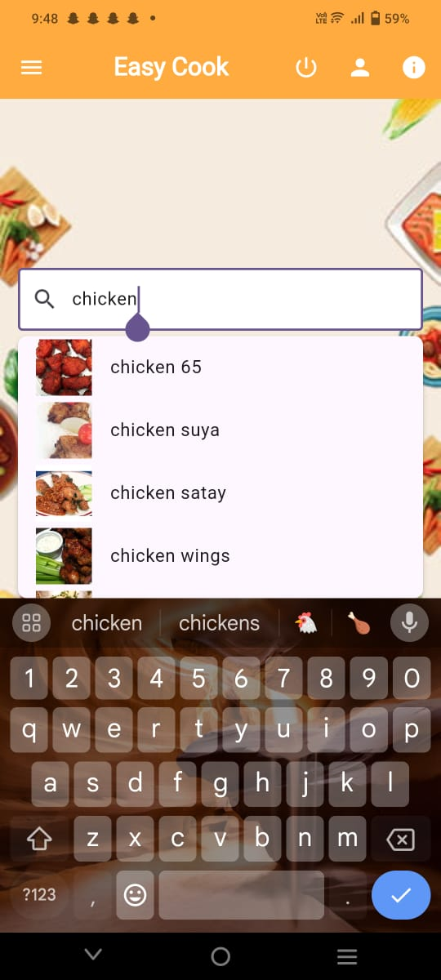
Output

Slide 7
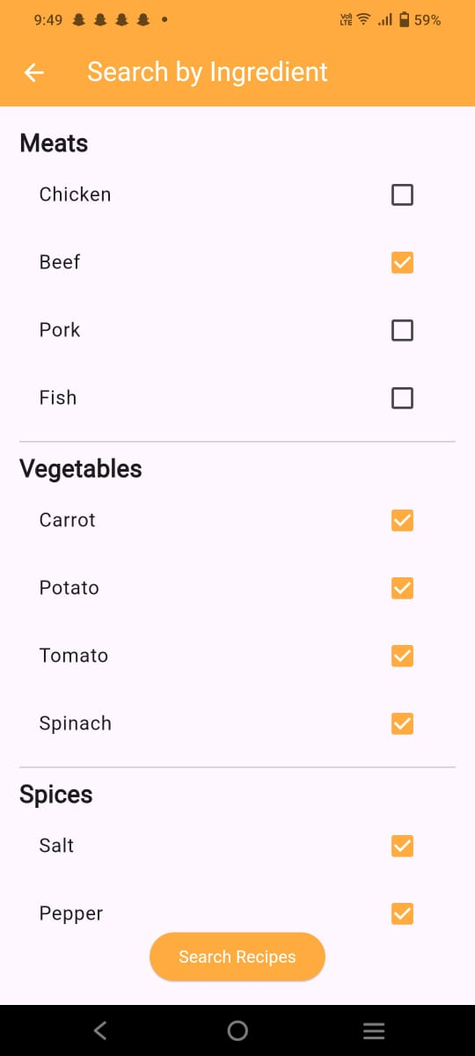
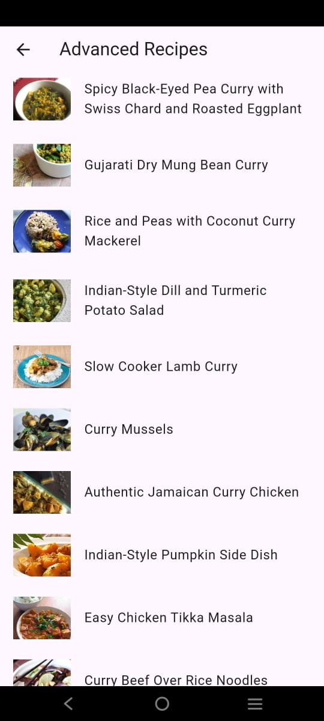
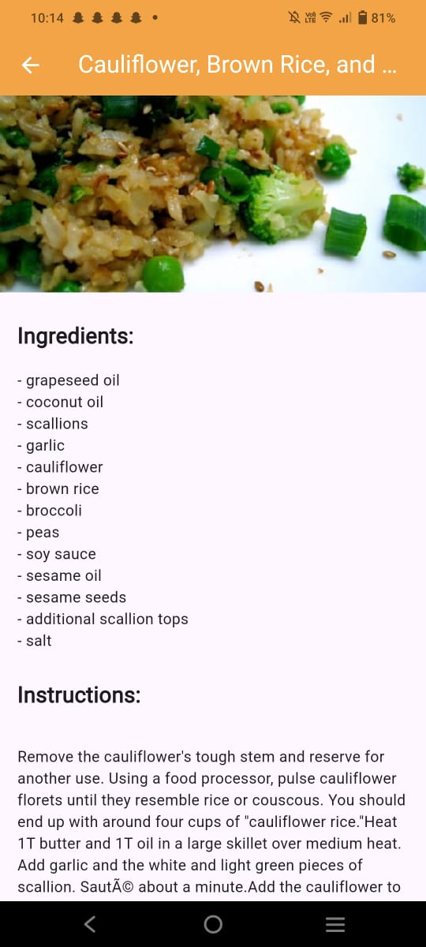

Slide 8
Future Enhancement
1. Enhanced Recommendation System:
Implement machine learning to suggest recipes based on user behavior, like frequently chosen cuisines or dietary restrictions.
2. Nutritional Information Analysis:
Integrate a feature that provides detailed nutritional breakdowns for each recipe to cater to health-conscious users.
3. User-Generated Recipes:
Allow users to submit their own recipes, expanding the app's recipe database and encouraging community engagement.
4. Meal Planning and Shopping List Generation:
Introduce a weekly meal planner and automatically generate shopping lists based on selected recipes.
5. Offline Mode:
Enable offline access for saved recipes, allowing users to view their favorites even without an internet connection.
6. Voice-Assisted Navigation:
Add voice commands for hands-free navigation, improving accessibility while cooking.

Slide 9
REFERENCES
1. Parth P. Sharma, Ankit Gupta, Hardik Parmar, Devang Patidar, Krupali Rana, Devangini Dave. Food Recipe Recommendation System. Smart Computing, 2021. DOI: https://doi.org/10.47531/SC.2022.15.
2. Spoonacular API Documentation. Details on the API functionalities for recipe search, filtering, and dietary data. Available at: https://spoonacular.com/food-api/docs.
3. Firebase Documentation. Official documentation covering Firebase authentication, database, and user management solutions. Available at: https://firebase.google.com/docs.
4. Flutter Documentation. Comprehensive resources on using Flutter for building cross-platform mobile apps. Available at: https://docs.flutter.dev/.

Slide 10
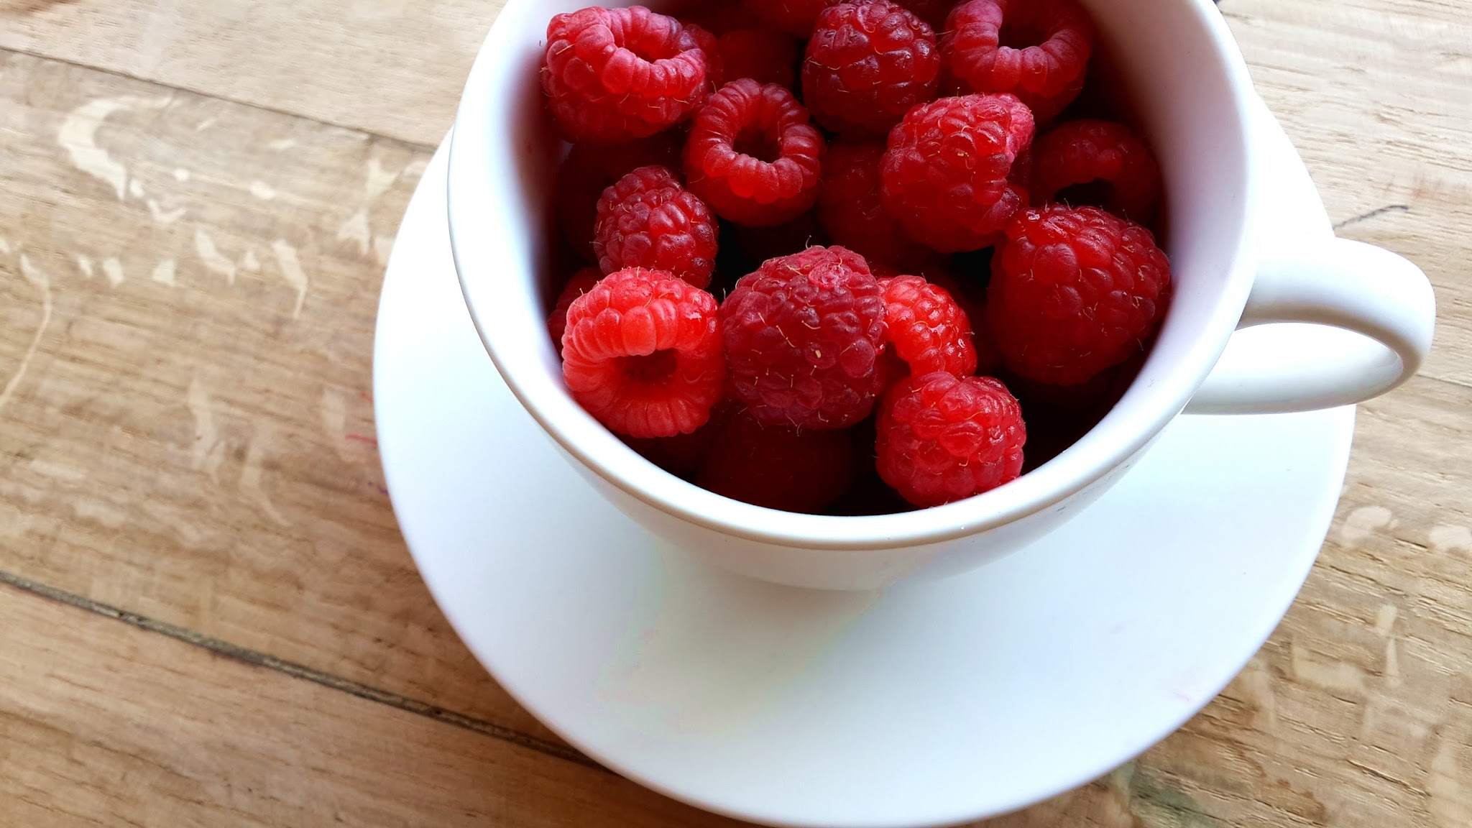
THANK YOU!!

