Slide 1

Cloud Forensics Automation
for Energy Breaches
PRJN26-141
BCA Final Year Project
Muhammed Rinshad PP

Slide 2




The Problem
Why Energy Sector Forensics Needs Automation
Manual Inspection Fails at Scale
Energy companies store thousands of files — manual review is impractical
Tampering Goes Undetected
Without hash comparison, modified files blend in with legitimate data
Chain-of-Custody Gaps
Manual processes lack timestamped audit trails required by regulators
No Structured Reporting
Ad-hoc investigation produces inconsistent, non-reproducible evidence

Slide 3
Aim & Objectives
1
Recursively scan directories and collect comprehensive file metadata
2
Compute dual cryptographic hashes (MD5 + SHA-256) for every file
3
Create baseline snapshots for future tamper comparison
4
Detect file tampering: flag NEW, MODIFIED, and DELETED files
5
Generate CSV evidence reports and HTML forensic dashboards
6
Maintain timestamped audit trail for chain-of-custody compliance
7
Zero external dependencies — Python standard library only

Slide 4





Technology Stack
Built entirely with Python Standard Library — zero external dependencies
Python 3.10+
hashlib
os / pathlib
Core language
MD5 & SHA-256
File traversal
json
csv
tkinter
Baseline storage
Evidence reports
Desktop GUI

Slide 5
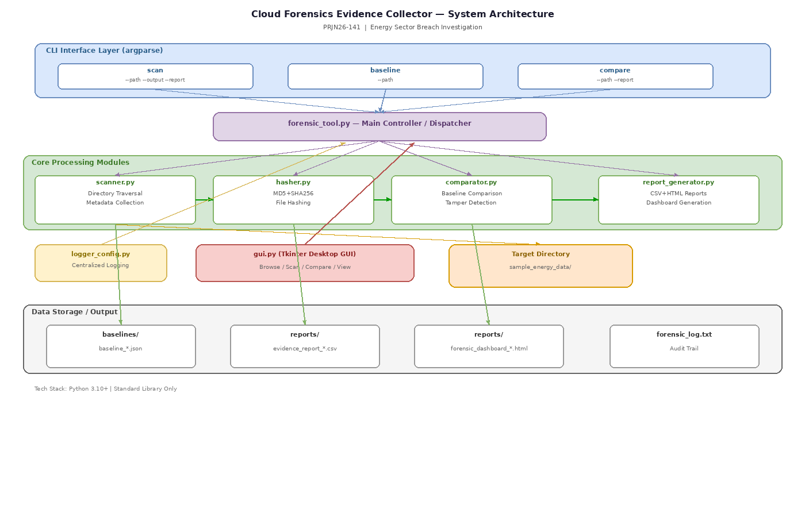
System Architecture

Slide 6






Module Breakdown
forensic_tool.py
scanner.py
CLI entry point & dispatcher
Directory traversal & metadata
hasher.py
comparator.py
MD5 + SHA-256 dual hashing
Baseline comparison & tamper detection
report_generator.py
logger_config.py
CSV & HTML report output
Timestamped audit trail

Slide 7
Data Enrichment Pipeline
1
2
3
4
SCAN
▶
HASH
▶
COMPARE
▶
REPORT
7 metadata fields
+2 hash fields
+1 status flag
CSV + HTML output
Each record is progressively enriched from 7 fields to a complete 10-field evidence record

Slide 8
Dual-Hash Integrity Verification
MD5
SHA-256
128-bit | 32 hex chars
256-bit | 64 hex chars
Fast computation speed
Quick file deduplication
Not collision-resistant
Preliminary comparison use
Forensic-grade security
NIST FIPS 180-4 compliant
Collision-resistant
Legal evidence standard
Both computed simultaneously in a single file read pass (8 KB streaming buffer)

Slide 9
Tamper Detection Engine
UNCHANGED
Hash matches baseline
NEW
File added after baseline
MODIFIED
Hash differs from baseline
DELETED
File missing from scan

Slide 10
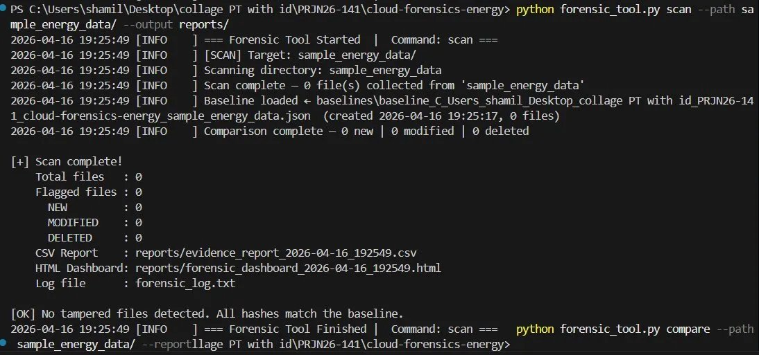
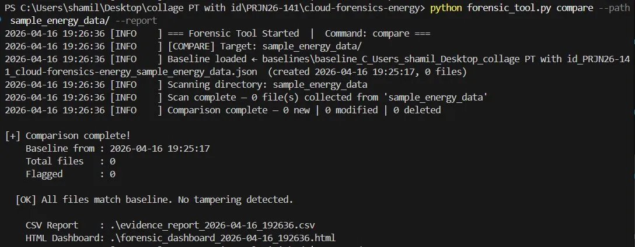
CLI Interface in Action
Scan Command
Compare Command
python forensic_tool.py scan --path <dir>
python forensic_tool.py baseline --path <dir>
python forensic_tool.py compare --path <dir> --report

Slide 11
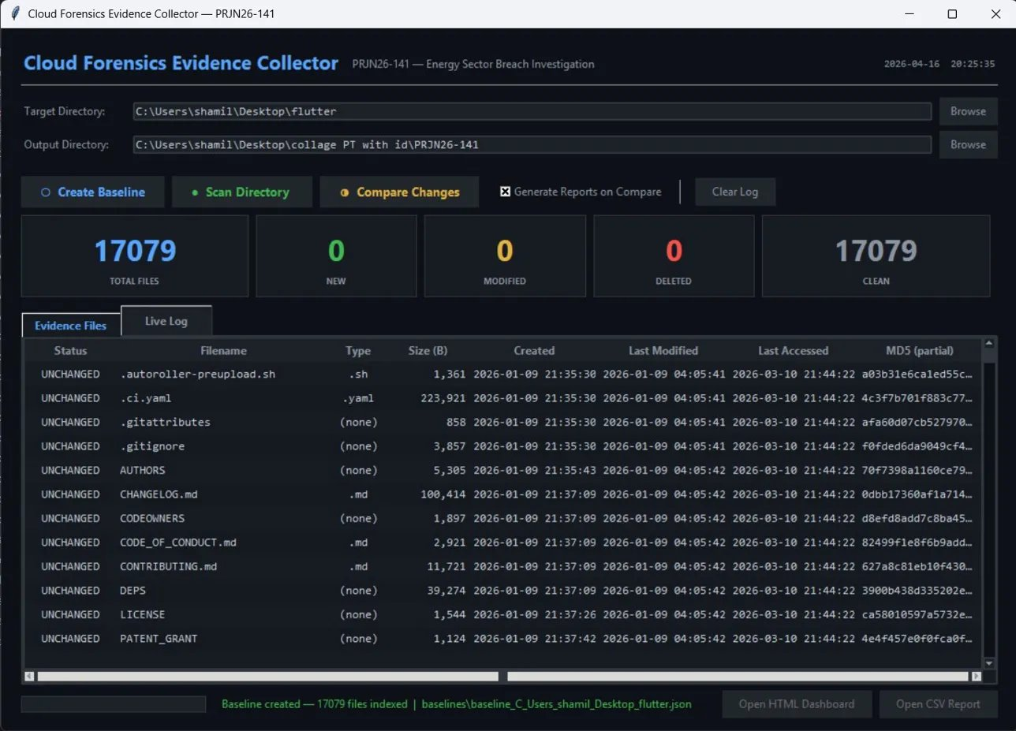
Desktop GUI Dashboard
Built with Python Tkinter — 17,079 files scanned successfully

Slide 12
Testing Results
16
6
3
0
Unit Tests
Passed
Integration
Tests Passed
Customer
Scenarios
Defects
Found
Key Test Scenarios:
Energy breach simulation: 1 NEW + 1 MODIFIED + 1 DELETED correctly detected
Large-scale audit: 17,079 files processed without errors
Error handling: Invalid paths produce clear diagnostics

Slide 13
Performance Benchmarks
~1,000
~35
~1.5
<1
files/sec
MB peak
seconds
second
Scan Speed
Memory
Reports
Startup
Target: >500
Target: <100 MB
For 17K files
No deps to load
Security Highlights
Read-only operation — never modifies target files
Fully offline — zero network calls, no remote attack vectors
Complete audit trail with timestamped logging

Slide 14
Future Development
Real-Time Monitoring
Cloud API Integration
Continuous file system watching via OS notification APIs
Native AWS S3, Azure Blob, and Google Cloud Storage support
Multi-Threaded Hashing
Database Backend
Parallel computation across CPU cores for faster scans
SQLite/PostgreSQL for historical trend analysis
Digital Signatures
ML Anomaly Detection
Cryptographically signed reports for legal admissibility
Intelligent pattern recognition for suspicious file activity

Slide 15

Thank You
Cloud Forensics Automation for Energy Breaches
PRJN26-141 | Rinshad
Questions?

