Slide 1

DATA ANALYTICS PROJECT
Sales and Product Analysis on Brazilian E Commerce Dataset
Rintu Ann Mathew Data Source:Kaggle
2026

Slide 2

Project description
Brazilian E Commerce Dataset by Olist(2016-2018)
The Olist dataset is used to analyze E-commerce sales performance,logistics efficiency, product category trends and customer order fulfillment.The analysis helps identify factors affecting freight costs, delivery success and product demand supporting data-driven business decisions.
Project goals(Evaluate sales performance,monthly revenue,order status distribution and understand the correlation between price,freight value and product weight)
Solutions(Improve inventory and demand forecasting,focus on profitable product categories, Optimize shipping and packaging, Reduce delivery delays and cancellations.

Slide 3
Motivation
To leverage e-commerce data to optimize sales strategies, reduce logistics costs, improve customer experience and support informed business decision-making.
To support data-driven business decisions that increase revenue and customer satisfaction.
To learn how to extract meaningful business insights from e-commerce data and use data analysis to support business decision-making.

Slide 4
Data cleaning
Data Importing(pandas.read_csv() in Python, importing the CSV dataset)
Merged the order and items dataset with order_id and then merge with products dataset with product_id. Selected only the relevant columns required for the analysis and graph generation.Final dataset is checked with null values and replaced missing values in product_category_name with “unknown”. Removed rows where product_weight_g was missing.
Removing Duplicates(using df.drop_duplicates(),Purpose: Ensure no empty or incomplete data affects analysis)
Converted the order_purchase_timestamp into a datetime format.
Extracted year, month, month_name and day from the order_purchase_timestamp to support time-based analysis.
Verified the cleaned and transformed dataset before creating visualizations.

Slide 5
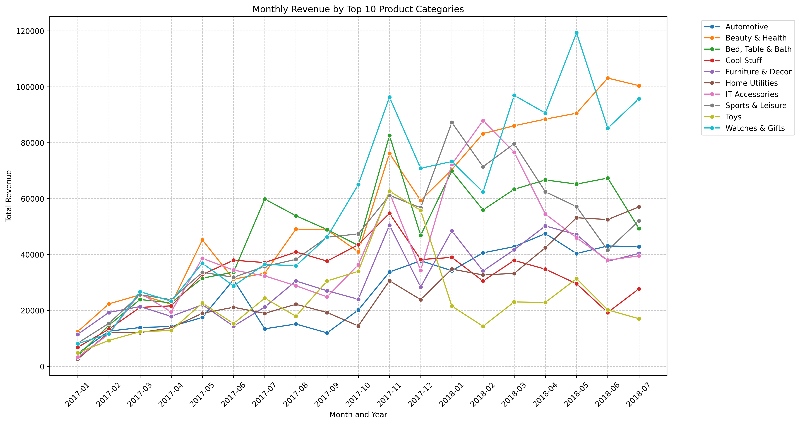
Findings
Certain categories consistently generate the highest revenue like Watches & gifts and Beauty & Health.
Revenue tends to increase during seasonal shopping periods(e.g holidays and year-end months).
Business Solution
Increase inventory and marketing investment for high-revenue categories.
Plan promotional campaigns during peak revenue months

Slide 6
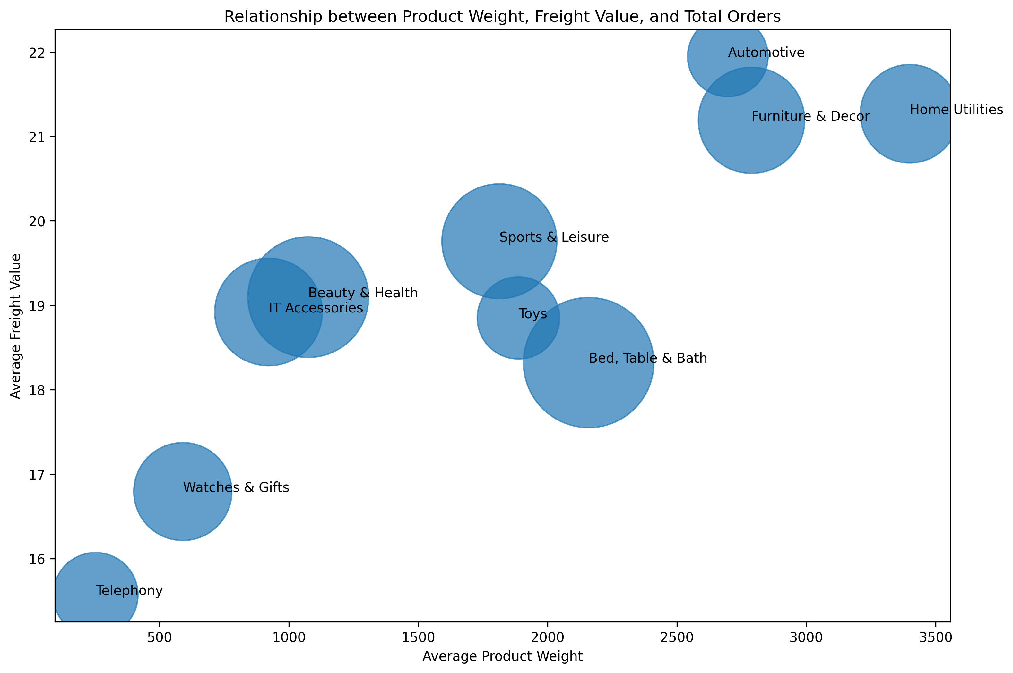
Findings
Freight value generally increases as product weight increases.
Heavier products tend to have fewer orders compared to lighter products.
Customers may avoid products with high shipping costs.
Business Solution
Optimize packaging to reduce shipping
weight.
Negotiate better logistics rates for heavy products.
Offer shipping discounts or free shipping thresholds to improve sales of bulky items.

Slide 7
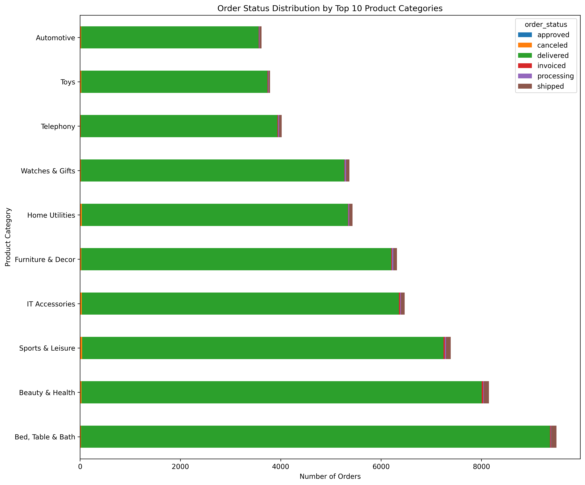
Findings
Most orders are marked as delivered, indicating good fulfillment performance.
Categories with higher proportions of cancelled or unavaliable orders may face supply-chain issues.
Business Solution
Improve inventory management for categories with many cancelled orders.
Strengthen supplier relationships to reduce unavailable products.
Monitor category-specific fulfillment KPIs regularly.

Slide 8
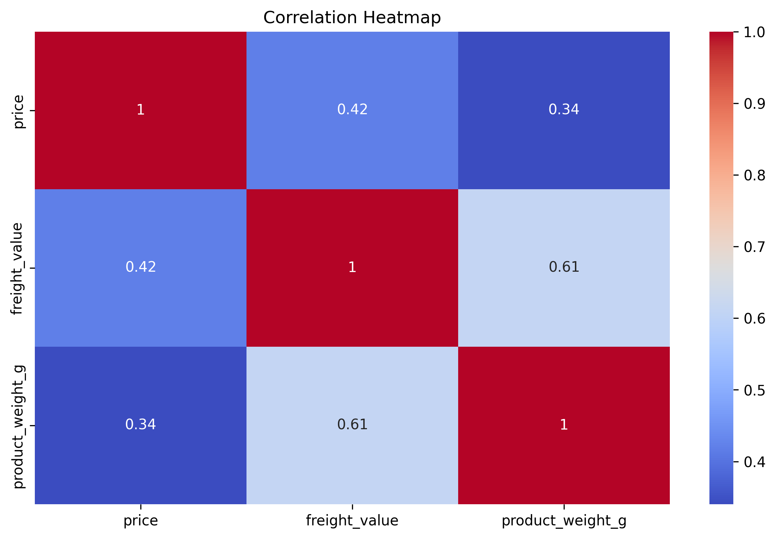
Findings
Shipping cost is mainly driven by product weight(strongest correlation 0.61)
Product price is not strongly dependant on weight(weak correlation 0.34) that means beyond weight factors like quality, brand or demand effect the product price.
Expensive products often have somewhat higher freight costs(moderate positive relationship 0.42)
Business Solution
Focus on packaging optimization, weight-based pricing and logistics improvement to reduce shipping costs.

Slide 9
Conclusion
The analysis of the Brazilian E-commerce Dataset revealed important relationships between sales performance, logistics costs, product performance and customer behavior.
These findings demonstrate the importance of efficient logistics management, strategic pricing and data-driven decision-making in improving profitability and customer satisfaction in e-commerce operations.
Results indicate that timely deliveries, effective logistics management and customer-focused strategies contribute significantly to higher satisfaction and sales performance.

Slide 10
Thank you!

