Slide 1
Hello!
[firstInstructorPhoto]
I am
{{firstInstructorName}}
{{firstInstructorAffiliation}}
{{firstInstructorContact}}
Notes:
Introduce yourself: Your name, your background, why you are interested in these topics.
Invite participants to get involved: If you find this interesting, if you want to get involved, please reach out. We're always happy to have more people contribute to this work and to run a workshop yourself. So welcome. We're really excited to be here.

Slide 2
Who are we?
Community of scientists in academia and industry who want to improve the reproducibility of science
Members all over the world!
Members help in developing new slides, hosting workshops, applying for funding, etc.
Developed this open access workshop, which you can use yourself for a journal club / seminar at your institute!
Want to join us? Reach out to the workshop organizers or through our website: https://www.repro4everyone.org/join
https://repro4everyone.org/

Slide 3

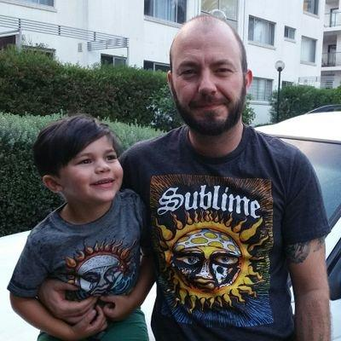



Thank You
Dorothy Bishop
Benjamin Schwessinger
@schwessinger
@repro4everyone
hello@repro4everyone.org
www.repro4everyone.org
Notes:
Thank sponsors: I just want to thank our sponsors that made this workshop possible: list the sponsors.

Slide 4
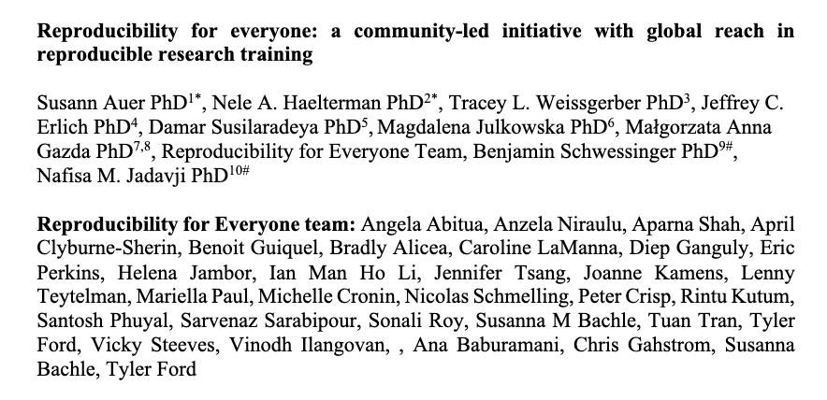
If you want to read more about our initiative:
https://osf.io/dxw67/
Notes:
Point people to the preprint about Reproducibility for Everyone if they want to learn more.

Slide 5
Participants agree to follow the R4E Community Participation Guidelines repro4everyone.org/pages/guidelines
DO
✅ Be respectful
✅ Give everyone a chance to contribute
✅ Use inclusive language
✅ Appreciate and accommodate differences
✅ Lead by example
DON'T
❌ Repeatedly interrupt or disrupt others
❌ Use sexual language or imagery
❌ Give unwelcome attention
❌ Bully, discriminate, or harass
❌ Make fun of personal appearance or choices
Have a concern?
Report by sending a private Zoom chat message to Nele.
Report by emailing coc@repro4everyone.org or anonymously at https://forms.gle/UaxjwEYWVNoCDwJs5
Violations may result in muting or removing of a participant.
Notes:
All workshop participants agree to follow the R4E Community Participation Guidelines.
Do a quick overview of the CPGs: You can find the Guidelines at this link if you wish. In summary, here are the Do’s and Don’ts to keep in mind during this workshop. Read these out loud.
Explain how to report: Please send a private Zoom chat message to {{Name the selected contact for this workshop}}. You can also send an email or report anonymously using this form.
Explain the consequences: Remember that violations of these guidelines during the workshop may result in being muted or removed from the workshop.

