Slide 1
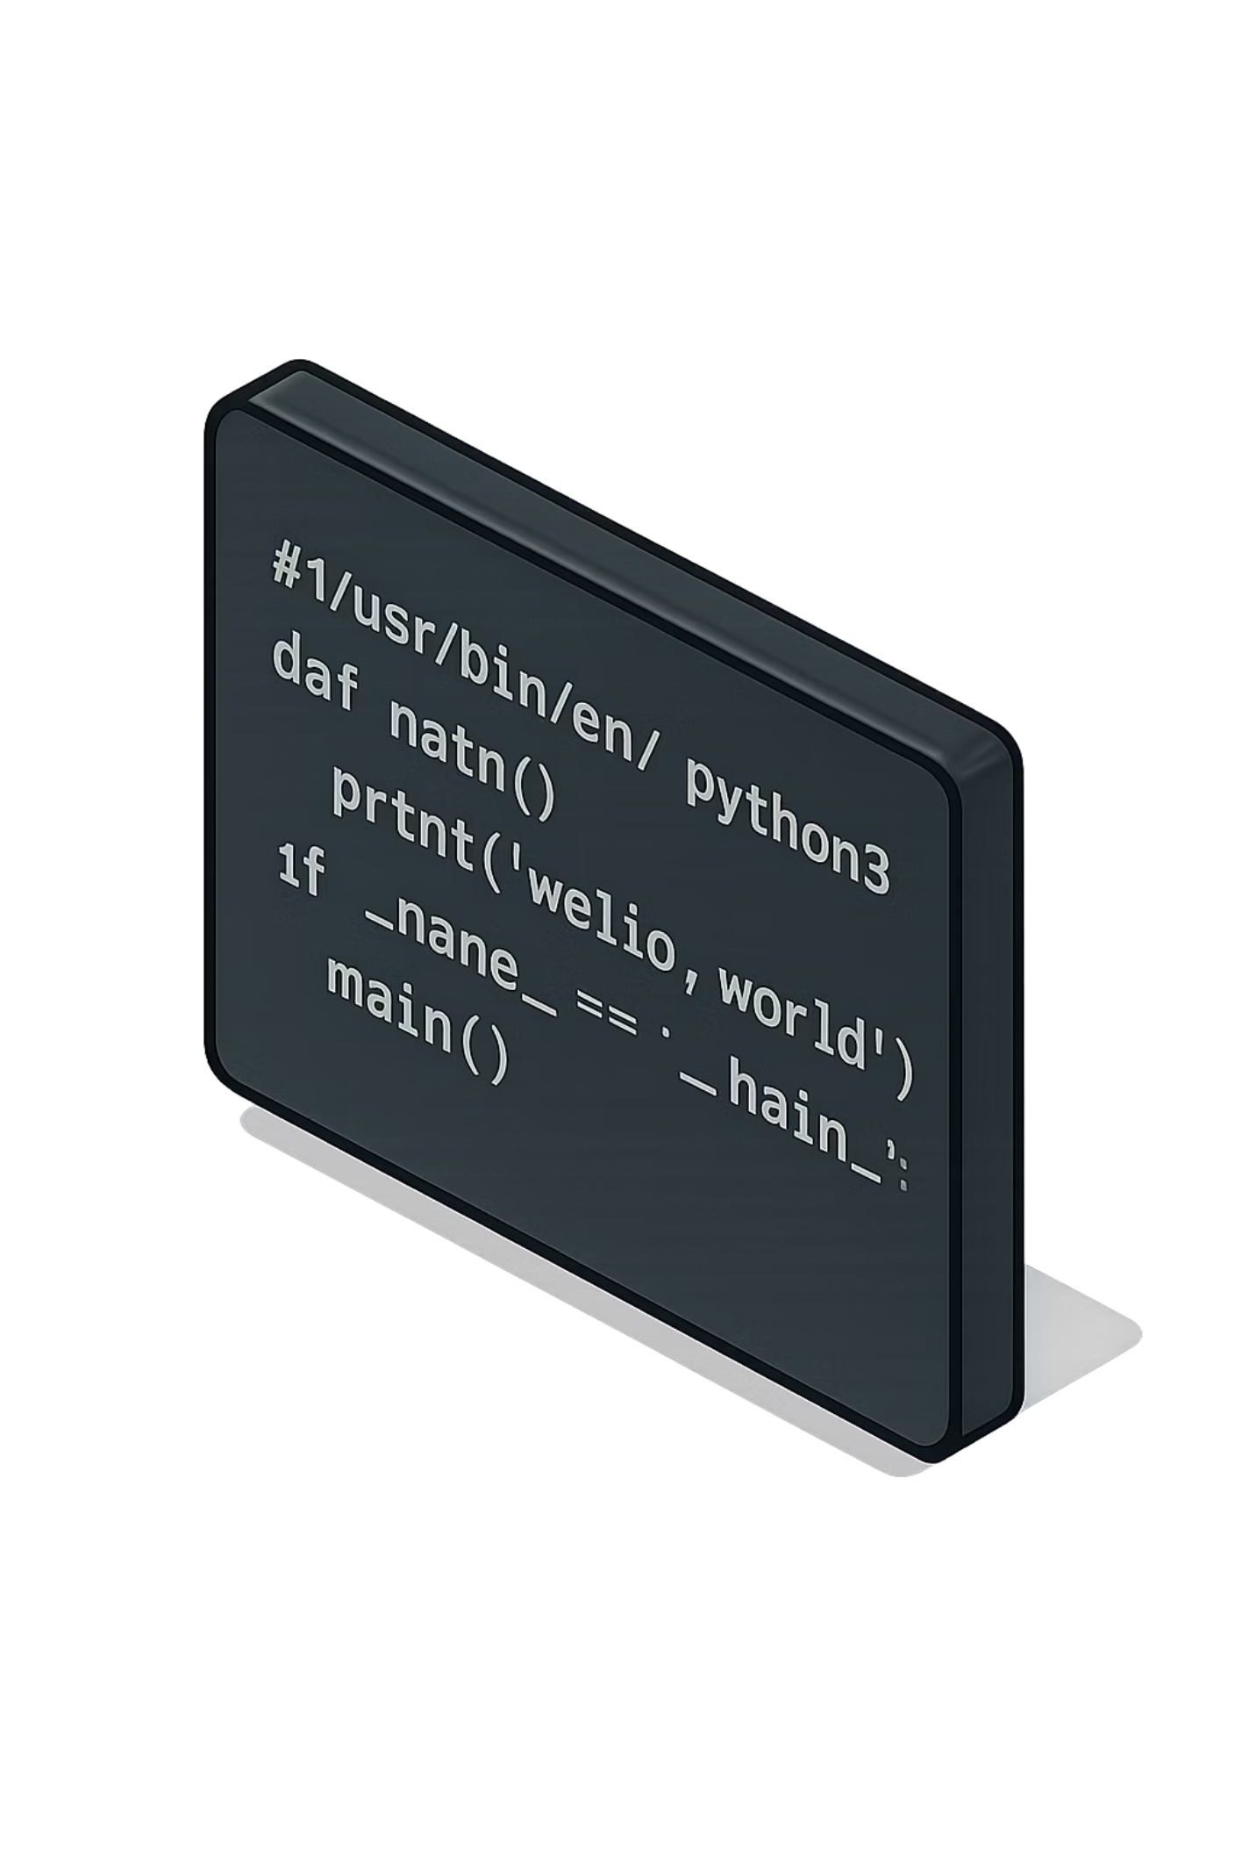
Writing Production-Ready Python
Module 2 — Forward Deployed Engineering
Clean Code
Readable and well-structured
Reusable Code
Functions and modules
Maintainable Code
Easy to update and extend
Backend-Ready Code
Production-grade patterns

Slide 2
PART 1 — WHY BAD CODE FAILS
🧩 Part 1: Why Bad Code Fails
Before writing better code, we need to understand what makes code fail at scale. This section covers the common patterns that work in notebooks but break in production systems.
01
02
Everything in One Place
Repeated Code
Logic, data, and output all tangled together
Copy-pasting instead of reusing
03
04
Hardcoded Values
Difficult Debugging
Magic strings and numbers embedded in logic
Hard to isolate and test individual parts

Slide 3

PART 1 — WHY BAD CODE FAILS
SLIDE 2 OF 21
Why Notebook-Style Code Fails in Production
Notebook-style code works great for exploration, but it breaks down quickly when shared, scaled, or maintained. Here is a classic example of the problem:
# Notebook-style — repeated, unstructured code
name1 = "Rocky"
print(name1)
name2 = "Alex"
print(name2)
name3 = "Priya"
print(name3)
Every time you add a new user, you copy-paste another block. This is not scalable — and it will break when someone else touches it.

Slide 4

PART 1 — WHY BAD CODE FAILS
SLIDE 3 OF 21
Problems With Bad Code
Poorly structured code doesn't just look messy — it actively slows down development, introduces bugs, and makes collaboration painful. These four failure modes appear again and again in real engineering teams.
Hard to Maintain
When logic is scattered, understanding what the code does — and why — takes more time than writing it.
Repetition
Hard to Collaborate
The same logic written multiple times in different places — any bug fix must be applied everywhere manually.
Teams cannot work in parallel on unstructured code. Merge conflicts and confusion become the norm.
Hard to Scale
Adding new features requires rewriting instead of extending. The codebase fights back.
Bad code compounds. The longer it stays in production, the more expensive it becomes to fix.

Slide 5




PART 1 — WHY BAD CODE FAILS
SLIDE 4 OF 21
The Refactor Mindset: Bad Code → Better Code
Refactoring is not about rewriting everything from scratch — it is about applying small, deliberate improvements that make code more reusable, readable, and robust. Three tools lead the way:
Functions
Modular Files
Reusability
Extract repeated logic into named, reusable units
Separate concerns into focused, single-purpose modules
Write once, call anywhere — with clean inputs and outputs
💻 Over to VS Code — We will refactor a messy notebook-style script into a clean, structured Python file together.

Slide 6
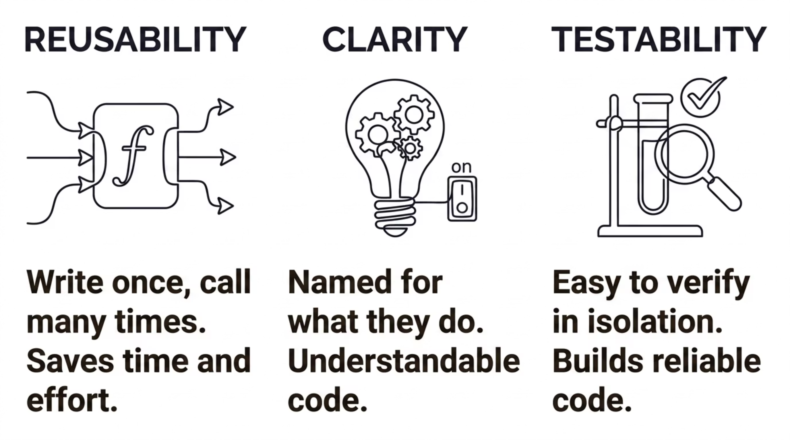

PART 2 — FUNCTIONS
🧩 Part 2: Functions
Functions are the single most important tool for writing clean, production-ready Python. In this section, we will learn how to define them well, name them clearly, and apply the Single Responsibility Principle.

Slide 7
PART 2 — FUNCTIONS
SLIDE 5 OF 21
Why Functions Matter
A function wraps a piece of logic behind a clear name and interface. Instead of repeating code, you call the function. Instead of debugging 50 lines, you test one function at a time.
# Without a function — repeated
print("Hello Rocky")
print("Hello Alex")
print("Hello Priya")
# With a function — reusable
def greet_user(name):
return f"Hello {name}"
print(greet_user("Rocky"))
print(greet_user("Alex"))
print(greet_user("Priya"))
Reusability
Cleaner Code
Call the same logic from anywhere in your codebase
Each block has a name and a purpose
Easier Debugging
Test one function at a time, in isolation

Slide 8
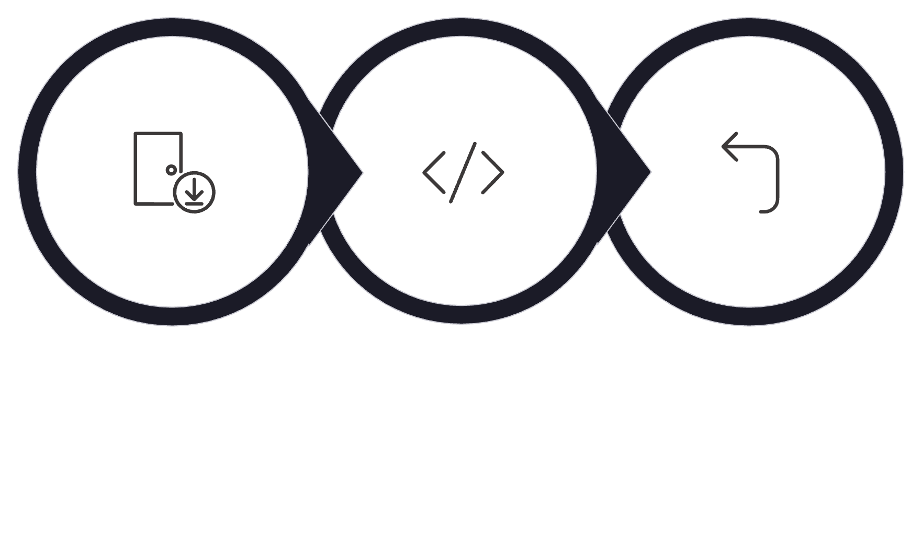


PART 2 — FUNCTIONS
SLIDE 6 OF 21
Function Inputs and Outputs
Every function has a clear contract: it accepts inputs (parameters), performs logic, and returns an output. This is the fundamental model behind all well-designed code.
Input
Function
Output
def calculate_discount(price, discount):
"""Calculate final price after discount."""
discounted = price * (1 - discount)
return round(discounted, 2)
# Call the function
final_price = calculate_discount(100, 0.2)
print(final_price) # → 80.0
💻 Over to VS Code — Let's write and call functions with different inputs and observe the outputs live.

Slide 9

PART 2 — FUNCTIONS
SLIDE 7 OF 21
Writing Better Functions: Naming Matters
A good function name reads like a sentence — it tells you exactly what the function does without needing to look inside. Poor naming is one of the most common sources of confusion in collaborative codebases.
✅ Good Function Names
❌ Bad Function Names
Clear, verb-based, describes the action:
Vague, ambiguous, tells you nothing:
validate_email(email)
calculate_discount(price, pct)
classify_product(category)
send_confirmation(order_id)
parse_api_response(data)
doStuff()
process()
handle()
run()
go()
If you can't name a function clearly, the function probably does too many things.

Slide 10

PART 2 — FUNCTIONS
SLIDE 8 OF 21
Single Responsibility Principle
The most important rule in function design: one function should do one thing. When a function tries to do everything, it becomes impossible to test, reuse, or debug. Break large functions into smaller, focused ones.
❌ Bad: One function does everything
✅ Good: One function, one job
def process_everything(order):
# validates input
# calculates total
# applies discount
# sends email
# logs to database
pass
def validate_order(order): ...
def calculate_total(order): ...
def apply_discount(total): ...
def send_confirmation(order): ...
def log_order(order): ...
💻 Over to VS Code — We will break apart a bloated function into clean, single-purpose pieces.

Slide 11

PART 3 — PROJECT STRUCTURE
🧩 Part 3: Project Structure
Good functions are not enough on their own. As projects grow, how you organize your files determines whether your codebase is a pleasure to navigate — or a nightmare to debug. This section covers professional Python project structure.

Slide 12
PART 3 — PROJECT STRUCTURE
SLIDE 9 OF 21
Why Structure Matters
When everything lives in a single file, the project starts small and manageable. But as logic grows, a single file becomes an obstacle — slow to navigate, hard to test, and impossible to split across a team.
Hard to Find Logic
No Separation of Concerns
Team Collaboration Breaks
Scrolling through 500 lines to find one function wastes time on every task.
API logic, business rules, and utilities all tangled together create fragile dependencies.
Multiple developers cannot safely work on the same file simultaneously.

Slide 13

PART 3 — PROJECT STRUCTURE
SLIDE 10 OF 21
Bad Project Structure: The One-File Problem
Dumping all logic into app.py is the most common structural mistake in early-stage projects. It works at first — and then it doesn't.
# app.py — doing everything
# ─────────────────────────
# Route handlers (API layer)
# Database queries
# Business logic
# Discount calculations
# Email sending
# Utility helpers
# Config variables
# Error messages
# ...all in one file
When app.py reaches 1,000+ lines, even simple changes carry risk. One edit can break something three screens away.
No Reusability
Utility functions buried inside route handlers can't be shared
No Testability
You can't unit test a function entangled with 10 others
No Clarity
New engineers have no map for where anything lives

Slide 14


PART 3 — PROJECT STRUCTURE
SLIDE 11 OF 21
Better Project Structure
A well-structured Python project separates concerns into focused files. Each file has a clear role — making the project easy to navigate, test, and extend.
project/
├── main.py # Entry point, app startup
├── services.py # Business logic
├── utils.py # Reusable helper functions
└── config.py # Settings, env variables
main.py
services.py
App startup and route wiring — nothing else
Core business logic, calculations, decisions
utils.py
config.py
Generic helpers — formatting, parsing, validation
All settings in one place — never hardcoded
Each file has one clear purpose. A new engineer can understand the project structure in under 60 seconds.
💻 Over to VS Code — We will restructure a single-file script into this clean four-file layout together.

Slide 15

PART 3 — PROJECT STRUCTURE
SLIDE 12 OF 21
Separation of Logic: API vs. Business Layer
One of the most important structural principles in backend development: the API layer and the business layer should be completely separate. The API receives requests and sends responses — it should not contain business rules.
API Layer
Request Validation
Business Layer
Recommend Product
Decision & Response
# API Layer — in main.py
def api_endpoint(request):
data = request.json()
result = recommend_product(data)
return {"recommendation": result}
# Business Layer — in services.py
def recommend_product(data):
category = data.get("category")
# Apply business rules here
return lookup_recommendation(category)

Slide 16
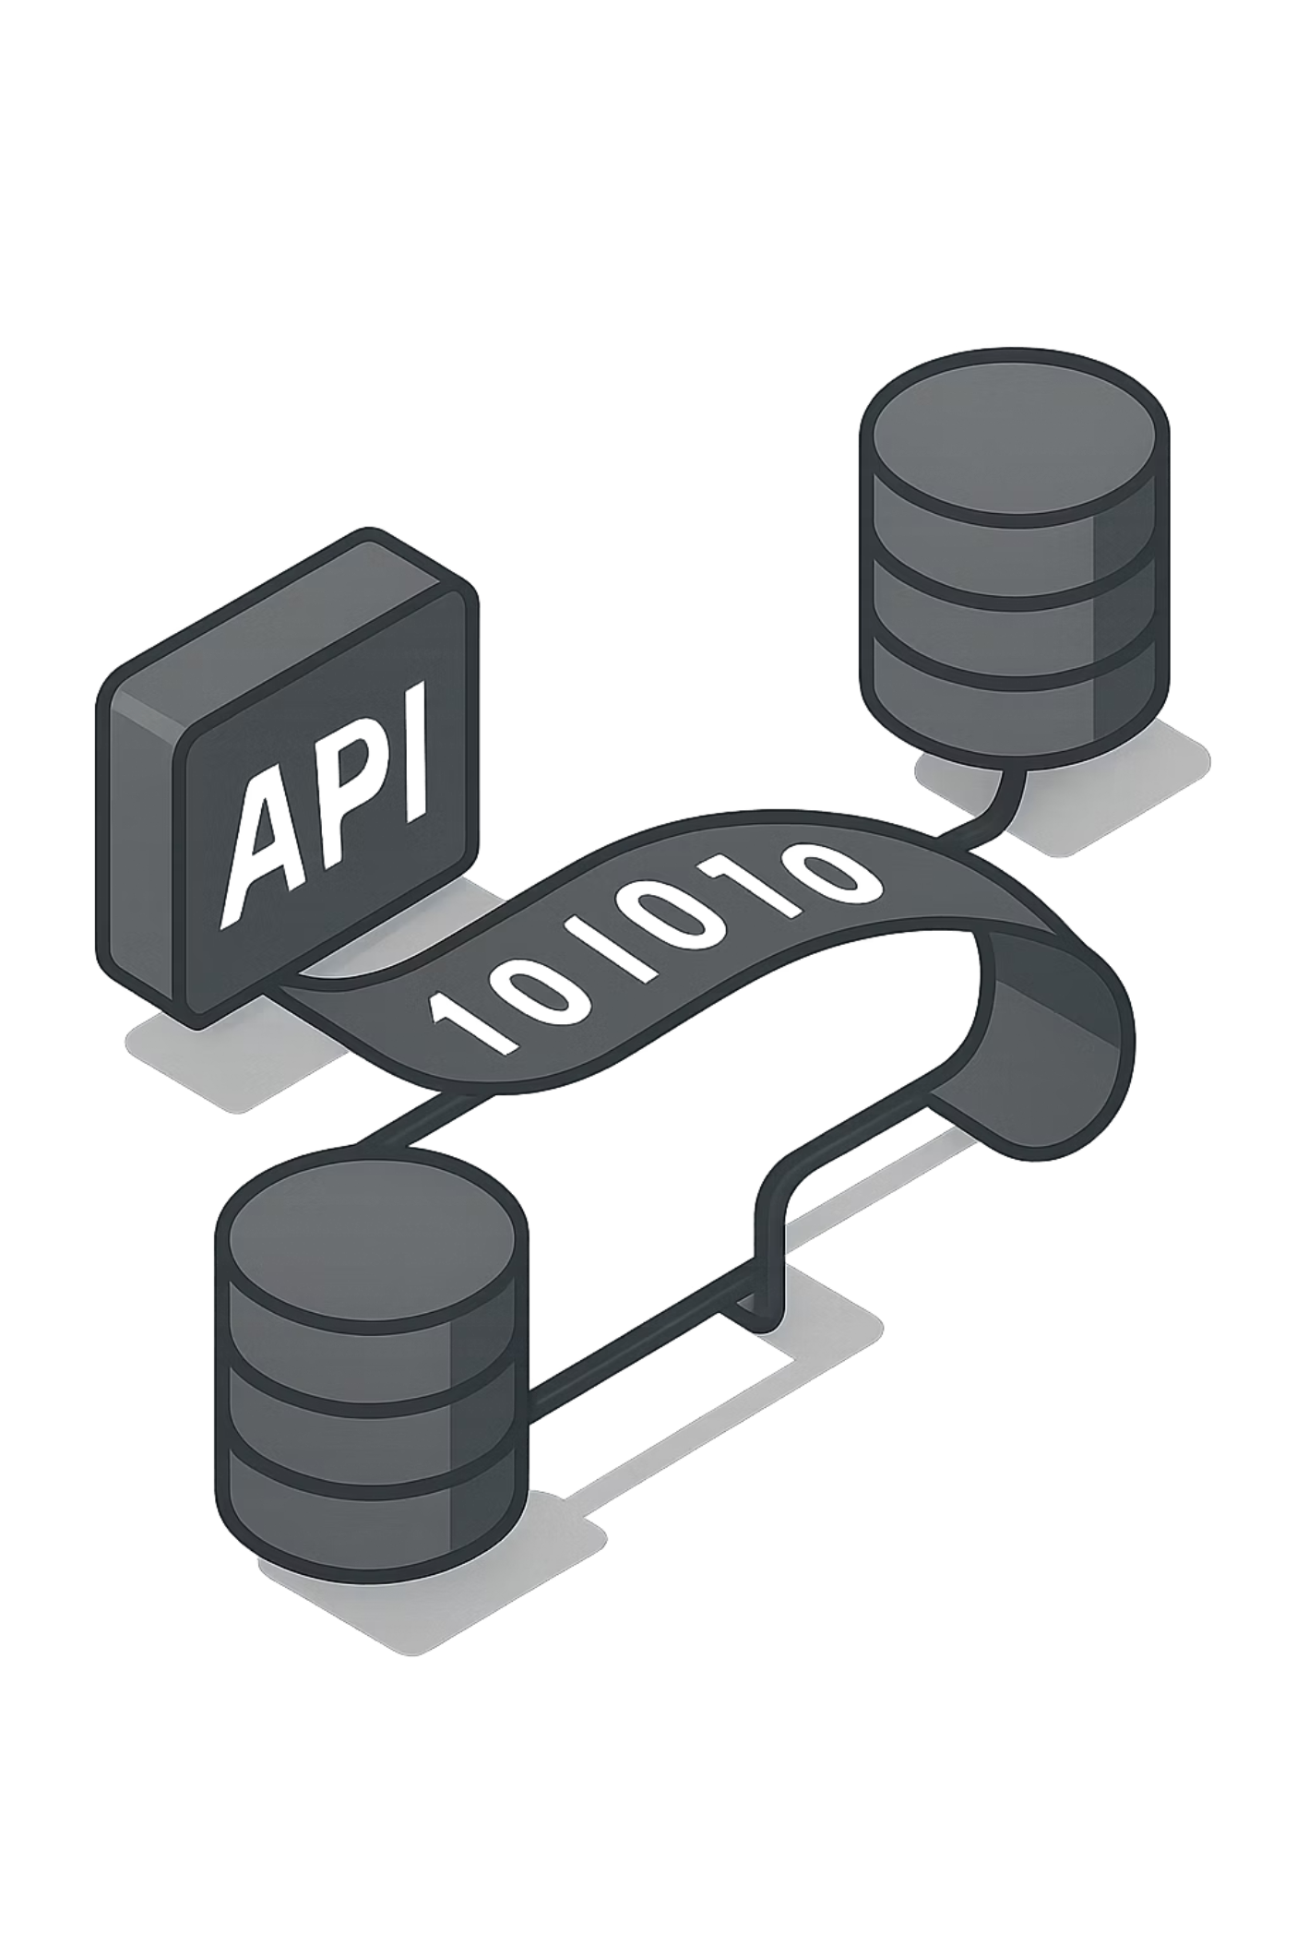
PART 4 — JSON + API RESPONSES
🧩 Part 4: JSON + API Responses
Modern backend services communicate through APIs, and APIs communicate through JSON. Understanding how to read, write, and structure JSON is a core skill for any production Python developer.

Slide 17
PART 4 — JSON + API RESPONSES
SLIDE 13 OF 21
Why JSON Matters
JSON (JavaScript Object Notation) is the universal language of APIs. Whether you are calling a payment gateway, a machine learning model, or a public data source — the data comes back as JSON. You need to be fluent in reading and writing it.
# A simple JSON response
{
"name": "Rocky",
"role": "engineer",
"active": true,
"score": 95
}
Human-Readable
Easy for developers to read and debug
Language-Agnostic
Every modern language can parse JSON
Structured
Key-value pairs map naturally to Python dictionaries

Slide 18
PART 4 — JSON + API RESPONSES
SLIDE 14 OF 21
Python Dictionary vs. JSON
Python dictionaries and JSON look nearly identical — but they are different things. Python dicts live in memory; JSON is a string format for transmission. Python's json module converts between them.
Python Dictionary (in memory)
JSON String (for transmission)
data = {
"name": "Rocky",
"score": 95
}
# Access a value
print(data["name"]) # → Rocky
import json
# Dict → JSON string
json_string = json.dumps(data)
# JSON string → Dict
parsed = json.loads(json_string)
print(parsed["name"]) # → Rocky
💻 Over to VS Code — We will convert Python dicts to JSON and back, then pretty-print real API responses.

Slide 19

PART 4 — JSON + API RESPONSES
SLIDE 15 OF 21
Reading API Responses
When you call an external API using the requests library, the response comes back as a JSON string. The .json() method parses it into a Python dictionary so you can extract the fields you need.
import requests
response = requests.get("https://api.example.com/user/1")
# Parse the JSON response
data = response.json()
# Extract specific fields
name = data["name"]
role = data["role"]
score = data.get("score", 0) # Safe default if key missing
print(f"{name} is a {role} with score {score}")
Always use .get("key", default) instead of ["key"] when the field might be missing — it prevents KeyErrors in production.

Slide 20
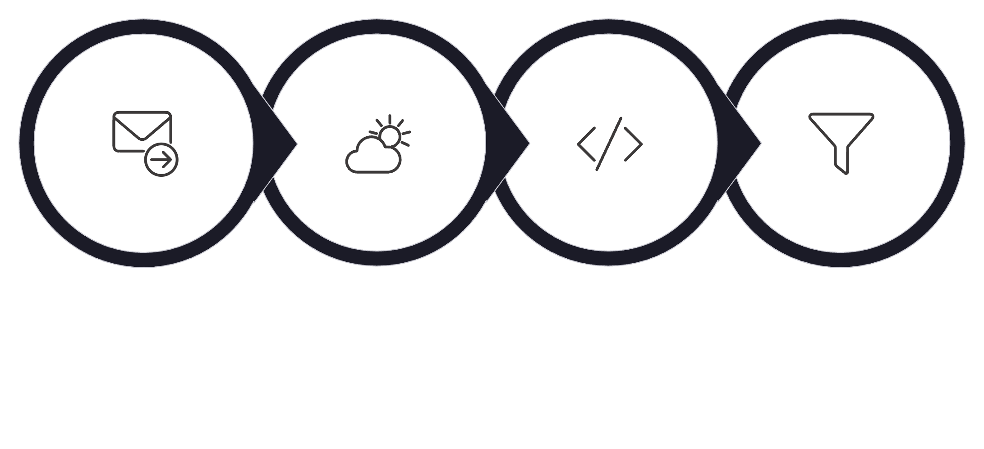
PART 4 — JSON + API RESPONSES
SLIDE 16 OF 21
Real API Example: Calling a Public API
Let's put it all together with a real public API call. We will fetch live data, parse the JSON response, and extract the fields we actually need — exactly as you would in a production service.
Send Request
Receive Response
Parse JSON
Extract Fields
import requests
# Call a real public API
response = requests.get("https://catfact.ninja/fact")
data = response.json()
# Extract and use the field
fact = data["fact"]
print(f"Cat fact: {fact}")
💻 Over to VS Code — We will call a live public API, inspect the raw response, and extract specific fields.

Slide 21

PART 5 — ERROR HANDLING
🧩 Part 5: Error Handling
Real production code breaks. Networks go down, users send bad input, APIs return unexpected data. Error handling is not optional — it is the difference between a system that crashes and a system that recovers gracefully.

Slide 22
PART 5 — ERROR HANDLING
SLIDE 17 OF 21
What Can Go Wrong?
In any real backend system, errors are not edge cases — they are normal events. Writing code that assumes everything will succeed is one of the most common causes of production outages.
Invalid Input
API Failures
Users send strings where numbers are expected, empty fields, or malformed data
External services time out, return errors, or go offline unexpectedly
Missing Files
Wrong Data Types
Config files, data files, or environment variables that aren't where the code expects them
A field arrives as a string when the code expects an integer — and the calculation fails

Slide 23

PART 5 — ERROR HANDLING
SLIDE 18 OF 21
Without Error Handling: The System Crashes
Without a safety net, a single bad input terminates the entire program. In a live backend service, this means a crash that affects every user — not just the one who triggered the error.
❌ No Error Handling
In production, this means:• The API returns a 500 error
• The user sees a broken experience
• Logs fill up with unhandled exceptions
• The entire service may go down
# If user types "hello", this crashes
user_input = input("Enter a number: ")
number = int(user_input) # ← CRASH
print(f"Double: {number * 2}")
# Output:
ValueError: invalid literal for
int() with base 10: 'hello'

Slide 24

PART 5 — ERROR HANDLING
SLIDE 19 OF 21
Try / Except: Handling Errors Gracefully
Python's try / except block lets you anticipate failures and respond to them — instead of letting them crash the system. Always catch specific exception types, and always tell the user what went wrong.
# Basic try/except
try:
user_input = input("Enter a number: ")
number = int(user_input)
print(f"Double: {number * 2}")
except ValueError:
print("Please enter a valid number.")
try:
except:
The code that might fail
What to do when it fails
finally:
Always runs — cleanup code
# With API error handling
try:
response = requests.get(url, timeout=5)
response.raise_for_status()
data = response.json()
except requests.exceptions.Timeout:
print("Request timed out.")
except requests.exceptions.HTTPError as e:
print(f"HTTP error: {e}")
💻 Over to VS Code — We will add error handling to our API calls and input functions.

Slide 25
PART 6 — MINI EXERCISE + WRAP UP
🧩 Part 6: Mini Exercise + Wrap Up
Time to apply everything from this module. This final section combines functions, project structure, JSON responses, and error handling into one cohesive exercise — the kind of task you would face in a real engineering role.
01
02
Functions
Project Structure
Clean, named, single-responsibility
Separated into logical files
03
04
JSON Handling
Error Handling
Structured response output
Graceful failure on bad input

Slide 26
PART 6 — MINI EXERCISE + WRAP UP
SLIDE 20 OF 21
Mini Exercise: Product Recommendation Logic
Build a simple product recommendation function that accepts a product category as input and returns a structured JSON response. This exercise combines every concept from the module.
Requirements
# Expected output structure
{
"category": "electronics",
"recommendation": "Laptop Pro X",
"reason": "Best seller in Q4",
"status": "success"
}
# Error output
{
"status": "error",
"message": "Unknown category"
}
Input
A product category string (e.g. "electronics")
Output
A JSON response with a recommended product name and reason
Add Functions
Separate validation, logic, and response building
Add Error Handling
Handle unknown categories and empty inputs gracefully

Slide 27
PART 6 — MINI EXERCISE + WRAP UP
SLIDE 21 OF 21
Module 2 Summary
You have covered the four pillars of production-ready Python. These are not just stylistic preferences — they are the engineering foundations that every backend developer is expected to apply on day one.
✅ Clean Functions
✅ Better Structure
Single responsibility, clear names, reusable across the codebase
Logic separated into focused files — maintainable and scalable
✅ JSON Handling
✅ Error Handling
Read and write structured data for API communication
Graceful failure with try/except — never let the system crash silently
🚀 Next: Module 3 — FastAPI Backend DevelopmentWe will take these patterns into a real web framework and build our first production API endpoint.

