Slide 1

Backend Development with APIs
Building Real Backend Systems Using FastAPI
MODULE 3
FORWARD DEPLOYED ENGINEERING

Slide 2
PART 1 — UNDERSTANDING APIS
What is a Backend?
The backend is the engine of any application — invisible to users, but responsible for everything that matters. It receives requests, applies rules, processes data, and sends back a structured response.
Business Logic
Request Processing
Applies rules and decisions that define how the system behaves
Receives and interprets incoming client requests
Data Validation
Response Delivery
Ensures all incoming data is correct before acting on it
Returns structured, meaningful responses to the client

Slide 3
PART 1 — UNDERSTANDING APIS
Frontend vs. Backend
Every application has two distinct layers. The frontend is what users see and interact with. The backend is where all logic, rules, and data handling happen — completely separate from the UI.
Frontend
Backend
User interface and visual elements
Handles user interactions and events
Runs in the browser or mobile app
Sends requests — it does NOT make decisions
Business rules and application logic
Controls what is allowed and what is not
Reads and writes data to the database
Returns a response the frontend can display

Slide 4

PART 1 — UNDERSTANDING APIS
The Restaurant Analogy
Think of a restaurant. The customer doesn't walk into the kitchen. They tell the waiter what they want, the kitchen prepares it, and the waiter brings it back. APIs work exactly the same way.
Customer Order
Waiter Relay
Kitchen Prepare
Food Response
The waiter is the API — a defined contract that bridges the customer and the kitchen without exposing how the kitchen works internally.

Slide 5
PART 1 — UNDERSTANDING APIS
What is an API?
An API (Application Programming Interface) is a formal contract between a client and a server. It defines exactly what requests can be made, what responses will be returned, and what rules must be followed by both sides.
Requests
Responses
Rules
Defines which endpoints exist, what methods to use, and what data to send
Defines the structure and format of data returned by the server
Enforces authentication, validation, and constraints on every interaction

Slide 6
PART 1 — UNDERSTANDING APIS
Client vs. Server
In every API interaction, there are two roles: the client and the server. Understanding their responsibilities is fundamental to designing robust backends.
Client
Server
Initiates the interaction by sending a request
Can be a browser, mobile app, or another service
Does not control backend logic
Receives and processes every incoming request
Owns and enforces all business logic
Decides what the client is allowed to see or do

Slide 7


PART 1 — UNDERSTANDING APIS
Never Trust the Client
This is one of the most important principles in backend development. The client can send anything — incorrect data, fake values, or requests that violate your rules. Your backend must always validate everything, no exceptions.
Wrong Data
Fake Data
A string sent where a number is expected
A user claiming to be an admin when they are not
Broken Rules
A negative price, a missing required field, an invalid ID
Backend must validate all incoming data — never rely on the client to send correct values.

Slide 8



PART 1 — UNDERSTANDING APIS
HTTP Communication
HTTP (HyperText Transfer Protocol) is the language that clients and servers use to communicate on the web. Every API interaction is an HTTP conversation — a request is sent, and a response is returned.
Client
HTTP Request
HTTP Response
Initiates the conversation by sending an HTTP request
Travels over the network carrying method, URL, headers, and body
Server replies with a status code and structured data

Slide 9
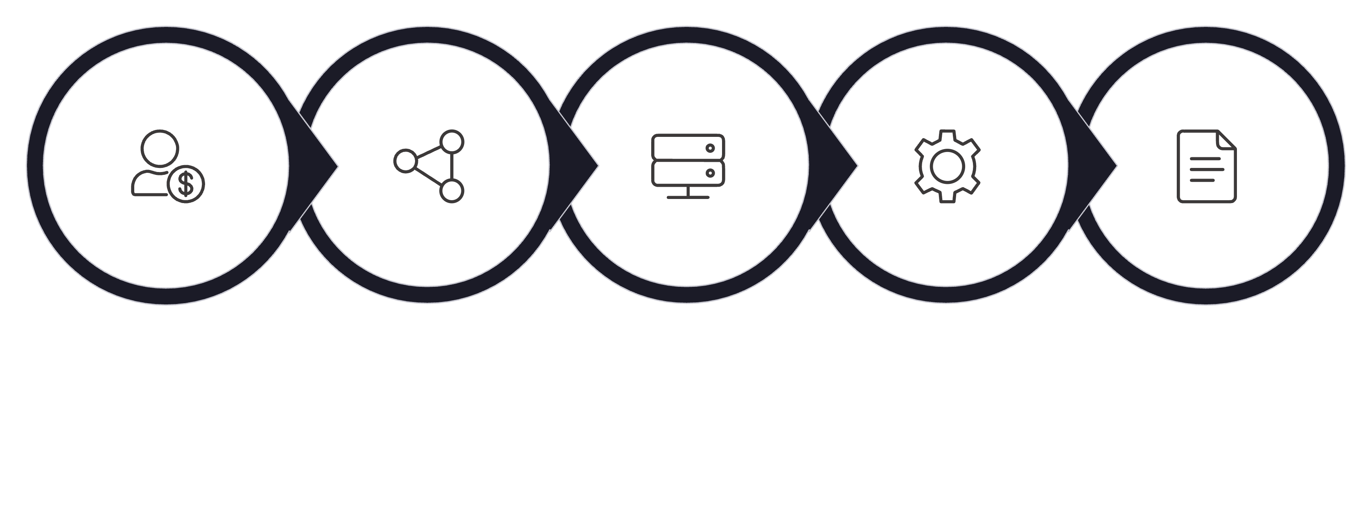

PART 1 — UNDERSTANDING APIS
Request → Response Flow
Every backend interaction follows the same lifecycle. A client sends an HTTP request, the backend applies its business logic, and a structured HTTP response is returned. Understanding this flow is the foundation of API development.
Client Request
HTTP Over Network
Backend Receives
Execute Logic
Build Response
This cycle repeats for every single API call — at any scale, from a single user to millions of concurrent requests.

Slide 10
PART 1 — UNDERSTANDING APIS
Inside a Request
Every HTTP request is made up of four key components. Together, they give the server everything it needs to understand what the client wants and how to process it.
1
2
Method
URL
The action type — GET, POST, PUT, or DELETE
The resource being targeted — e.g., /items/10
3
4
Headers
Body
Metadata such as content type, auth tokens, and encoding
The data payload — typically JSON, used with POST and PUT

Slide 11
PART 1 — UNDERSTANDING APIS
Inside a Response
When a server finishes processing a request, it sends back an HTTP response. The response tells the client whether the operation succeeded, and delivers any resulting data in a structured format.
Status Code
JSON Data
Messages
A numeric code indicating success, failure, or redirection — e.g., 200, 404
The actual payload returned — structured data the client can parse and display
Human-readable details, especially useful when errors occur

Slide 12
PART 1 — UNDERSTANDING APIS
HTTP Methods
HTTP methods define the intent of a request. The two most fundamental methods are GET and POST — they cover the majority of API interactions you will build and use as a backend developer.
GET
POST
Used to retrieve data from the server. GET requests do not modify anything — they are read-only operations. No request body is sent.
Used to send data to the server to create or trigger something. POST requests include a body and change server state.
Example: GET /items/10
Example: POST /items

Slide 13
PART 1 — UNDERSTANDING APIS
GET vs. POST — Key Differences
Attribute
GET
POST
Purpose
Fetch / read data
Create / send data
Request Body
None
JSON payload required
Server State
No change
Changes server state
Typical Use
Retrieve a record
Create a new record
Example URL
GET /items/5
POST /items

Slide 14
PART 1 — UNDERSTANDING APIS
HTTP Status Codes
Status codes are the server's way of communicating the outcome of a request. Every response includes one. As a backend developer, you are responsible for returning the right code in every situation.
Code
Name
Meaning
200
OK
Request succeeded — data returned as expected
201
Created
Resource successfully created
400
Bad Request
Client sent invalid or malformed data
404
Not Found
The requested resource does not exist
500
Server Error
Something went wrong on the backend

Slide 15
PART 1 — UNDERSTANDING APIS
Why JSON?
JSON (JavaScript Object Notation) is the standard data format for APIs. It is lightweight, human-readable, and supported natively by virtually every programming language — making it the universal language of web APIs.
Example JSON Response
Lightweight
Minimal overhead — fast to send and parse over the network
{
"name": "Alex",
"age": 28
}
Structured
Key-value pairs make data predictable and easy to work with
Simple, clean, and immediately understandable — no parsing ambiguity.
Human Readable
Developers can inspect JSON directly without special tools
Cross-Language
Supported by Python, JavaScript, Java, Go, and virtually all others

Slide 16
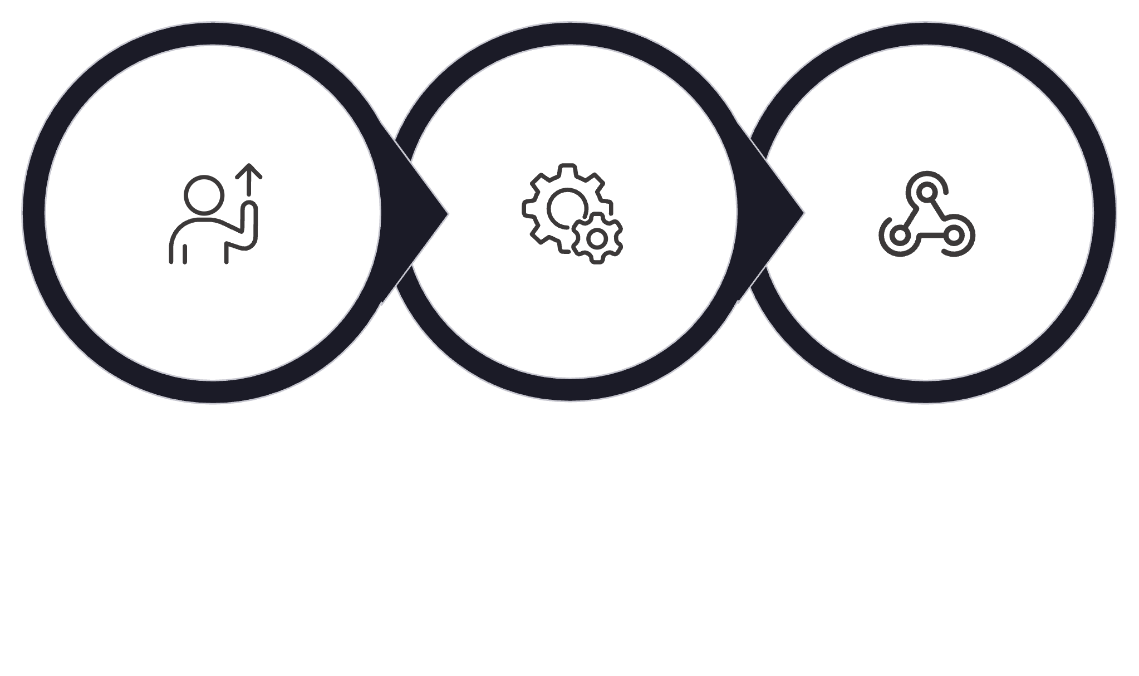

PART 1 — UNDERSTANDING APIS
Core Mental Model
Before writing a single line of backend code, internalize this fundamental model. Every backend API you will ever build follows this exact pattern — from the simplest endpoint to the most complex system.
Client Request
Apply Logic
Return JSON
Master this loop and you understand the essence of backend development. Everything else is just detail on top of this foundation.

Slide 17

Part 2
Building APIs Using FastAPI
From theory to code — setting up your first real backend server.
PART 2 OF 6

Slide 18
PART 2 — BUILDING APIS
Introducing FastAPI
FastAPI is a modern Python web framework designed specifically for building backend APIs quickly and correctly. It is one of the fastest Python frameworks available and is rapidly becoming the industry standard for new backend projects.
Fast to Build
Built-in Validation
Auto Documentation
Minimal boilerplate — go from zero to a working API in minutes
Automatic type checking and data validation powered by Pydantic
Swagger UI generated automatically — no extra work required

Slide 19
PART 2 — BUILDING APIS
What FastAPI Handles
FastAPI is not just a router. It takes care of the entire request-to-response lifecycle, so you can focus on writing business logic instead of plumbing code.
Routing
Validation
Maps incoming URLs and methods to the correct handler function
Automatically rejects requests that don't match your defined schema
JSON Conversion
API Documentation
Automatically serializes Python objects into JSON responses
Generates interactive Swagger UI docs from your code automatically

Slide 20
PART 2 — BUILDING APIS
What is Uvicorn?
Uvicorn is the web server that actually runs your FastAPI application. Think of FastAPI as your application code — Uvicorn is the engine that starts it up, listens for incoming connections, and passes requests to your app.
Listens for Connections
Forwards to FastAPI
Returns Response
Binds to a port (default: 8000) and waits for incoming HTTP requests
Passes each request to your FastAPI application for processing
Sends the HTTP response back to the client after your code executes

Slide 21

PART 2 — BUILDING APIS
Understanding This Command
This is the command you will use every time you start your FastAPI backend. Understanding each part of it is essential before moving forward.
uvicorn main:app --reload
Run this from your terminal, inside the directory where your main.py file lives. Once running, your backend will be live and accepting requests.
The --reload flag means the server automatically restarts whenever you save a file — essential for development speed.

Slide 22
PART 2 — BUILDING APIS
Breaking Down the Command
Every part of the uvicorn main:app --reload command has a specific meaning. Let's break it down so you know exactly what you're running.
1
2
uvicorn
main
The ASGI web server — runs your Python backend application
The filename — tells Uvicorn to look inside main.py
3
4
app
--reload
The FastAPI instance — the variable name inside main.py
Auto-restarts the server on every file save — for development only

Slide 23
PART 2 — BUILDING APIS
Our First FastAPI App
This is the minimal structure of a working FastAPI backend. Every component here is intentional — nothing is wasted. This pattern is the starting point for every API you will build.
from fastapi import FastAPI
app = FastAPI()
@app.get("/")
def root():
return {"message": "Backend is running"}
app = FastAPI()
@app.get("/")
return {"message": ...}
Creates the application instance — this is your backend object
Registers a GET route at the root URL /
FastAPI automatically converts this dict into a JSON response

Slide 24
Over to VS Code
👨‍💻
Over to VS Code
Run your first backend server and confirm it responds at http://127.0.0.1:8000

Slide 25

PART 2 — BUILDING APIS
Running the Server
Once your main.py is ready, start the server from your terminal. Then open your browser to confirm the backend is live and responding.
Start the server
uvicorn main:app --reload
Open in your browser
http://127.0.0.1:8000
You should see the JSON response {"message": "Backend is running"} returned directly in your browser — your first live backend endpoint.
If you see a JSON response in the browser, your backend is running successfully. 🎉

Slide 26
PART 2 — BUILDING APIS
Automatic API Documentation
One of FastAPI's most powerful features is that it automatically generates an interactive Swagger UI from your code — no extra setup required. This gives you a complete, live interface to explore and test every endpoint.
Open Swagger UI
http://127.0.0.1:8000/docs
Try It Out
Always Up to Date
No Extra Work
Click any endpoint and send a real request directly from the browser
Docs update automatically every time you add or modify an endpoint
Generated entirely from your code — zero manual documentation effort

Slide 27
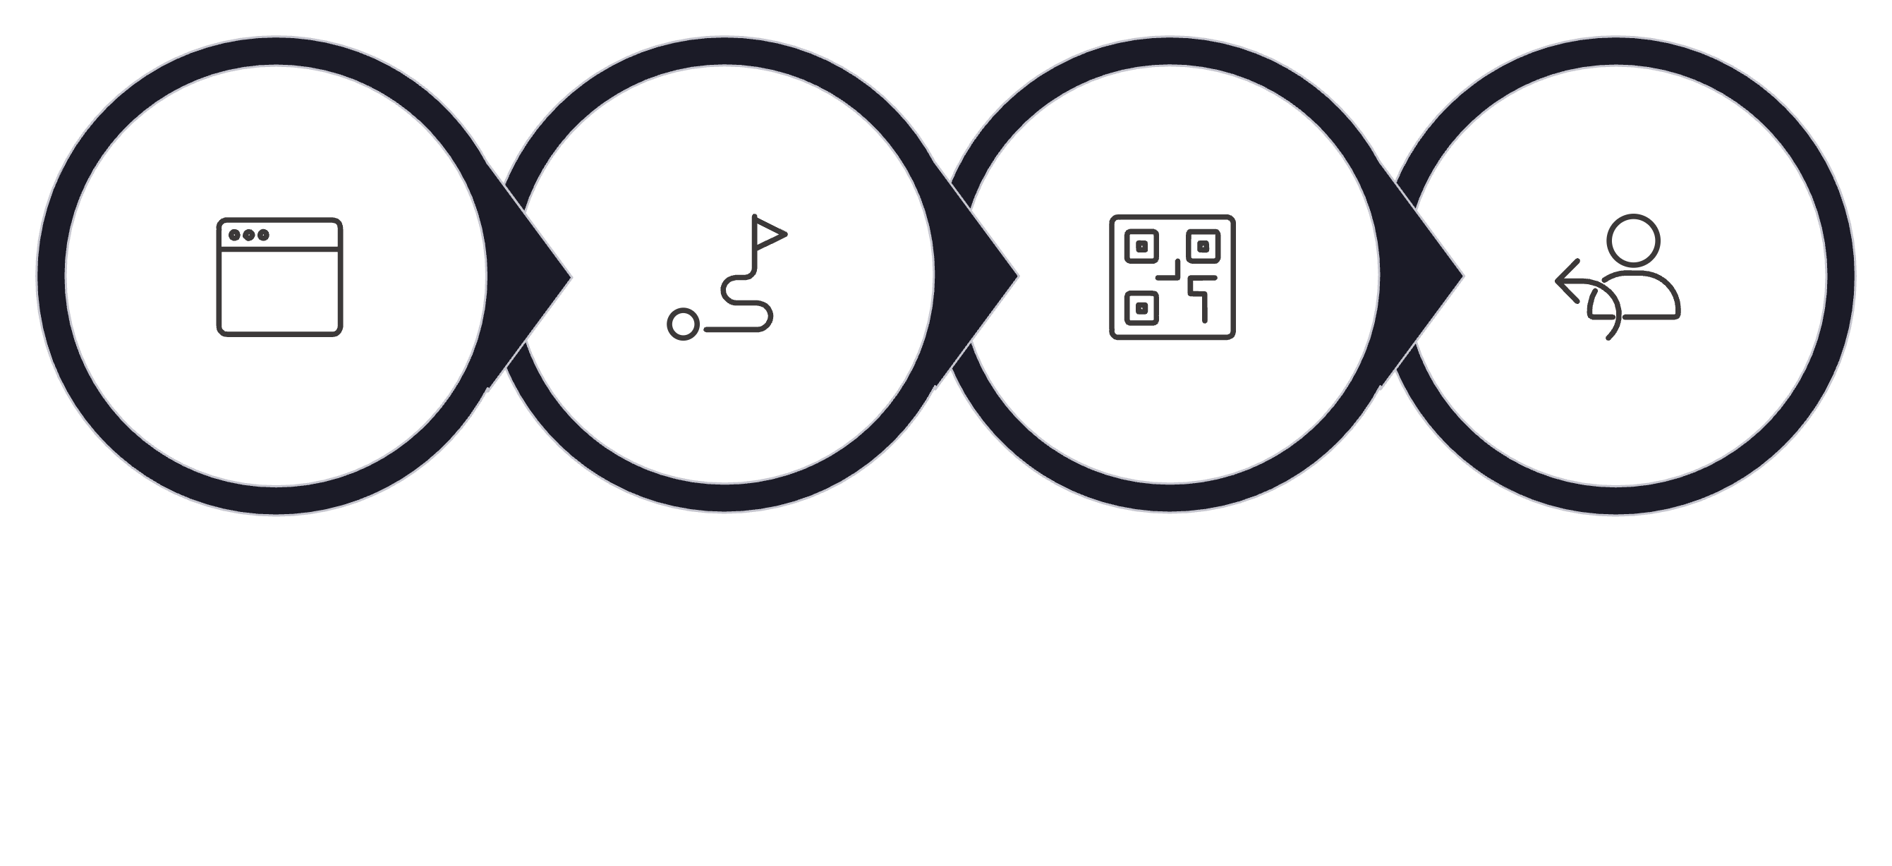
PART 2 — BUILDING APIS
What Happens Internally?
When a browser hits your FastAPI server, a precise sequence of events takes place internally. Understanding this flow helps you debug issues and design better endpoints.
Browser Request
Route Match
Handler Runs
Return JSON
FastAPI acts as the coordinator — it finds the right function for the right URL, runs it, and packages the return value into a proper HTTP response automatically.

Slide 28
PART 2 — BUILDING APIS
Understanding Decorators
The @app.get("/") line is a Python decorator. It tells FastAPI: "When a GET request arrives at this URL, call this function." Decorators are how FastAPI connects URLs to code.
@app.get("/")
def root():
return {"message": "Backend is running"}
@app.get
"/"
The function below
Registers this function as a handler for GET requests
The URL path this handler is bound to — the root of your API
Executes whenever a matching request arrives — its return value becomes the response

Slide 29
PART 2 — BUILDING APIS
The Routing Table Concept
FastAPI maintains an internal routing table — a map of every registered URL pattern and the function that handles it. When a request arrives, FastAPI looks up the URL in this table and calls the matching function.
Method
Path
Handler Function
GET
/
root()
GET
/hello
say_hello()
Each row in the routing table corresponds to one @app.get() or @app.post() decorator in your code. As you add more endpoints, the table grows.

Slide 30
PART 2 — BUILDING APIS
Adding Another Endpoint
Extending your API is as simple as writing a new function and decorating it. Each endpoint is independent — its own URL, its own logic, its own response.
@app.get("/hello")
def say_hello():
return {"message": "Hello"}
Add this below your existing root() function in main.py. With --reload running, the server will pick up the change instantly. Visit http://127.0.0.1:8000/hello to see the new response.
Every new @app.get() decorator adds a new row to FastAPI's routing table automatically.

Slide 31
Over to VS Code
👨‍💻
Over to VS Code
Create multiple endpoints and verify each one at its own URL in the browser.

Slide 32

Part 3
Designing Endpoints
Path parameters, query parameters, POST requests, and request bodies — the building blocks of real API design.
PART 3 OF 6

Slide 33
PART 3 — DESIGNING ENDPOINTS
Designing Real APIs
Real-world APIs need more than just static routes. They need to accept dynamic values in URLs, support filtering via query parameters, and receive structured data from clients through POST requests.
01
02
Path Parameters
Query Parameters
Capture dynamic values directly in the URL — e.g., an item ID
Accept optional values for filtering and searching — e.g., ?name=alex
03
04
POST Requests
Request Bodies
Receive structured JSON data sent in the request body
Define and validate the shape of incoming data using Pydantic models

Slide 34
PART 3 — DESIGNING ENDPOINTS
Path Parameters
Path parameters allow you to capture dynamic values directly from the URL. Instead of creating a separate endpoint for every item, you define one endpoint with a variable placeholder — FastAPI extracts the value and passes it to your function.
/items/10
/items/42
/items/999
All three URLs above are handled by a single endpoint. The number in the URL is the path parameter — it changes with every request, and your backend uses it to determine which item to work with.
Path parameters are ideal for identifying a specific resource — a user, an order, a product.

Slide 35
PART 3 — DESIGNING ENDPOINTS
Path Parameter Example
The curly brace syntax {item_id} in the route tells FastAPI this is a dynamic segment. The matching parameter in the function signature receives the value, and FastAPI handles the type conversion automatically.
@app.get("/items/{item_id}")
def get_item(item_id: int):
return {"item_id": item_id}
{item_id} in the URL
item_id: int in the function
Declares a variable segment — any value at this position is captured
FastAPI extracts and converts the value — if it's not an integer, a 422 error is returned automatically

Slide 36
PART 3 — DESIGNING ENDPOINTS
Query Parameters
Query parameters appear after the ? in a URL. They are optional values used for filtering, sorting, or searching — without changing the route itself. They are ideal when the client needs to narrow down results.
/search?name=alex
/products?category=electronics&min_price=100
When to Use
How It Works
Filtering a list of results
Searching by keyword
Sorting or paginating data
FastAPI automatically reads query parameters from the URL and maps them to function parameters by matching their names. No extra parsing code required.

Slide 37
PART 3 — DESIGNING ENDPOINTS
Query Parameter Example
When a function parameter is not defined as a path variable, FastAPI treats it as a query parameter automatically. The value is read directly from the URL's query string.
@app.get("/search")
def search_item(name: str):
return {"search": name}
A request to /search?name=alex will call search_item(name="alex") and return {"search": "alex"}. If name is missing from the URL, FastAPI returns a 422 validation error automatically.
To make a query parameter optional, give it a default value: name: str = ""

Slide 38

PART 3 — DESIGNING ENDPOINTS
POST Requests
POST requests are used when the client needs to send data to the backend — to create a new resource, submit a form, or trigger an action. Unlike GET, POST requests include a request body containing structured JSON data.
Send JSON
Validate Data
Create & Respond
The backend receives the JSON, validates its structure, applies business logic, and returns a confirmation response. POST is the foundation of all create operations in a REST API.

Slide 39
PART 3 — DESIGNING ENDPOINTS
Introducing Pydantic
Pydantic is the validation layer that FastAPI uses under the hood. You define the shape of your data as a Python class, and Pydantic automatically validates every incoming request against that schema — before your business logic ever runs.
Validation
Type Checking
Parsing
Rejects requests with missing or invalid fields — returns a clear error message automatically
Ensures each field matches its declared Python type — str, int, float, etc.
Converts raw JSON into a clean, typed Python object ready for your code

Slide 40
PART 3 — DESIGNING ENDPOINTS
Pydantic Model Example
A Pydantic model is a Python class that inherits from BaseModel. Each class attribute defines a field name and its expected type. FastAPI uses this model to validate every POST request body automatically.
from pydantic import BaseModel
class Item(BaseModel):
name: str
price: float
name: str
price: float
This field is required and must be a string — missing or wrong type triggers a 422 error
Must be a valid floating-point number — "expensive" will be rejected

Slide 41
PART 3 — DESIGNING ENDPOINTS
POST Endpoint Example
To use your Pydantic model, declare it as a parameter in your endpoint function. FastAPI reads the request body, validates it against the model, and passes a clean Python object to your function.
@app.post("/items")
def create_item(item: Item):
return {"received": item}
If the client sends {"name": "Laptop", "price": 999.99}, the item parameter will be a fully validated Item object. If the body is missing or malformed, FastAPI automatically rejects the request with a descriptive 422 error — no extra code needed.

Slide 42
PART 3 — DESIGNING ENDPOINTS
Testing APIs Using Swagger
FastAPI's built-in Swagger UI at /docs is the fastest way to test your endpoints during development. No external tools needed — you can send real requests directly from the browser.
01
02
Open Swagger UI
Click "Try It Out"
Navigate to http://127.0.0.1:8000/docs in your browser
Select any endpoint and click the Try It Out button to enable input
03
04
Send a Request
Inspect the Response
Fill in parameters or a request body and click Execute
See the live status code, response body, and headers returned by your backend

Slide 43
Over to VS Code
👨‍💻
Over to VS Code
Build and test GET endpoints with path and query parameters, then create a POST endpoint with a Pydantic model.

Slide 44

Part 4
Business Logic
Adding real decisions, calculations, and filtering to your backend endpoints.
PART 4 OF 6

Slide 45
PART 4 — BUSINESS LOGIC
What is Business Logic?
Business logic is what separates a real backend from a simple data pipe. It is the set of rules, decisions, and calculations that define how your system behaves — what is allowed, what gets computed, and what gets returned.
Rules
Decisions
Calculations
What conditions must be met for an action to proceed
Branching logic that determines different outcomes based on input
Computing totals, discounts, taxes, scores, or any derived value
Business logic lives exclusively in the backend — the client should never be trusted to compute or enforce rules.

Slide 46
PART 4 — BUSINESS LOGIC
Adding Calculations
The simplest form of business logic is a calculation. Your endpoint receives data from the client, applies a formula, and returns the computed result. The client never sees the formula — only the answer.
@app.post("/items")
def create_item(item: Item):
total = item.price * item.quantity
return {"item": item.name, "total": total}
Here the backend computes the total cost from price and quantity. The client simply sends the raw values — the backend does the math and returns the result. This is the correct separation of concerns.

Slide 47
PART 4 — BUSINESS LOGIC
Conditional Logic
Real systems rarely return the same result for every request. Conditional logic allows your backend to make decisions — applying different rules based on the values it receives.
total = item.price * item.quantity
if total > 10000:
discount = 0.1 * total
total = total - discount
return {"total": total, "discount_applied": True}
return {"total": total, "discount_applied": False}
Orders above $10,000 receive a 10% discount automatically. The client doesn't decide this — the backend enforces the rule every time, consistently and reliably.

Slide 48
PART 4 — BUSINESS LOGIC
Why Business Logic Matters
Without business logic, your API is just a data pass-through. With it, your backend becomes an intelligent system that enforces rules, calculates results, and delivers meaningful, dynamic responses tailored to each request.
Real Backend Behavior
Consistent Decision Making
Dynamic Responses
Your API behaves like a real product — not just a database wrapper
Rules are enforced the same way every time, for every user
Different inputs produce different outputs — the system reacts intelligently

Slide 49
PART 4 — BUSINESS LOGIC
Separating Logic From Routes
As your API grows, putting all logic inside route functions creates messy, untestable, hard-to-maintain code. The best practice is to extract business logic into dedicated helper functions and call them from your routes.
❌ Bad — Logic Inside Route
✅ Good — Reusable Function
@app.post("/items")
def create_item(item: Item):
total = item.price * item.qty
if total > 10000:
total -= 0.1 * total
return {"total": total}
def calculate_price(p, q):
total = p * q
if total > 10000:
total -= 0.1 * total
return total
@app.post("/items")
def create_item(item: Item):
total = calculate_price(
item.price, item.quantity)
return {"total": total}

Slide 50
PART 4 — BUSINESS LOGIC
Business Logic Function
Extracting logic into its own function makes your code reusable, testable, and easy to read. The route handler stays clean — it only deals with receiving the request and returning the response.
def calculate_price(price: float, quantity: int) -> dict:
total = price * quantity
discount = 0.0
if total > 10000:
discount = 0.1 * total
total = total - discount
return {"total": total, "discount": discount}
This function has a single responsibility: compute the price. It can be called from any endpoint, tested independently, and modified without touching your route definitions.

Slide 51
PART 4 — BUSINESS LOGIC
Filtering Logic
Query parameters aren't just for searching — they power filtering logic on the backend. Instead of returning all items, you filter the list based on what the client requests, keeping responses lean and relevant.
@app.get("/items")
def get_items(min_price: float = 0):
results = [
item for item in items
if item["price"] >= min_price
]
return {"items": results}
A request to /items?min_price=1000 returns only items priced at $1,000 or above. The filtering happens entirely in the backend — the client just passes a value and receives a filtered response.

Slide 52
Over to VS Code
👨‍💻
Over to VS Code
Add calculations, conditional discounts, and price filtering to your backend endpoints.

Slide 53

Part 5
Error Handling + Testing
Building backends that fail clearly, gracefully, and informatively.
PART 5 OF 6

Slide 54
PART 5 — ERROR HANDLING
Production APIs Need Error Handling
In production, things go wrong constantly. Clients send invalid data, request resources that don't exist, or submit incomplete forms. A well-built backend doesn't crash silently — it fails clearly with a meaningful error message and the correct HTTP status code.
Clear Failures
Helpful Messages
Consistent Behavior
Return the right status code so the client knows exactly what went wrong
Include a human-readable detail message that explains the error
Every error path follows the same response structure — no surprises
Silent failures are more dangerous than loud ones — always communicate errors explicitly.

Slide 55
PART 5 — ERROR HANDLING
HTTPException
FastAPI provides HTTPException to raise structured HTTP errors from anywhere in your code. It immediately stops execution and returns an error response with the status code and detail message you specify.
from fastapi import HTTPException
@app.get("/items/{item_id}")
def get_item(item_id: int):
if item_id not in items:
raise HTTPException(
status_code=404,
detail="Item not found"
)
return items[item_id]
When raised, FastAPI returns a clean JSON error response: {"detail": "Item not found"} with a 404 status code. No extra code required.

Slide 56
PART 5 — ERROR HANDLING
400 vs. 404 — Choosing the Right Code
Using the correct status code communicates the nature of the problem clearly. The two most common error codes you'll use are 400 and 404 — and they mean very different things.
Code
Name
When to Use
400
Bad Request
The client sent invalid input — wrong format, negative price, out-of-range value
404
Not Found
The resource the client requested does not exist — wrong ID, deleted record
Use 400 when the client's data is wrong. Use 404 when the client's target doesn't exist. Don't swap them — they communicate very different problems.

Slide 57
PART 5 — ERROR HANDLING
Validation Errors
When a client sends a request body that doesn't match your Pydantic model, FastAPI automatically returns a 422 Unprocessable Entity response — no extra code needed. This is one of FastAPI's most powerful built-in features.
Missing Fields
Wrong Types
If a required field is absent from the request body, Pydantic flags it immediately and returns which field is missing.
If price is declared as float but receives "cheap", the request is rejected before your code even runs.
The response includes a detailed error list explaining exactly which field failed and why — making it easy for the client to fix the problem.

Slide 58
PART 5 — ERROR HANDLING
Testing Errors with Swagger
Swagger UI is the perfect tool for testing your error handling. You can deliberately send bad requests to verify that your backend responds correctly in every failure scenario.
01
02
03
Test Wrong Input
Test Missing Fields
Test Invalid IDs
Send a string where an integer is expected — confirm a 422 is returned
Submit a POST body with a required field removed — verify the validation error
Request an item ID that doesn't exist — confirm a 404 with the correct detail message

Slide 59
Over to VS Code
👨‍💻
Over to VS Code
Add HTTPException error handling to your endpoints and test every error scenario using Swagger UI.

Slide 60

PART 6 — FINAL PROJECT
Final Backend Project
Inventory Management API
You will build a complete, production-style backend API from scratch — combining everything from this module into a single working system: routing, validation, business logic, and error handling.
Create Items
POST /items — Accept a validated request body and add an item to inventory
Read Items
GET /items and GET /items/{id} — Retrieve all items or a specific one
Update Items
PUT /items/{id} — Modify an existing item with validated new data
Delete Items
DELETE /items/{id} — Remove an item and return a confirmation response

