Slide 1

MODULE 4
Data Flow in Applications
How backend systems store, manage, and persist data — from simple in-memory variables to structured CSV-based storage with full CRUD operations.

Slide 2
PART 1 — UNDERSTANDING DATA FLOW
Understanding
Data Flow
Before we write a single line of persistent storage, we need to understand why backends need to remember things — and what happens when they don't.

Slide 3

SLIDE 1
Data Flow in Applications
Every web application has a backend that receives requests, processes logic, and returns responses. But where does the data live between those requests? Understanding data flow means understanding how information moves through your system — from the client, through your API, all the way to storage and back.
Client Request
Backend Logic
Response
This module focuses on what happens in between: how data is stored, retrieved, and modified persistently.

Slide 4

SLIDE 2
What We Built Earlier
In previous modules, we created a basic FastAPI backend that responds to HTTP requests. The pattern was simple — a request comes in, logic runs, and a response goes out.
@app.get("/")
def home():
return {"message": "hello"}
This is a stateless endpoint — it processes the request and immediately forgets it ever happened. No data is saved.

Slide 5


SLIDE 3
The Problem
Our backend currently has a critical limitation: it forgets everything after every request. Each time a new HTTP request arrives, the server starts fresh with no memory of previous interactions. This is fine for a simple greeting, but completely inadequate for any real-world application that needs to track users, orders, or messages.
Without persistent storage, your backend cannot build any meaningful product.

Slide 6
SLIDE 4
Why Real Applications Need Memory
Every application you use daily relies on a backend that remembers state. Think about what breaks without it:
📸 Instagram
🛒 Amazon
💬 WhatsApp
Remembers your account, followers, and every post you've ever uploaded.
Tracks your orders, cart items, and purchase history across sessions.
Stores every message, media file, and conversation thread persistently.

Slide 7
SLIDE 5
What is State?
Definition
Common Examples of State
State is any information that a system remembers over time. It's the difference between a calculator and a database — one forgets, the other remembers.
Users — account details, login status, preferences
Orders — items purchased, delivery status, history
Messages — chat history, read receipts, timestamps
Sessions — who is currently logged in

Slide 8

SLIDE 6
Without State
Imagine a real conversation with a stateless backend:
👤 User
🤖 Backend
"Show me my previous order."
"I'm sorry — I forgot everything the moment your last request ended."
A stateless backend cannot support login systems, shopping carts, order history, or any feature that depends on remembering the past.

Slide 9
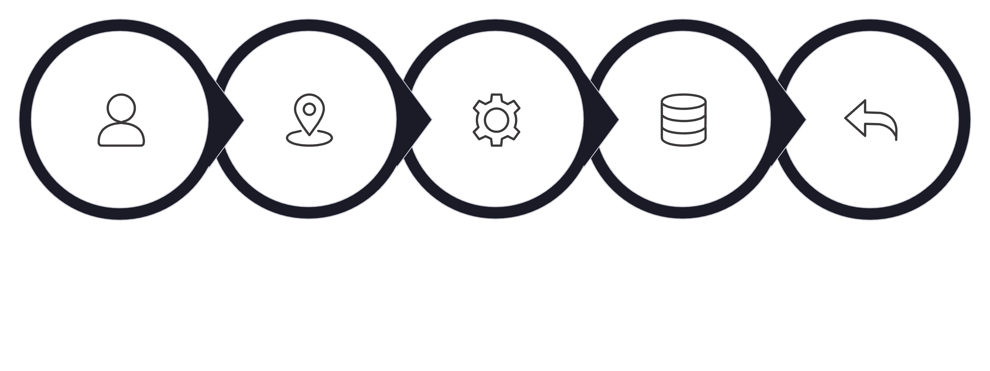

SLIDE 7
Core Backend Flow
A complete backend system doesn't just respond — it reads and writes to storage on every meaningful operation. Here is the full data flow we will be building toward:
Business Logic
Client
API Route
Storage
Response
Each stage has a clear responsibility. The API Route receives the request, Business Logic processes it, and Storage holds the data between requests — making the system truly useful.

Slide 10
SLIDE 8
What We Will Build
By the end of this module, you will have a working backend system with real, persistent data. Here's what we're building:
1
2
Persistent Storage
CRUD Operations
Data that survives server restarts using CSV files.
Full Create, Read, Update, and Delete endpoints.
3
4
CSV as a Database
Live Data Flow
Use pandas to read, modify, and save structured data.
See how real-time changes are reflected through the API.

Slide 11
PART 2 — CSV STORAGE
CSV
Storage
We'll start with a simple but powerful approach: using a CSV file as our data store. It's human-readable, easy to inspect, and a perfect first step before moving to a full database.

Slide 12
SLIDE 9
Project Structure
Our project is intentionally minimal. Two files: one for backend logic, one for data. This separation is the foundation of good architecture — code and data live separately.
backend_course/
├── main.py ← FastAPI application
└── items.csv ← Persistent data store
main.py contains all route definitions and logic. items.csv acts as our database — it persists between server restarts.

Slide 13
SLIDE 10
CSV Dataset
Our data file contains a simple product inventory. Each row represents one item, and the header row defines the columns — just like a spreadsheet or database table.
id,name,price,quantity
1,Laptop,50000,2
2,Phone,20000,5
3,Mouse,500,10
id
name
price
quantity
1
Laptop
50000
2
2
Phone
20000
5
3
Mouse
500
10

Slide 14
SLIDE 11
CSV as Storage
Think of it as a Mini Database
What makes it work?
A CSV file gives you everything a basic database provides: structured rows, named columns, and the ability to read and write data. For learning purposes, it's perfect.
Lives on disk, not just in memory
Survives server restarts
Readable and editable as plain text
Pandas makes it easy to query and modify

Slide 15
SLIDE 12
Installing Dependencies
Before we write any code, install the required libraries. Run this command in your terminal inside your project directory:
pip install fastapi uvicorn pandas
fastapi
uvicorn
pandas
Web framework for building APIs
ASGI server to run FastAPI
Data manipulation library

Slide 16
SLIDE 13
Why Pandas?
Pandas is the standard Python library for working with structured data. It turns your CSV file into a powerful, in-memory DataFrame that you can query, modify, and save with just a few lines of code.
Read CSV
Modify Rows
Save Files
Load the file into a DataFrame with a single line
Filter, update, and append rows using simple syntax
Write changes back to disk, making them persistent

Slide 17
SLIDE 14
Reading CSV Files
The first step in any CSV-backed API is loading the data file into memory. Pandas makes this a single line:
import pandas as pd
df = pd.read_csv("items.csv")
This reads the entire CSV file and stores it as a DataFrame — a table-like structure with rows and columns. The variable df now holds all your data in memory, ready to be queried.

Slide 18
SLIDE 15
Converting Data to JSON
FastAPI returns Python dictionaries and lists as JSON automatically. To convert a DataFrame into a format FastAPI can return, use:
df.to_dict(orient="records")
The orient="records" option converts each row into a dictionary where keys are column names. The result is a list of dictionaries — exactly what JSON arrays look like.
Example output: [{"id": 1, "name": "Laptop", "price": 50000, "quantity": 2}, ...]

Slide 19

SLIDE 16
Creating the API Endpoint
Now we connect the CSV read to a live API route. When a client sends a GET request to /items, the backend reads the CSV and returns all items as JSON:
@app.get("/items")
def get_items():
df = pd.read_csv("items.csv")
return df.to_dict(orient="records")
Every time this endpoint is called, it reads the latest version of the CSV — so any manual edits to the file are immediately reflected in the API response.

Slide 20

SLIDE 17
Over to VS Code
Let's build the CSV-based backend API step by step — setting up the project structure, creating the data file, and wiring up the first GET endpoint.

Slide 21
SLIDE 18
Testing the API
Once your server is running with uvicorn main:app --reload, open your browser and navigate to the items endpoint:
GET /items
→ http://127.0.0.1:8000/items
You should see a JSON array with all items from your CSV file. Try editing items.csv directly — add a row, save, and refresh the browser. The API will instantly reflect your changes without restarting the server.

Slide 22
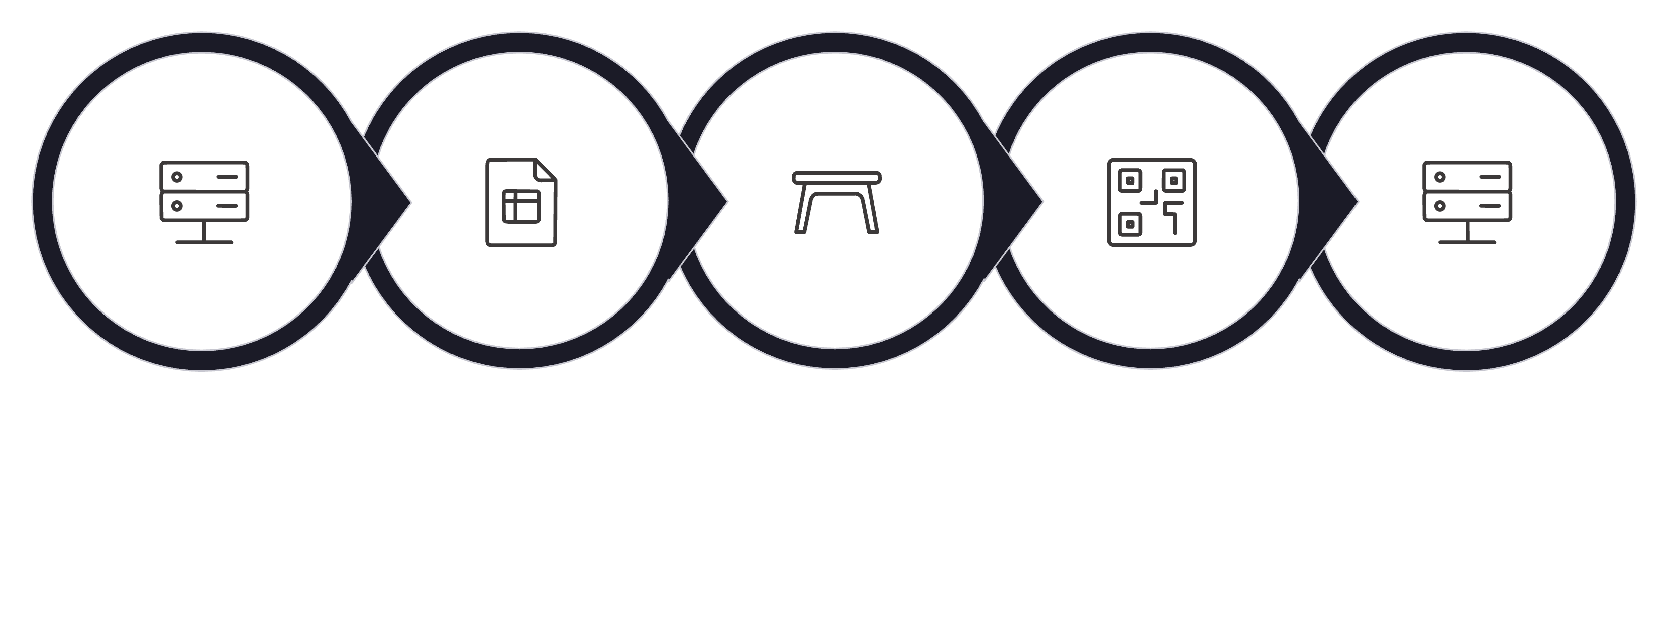
SLIDE 19
What Happened Internally?
Let's trace exactly what occurred when you hit GET /items. Every step happens in milliseconds:
HTTP Request
Load DataFrame
Convert to JSON
HTTP Response
Read CSV
Notice that the CSV is re-read on every request. This is intentional — it ensures the response always reflects the latest data on disk.

Slide 23
SLIDE 20
Live Dataset Updates
Step 1: Edit the CSV
Step 2: Refresh the API
Open items.csv in any text editor. Add a new row, change a price, or modify a quantity. Save the file.
Hit your browser or Swagger UI again at /items. No server restart needed — the updated data appears immediately in the response.
This demonstrates the power of reading from disk on every request. The API and the file are always in sync.

Slide 24
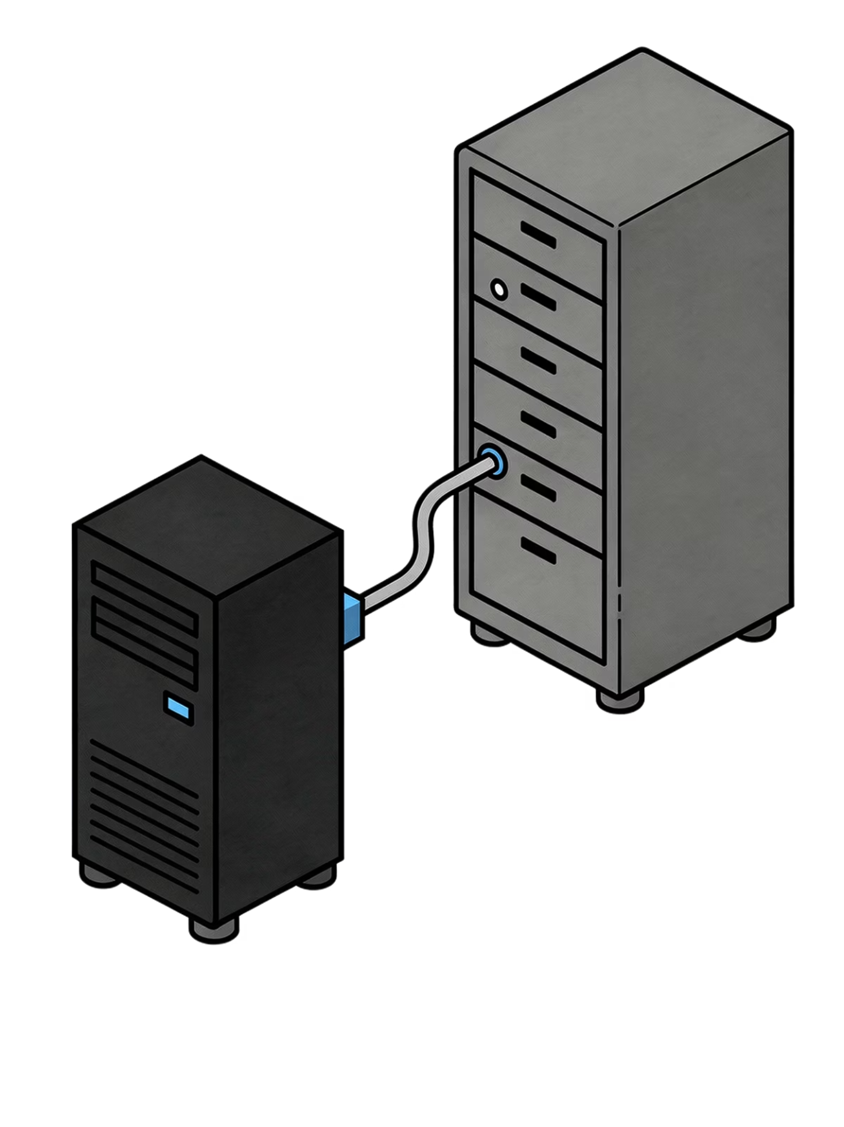
SLIDE 21
Backend + Storage Connected
Your backend now reads live, stored data from disk on every API call. This is a fundamental shift — you've moved from a hardcoded response to a dynamic system driven by real data. The backend and storage layer are now fully connected.
This is the foundation every real-world API is built on. Data lives in storage; the API serves it on demand.

Slide 25
PART 3 — MEMORY VS PERSISTENCE
Memory vs
Persistence
Not all storage is equal. We'll now explore the critical difference between data stored in RAM (temporary) and data stored on disk (persistent).

Slide 26
SLIDE 22
Temporary Storage Example
Let's look at the simplest form of "storage" — a Python variable. This is what in-memory state looks like:
counter = 0
This variable lives entirely in RAM. It exists only while the Python process is running. The moment the server stops or crashes, this value is permanently lost. There is no file, no database — nothing saved to disk.

Slide 27
SLIDE 23
Counter API
Let's build a simple counter endpoint to demonstrate in-memory state. Each request increments the counter and returns the new value:
counter = 0
@app.get("/count")
def increment():
global counter
counter += 1
return {"count": counter}
This works correctly while the server is running. Hit the endpoint five times and get back 1, 2, 3, 4, 5. But what happens when you restart the server?

Slide 28
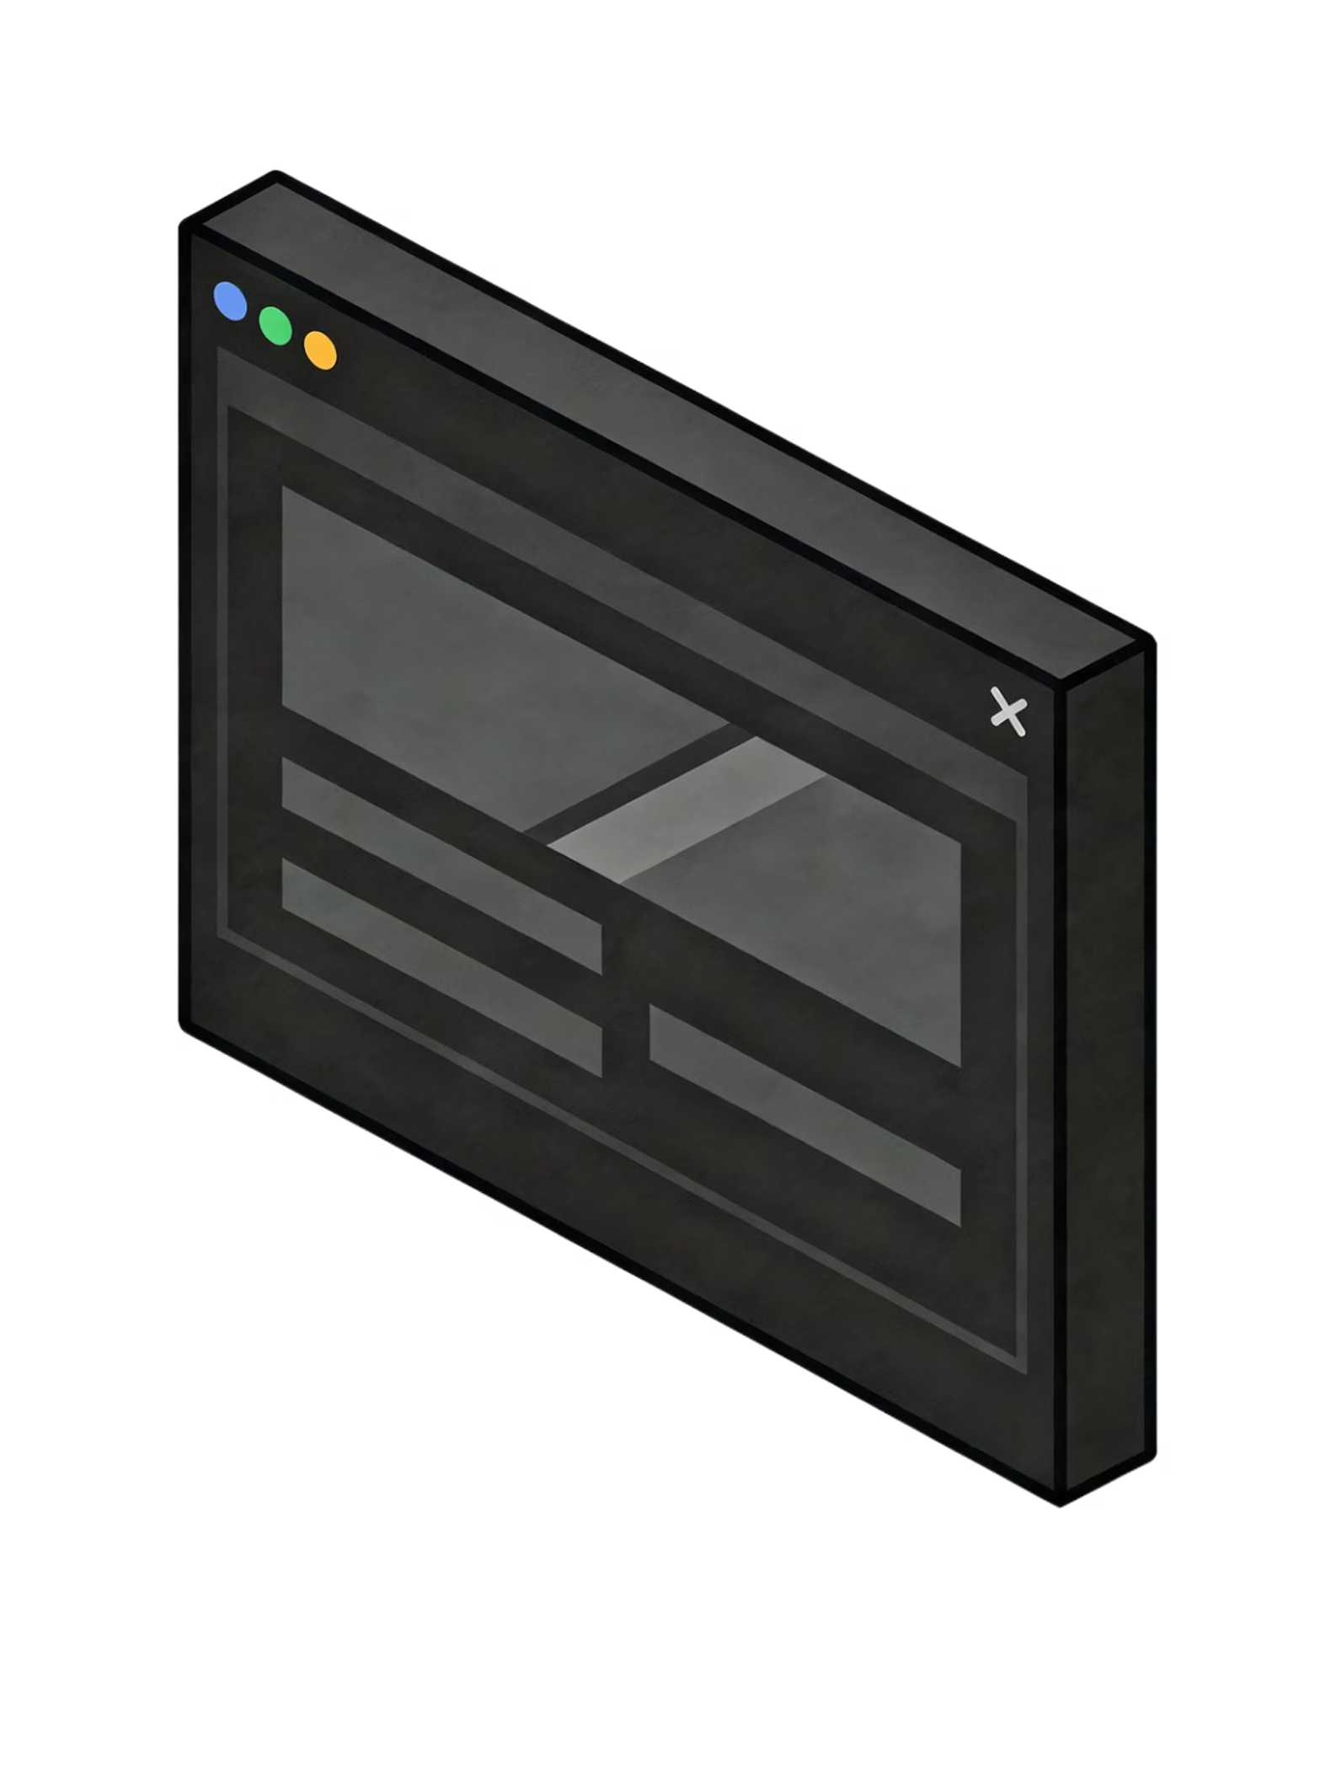
SLIDE 24
Over to VS Code
Let's run the counter API live — observe it incrementing correctly, then restart the server and watch what happens to the stored value.

Slide 29
SLIDE 25
What Happens After Restart?
Before Restart
After Restart
Counter is at 42 after many requests. Everything looks fine while the server is running.
Counter resets to 0. All accumulated state is gone — as if those 42 requests never happened.
This is not a bug — it's the expected behavior of in-memory variables. RAM is cleared when a process ends. This is why production systems never rely on variables alone for important data.

Slide 30
SLIDE 26
Why Did It Reset?
The answer lies in how computers work. When a Python process starts, it allocates space in RAM to hold all variables. When that process ends — by restart, crash, or shutdown — that memory is released and cleared.
RAM (Random Access Memory)
Disk Storage
Extremely fast but volatile — contents are lost when power is removed or the process ends. Great for speed, terrible for persistence.
Slower than RAM but non-volatile — data survives restarts, crashes, and power loss. This is where databases and files live.

Slide 31
SLIDE 27
CSV vs Memory
Here's the core tradeoff every backend developer must understand:
Feature
In-Memory Variable
CSV File
Speed
⚡ Very fast
🐢 Slower (disk I/O)
Persistence
❌ Lost on restart
✅ Survives restart
Capacity
Limited by RAM
Limited by disk
Use case
Temporary calculations
Persistent data storage

Slide 32
SLIDE 28
Why Databases Exist
The Fundamental Problem
The Solution: Persistent Storage
RAM is fast but temporary. Applications need storage that is both reliable and permanent — data that outlives any single server process.
CSV files → great for learning
SQLite → local file-based database
PostgreSQL / MySQL → production databases
All survive restarts and power loss
CSV is our stepping stone. The exact same concepts apply when you move to a real database later in this course.

Slide 33
PART 4 — CRUD OPERATIONS
CRUD
Operations
The four fundamental operations that every data-driven backend must support: Create, Read, Update, Delete. We'll implement each one using FastAPI and pandas.

Slide 34
SLIDE 29
CRUD Operations
CRUD is the backbone of every data-driven application. Every interaction a user has with stored data maps to one of these four operations:
Create
Read
Add new records to storage
Retrieve existing records
Update
Delete
Modify existing records
Remove records permanently

Slide 35
SLIDE 30
READ Operation
The READ operation retrieves stored data and returns it to the client. It's the most common operation in any API — users constantly request to view information.
GET /items
Client sends GET /items
Backend reads CSV
Response returned as JSON
An HTTP GET request arrives at the server
Pandas loads the file into a DataFrame
All rows are converted to a list of dictionaries

Slide 36
SLIDE 31
CREATE Operation
The CREATE operation adds a new item to storage. Clients send data in the request body via HTTP POST, and the backend saves it persistently to the CSV file.
POST /items
Unlike GET requests (which only read), POST requests carry a body — the data for the new item. FastAPI reads this body, validates it, and saves it to the CSV. The new item is then available in all future GET requests.

Slide 37
SLIDE 32
Pydantic Validation
Before saving any data, we need to validate it. FastAPI uses Pydantic models to automatically check that incoming data has the right types and structure.
from pydantic import BaseModel
class Item(BaseModel):
name: str
price: float
quantity: int
Types
Missing Fields
Structure
Ensures price is a number, not text
Rejects requests without required data
Confirms the shape of the input

Slide 38
SLIDE 33
Generating IDs
Each new item needs a unique identifier. Rather than letting the user provide one (which could conflict), we auto-generate the next ID from the existing data:
df = pd.read_csv("items.csv")
new_id = int(df["id"].max()) + 1
This finds the current highest ID in the DataFrame and adds 1. If the file has items with IDs 1, 2, and 3, the next item will get ID 4. This guarantees uniqueness without requiring a separate ID counter.

Slide 39
SLIDE 34
Appending New Rows
Once the new item is validated and an ID is generated, we add it to the DataFrame as a new row:
new_row = {"id": new_id, "name": item.name,
"price": item.price,
"quantity": item.quantity}
df.loc[len(df)] = new_row
df.loc[len(df)] adds the new row at the end of the DataFrame. The DataFrame now holds the original data plus the new item — but it's still only in memory until we save it.

Slide 40
SLIDE 35
Saving the CSV
After modifying the DataFrame, we must write it back to disk. This is the step that makes the change permanent:
df.to_csv("items.csv", index=False)
The index=False parameter prevents pandas from adding an extra row-number column to the file. After this line executes, the new item is saved to disk and will persist across server restarts. Every future GET request will include this item.

Slide 41

SLIDE 36
Over to VS Code
Let's implement the full CREATE operation — the Pydantic model, ID generation, row append, and CSV save — then test it using Swagger UI at /docs.

Slide 42
SLIDE 37
UPDATE Operation
The UPDATE operation modifies an existing item. The client specifies which item to update via its ID in the URL, and sends new values in the request body.
PUT /items/{item_id}
Find the item
Apply changes
Save to disk
Locate the row where id == item_id
Overwrite the row's fields with new values
Write the updated DataFrame back to CSV

Slide 43
SLIDE 38
Finding Matching Rows
Before updating, we need to verify the item exists. Pandas makes it easy to filter rows by a condition:
df = pd.read_csv("items.csv")
match = df[df["id"] == item_id]
if match.empty:
raise HTTPException(status_code=404,
detail="Item not found")
The expression df["id"] == item_id creates a boolean mask — a True/False value for every row. This is how pandas filters rows. If no rows match, we return a 404 error before attempting any update.

Slide 44
SLIDE 39
Updating Rows
Once we've confirmed the item exists, we update its fields directly in the DataFrame using .loc:
df.loc[df["id"] == item_id,
["name", "price", "quantity"]] = [
item.name,
item.price,
item.quantity
]
This targets only the row(s) where the ID matches and updates only the specified columns. The rest of the DataFrame — all other rows — is left completely unchanged.

Slide 45
SLIDE 40
Saving the Updated CSV
In Memory vs On Disk
Making it Permanent
After updating the DataFrame, the change exists only in RAM. Without saving, a server restart would revert the item to its original values.
The same to_csv() call writes the entire updated DataFrame back to disk, making the modification persistent and permanent.
df.to_csv("items.csv", index=False)

Slide 46

SLIDE 41
Over to VS Code
Let's implement the full UPDATE operation — finding the row, applying the changes, and saving back to disk. We'll verify the update persists after server restart.

Slide 47
SLIDE 42
DELETE Operation
The DELETE operation permanently removes an item from storage. The client identifies the item by its ID in the URL path — no request body is needed.
DELETE /items/{item_id}
Receive the ID
Filter the row out
Save to disk
Extract item_id from the URL path parameter
Keep all rows except the one matching the ID
Persist the filtered DataFrame back to CSV

Slide 48
SLIDE 43
Removing Rows
Deletion in pandas is done by keeping everything except the matching row. This is an elegant approach — you create a new DataFrame without the unwanted item:
df = pd.read_csv("items.csv")
df = df[df["id"] != item_id]
The condition df["id"] != item_id evaluates to True for every row except the one to delete. The result is a new DataFrame containing all rows except the deleted item. The original data is not mutated — a new filtered DataFrame is assigned.

Slide 49
SLIDE 44
Saving After Delete
Just like Create and Update, the deletion only becomes permanent once we write the updated DataFrame back to the CSV file:
df.to_csv("items.csv", index=False)
return {"message": f"Item {item_id} deleted"}
Deletion is irreversible. Once saved, there is no undo — the row is gone from the file. In production systems, you'd typically implement "soft deletes" (marking records as inactive) rather than physically removing them. For now, we keep it simple.

Slide 50

SLIDE 45
Over to VS Code
Let's implement the full DELETE operation — filtering the row out of the DataFrame and saving the result. We'll then verify the item is gone from future GET requests.

Slide 51
SLIDE 46
Full CRUD Backend System
With all four operations implemented, you now have a complete, functional backend. Here's the HTTP method mapping:
HTTP Method
Route
Operation
Action
POST
/items
Create
Add a new item
GET
/items
Read
Retrieve all items
PUT
/items/{id}
Update
Modify existing item
DELETE
/items/{id}
Delete
Remove an item

Slide 52

SLIDE 47
Complete Backend Architecture
Let's trace the full path of a request through the complete system — from the client all the way to persistent storage and back:
Client
FastAPI Routes
Initiates request to the backend system.
Receives request and dispatches to handlers.
Pydantic Validation
Business Logic
Processes rules and prepares storage payload.
Validates and sanitizes incoming data.
Every request flows through this exact pipeline. Validation protects your data layer. Business logic handles the rules. CSV storage makes changes permanent. The response confirms the result to the client.

Slide 53
PART 5 — MODULE WRAP-UP
Module
Wrap-Up
Let's consolidate what you've built and learned — and understand why these concepts form the foundation of every real-world backend system.

Slide 54

SLIDE 48
What You Built
Persistent Backend
A FastAPI server that retains data across restarts
CSV Storage Layer
A file-based data store read and written by pandas
Full CRUD API
Four working endpoints for Create, Read, Update, Delete
Live Data Flow
Changes persist immediately and are visible in future requests

Slide 55
SLIDE 49
What You Learned
01
02
03
State
Persistence
CRUD
What it means for a system to "remember" information between requests
The difference between RAM (temporary) and disk (permanent) storage
The four fundamental operations every data system must support
04
05
Storage Systems
Backend Data Flow
How CSV files serve as a simple, inspectable database layer
How requests travel through validation, logic, and storage layers

Slide 56
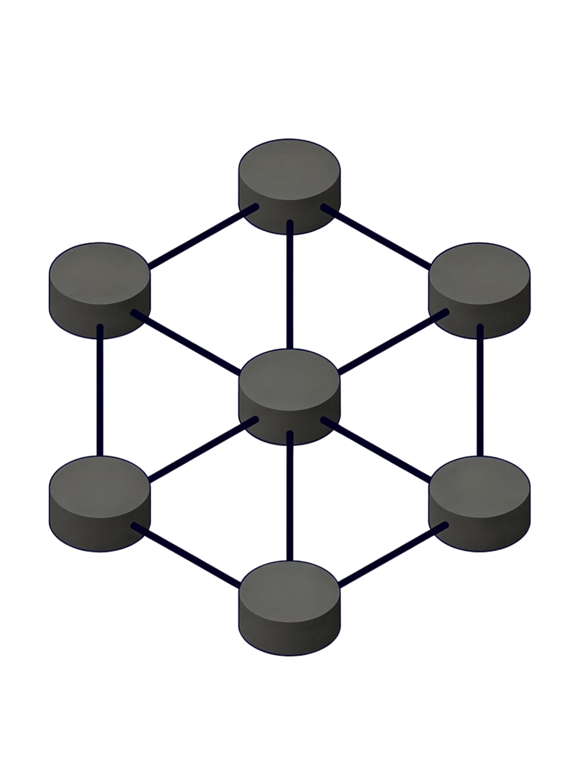
SLIDE 50
Key Takeaway
Backend systems only become truly useful when they remember data. Persistence transforms a simple request handler into a real application.
Every concept in this module — state, persistence, CRUD, CSV storage — applies directly when you graduate to real databases like PostgreSQL or MongoDB. The patterns don't change. Only the storage engine does.
You now understand the core of how every production backend in the world manages data. This is the foundation everything else is built on.

