Slide 1
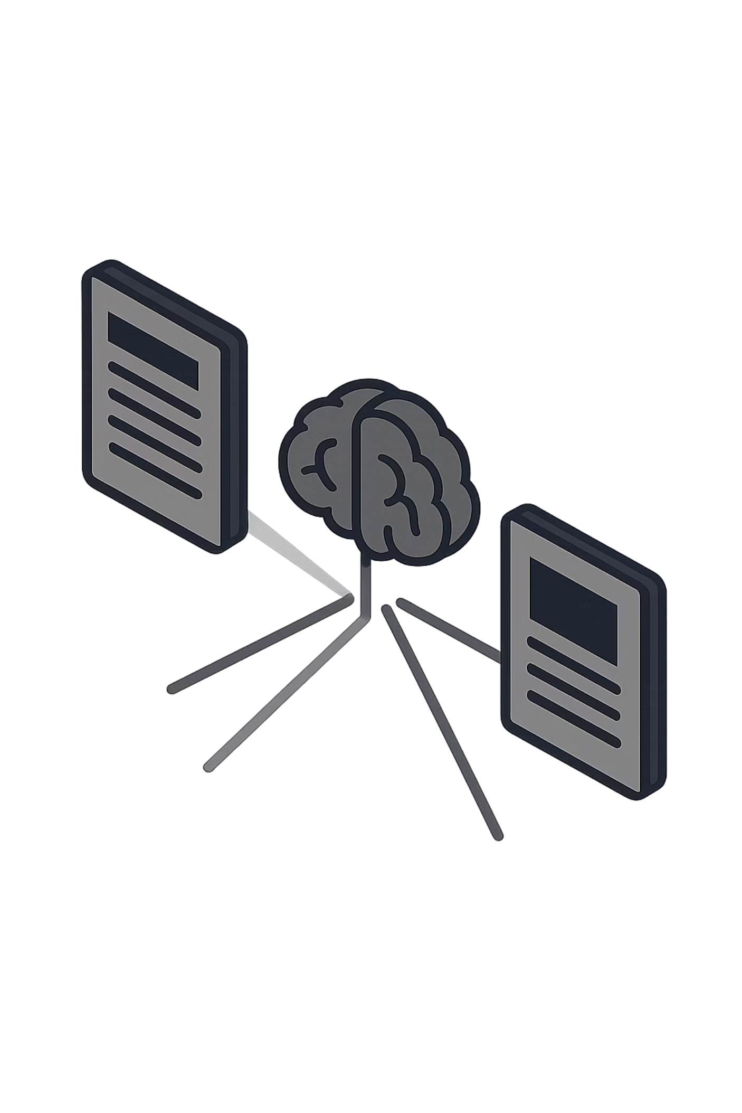
Retrieval-Augmented Generation (RAG)
Building Document Question Answering Systems — Module 6 · Forward Deployed Engineering
4-HOUR MODULE
PRACTICAL IMPLEMENTATION

Slide 2
MODULE OVERVIEW
What We're Building Today
By the end of this module, you will have built a complete RAG pipeline that can answer questions from a real PDF document — using nothing but Python and the OpenAI API.
01
02
03
Why RAG Exists
Embeddings
Retrieval
Understanding the core limitation of LLMs and why retrieval is necessary
Converting meaning into numbers for semantic search
Finding the most relevant chunks using cosine similarity
04
05
Generation
Failure Cases & Chatbot
Feeding context to the LLM to produce grounded answers
Debugging common issues and building the final exercise

Slide 3
PART 1
WHY RAG EXISTS
Part 1
Why RAG Exists
Understanding the fundamental limitation that makes retrieval necessary.

Slide 4


The Limitation of LLMs
Large Language Models are powerful — but their knowledge is frozen at the point of training. They have no awareness of anything that happened after their training cutoff, and they have never seen your organization's private documents.
Company Policies
Private PDFs
Internal HR handbooks, SOPs, and guidelines your LLM has never read
Contracts, reports, and internal documentation that were never public
New Information
Anything created or updated after the model's training cutoff date
Key Idea: LLMs only know what they learned during training. They cannot access your files, your database, or the real world.

Slide 5

RUNNING EXAMPLE
The Problem We're Solving
The Question
Where the Answer Lives
"What is the notice period for interns?"
A perfectly reasonable HR question that any employee might ask.
The answer exists inside:
employee_policy_handbook.pdf
A private document the LLM has never seen — and cannot access on its own.
This is the running example we'll use throughout the entire module. Every concept we introduce will connect back to this document and this question.

Slide 6
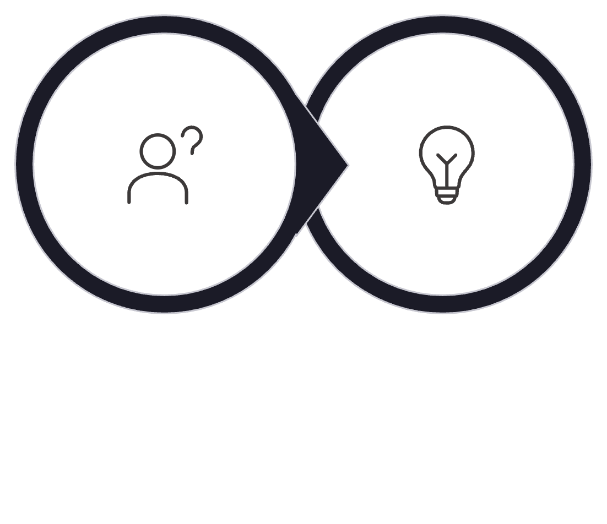

Traditional LLM Approach vs. RAG
❌ Without RAG
✅ With RAG
User Question
Query about the PDF
Grounded Answer from LLM
Question
Hallucinated Answer
LLM Inference
Retrieved Context
The LLM has no access to your PDF. It either says "I don't know" or — worse — invents a plausible but incorrect answer. This is called hallucination.
Combines question and context
Relevant passage from documents
We first retrieve the relevant passage from the PDF, then pass it alongside the question. The LLM now has real evidence to reason from.

Slide 7

What Does RAG Stand For?
RAG is an architecture pattern, not a specific library or tool. The three words describe exactly what happens at each stage of the pipeline.
Retrieval
Augmented
Generation
Find the most relevant passages from your document store using semantic search
Inject that retrieved context into the prompt — augmenting what the LLM can see
The LLM generates a grounded, accurate answer using only the provided context

Slide 8

The Full RAG Pipeline
Every step in this pipeline will be implemented in this module. Keep this architecture in mind as we build each piece.
Create Embeddings
Ingest Document
Generate Answer
Our running document throughout: employee_policy_handbook.pdf. Each stage transforms the data into a form the next stage can use.

Slide 9
PART 2
WHAT ARE EMBEDDINGS?
Part 2
What Are Embeddings?
Converting language meaning into numbers so computers can measure similarity.

Slide 10

The Keyword Search Problem
Before we can understand embeddings, we need to understand why simple keyword matching fails. Consider these two sentences from our pipeline:
What's in the PDF
What the User Asks
"Interns must serve a notice period of 15 days."
"How long before resigning should interns inform the company?"
A human immediately understands these sentences are about the same thing. A keyword search engine does not — because the words are completely different. We need a smarter matching method.

Slide 11
Why Keyword Search Fails
The Mismatch
What We Need Instead
We need a system that understands semantic meaning — the intent behind the words — rather than performing literal string matching.
This is exactly what embeddings provide. Instead of comparing words, we compare meaning encoded as mathematical vectors.
In the document
In the question
"notice period"
"inform before resigning"
Meaning is identical. Words are different. A keyword search returns zero matches.

Slide 12
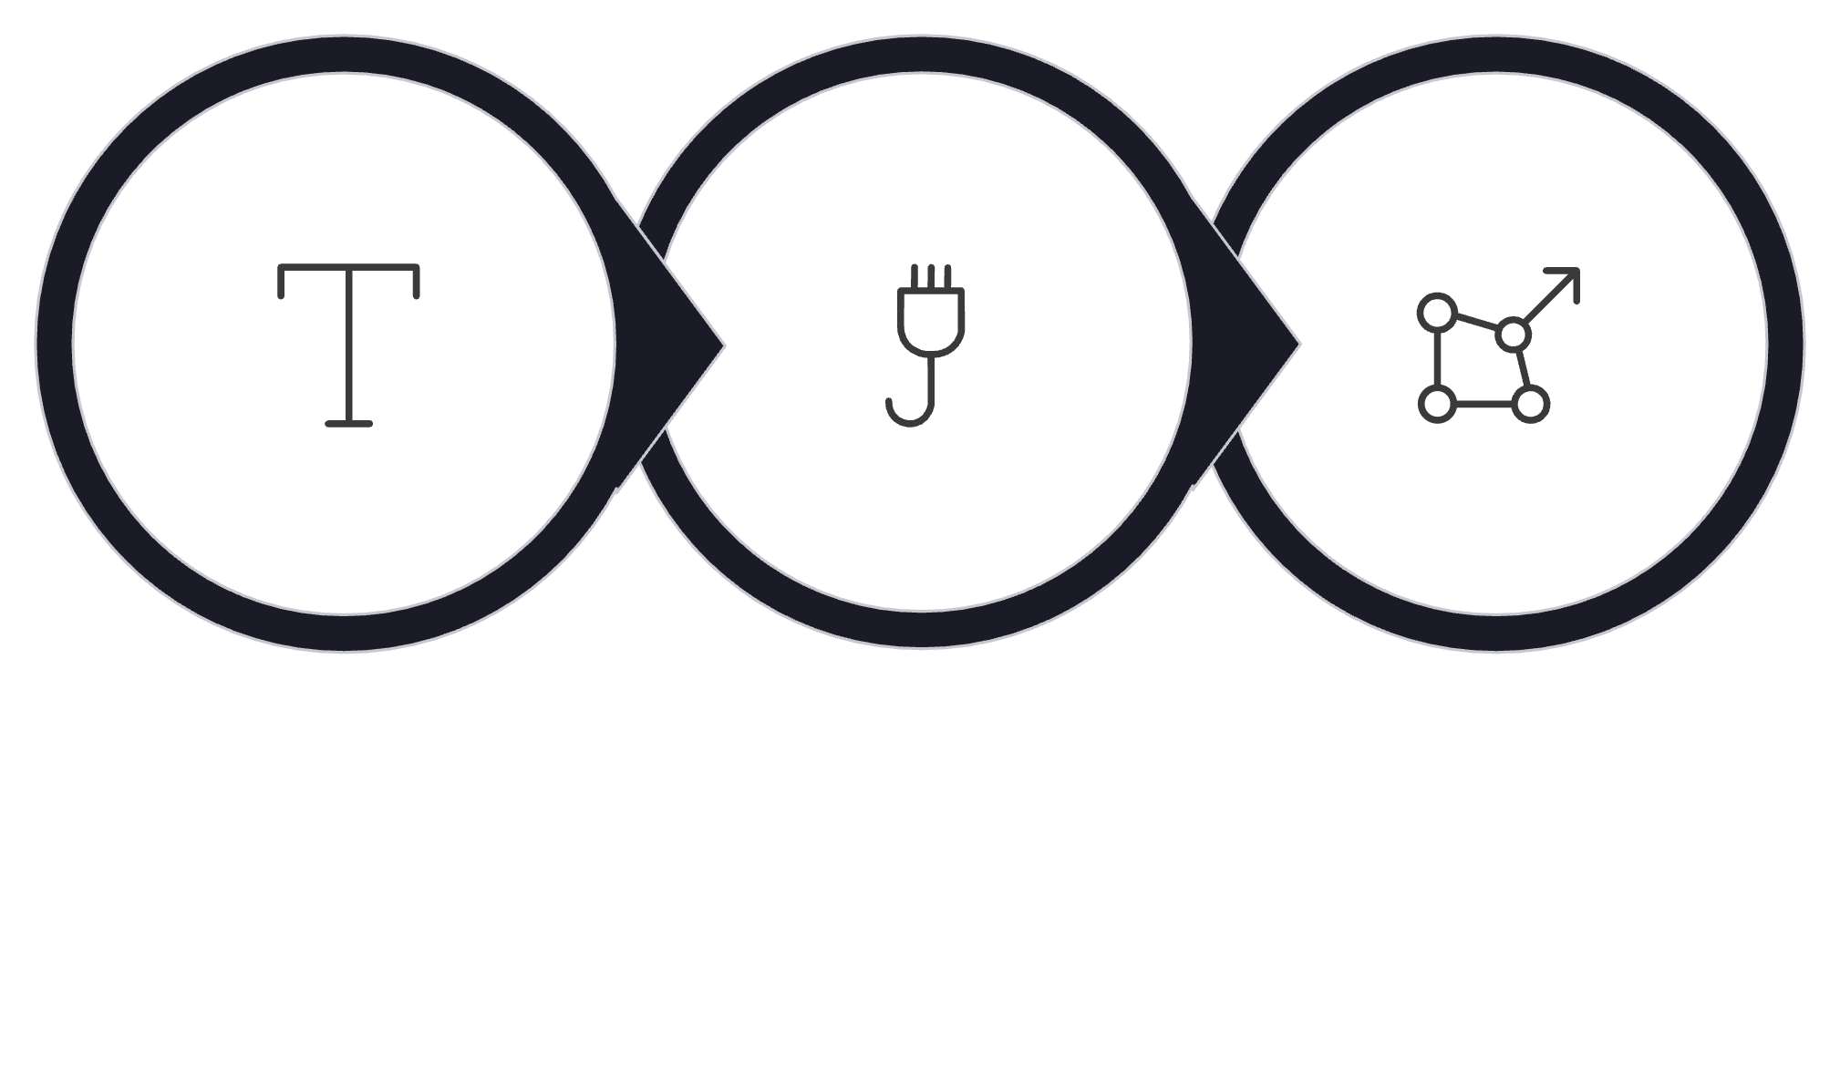
The Solution: Embeddings
An embedding model reads a piece of text and converts its meaning into a list of numbers — called a vector. Similar meanings produce numerically similar vectors.
Embedding Model
Numerical Vector
Text Input
This is the breakthrough that makes semantic search possible. We stop asking "do these strings match?" and start asking "are these vectors close to each other?" — which maps directly to "do these sentences mean the same thing?"

Slide 13

Embedding Intuition: A 2D Example
In reality, embeddings live in hundreds of dimensions — but imagine we could plot them in 2D. Semantically similar texts would cluster near each other in this space.
Notice policy sentence → (2, 5)
Similar question → (3, 5)
Unrelated topic → (100, 200)
"Interns must serve a notice period of 15 days"
"How long before resigning should interns inform the company?"
"What are the cafeteria timings on weekends?"
Key insight: Similar meaning = numerically close vectors. Unrelated meaning = numerically far apart.

Slide 14
Reality: High-Dimensional Vectors
In production, embeddings are not 2D points. They are long lists of decimal numbers — each dimension capturing a subtle aspect of meaning.
[0.012, -0.543, 0.222, 0.891, -0.034, 0.667, ...]
... 1536 values total
Model We'll Use
Why So Many Dimensions?
text-embedding-3-small by OpenAI
Produces 1,536-dimensional vectors. Each number encodes a nuance of meaning from the input text.
More dimensions = richer representation of meaning. The model can distinguish subtle differences in intent, tone, topic, and context across all 1,536 axes simultaneously.

Slide 15
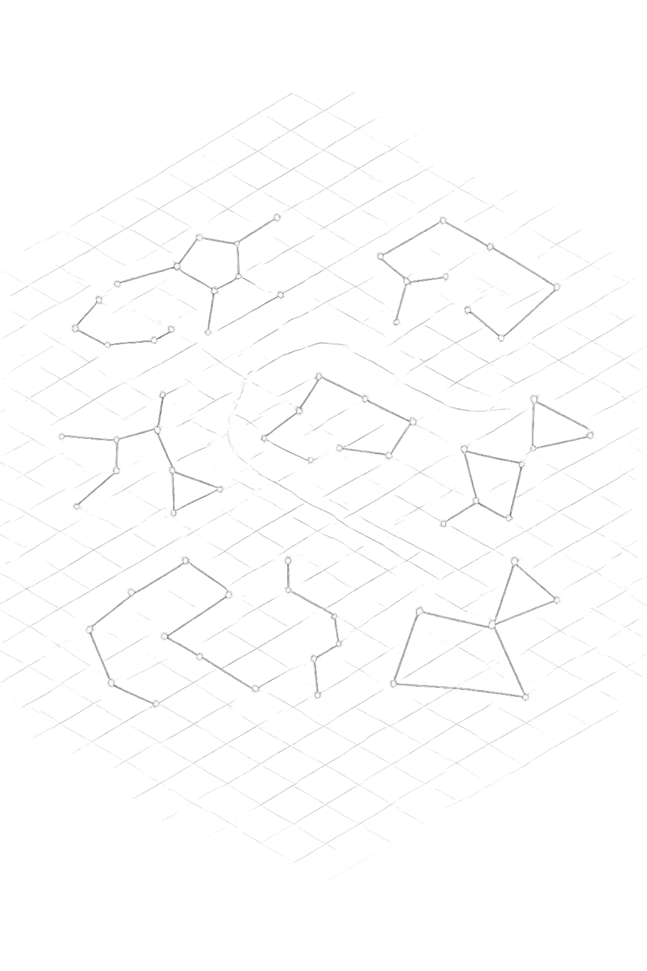
Semantic Space: Similar Meanings Cluster Together
When you embed all the chunks from your PDF, they naturally organize themselves into clusters by topic. This is the geometric structure that makes retrieval work.
Notice Policy Cluster
Cafeteria Cluster
All chunks about notice periods, resignation procedures, and exit formalities land near each other
Lunch timings, menu policies, and dining rules group separately
Insurance Cluster
Health coverage, claims, and benefits information forms its own neighborhood

Slide 16
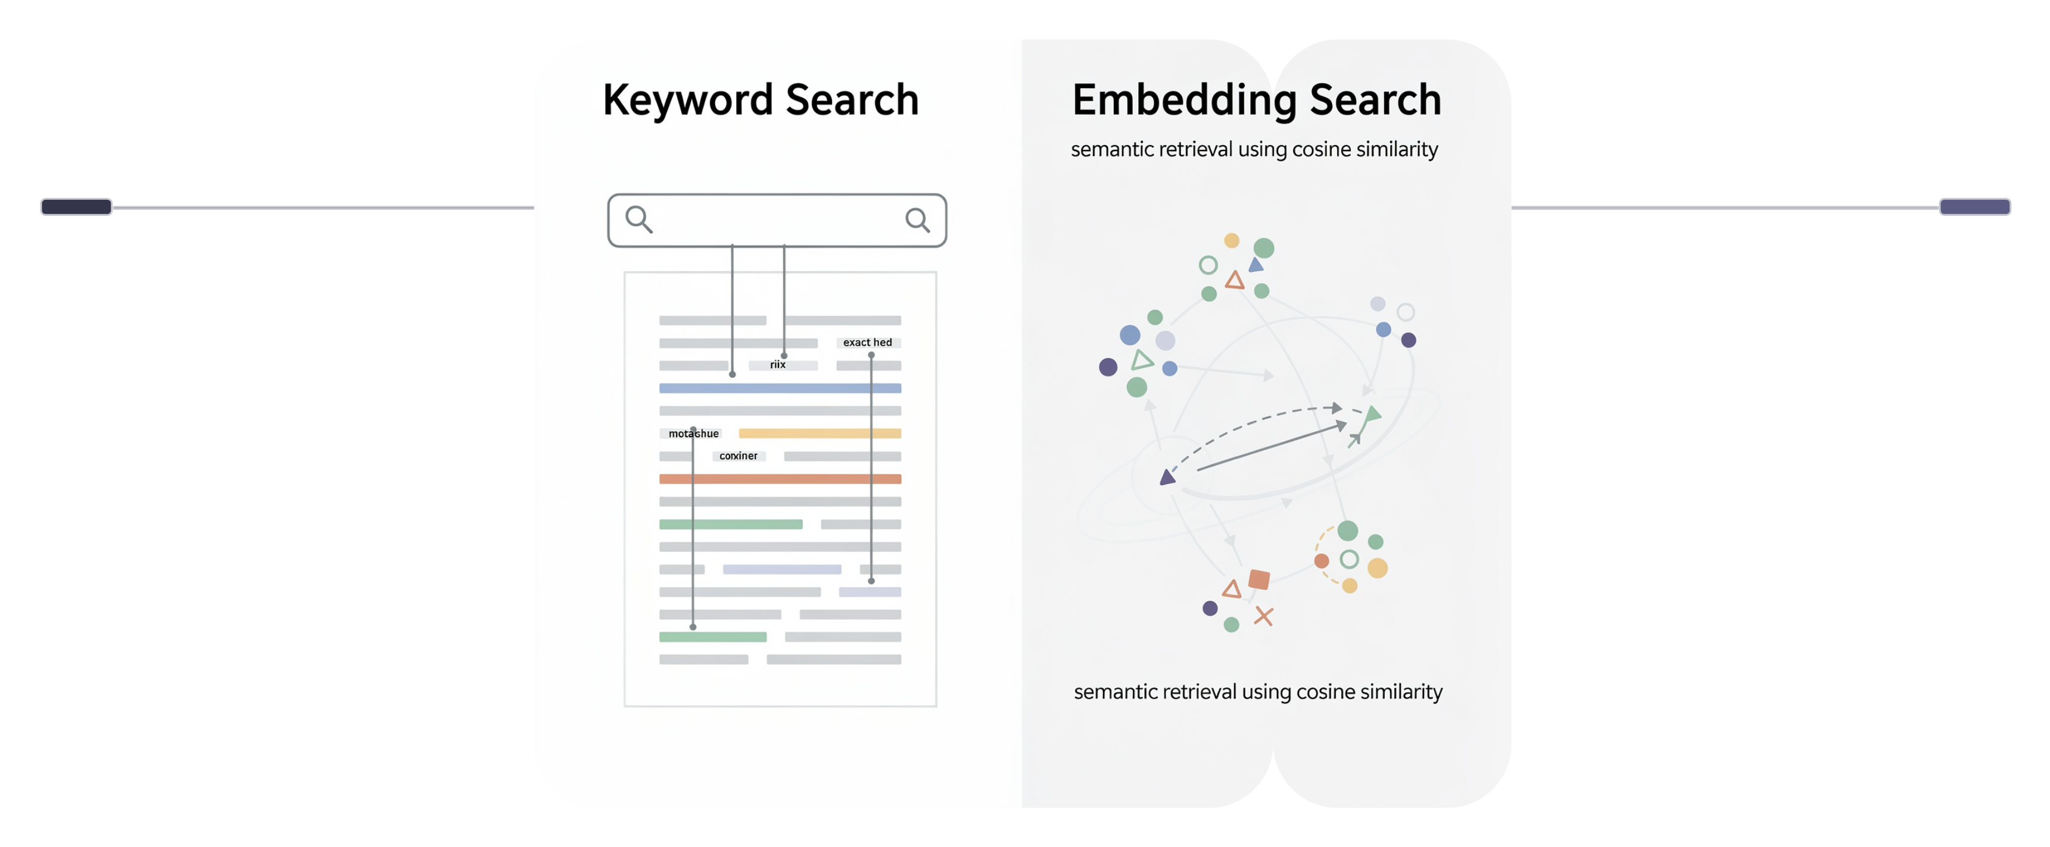
Why RAG Needs Embeddings
Path A: Keyword Search
Path B: Embedding Search
Question → Keyword Match → Weak Retrieval
Question → Embedding → Cosine Similarity → Strong Retrieval
Embeddings are what elevate RAG from a brittle keyword lookup system into a robust semantic search engine. Without them, your retrieval is fragile and misses questions that are phrased differently from the source text.

Slide 17
OPENAI API
The OpenAI Embeddings API
Model
What You Send
text-embedding-3-small
A string of text — a question, a chunk of your document, or any passage you want to embed.
Purpose
What You Get Back
Convert any text string into a 1,536-dimensional vector
A vector. That's it. A list of 1,536 numbers that mathematically encodes the meaning of your input text, ready to be compared against other embeddings.
Output
A list of floating-point numbers representing the meaning of the input

Slide 18

VS CODE
Over to VS Code — Creating Your First Embedding
Let's call the OpenAI Embeddings API and inspect what it returns. This is the foundation of everything else we build.
from openai import OpenAI
client = OpenAI()
response = client.embeddings.create(
model="text-embedding-3-small",
input="Interns must serve a notice period of 15 days."
)
vector = response.data[0].embedding
print(f"Dimensions: {len(vector)}") # → 1536
print(f"First 5 values: {vector[:5]}")
# → [0.012, -0.543, 0.222, 0.891, -0.034]
Run this and inspect the output. Notice that the vector always has exactly 1,536 values, regardless of how long or short your input text is.

Slide 19
PART 3
MEASURING SIMILARITY
Part 3
Measuring Similarity
How do we determine which vectors are "close" to each other?

Slide 20
The Core Question: How Do We Compare Vectors?
We now know how to turn text into vectors. But to build retrieval, we need to answer a precise question: given a question vector, which of our document chunk vectors is most similar to it?
Euclidean Distance
Cosine Similarity
Dot Product
Measures straight-line distance between two points. Sensitive to vector magnitude — less ideal for text.
Measures the angle between two vectors, ignoring their length. Industry standard for text embeddings.
Related to cosine similarity but affected by magnitude. Used in some vector stores when vectors are normalized.

Slide 21

Cosine Similarity: The Mathematical Heart of Retrieval
Cosine similarity measures the angle between two vectors in high-dimensional space. The smaller the angle, the more similar the meaning — regardless of text length.
The Formula
Score Interpretation
Score = 1.0
Identical meaning (same vector direction)
Dot product of vectors A and B, divided by the product of their magnitudes.
Score ≈ 0.85+
Highly similar — strong retrieval candidate
Score ≈ 0.0
Completely unrelated topics

Slide 22
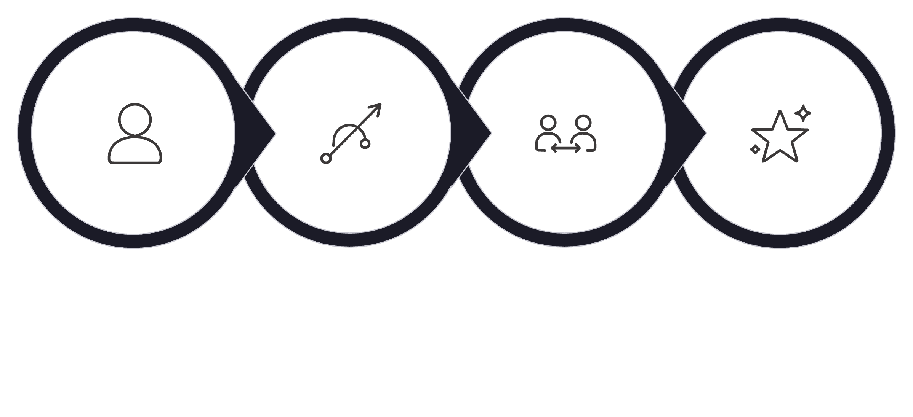

Retrieval Intuition: Finding the Best Match
When a user asks a question, we embed it and then compare that question vector against every chunk embedding stored in our system. The chunks with the highest cosine similarity scores win.
User Question
Embed Question
Compare Embeddings
Return Top-K
This comparison process is the core of retrieval. Every sophisticated vector database (FAISS, Chroma, Pinecone) is ultimately doing a fast version of this same operation.

Slide 23

VS CODE
Over to VS Code — Computing Cosine Similarity
Here's how to implement cosine similarity from scratch using NumPy. Understanding this formula directly will help you debug retrieval problems later.
import numpy as np
def cosine_similarity(a, b):
return np.dot(a, b) / (np.linalg.norm(a) * np.linalg.norm(b))
# Example usage
question_embedding = embed("How long must interns work before leaving?")
chunk_embedding = embed("Interns must serve a notice period of 15 days.")
score = cosine_similarity(question_embedding, chunk_embedding)
print(f"Similarity: {score:.4f}") # → ~0.91 (very high)
Try comparing semantically different sentences. Notice how the score drops dramatically for unrelated text.

Slide 24
PART 4
PDF INGESTION
Part 4
PDF Ingestion
Before we can embed anything, we need to extract plain text from our source document.

Slide 25
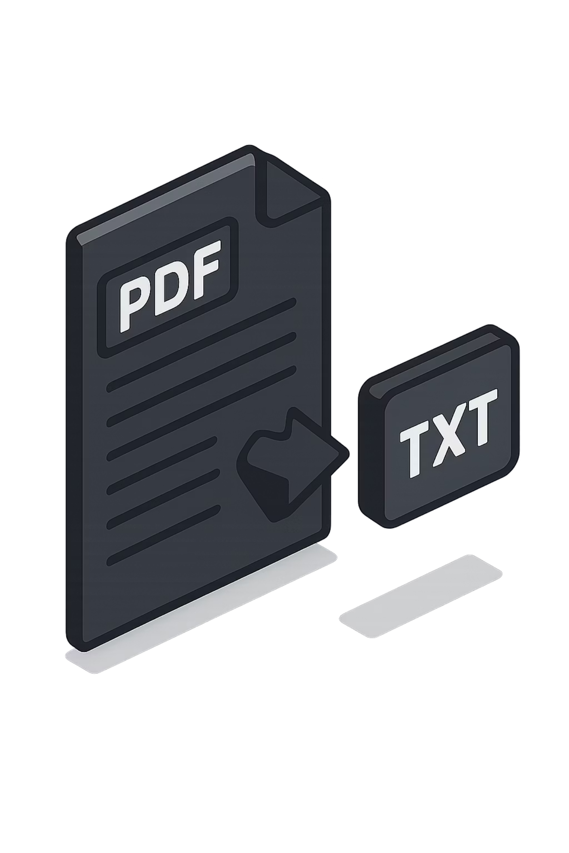
Reading the PDF
LLMs cannot directly reason over binary PDF files. The first step in any RAG pipeline is extracting the raw text from your documents and converting it into a plain string that Python can work with.
Input
Output
employee_policy_handbook.pdf
A binary file with formatting, fonts, layout, and metadata — none of which we need.
full_text
A single plain-text string containing all the readable content from every page of the document.

Slide 26
Example: What Extracted Text Looks Like
After extraction, you'll have a single string. Here's a snippet of what we'd expect from our running example document:
NOTICE PERIOD POLICY
---------------------
Full-time employees must serve a notice period of 60 days.
Part-time employees must serve a notice period of 30 days.
Interns must serve a notice period of 15 days.
EXIT PROCESS
------------
Employees must return all company equipment before their last day.
Final settlements are processed within 30 working days of exit.
Notice how all structure (headers, paragraphs, sections) becomes a flat text stream. This is expected — the next step, chunking, will restore meaningful boundaries.

Slide 27

VS CODE
Over to VS Code — Reading PDF with PyPDF
We use the pypdf library to extract text from each page and join it into one continuous string.
from pypdf import PdfReader
def extract_text_from_pdf(path):
reader = PdfReader(path)
full_text = ""
for page in reader.pages:
full_text += page.extract_text() + "\n"
return full_text
# Load our document
full_text = extract_text_from_pdf("employee_policy_handbook.pdf")
print(f"Extracted {len(full_text)} characters")
print(full_text[:300]) # Preview first 300 chars
Always inspect your extracted text. OCR errors, garbled tables, or missing sections at this stage will silently degrade every downstream step.

Slide 28
PART 5
CHUNKING
Part 5
Chunking
Splitting documents into the right-sized pieces for embedding and retrieval.

Slide 29
Why Chunking Exists
You cannot embed an entire 50-page document as a single vector. Two reasons: embedding models have token limits, and a single embedding for a huge document captures everything — meaning it captures nothing specifically.
The Problem
The Solution
If you embed the entire handbook as one vector, a question about "notice period" has to compete with cafeteria policies, insurance clauses, and every other topic in the document.
Break the document into smaller, focused pieces — called chunks. Each chunk gets its own embedding. When a user asks a question, we retrieve only the 2–3 most relevant chunks.

Slide 30
Three Chunking Strategies
1
2
3
Fixed-Size Chunking
Sentence Chunking
Recursive Chunking
Split after a fixed number of characters (e.g., every 300 chars).
Pros: Simple, predictable, fast
Cons: May cut a sentence mid-thought, breaking meaning
Split at sentence boundaries using punctuation detection.
Pros: Natural, preserves sentence integrity
Cons: Variable chunk sizes; very long sentences become large chunks
Try to split at paragraphs first, then lines, then words, then characters.
Pros: Best balance of meaning preservation and size control
Cons: Slightly more complex to configure

Slide 31
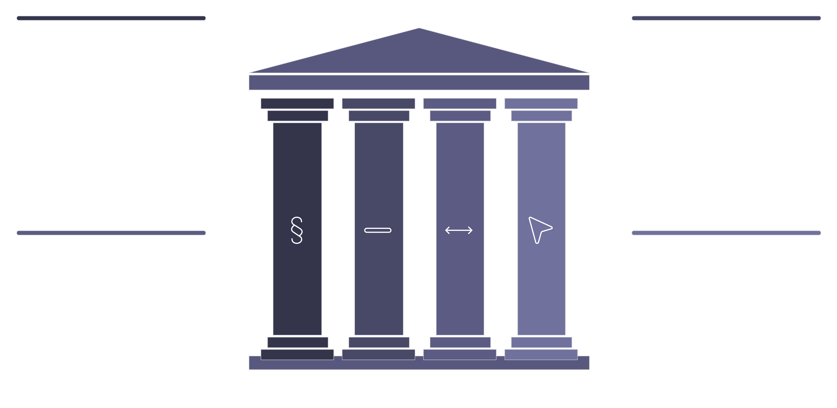
Recursive Chunking: The Recommended Approach
RecursiveCharacterTextSplitter from LangChain is the industry-standard starting point. It tries to preserve semantic boundaries by attempting splits in this order:
Try Paragraphs
Then Lines
Prefer paragraph breaks to keep context
Split at line breaks when needed
Then Words
Then Characters
Use word boundaries to refine chunks
Last resort: split by characters
Only if a split at a higher level produces a chunk that is still too large does it fall back to the next level. This gives you size-controlled chunks that respect natural language boundaries as much as possible.

Slide 32

Two Key Parameters: chunk_size and chunk_overlap
chunk_size = 300
chunk_overlap = 50
Maximum number of characters per chunk.
Too small: Chunks lack context — "15 days" with no surrounding explanation.
Too large: Chunks mix multiple topics, weakening the embedding signal.
How many characters the end of one chunk shares with the start of the next.
Without overlap, a sentence that spans a chunk boundary gets split. Overlap ensures that boundary context appears in both adjacent chunks, preventing information loss.
Start with chunk_size=300, chunk_overlap=50. Tune based on your document structure and retrieval quality. These are not magic numbers.

Slide 33
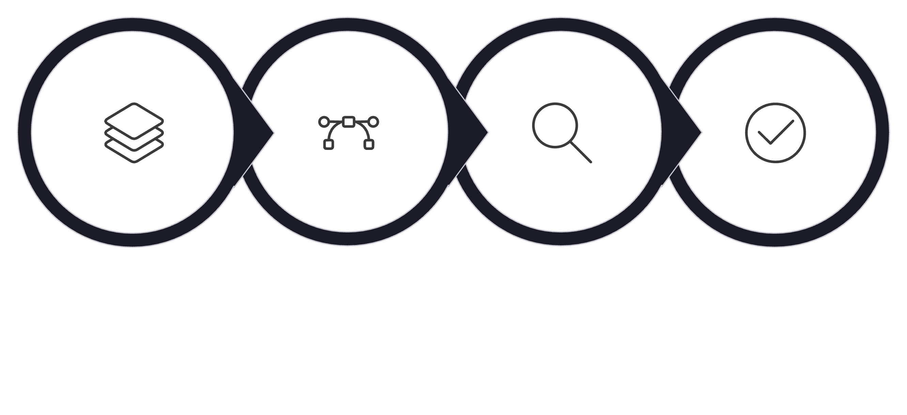
Why Chunking Quality Matters So Much
Good Chunking
Good Embeddings
Good Retrieval
Good Answers
Chunking is upstream of everything. A poorly chunked document cannot be saved by a better embedding model or a smarter LLM. Garbage in, garbage out. Always inspect your chunks visually before proceeding.

Slide 34

VS CODE
Over to VS Code — RecursiveCharacterTextSplitter
Install LangChain's text splitters and chunk our extracted document text.
from langchain.text_splitter import RecursiveCharacterTextSplitter
splitter = RecursiveCharacterTextSplitter(
chunk_size=300,
chunk_overlap=50
)
chunks = splitter.split_text(full_text)
print(f"Total chunks: {len(chunks)}")
print(f"\n--- Chunk 0 ---\n{chunks[0]}")
print(f"\n--- Chunk 1 ---\n{chunks[1]}")
Inspect several chunks. Do they make sense on their own? Would they be useful if retrieved in isolation? This is your quality check before proceeding to embeddings.

Slide 35
PART 6
EMBEDDING THE CHUNKS
Part 6
Embedding the Chunks
Converting every chunk of our document into a searchable vector.

Slide 36

From Chunks to Vectors: The Index
Now we apply the embedding model to every chunk. The result is our vector index — a list of (chunk_text, vector) pairs. This is the searchable knowledge base for all future queries.
Text Chunks
Embedding Model
Vector Index
This step runs once per document. In production systems, you'd store these vectors in a dedicated vector database (FAISS, Chroma, Pinecone). For now, we'll keep them in memory as a Python list.

Slide 37

VS CODE
Over to VS Code — Embedding All Chunks
We embed all chunks in a single API call — the OpenAI API accepts a list as input, making this efficient.
def embed_chunks(chunks):
response = client.embeddings.create(
model="text-embedding-3-small",
input=chunks # Send all chunks at once
)
embeddings = [item.embedding for item in response.data]
return embeddings
chunk_embeddings = embed_chunks(chunks)
# Build our searchable index
chunk_index = list(zip(chunks, chunk_embeddings))
print(f"Indexed {len(chunk_index)} chunks")
print(f"Each vector has {len(chunk_index[0][1])} dimensions")
Be mindful of API costs. For large documents, batch your calls. For this exercise, the full handbook will cost a fraction of a cent.

Slide 38
PART 7
RETRIEVAL
Part 7
Retrieval
Finding the most relevant chunks for any given user question.

Slide 39
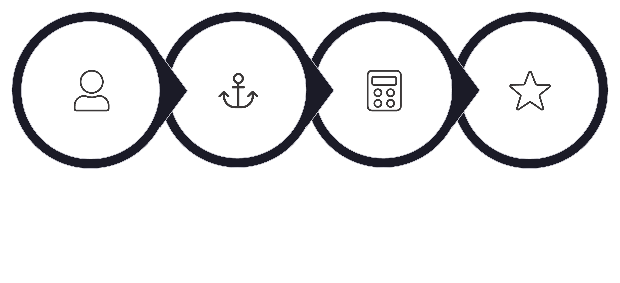
The Retrieval Pipeline
Every time a user asks a question, we run this four-step process. It happens in milliseconds and is the entire value proposition of the R in RAG.
User Question
Embed Question
Compute Cosine
Return Top-3
Notice that we embed the question using the same model (text-embedding-3-small) that we used for the chunks. This is essential — the vectors must live in the same semantic space to be comparable.

Slide 40
Top-K Retrieval
We don't return all matching chunks — only the top K by similarity score. Passing too many chunks into the prompt introduces noise and inflates costs.
Why K = 3?
Example Retrieval Result
For most HR policy questions, the answer lives in 1–2 chunks. Retrieving 3 gives a safety margin without flooding the prompt with irrelevant content.
Rank 1 — Score: 0.92
Rank 2 — Score: 0.81
Notice Period Policy — Intern rules
Exit Process — General procedures
Rank 3 — Score: 0.74
Intern Guidelines — General conduct

Slide 41
VS CODE
Over to VS Code — Retrieving Top Chunks
Embed the user's question, compute similarity against every indexed chunk, sort, and return the top K results.
def retrieve_top_chunks(question, chunk_index, k=3):
# 1. Embed the question
q_embedding = client.embeddings.create(
model="text-embedding-3-small",
input=question
).data[0].embedding
# 2. Score every chunk
scores = []
for chunk_text, chunk_vec in chunk_index:
score = cosine_similarity(q_embedding, chunk_vec)
scores.append((chunk_text, score))
# 3. Sort and return top-k
scores.sort(key=lambda x: x[1], reverse=True)
return scores[:k]
results = retrieve_top_chunks(
"What is the notice period for interns?",
chunk_index
)
for text, score in results:
print(f"Score: {score:.4f}\n{text}\n")

Slide 42
PART 8
GENERATION
Part 8
Generation
Using the retrieved context to produce a grounded, accurate answer.

Slide 43
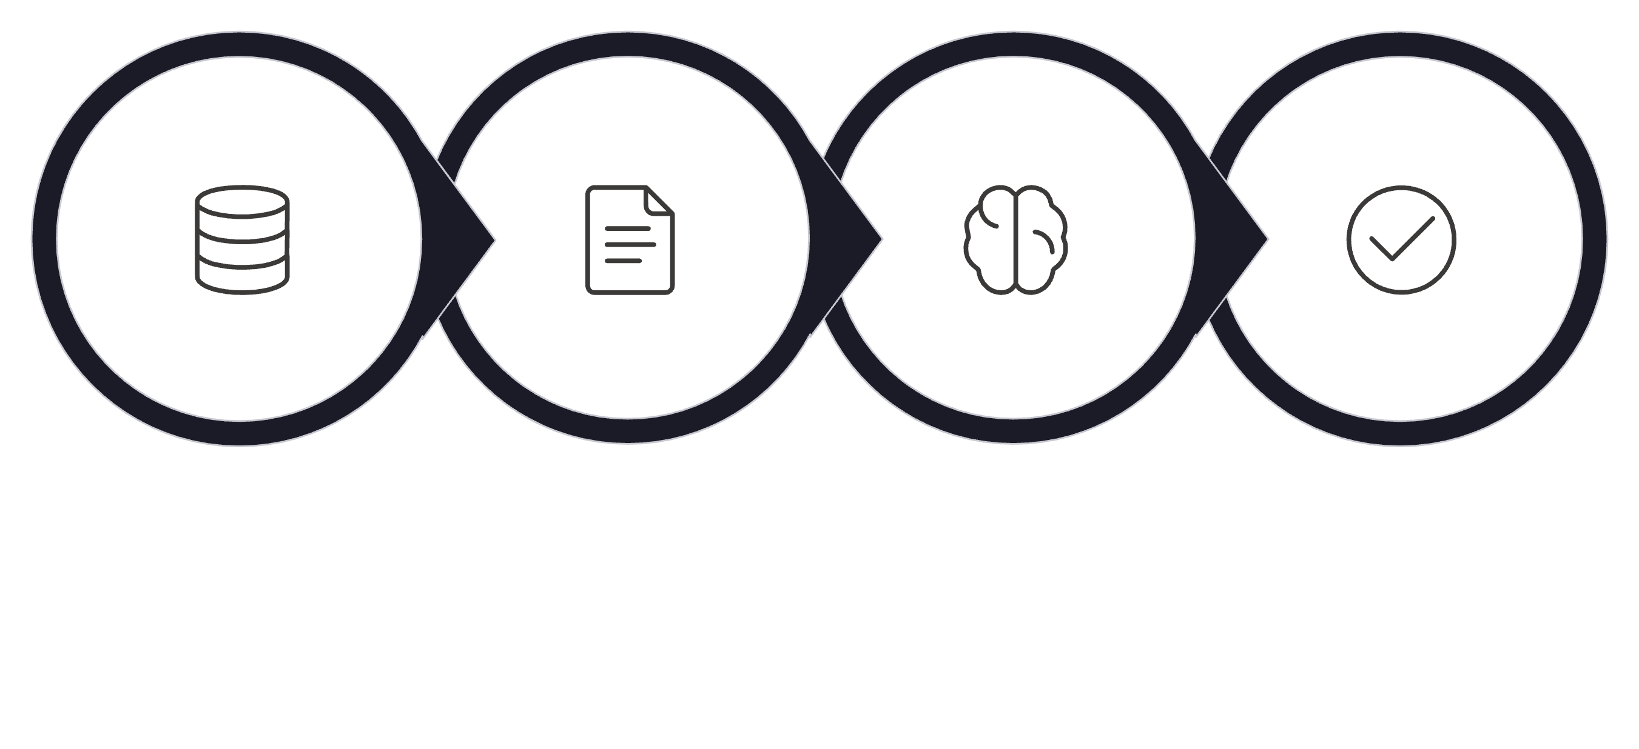

Retrieval Is Not the End
We've found the right chunks. But raw retrieved text is not an answer — it's evidence. We now need the LLM to read that evidence and synthesize a clear, coherent response.
Retrieve Chunks
LLM Reads Context
Produce Answer
Build Context
The LLM's role in RAG is not to recall from memory. It is to read and reason over the provided context. This is a fundamentally different task from open-ended generation.

Slide 44

Building the Prompt: Context + Question
A well-structured RAG prompt has two parts: the retrieved context and the user's question. How you frame the instructions to the LLM significantly affects answer quality.
SYSTEM PROMPT:
You are an HR policy assistant for our company.
Answer the user's question using ONLY the information
provided in the context below.
If the answer is not found in the context, respond with:
"This information is not available in the provided documents."
Do not use any outside knowledge.
USER PROMPT:
Context:
---------
{chunk_1}
{chunk_2}
{chunk_3}
---------
Question: {user_question}
The key instruction: "Answer using ONLY the provided context." This constraint is what prevents hallucinations and keeps responses grounded in your documents.

Slide 45
VS CODE
Over to VS Code — Full Generation Step
Combine the retrieved chunks into a context string and call the Chat Completions API.
def generate_answer(question, chunk_index, k=3):
# Retrieve relevant chunks
top_chunks = retrieve_top_chunks(question, chunk_index, k)
context = "\n\n".join([text for text, _ in top_chunks])
# Build and send the prompt
response = client.chat.completions.create(
model="gpt-4o-mini",
messages=[
{"role": "system", "content": (
"You are an HR policy assistant. Answer using ONLY "
"the provided context. If the answer is not there, "
"say: 'Not found in the provided documents.'"
)},
{"role": "user", "content": (
f"Context:\n{context}\n\nQuestion: {question}"
)}
]
)
return response.choices[0].message.content
answer = generate_answer(
"What is the notice period for interns?",
chunk_index
)
print(answer)

Slide 46
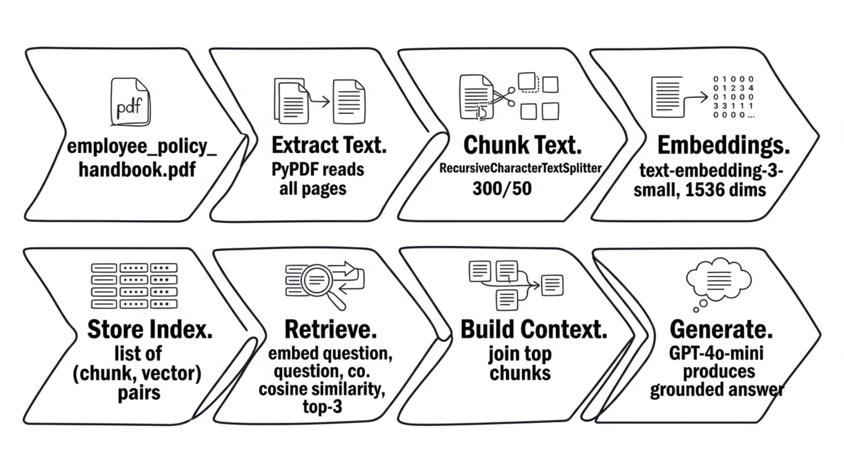

The Complete Vanilla RAG Pipeline
You've now built every piece. Here is the full end-to-end architecture from PDF to answer.
Each stage has one clear responsibility. This separation makes the system easy to debug, replace components in, and extend.

Slide 47
PART 9
WHY RAG FAILS
Part 9
Why RAG Fails
Understanding failure modes is as important as understanding success cases.

Slide 48
Common RAG Failure Cases
RAG is not magic. Each stage in the pipeline can fail independently. Here are the four most common failure modes you'll encounter in practice.
1. Retrieval Failure
2. Bad Chunking
The right chunk exists but isn't retrieved. Usually caused by poor embeddings, mismatched phrasing, or an incorrect k value. Fix: inspect similarity scores and lower the threshold.
The answer is split across a chunk boundary. One chunk has "interns must serve" and another has "15 days" — neither alone is useful. Fix: increase chunk_overlap or adjust chunk_size.
3. Context Pollution
4. Hallucination Despite RAG
Irrelevant chunks are retrieved alongside the correct one. The LLM gets confused by contradictory or unrelated content. Fix: tighten retrieval with a similarity threshold filter.
The LLM ignores the provided context and answers from memory. Usually a prompting problem. Fix: strengthen the system prompt constraint and use a lower-temperature model.

Slide 49

RAG Debugging Checklist
When your RAG system gives a wrong answer, work through this checklist stage by stage. The bug is almost always isolated to one step.
01
What We Intentionally Skipped
This module focused on the core concepts. These tools are wrappers around the same ideas:
• Vector Stores: FAISS, Chroma, Pinecone
• Semantic Chunking
• Re-ranking
• Hybrid Search
Understand retrieval first. Tools can come later.
Check extracted text
Is the answer actually in the raw extracted text? Print and confirm.
02
Check chunks
Does any single chunk contain the complete answer? Check chunk boundaries.
03
Check embeddings
Are embeddings being created without errors? Check dimensions and values.
04
Check retrieval
Is the correct chunk in the top-K results? Print scores and inspect.
05
Check prompt & answer
Is the context being passed correctly? Is the system prompt constraining hallucination?

Slide 50
FINAL EXERCISE
Build the Employee Policy Chatbot
Your final exercise is to combine everything from this module into a working interactive chatbot that answers questions from employee_policy_handbook.pdf.
PDF Loader
Chunking
Embeddings
Extract full text from the handbook using PyPDF
Split with RecursiveCharacterTextSplitter (300/50)
Embed all chunks with text-embedding-3-small
Retrieval
Prompt + Generation
Embed the question and fetch top-3 by cosine similarity
Build the context string and call GPT-4o-mini in a loop

Slide 51

Key Takeaways
LLMs need help with private knowledge
RAG is the standard pattern for grounding LLM responses in your own documents.
Embeddings enable semantic search
Converting meaning to vectors lets you find relevant content even when the words don't match.
Chunking quality is upstream of everything
Bad chunks produce bad embeddings, bad retrieval, and bad answers. Inspect every stage.
Understand retrieval first, tools second
FAISS, Chroma, and Pinecone are optimizations of the same core ideas you built today.

