Slide 1

Building AI Agents
From LLMs → Tools → Decisions → Multi-Step AI Agents
MODULE 7
HANDS-ON TRAINING

Slide 2



THE STARTING POINT
From Answer to Action
Traditional LLM Application
The LLM can generate an answer — but can it?
Look up order 1001?
Check the refund policy?
Return Response
Calculate the refund amount?
Send Prompt
LLM Receives
Generate Text
Example:
User: "My order 1001 arrived damaged. Can I get a refund?"
LLM: "Yes, damaged products may be eligible for a refund."
Process the refund?
Escalate for human approval?
An AI Agent is not just an LLM generating text. It is an LLM participating in a workflow where it can decide and use capabilities.

Slide 3
CORE CONCEPT
LLM vs AI Agent
LLM — Generate Text
AI Agent — Execute Tasks
01
01
Understand input
Understand the task
02
02
Generate text response
Decide what action is needed
03
03
Return answer
Select and execute a tool
Summarizes, answers, extracts — but has no access to external systems or real-time data.
04
Observe the result
05
Repeat until task is complete
Key distinction: An LLM generates responses. An agent uses an LLM to make decisions within an execution workflow.

Slide 4
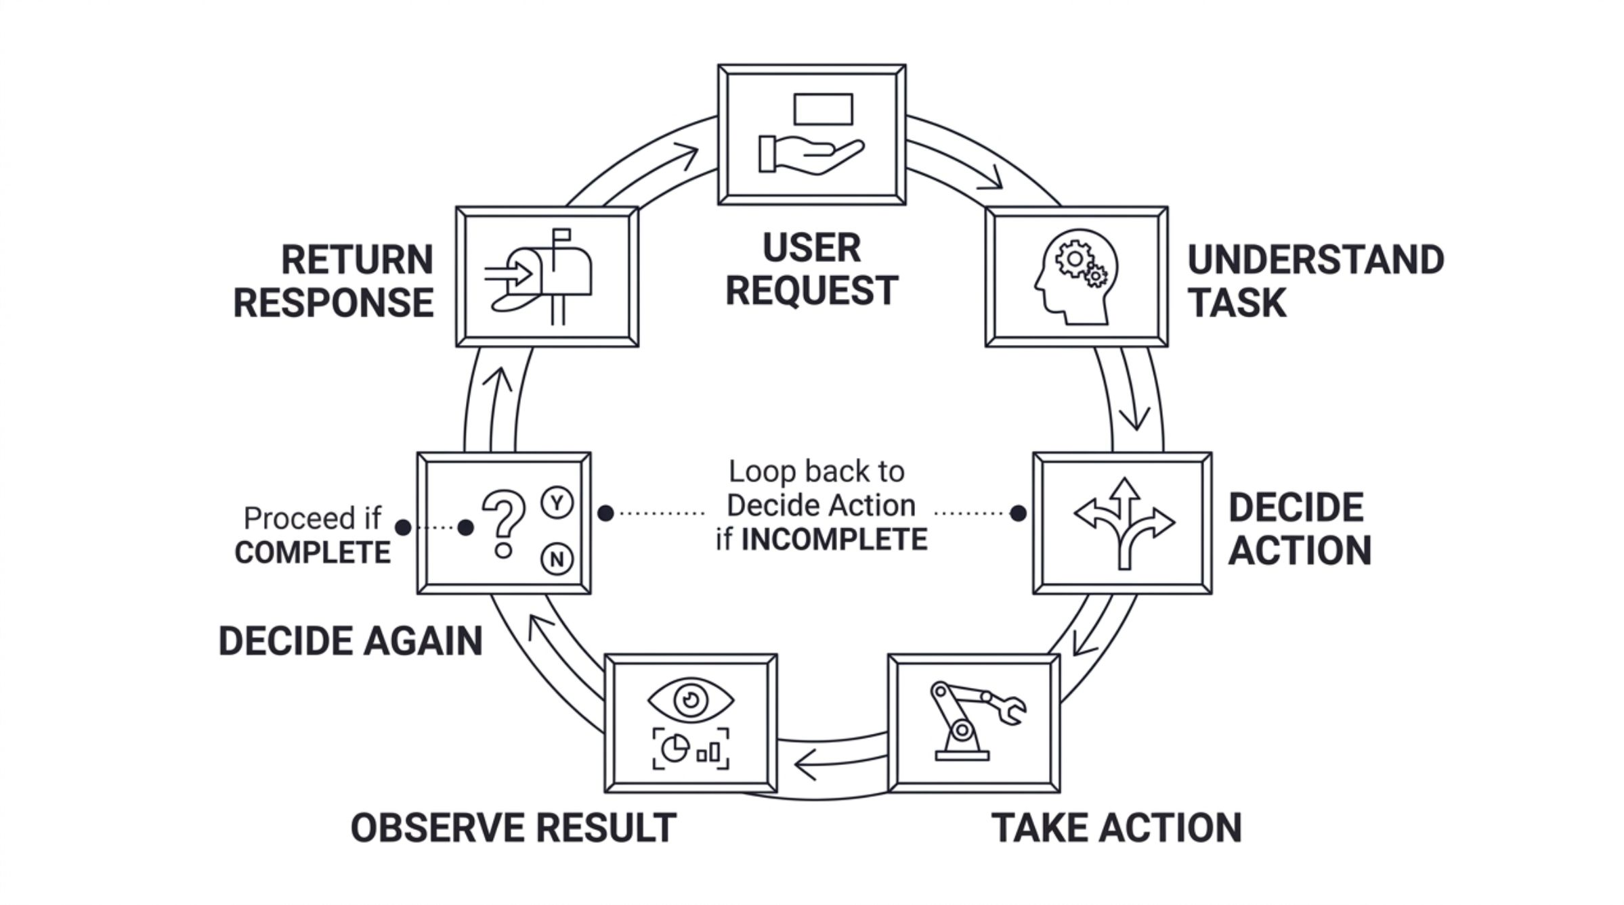

MENTAL MODEL
Think of an Agent as a Decision-Making Loop
The LLM is the decision-maker, not the executor. Your Python application is the execution environment, and tools are the capabilities exposed to the model. The loop continues until the task is resolved.
Agent = LLM + Tools + Execution Loop + State/Context + Control Logic

Slide 5
CAPABILITIES
Tools Give the Agent Capabilities
Without tools: "I don't have access to your order database."
With tools: The agent can look up orders, apply policy, calculate amounts, and process refunds — in sequence.
A tool is simply a capability that your application exposes to the model. The architecture is always the same: LLM → Tool Selection → Python Function → Result → Next Decision.
get_order()
get_customer()
Retrieve order details
Fetch customer profile
get_refund_policy()
calculate_refund()
Load business rules
Compute refund amount
process_refund()
Execute the refund

Slide 6
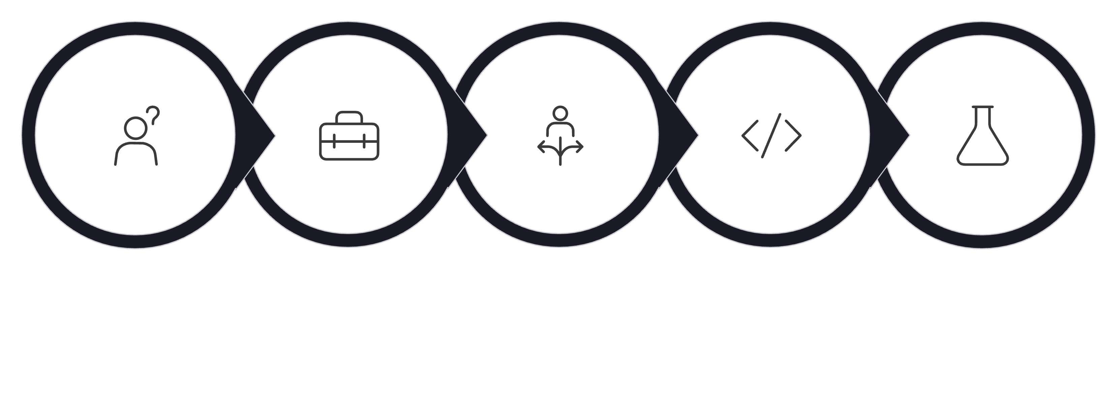
CORE MECHANISM
Tool Calling — What Actually Happens?
LLM gets tools
LLM selects tool
LLM returns call
App runs function
User asks
Critical distinction: The LLM does not directly execute your Python function. The model returns a structured tool call (e.g., get_order(order_id="1001")). Your application receives this, executes the corresponding function, and returns the result. The model then decides the next step. Understanding this boundary is fundamental to building reliable agents.

Slide 7
TOOL SOURCES
Two Ways Agents Get Capabilities
Built-In / Platform Tools
Custom Tools — Your Application
Web Search
File Search
get_order()
calculate_refund()
Real-time information retrieval
Search across uploaded documents
Your database, your logic
Your business rules
process_refund()
Computer Interaction
Your payment systems
Browser and OS automation
Functions you write in Python — exposed as capabilities.
Provided and managed by the platform or API provider.
The agent architecture is identical in both cases. The difference is only who provides the capability.

Slide 8
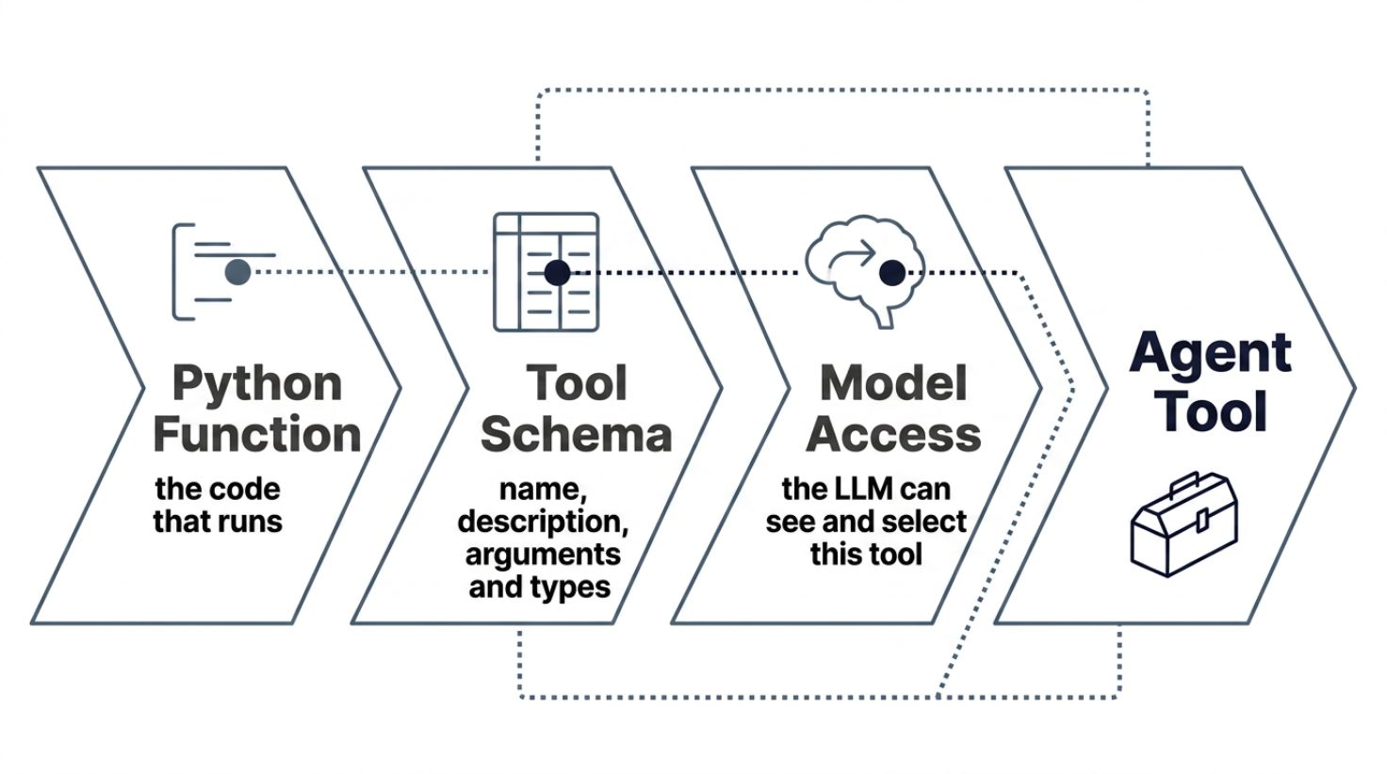
IMPLEMENTATION
A Custom Tool Starts as a Normal Python Function
The Python function you already write
The transformation
def get_order(order_id):
# Look up order in database
return order
Becomes an agent capability
get_order(
order_id="1001"
)
The model needs to know: the tool name, what it does, what arguments it accepts, and the argument types.
get_order(order_id)
Retrieve order details by ID
get_customer(customer_id)
Fetch customer profile
calculate_refund(amount, condition)
Compute eligible refund

Slide 9


TOOL SCHEMA
The Model Needs a Contract for Each Tool
Tool Definition: get_order
What each part does
Name
Description → WHAT the tool does
get_order
The LLM reads this to decide whether to use the tool
Description
Retrieve order details using an order ID.
Schema → WHAT inputs it expects
The LLM uses this to construct the correct arguments
Argument: order_id
Type: string — Required: yes
Python function → PERFORMS the action
Your application executes this and returns the result
Good tool descriptions and schemas are critical for reliable agent behavior. Vague descriptions lead to wrong tool selection.

Slide 10

HANDS-ON TRANSITION
Over to VS Code
Let's turn a normal Python function into an agent capability
1
Create a simple Python function
get_order(order_id)
2
Define what the function does and its inputs
3
Expose it as a tool and provide it to the LLM
4
Ask the LLM to decide whether to use it
5
Execute the tool — return the result to the model
Open the IPYNB notebook for the full implementation. We will follow the same flow there.

Slide 11

MULTI-TOOL
The Real Power: Multiple Tools
User: "My order 1001 arrived damaged. Can I get a refund?"
CUSTOMER
get_customer()
Approval Needed?
Decision: auto or escalate
ORDER
Calculate Refund
get_order()
Compute refundable amount
Load Policy
POLICY
Fetch refund rules
get_refund_policy()
Get Order
Retrieve order 1001 details
CALCULATION
The agent selects the next tool based on the current information — not a fixed script. This is where an LLM becomes valuable as a dynamic decision-maker.
calculate_refund()
ACTION
process_refund()

Slide 12

EXECUTION FLOW
Agents Don't Just Call One Tool
Each tool result informs the next decision. Follow the actual refund scenario step by step:
Step 1: get_order("1001")
Step 3: calculate_refund(₹1800, damaged)
Product: MacBook Pro
Amount: ₹1800
Condition: damaged
Refund amount: ₹1800
1
2
3
4
Step 2: get_refund_policy()
Step 4: Decision
Damaged products: eligible
Refunds > ₹1000: require human approval
₹1800 > ₹1000 → human approval required before processing
The critical concept is not the number of tools — it is that the result of one action directly influences the next action. This is dynamic reasoning.

Slide 13
STATE & MEMORY
How Does the Agent Remember What Happened?
The agent needs access to information from all previous steps when making each new decision. The application maintains this context and includes it with every call to the LLM.
In the refund example
01
What state/context can contain:
Order 1001 → damaged MacBook Pro, ₹1800
02
User Request
Previous Tool Calls
Policy → refunds > ₹1000 require approval
The original intent
What was already tried
03
Tool Results
Intermediate Decisions
Refund = ₹1800 → approval required
Data retrieved so far
Reasoning so far
All of this must be available to the LLM when it decides what happens next.
Current Task Status
Complete or in progress
Agent state is the information required to continue the workflow correctly.

Slide 14





SAFETY
Guardrails — LLM Decisions Need Application Control
The Problem
The Safer Architecture
LLM says
Decision & Escalation
Allow to run or human review
"Refund approved."
Guardrail Evaluation
Business rules check policy
App Receives Suggestion
Python service ingests request
Business policy says
LLM Suggests Action
Provides suggested operation
Refunds > ₹1000 require human approval.
Do not rely solely on the LLM to enforce:
Financial limits and authorization rules
Permissions and compliance requirements
Critical business logic
LLMs can make decisions — but deterministic business rules must enforce critical constraints. Never delegate compliance to a probabilistic model.

Slide 15

HUMAN OVERSIGHT
When Should a Human Take Over?
Refund Policy Example
Human-in-the-Loop is appropriate when:
≤ ₹1000
Financial impact is high
Automatic — no approval needed
Action is irreversible
> ₹1000
Authorization is explicitly required
Human approval required before processing
Risk level is elevated
Calculate Refund
Business policy mandates approval
Guardrail Check
Human Approval
Agentic systems should know exactly where autonomy ends.

Slide 16

BEST PRACTICES
Agents Are Powerful — But Not Automatically Reliable
Limitation
Best Practice
Hallucinated decisions
Ground decisions in tool results and trusted data
Wrong tool selection
Use clear tool names, descriptions, and schemas
Incorrect arguments
Validate tool inputs before execution
Infinite or unnecessary loops
Set step limits and explicit termination conditions
Unsafe actions
Use permissions, guardrails, and human approval
Unnecessary complexity
Use deterministic code where rules are deterministic
Poor tool design
Keep tools focused, single-purpose, and well-named
Use agents where dynamic decision-making genuinely adds value — not simply because an LLM is available.

Slide 17

HANDS-ON TRANSITION
Over to IPYNB — Build the Agent
Let's implement the concepts we just learned, step by step
Part 1: Basic LLM
Single prompt → response
Part 2: Single Tool
Define, expose, call one tool
Part 3: Multiple Tools
Agent selects from a toolkit
Part 4: Tool Calling Loop
Repeat until task resolves
Part 5: Results → Next Decision
Context-driven reasoning
Part 6: Guardrails
Application-level enforcement
Part 7: Human-in-the-Loop
Approval flow integration
Implemented entirely in Python + OpenAI API — no frameworks required. Scenario: "My order 1001 arrived damaged. Can I get a refund?"

Slide 18
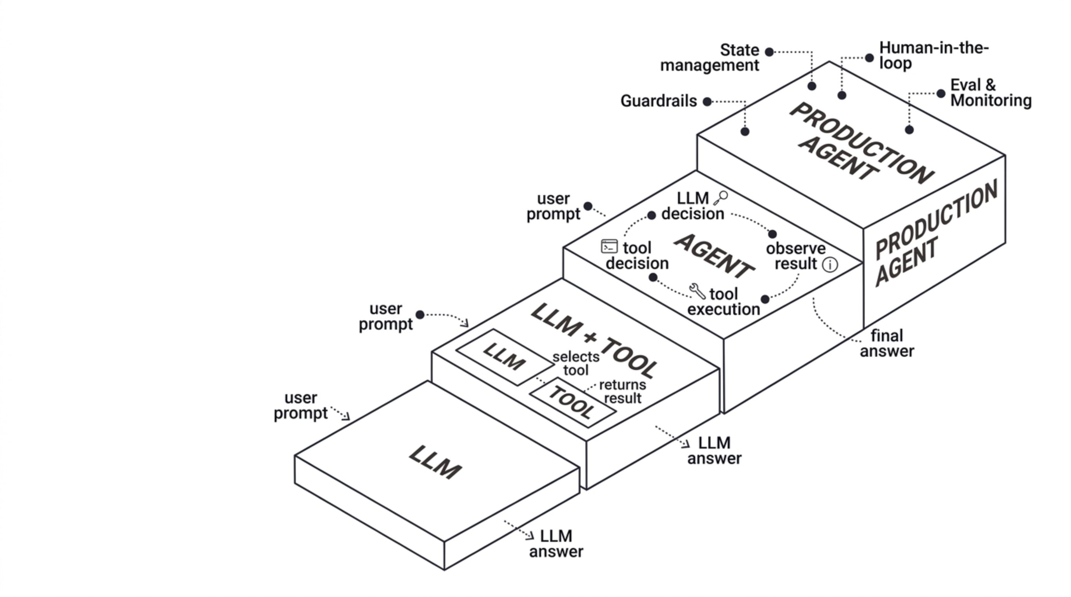
MODULE SUMMARY
From LLM to Agent
Agentic systems are not magic. They are orchestrated systems built from understandable components.

Slide 19






COURSE PROJECT
Putting It All Together: Customer Support Agent
Every concept from this module comes together in the existing Customer Support Agent project. You now have the vocabulary and mental model to understand exactly what is happening inside it.
The architecture you now understand
Customer
AI Agent
LLM decision-making
Request received
Decides and acts
Tools
Guardrails
Tool calling mechanism
Orders · Policies · Data
Business rules enforced
Custom tools from Python functions
Human Approval
When required
Multi-step workflows with context
Guardrails and business rules
Human-in-the-loop approval
Now you can recognize what is happening inside an AI Agent — and build the core architecture yourself.

