Slide 1
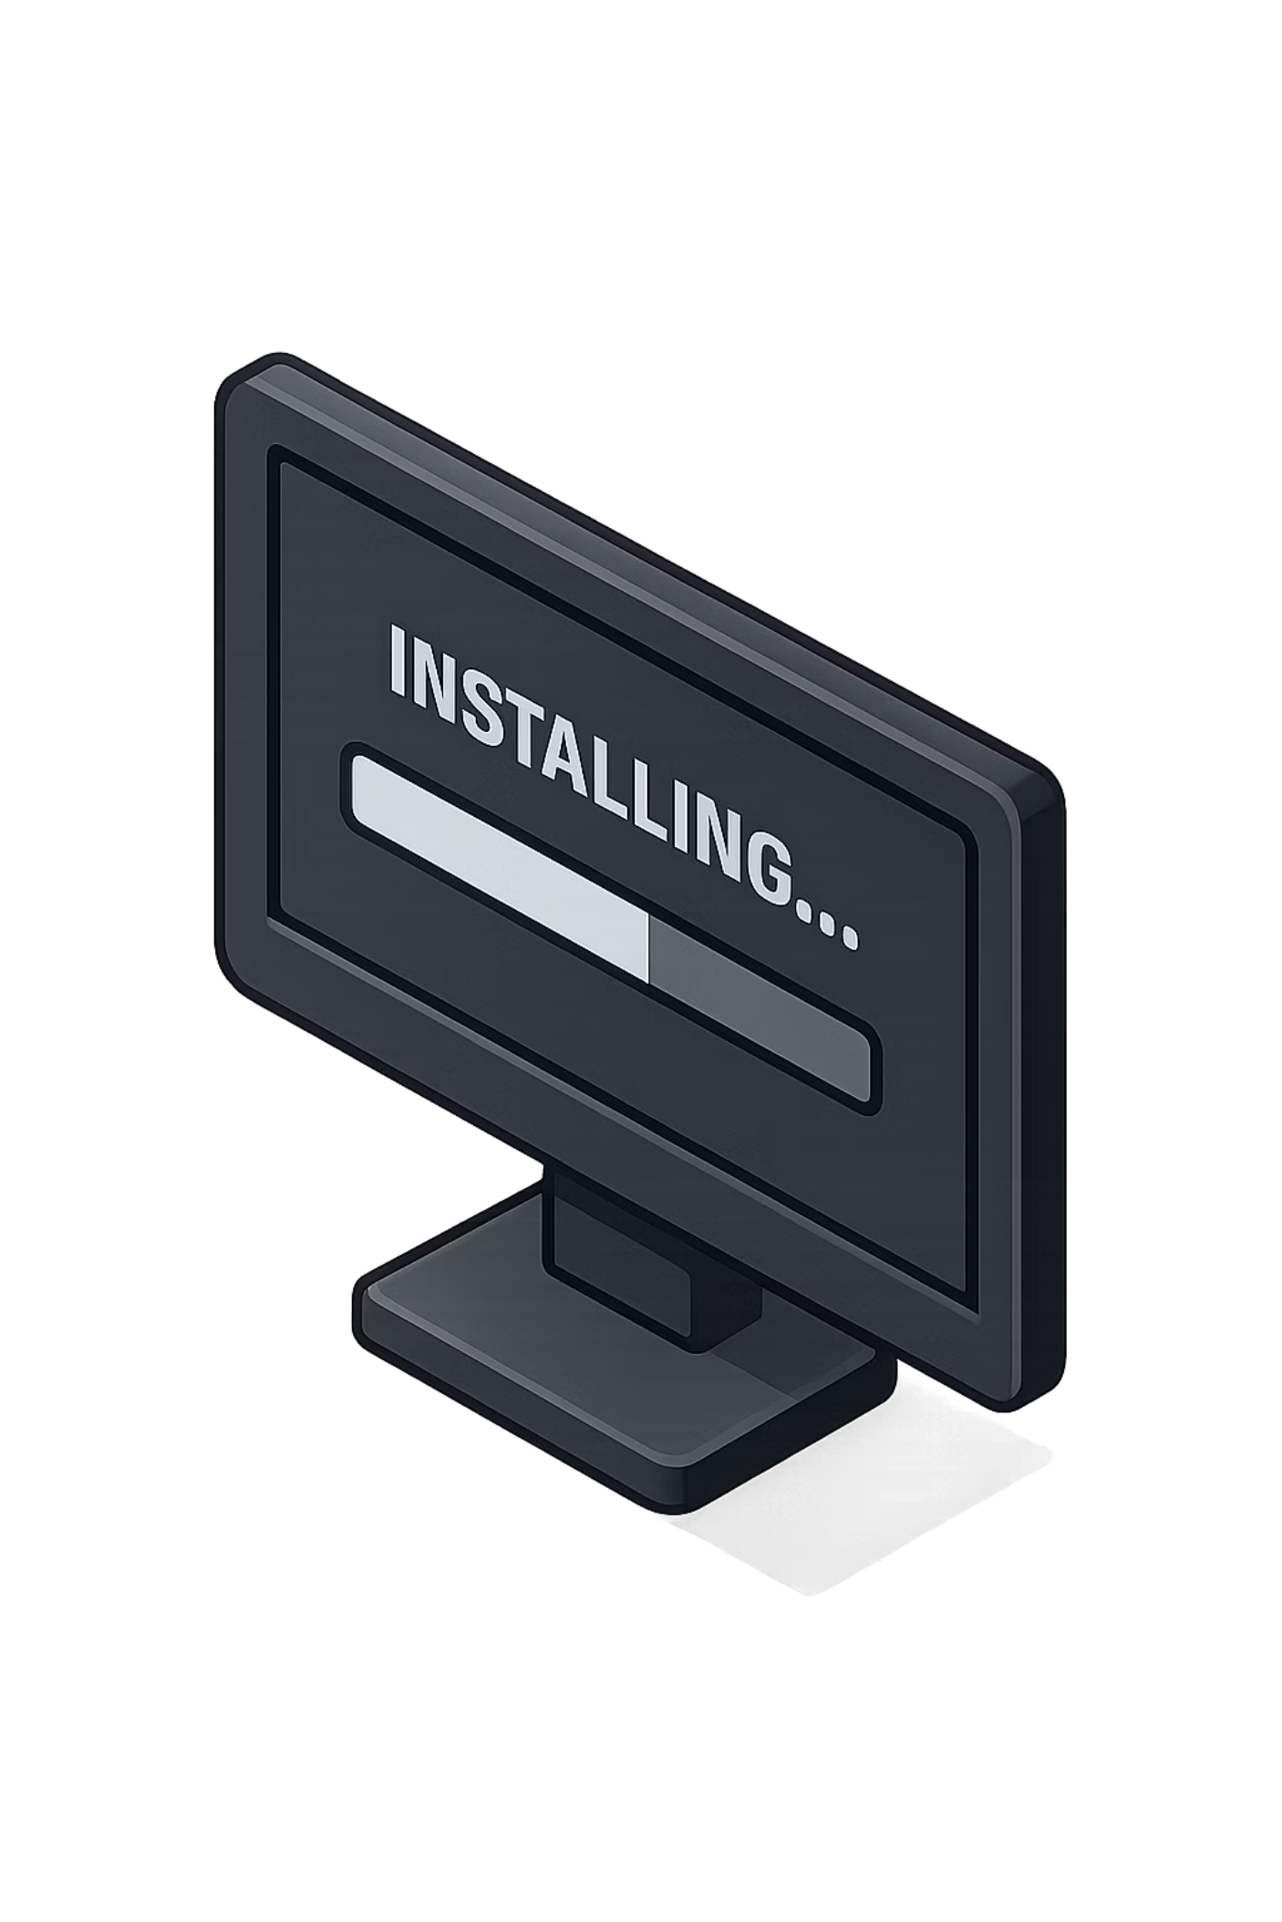
PART 5
Installing Docker
Before writing a Dockerfile, Docker Desktop needs to be installed and running on your machine. Let's get set up.

Slide 2

PART 5 · SLIDE 28
Docker Installation — Windows
Installation Steps
Verify in Terminal
01
$ docker --version
Docker version 24.0.5,
build ced0996
Download Docker Desktop
Visit docker.com and download Docker Desktop for Windows.
02
Run the Installer
If you see a version number, Docker is installed and working correctly. If the command is not found, restart your terminal or machine after installation.
Double-click the installer and follow the setup wizard prompts.
03
Enable WSL2
When prompted, enable WSL2 (Windows Subsystem for Linux). This is required for Docker to run on Windows.
04
Verify Installation
Open a terminal and run docker --version.

Slide 3

PART 5 · SLIDE 29
Docker Installation — Mac
Installation Steps
Verify in Terminal
01
$ docker --version
Docker version 24.0.5,
build ced0996
Download Docker Desktop
Visit docker.com and download Docker Desktop for Mac. Choose the correct chip version — Intel or Apple Silicon (M1/M2/M3).
02
Make sure Docker Desktop is running (the whale icon is visible in the menu bar) before using any Docker commands. Commands will fail if Docker isn't started.
Install the Application
Open the .dmg file and drag Docker to your Applications folder.
03
Start Docker
Open Docker from Applications. Wait for the Docker whale icon to appear in your menu bar and stop animating.
04
Verify Installation
Open a terminal and run docker --version.

Slide 4


PART 5 · SLIDE 30
Verifying Your Docker Installation
Use these two commands to confirm Docker is installed and running correctly before proceeding. Both should return output without any errors.
Check Version
Run Hello World
docker --version
docker run hello-world
Expected output: Docker version 24.x.x, build xxxxxxx
Confirms Docker is installed and accessible in your terminal.
Expected output: Hello from Docker!
Confirms Docker can pull images and run containers end-to-end. This is the simplest possible container test.
If both commands succeed, your Docker installation is complete and ready to use. Proceed to the Dockerfile section.

Slide 5

PART 6
The Dockerfile
The Dockerfile is where everything comes together. It's the recipe that tells Docker exactly how to build your application's image.

Slide 6
PART 6 · SLIDE 31
What Is a Dockerfile?
A Dockerfile is a plain text file named exactly

Slide 7

PART 6 · SLIDE 32
Dockerfile Structure — A Real Example
Here is the complete Dockerfile for a FastAPI application. Every line has a specific purpose, and together they define everything needed to run the application inside a container.
# Use Python 3.11 as the base image
FROM python:3.11
# Set the working directory inside the container
WORKDIR /app
# Copy all project files into the container
COPY . .
# Install Python dependencies
RUN pip install -r requirements.txt
# Start the FastAPI server when the container runs
CMD ["uvicorn", "backend:app",
"--host", "0.0.0.0",
"--port", "8000"]
This is a complete, working Dockerfile. Save it as Dockerfile (no extension) in the root of your project. That's all you need to build a Docker image.
Each instruction in a Dockerfile creates a layer in the image. Docker caches these layers, so unchanged steps don't need to be rerun — making rebuilds fast.

Slide 8
PART 6 · SLIDE 33
Understanding Each Dockerfile Instruction
FROM
Sets the base image to build on top of. FROM python:3.11 starts with an official Python 3.11 image from Docker Hub — a minimal Linux OS with Python pre-installed.
WORKDIR
Sets the working directory inside the container. All subsequent commands run from this path. WORKDIR /app creates and navigates to /app.
COPY
Copies files from your local machine into the container. COPY . . copies everything from your current folder into the container's /app directory.
RUN
Executes a shell command during the build process. RUN pip install -r requirements.txt installs all Python dependencies into the image.
CMD
Defines the default command to run when a container starts. Unlike RUN, CMD executes at runtime, not at build time. Only one CMD is allowed per Dockerfile.

Slide 9
PART 6 · SLIDE 34
Why the Dockerfile Matters
The Dockerfile is the central document that makes Docker so powerful. It explicitly defines everything that was previously implicit, informal, or undocumented about your application's environment.
Defines the Environment
Declares Dependencies
Specifies the Startup Command
The exact OS base, Python version, and system configuration are declared explicitly — no more guesswork about what version to install.
All required libraries are installed automatically during the build. Anyone with the Dockerfile gets the same dependencies — guaranteed.
The exact command to start the application is built into the image. No README required. No manual steps. The container just starts.

Slide 10
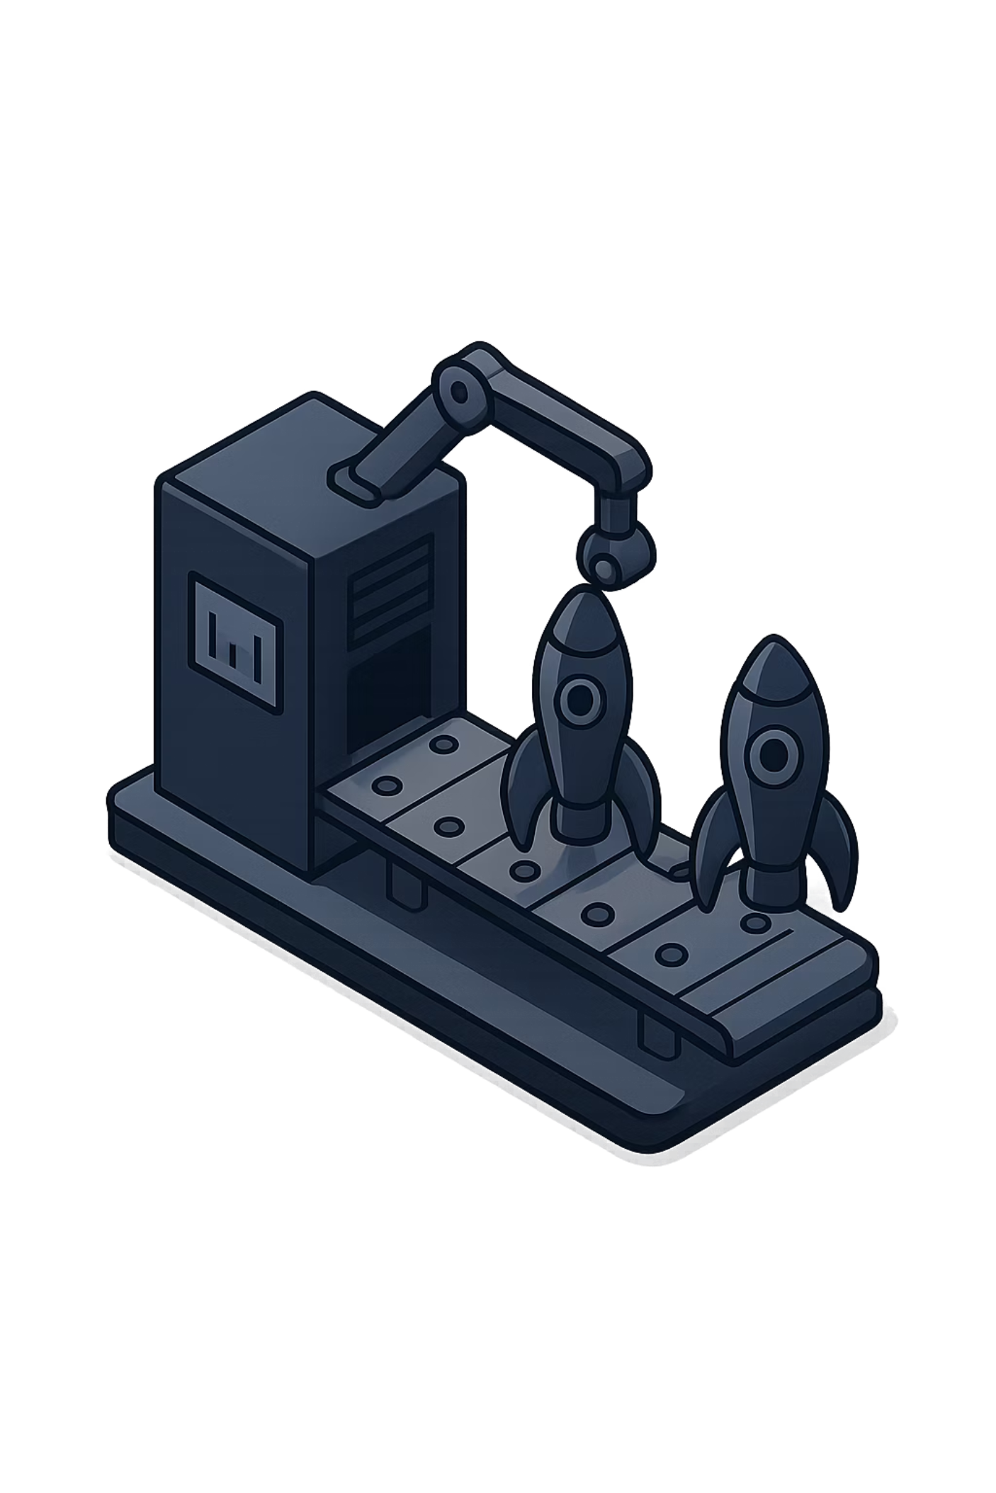
PART 7
Building Images
With a Dockerfile in place, you're ready to build your first Docker image. This is where your instructions become a portable, runnable package.

Slide 11
PART 7 · SLIDE 35
What Is a Docker Image?
A Docker image is a packaged, portable snapshot of your application and its entire environment. It is built from your Dockerfile and contains everything needed to run your application — code, runtime, libraries, environment variables, and configuration.
Images are immutable — once built, they don't change. If you need to update the application, you build a new image. This immutability is what guarantees consistent behavior across every environment.
What's Inside an Image
Base operating system layer
Python 3.11 runtime
Installed packages from requirements.txt
Your application source code
The startup command (CMD)

Slide 12
PART 7 · SLIDE 36
Building a Docker Image
Command
Build Output
docker build -t email_router .
$ docker build -t email_router .
[1/4] FROM python:3.11
[2/4] WORKDIR /app
[3/4] COPY . .
[4/4] RUN pip install -r requirements.txt
Successfully built a8f3c91d2b11
Successfully tagged email_router:latest
Breaking It Down
docker build
-t email_router
Tells Docker to build a new image.
Tags the image with the name email_router for easy reference later.
Each numbered step corresponds to a Dockerfile instruction. Docker executes them in order, caching each layer.
. (dot)
Tells Docker to look for the Dockerfile in the current directory.

Slide 13

PART 7 · SLIDE 37
Where Is the Image Stored?
After a successful build, the image is stored locally inside Docker Engine on your machine — not as a file you can browse to in Finder or Explorer, but in Docker's internal image store managed by the Docker daemon.
To see all locally stored images, run:
Example Output
REPOSITORY TAG IMAGE ID
email_router latest a8f3c91d2b11
python 3.11 4a7a1f401734
hello-world latest 9c7a54a9a43c
docker images
Each row is a stored image. REPOSITORY is the name, TAG is the version label (default: latest), and IMAGE ID is the unique identifier.
Images stay stored locally until you explicitly delete them with docker rmi image_name. Large images can take up significant disk space over time.

Slide 14
PART 7 · SLIDE 38
Viewing Your Docker Images
The docker images command is your inventory of everything Docker has built or pulled on your machine. Get familiar with reading this output.
REPOSITORY
TAG
IMAGE ID
SIZE
email_router
latest
a8f3c91d
185MB
python
3.11
4a7a1f40
912MB
hello-world
latest
9c7a54a9
13.3kB
REPOSITORY
TAG
The name given to the image with -t during docker build.
Version label. Defaults to latest when not specified explicitly.
IMAGE ID
SIZE
A unique hash identifying this exact image build.
Disk space used by the image on your local machine.

Slide 15
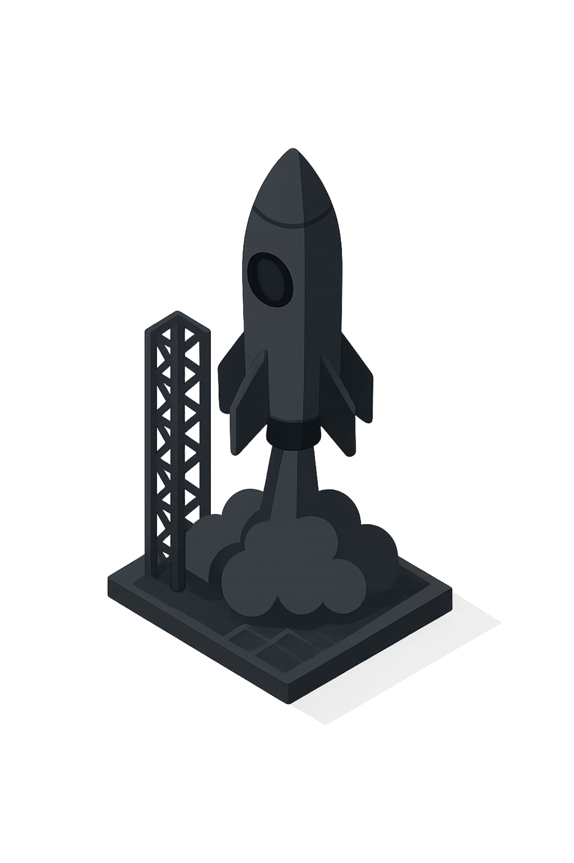
PART 8
Running Containers
An image is just a blueprint. A container brings it to life. Let's start our application and see Docker in action.

Slide 16
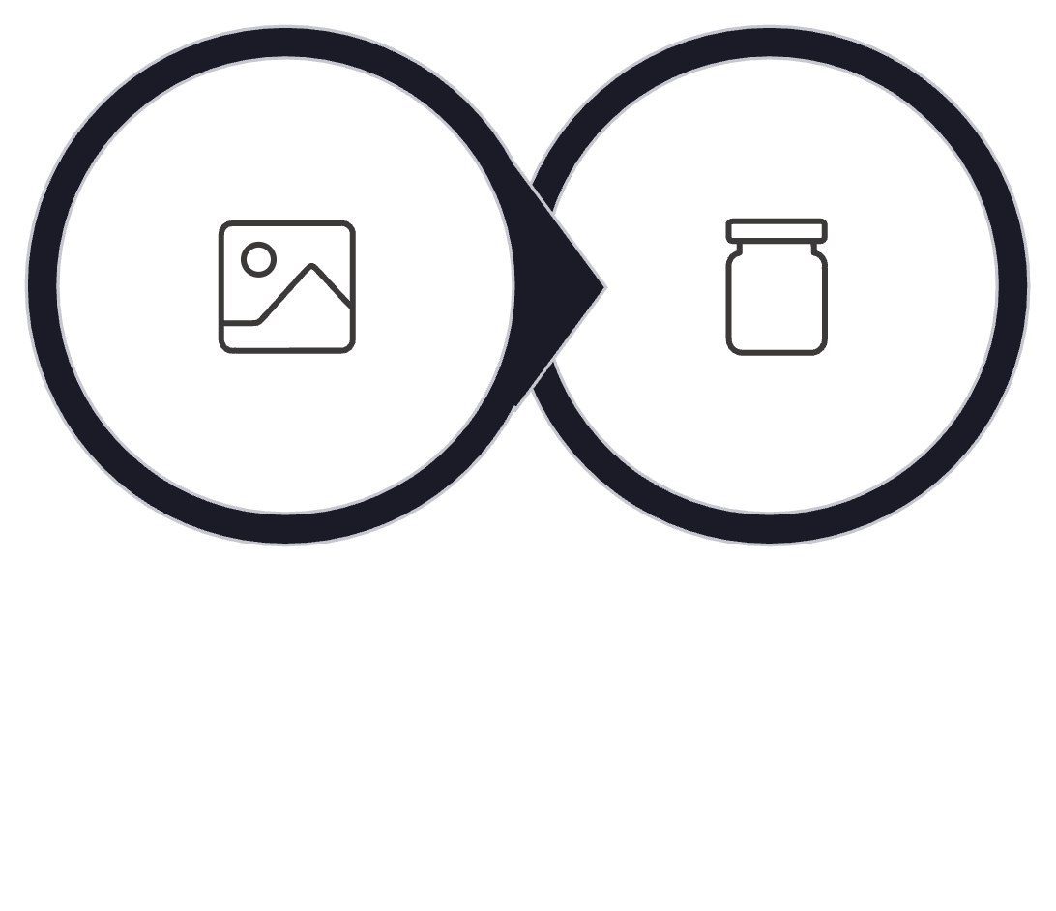
PART 8 · SLIDE 39
What Is a Docker Container?
A Docker container is a live, running instance of an image. When you run a container, Docker takes the image (the static blueprint) and executes it as an isolated process on your machine.
The container is isolated — it has its own filesystem, its own network stack, and its own processes. It cannot interfere with other containers or the host machine, making it safe and predictable.
You can run multiple containers from the same image simultaneously. Each is completely independent of the others.
Docker Container
Docker Image
The transition from image to container takes only seconds. Docker reads the image, creates an isolated environment, and starts executing the CMD instruction defined in the Dockerfile.

Slide 17
PART 8 · SLIDE 40
Running a Container
Command
Expected Output
docker run -p 8000:8000 email_router
$ docker run -p 8000:8000 email_router
INFO: Started server process [1]
INFO: Waiting for application startup.
INFO: Application startup complete.
INFO: Uvicorn running on
http://0.0.0.0:8000
Breaking It Down
docker run
-p 8000:8000
Creates and starts a new container from an image.
Maps port 8000 on your machine to port 8000 inside the container. This is how you access the application from your browser.
Open your browser and navigate to http://localhost:8000 — your FastAPI application is live inside a Docker container.
email_router
The name of the image to run (set during docker build -t).

Slide 18
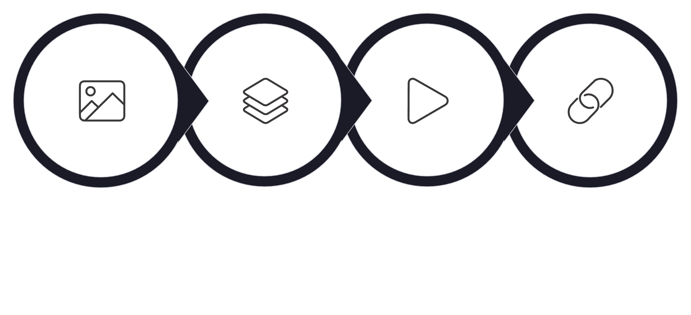
PART 8 · SLIDE 41
What Happens Internally When You Run a Container
When docker run is executed, Docker performs a sequence of operations in the background to bring your application to life inside an isolated environment.
Create Container
Read Image
Start FastAPI
Map Ports
Creates Container
Starts FastAPI
Maps Ports
Docker creates a new isolated filesystem layer on top of the image.
Docker executes the CMD from the Dockerfile — starting the Uvicorn server.
The -p flag bridges the container's internal port to your machine's port, making the app accessible in your browser.

Slide 19

PART 8 · SLIDE 42
Viewing Running Containers
Command
Example Output
docker ps
CONTAINER ID IMAGE STATUS
a7f3c91d2b11 email_router Up 2 minutes
What It Shows
Lists all currently running containers. Use docker ps -a to also see stopped containers.
Key Columns
CONTAINER ID — Unique ID for this running instance.
IMAGE — Which image this container was created from.
To stop a running container, use docker stop CONTAINER_ID. Copy the container ID from the docker ps output.
STATUS — Whether it's currently running, paused, or stopped.

Slide 20
PART 8 · SLIDE 43
The FastAPI Example: Email Router API
Throughout this module, we use a FastAPI Email Router application as our real-world example. FastAPI is a modern Python web framework for building APIs quickly and efficiently.
This application receives email content and routes it based on rules — a practical, realistic use case that demonstrates exactly why Docker is valuable: the app has dependencies, a startup command, and a specific port to expose.
The App at a Glance
Framework
Port
FastAPI with Uvicorn server
Exposed on port 8000
Entry Point
Dependencies
backend:app
Declared in requirements.txt
By Dockerizing this app, we've eliminated every manual setup step. Anyone with Docker can run this API in seconds — no Python installation instructions needed.

Slide 21

PART 8 · SLIDE 44
Without Docker vs. With Docker
The contrast between setting up an application manually versus running it with Docker illustrates exactly why containerization matters — especially when onboarding new team members or deploying to new machines.
❌ Without Docker
✅ With Docker
01
01
Install Python 3.11
Run one command
Hope the machine doesn't already have a conflicting version.
docker run -p 8000:8000 email_router
02
02
Create virtual environment
Done.
python -m venv venv
Application is running. Visit localhost:8000.
03
The Dockerfile already encoded all the setup steps. Every step from the "without Docker" column happens automatically inside the image build — once, by the person who wrote the Dockerfile.
Install packages
pip install -r requirements.txt
04
Configure environment variables
Manually set up .env file.
05
Run the app
uvicorn backend:app --host 0.0.0.0 --port 8000

Slide 22
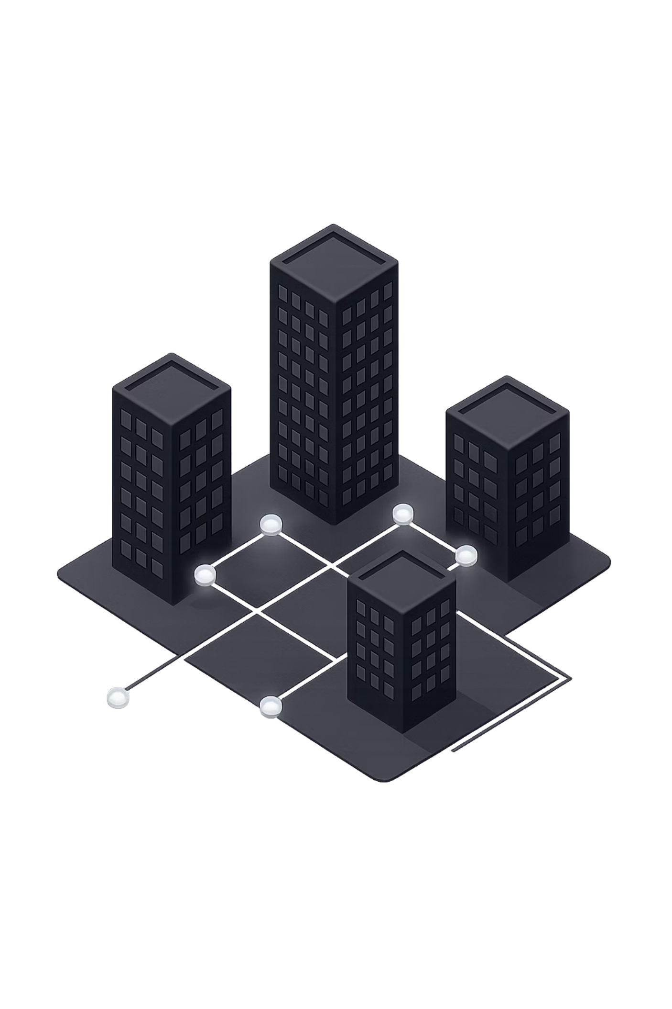
PART 9
The Big Picture
Every tool we've covered this module serves a specific role in a larger workflow. Let's step back and see how Git, GitHub, and Docker fit together from end to end.

Slide 23




PART 9 · SLIDE 46
The Complete Journey
Every production application follows a version of this pipeline. The tools we've learned today are the industry-standard building blocks for each stage of the journey.
Build Application
Git
Write code locally. Your application runs on your machine.
Track every change. Stage and commit your work into a full history.
GitHub
Dockerfile
Push to the cloud. Code is backed up, shared, and collaborative.
Define the environment. Write the recipe for building the image.
Docker Image
Docker Container
Build the package. Code + dependencies + environment in one portable unit.
Run the application. The live, running app in any environment.

Slide 24
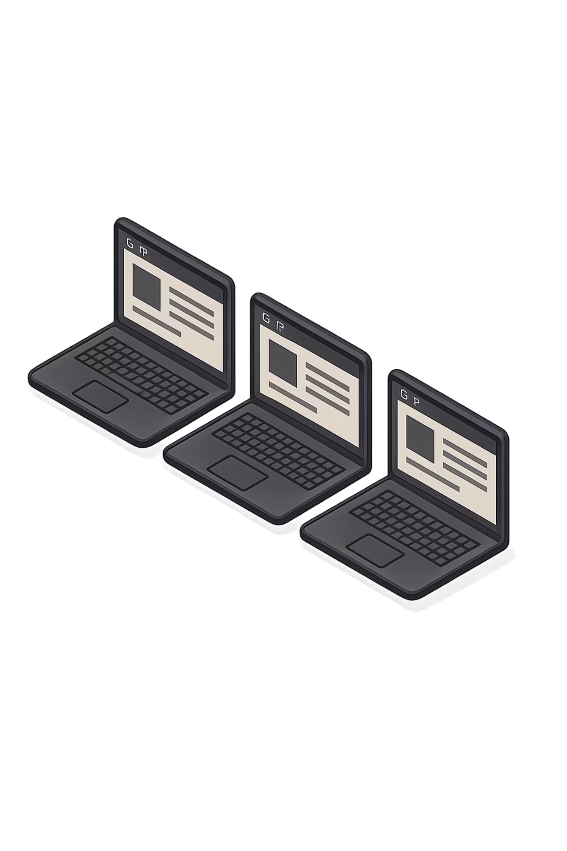
PART 9 · SLIDE 47
Why Docker Images Are So Useful
A Docker image is more than a convenient packaging format — it's a guarantee. It ensures that the exact same application, with the exact same environment, runs identically on every machine it's deployed to.
One Package
Code, runtime, libraries, and config are bundled together. There's nothing extra to install or configure on the target machine.
Same Environment
The container runs on the same OS base and Python version everywhere — developer laptop, teammate's machine, or cloud server.
Runs Consistently Everywhere
Once an image works, it works everywhere. No more "it works on my machine" — it works on every machine.

Slide 25
PART 9 · SLIDE 48
Real Deployment: From Local to Cloud
Today — Local Image
Tomorrow — Cloud Deployment
You build and run your Docker image locally on your laptop. The container runs on your machine, accessible at localhost:8000. This is what we've been doing in this module.
The same Docker image can be pushed to a cloud platform — AWS, Google Cloud, Azure, or others — where it runs on a server accessible from the public internet.
The image is identical. Only the machine running it changes.
docker build -t email_router .
docker run -p 8000:8000 email_router
Cloud deployment is beyond the scope of this module. But understanding that your local Docker image is already ready for cloud deployment is the key insight — you've already done the hard work.

Slide 26
PART 9 · SLIDE 49
Key Takeaways
Two tools, two distinct problems, one complete solution for building applications that run reliably everywhere.
🐳 Docker
Package and run applications. Docker bundles code, dependencies, and environment into a portable container that runs identically on any machine.
Dockerfile — define the environment
docker build — create the image
docker run — start the container

