Slide 1
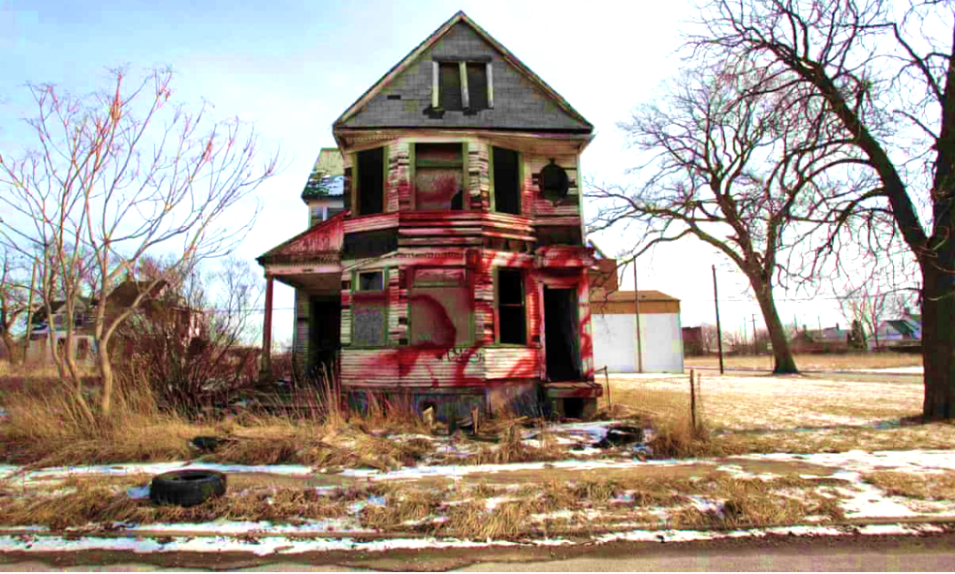
Blight Ticket Compliance Prediction
Jibin John (C0796674)
Nidhi Parmar (C0796680)
Arathy Ajith (C0790836)
Rincy Jose (C0790298)
Taranpreet Kaur (C0793771)

Slide 2
Project Life cycle Steps
Introduction
Dataset Loading
Data Preprocessing
Data Visualization
Modelling
Accuracy Check
Comparison
Feature Importance
Feature Selection
Conclusion

Slide 3
Introduction
Introduction
Blight Tickets, that have been issued from 2005 to property owners who have violated City of Detroit ordinances
However, issued tickets are subsequently voided by the ticket writing department for various reasons
Through this project, the team aims to:
Predict whether a issued ticket would be in compliance
Determine the factors causing non compliance and propose solution

Slide 4
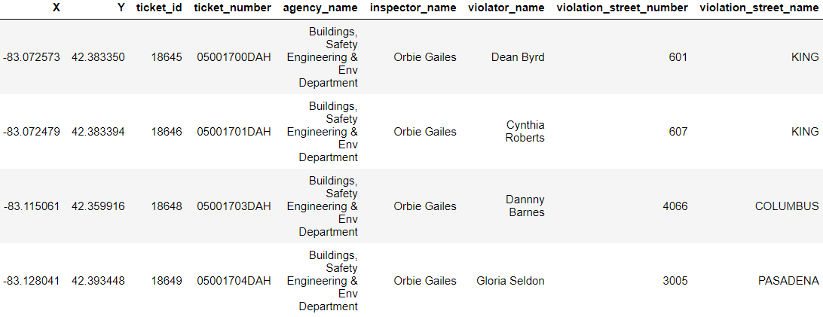
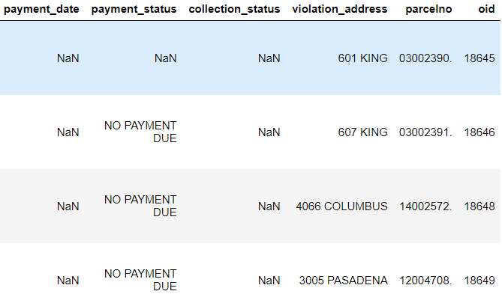
About the dataset
Dataset available in Detroit’s Open Data Portal
Contains 501689 records with 41 attributes.
Retrieved on April 01,2021

Slide 5
Data Pre-processing
Through pre-processing the primary targets to achieve were:
Understand each attribute
Handle missing values
Filter for records which meets project’s requirement
To create an label (target) in the dataset

Slide 6
Data Pre-processing
Pre Processing Cycle
Filtered attributes with no values
Define condition for compliance
Imputation of missing values
Filtered instances for recent tickets (rows filtering)

Slide 7
Data Pre-processing
Understanding each attributes
Most attributes highlights the fine amount (paid, balance, fees) and their corresponding dates (violation date, hearing date, judgment date)
Few attributes had no data at all
Few attributes didn’t contribute much information with respect to the project’s requirement.

Slide 8
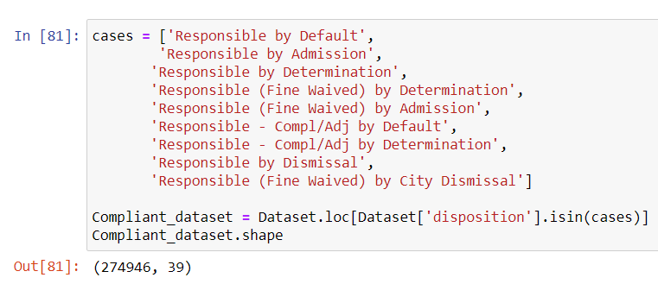
Data Pre-processing
Filtering records
Dataset consisted of records for which no fine were imposed or adjudged
Determined by ‘Disposition’ attribute
Filtered records for cases where the ticket holder were judged responsible
Some exceptional cases were studied and handled

Slide 9
Data Pre-processing
Defining the target
Target attribute comprised of: ‘Compliant’ and ‘Non-compliant’
Compliant was defined (assumption) as:
The person pays fine within 6 months after being adjudged responsible
The person pays full amount of the fine
The person pays fine prior to judgment (By own admission)

Slide 10
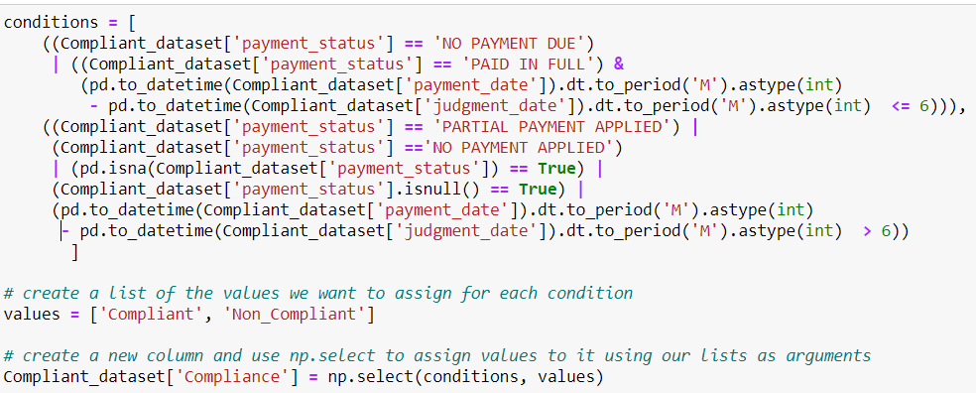
Data Pre-processing
Defining the target

Slide 11
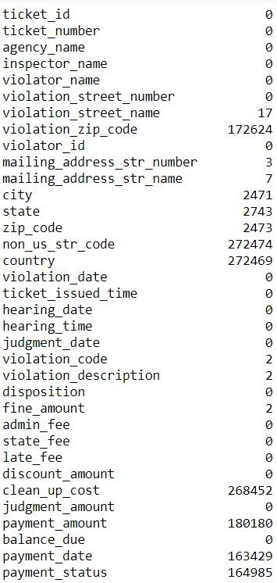
Data Pre-processing
Handling missing values
There were too many missing values in the dataset
Few attributes were removed which didn’t had an impact for this project (column deletion)
Few records with very less missing values were dropped (row wise deletion)

Slide 12

Data Pre-processing
Handling missing values - Imputation
Imputation were done on following attributes:
Payment status
Payment date
For cases fine was waived off, the payment date was replaced with corresponding judgment date
For existing non-compliance cases, payment date was replaced with: 2099/12/12 00:00:00+00 and payment status was replaced with ‘NO PAYMENT MADE’

Slide 13
Data Pre-processing
The resultant dataset after pre processing has:
79597 records
30 attributes
Tickets issued from 1st January, 2018 ( to find recent trends/patterns)

Slide 14
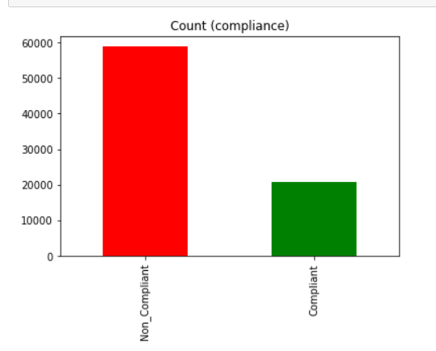
Data Visualization
Data visualization helps to find the very useful patterns/insights from the datasets
Insights drawn had relevance (as data is recent)
Out of 79,597 records approximately 59,000 were non-compliance and 20,000 compliance

Slide 15
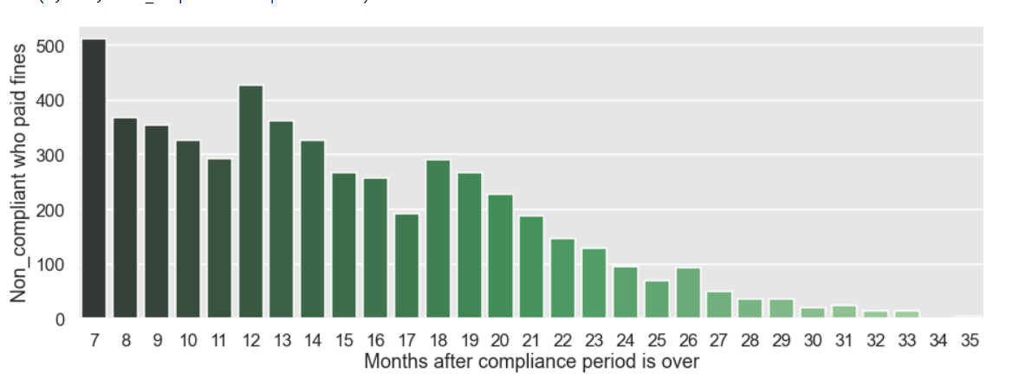
Data Visualization
Key Observations
The figure shows the time period a non-compliant person takes to pay his/her fine. It was noted that after a period of 26 months, the person could be considered a permanent defaulter.

Slide 16
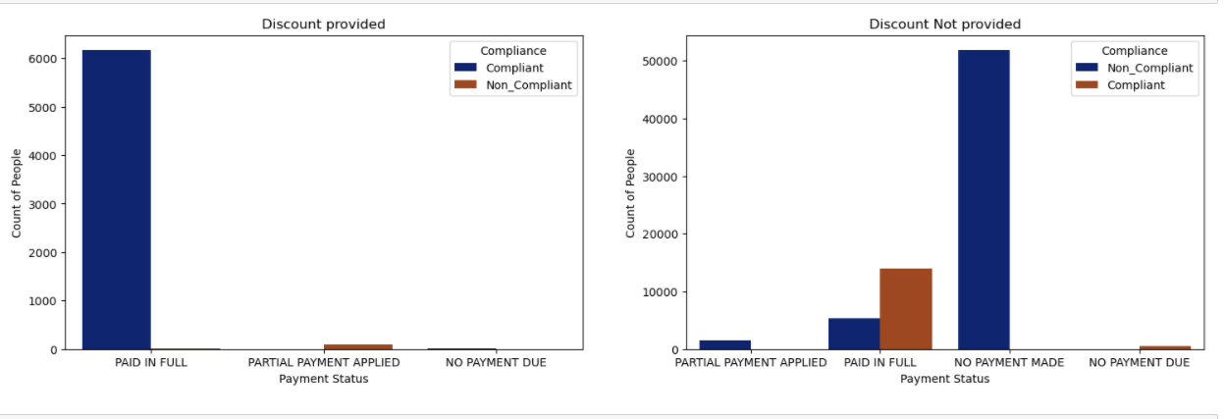
Data Visualization
Key Observations:
Compliance rate is higher when certain discounts are provided

Slide 17
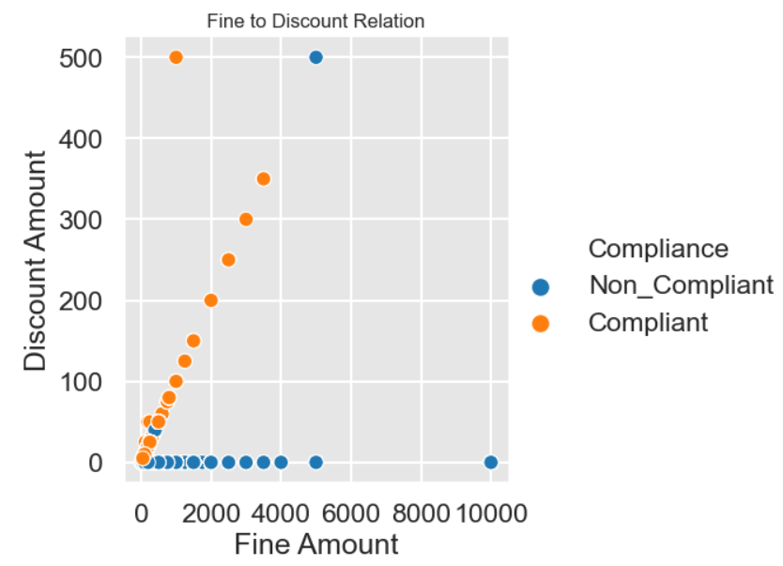
Data Visualization
Key Observations:
The higher the fine, the chances of being non-complaint increased, whereas if the discount amount is high, the chances of being compliant also increase.

Slide 18
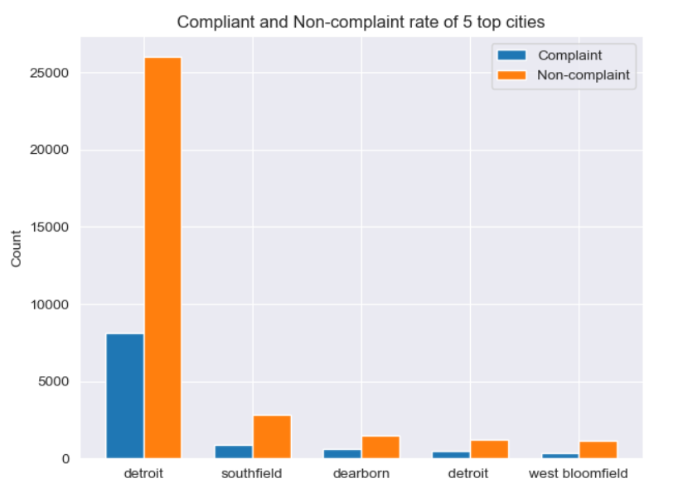
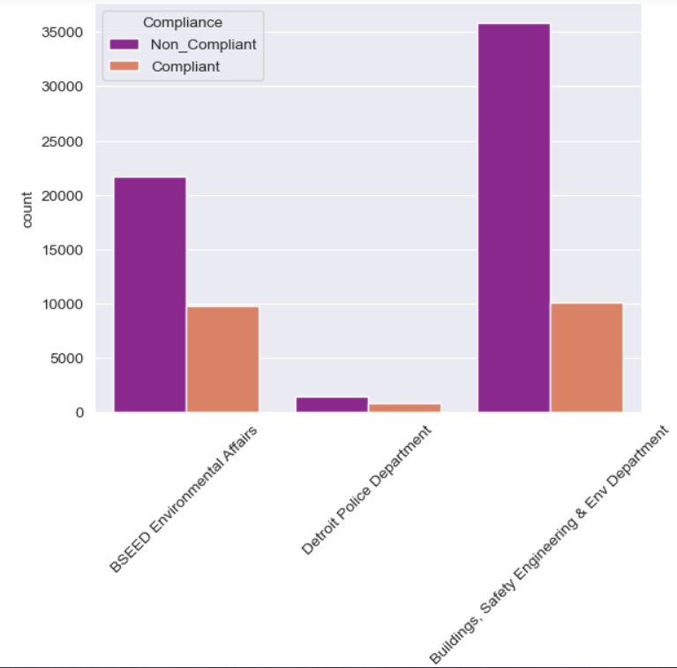
Data Visualization
Key Observations:
Buildings, Safety Engineering, and Env department has more number of tickets issued.

Slide 19
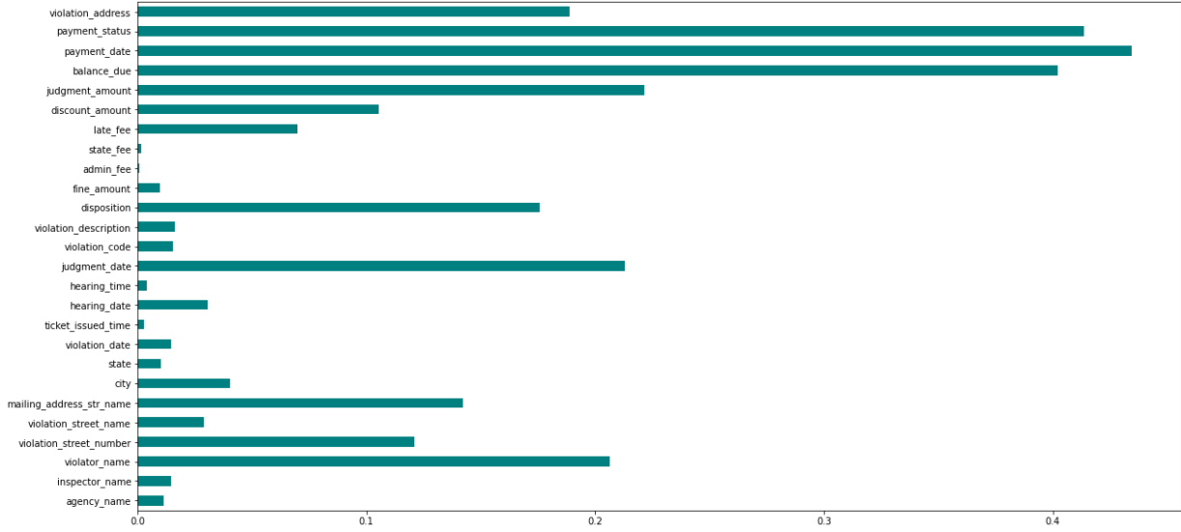
Feature Importance
The attributes were encoded (for text) and scaled using LabelEncoder and StandardScaler respectively
To determine which attributes can be used as features, used Mutual Information classifying technique

Slide 20
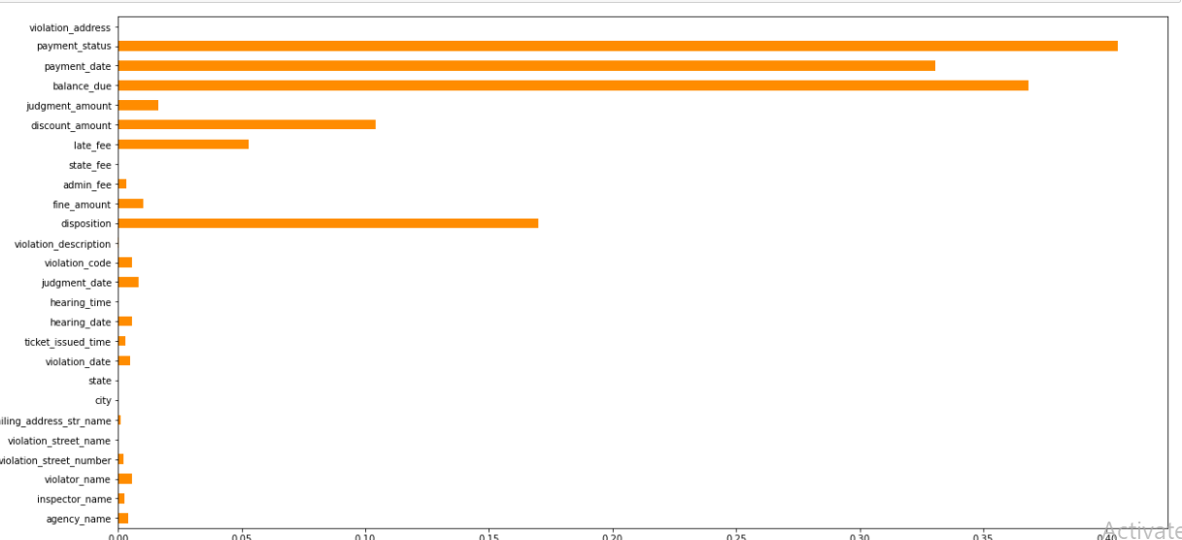
Feature Importance
The features were selected were based on high level of score among the classifiers
These selected features were then used for training the models

Slide 21
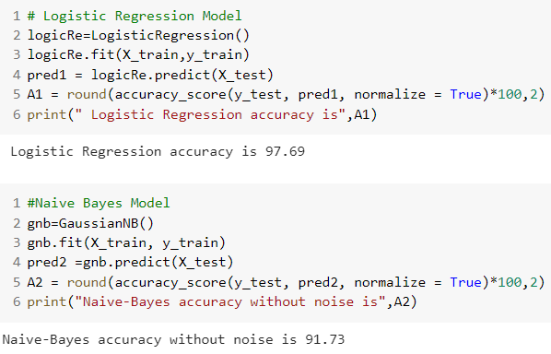
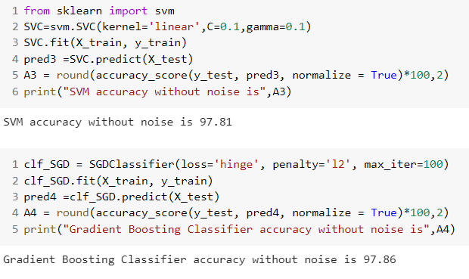
Modelling
The dataset was split into 80:20 train to test ratio.
Four different machine learning models
Logistic Regression
Naïve Bayes
Support Vector Classification
Stochastic Gradient Decent (SGD)

Slide 22
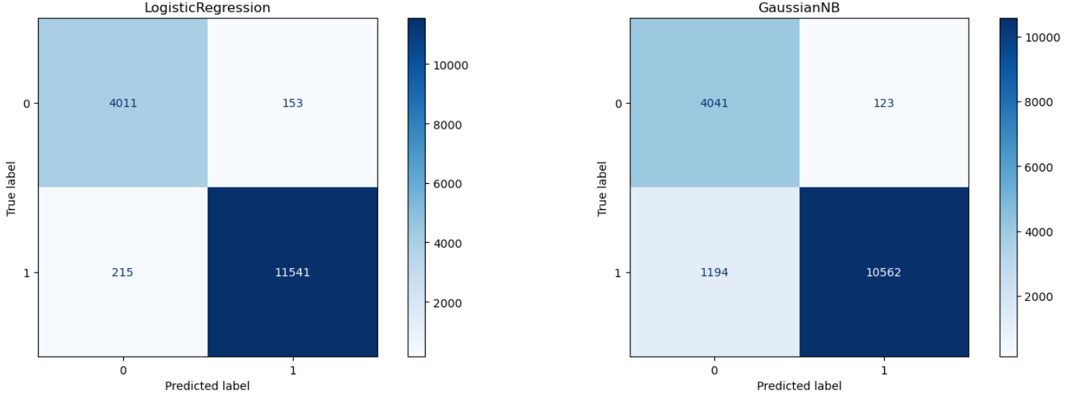
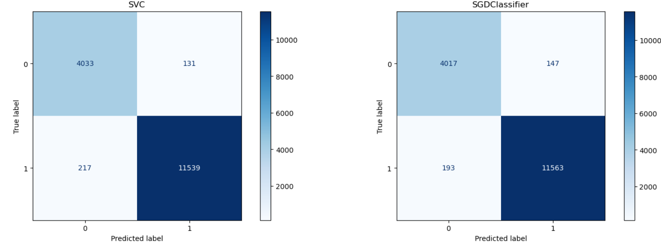
Confusion Matrix
A confusion matrix, also known as an error matrix, is a specific table layout that allows visualization of the performance of an algorithm.

Slide 23
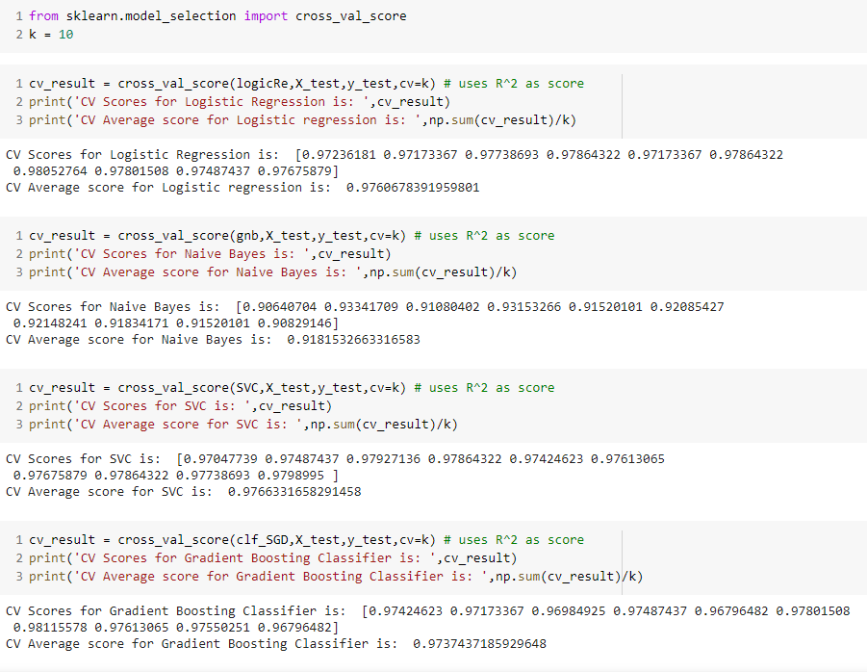
Cross Validation
Cross-validation is used for evaluating ML models by training several ML models on subsets
Subsets with 10 folds were used
The mean cross validation score considered for model selection

Slide 24
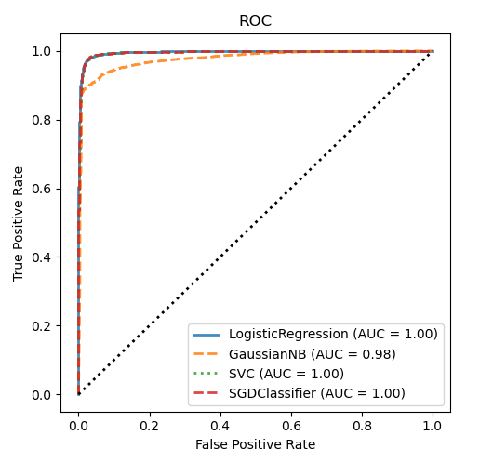
AUC-ROC Curve
AUC-ROC curve tells how much model is capable of distinguishing between classes.
Most model scores are close enough to 1

Slide 25
Results
From analysis, based on various validation scores, teams suggestion would be use Support Vector Classification model for this dataset
The time period to consider a non compliant person to be permanent defaulter is 26 months
Compliance were noted for more records with discounts

Slide 26
Conclusion
The team have the following suggestion to increase compliance based on analysis
Lure ticket holder with discount (similar to e commerce)
Instead of imposing heavy fines, propose fines on installment basis
Awareness program on Building Safety Engineering as most cases were occurring for this agency

Slide 27
Future Scope
The dataset consists of records for which judgment is pending as of today, which can be used later to check model performance
Do similar analysis on tickets for which disposition was adjudged as ‘Not Responsible’ to reduce the number of tickets issued
To analyze compliance based on location (city, state)

Slide 28
Thank you

