Slide 1

SALES PREDICTION ON
BLACK FRIDAY
Arathy Ajith
Elu Alias
Nidhi
Rincy Jose
Tharanpreeth
Sachin

Slide 2


Background
The day after Thanksgiving in the U.S. is called Black Friday (BF) and serves as the traditional start to the holiday shopping season.
It is known for deep discounts (e.g., doorbusters), Black Friday shopping manifests adventure, competition and urgency around getting great deals.

Slide 3
Objective
Predicting Purchase
Build a simple Machine Learning model that can predict how much a
Customer is likely to spend on the eve of Black Friday.
Pattern Recognition
Reveal and Understand the most important factors from predictors such as Age, Gender, City of Residence etc., that influence the spending of a Customer.
Establish a quantitative impact of the revealed factors and how they influence Purchase by a Customer on a personal level i.e., whether they have a positive or negative contribution on the Purchase.

Slide 4
Motivation
Black Friday sales in US still accounts for a whopping 6 Billion $ in revenue.
In order to compete with Online Shopping Platforms, Brick and Mortar based Retailers need to figure out how to boost Sales during the most important Shopping Day of the Year.
By understanding the Purchase Patterns of the Customers Retailers can provide improved Service Quality.
Improve Staffing and Inventory of the Retail Store.
Increase Revenue and Sales.

Slide 5



Tools Used

Slide 6
Dataset
Collection:
https://www.kaggle.com/mehdidag/black-friday/home
Description:
  The Dataset comprises of 550000 observations about the Black Friday in a retail store and 12 columns.
  It contains various kinds of variables either Numeric or Categorical in nature. The dataset
  contains 2 columns with missing values: 166986 observations missing in column ‘Product_Category_2 and 373299 observations missing in column ‘Product_Category_3.

Slide 7
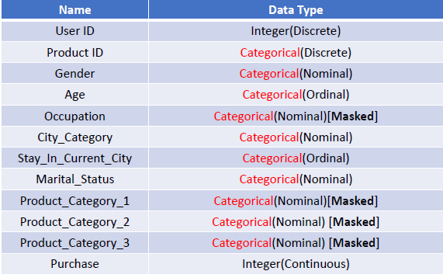
Description
Name Data Type

Slide 8
Pre-Processing
Most of the raw data contained in any given Dataset is usually unprocessed, incomplete, and noisy.
In order to be useful for data mining purposes, the Dataset needs to undergo pre-processing, in the form of ‘Data Cleaning’ and ‘Data Transformation’.
Handling Missing Values-Using mean to impute the missing values .

Slide 9
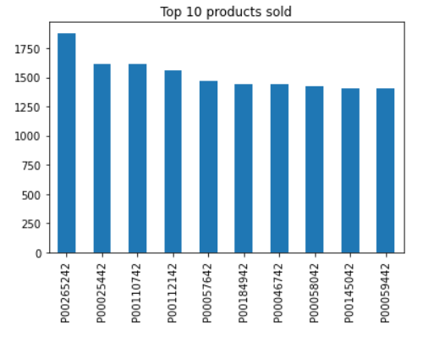
Exploratory Data Analysis
Plotting the top 10 products sold

Slide 10
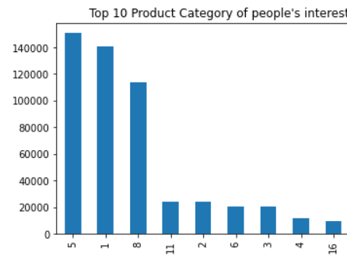
Exploratory Data Analysis
plotting the product category

Slide 11
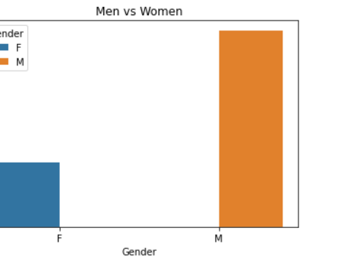
Exploratory Data Analysis
Who spend more,men or women?

Slide 12
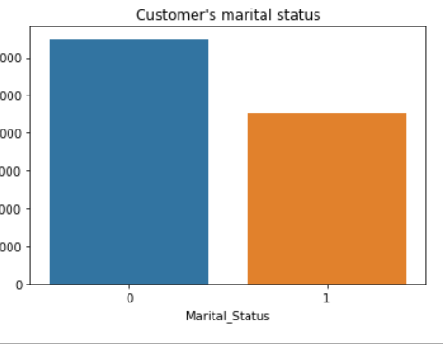
Exploratory Data Analysis
Who spend more, married or individuals?

Slide 13
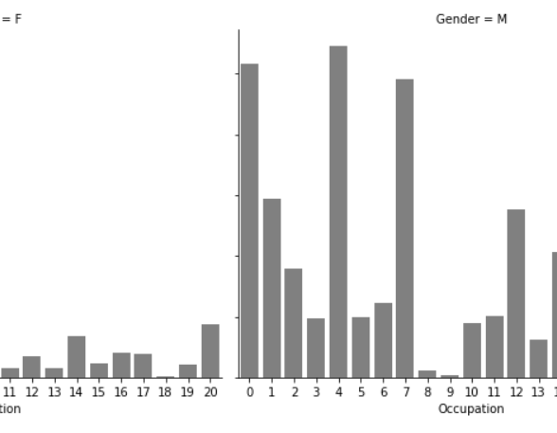
Exploratory Data Analysis
Customer distribution by occupation

Slide 14
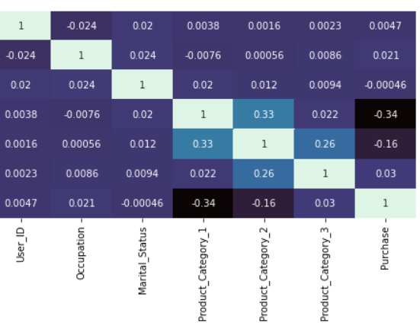
Exploratory Data Analysis
Correlation

Slide 15
Pre-Processing
Used label encoding to convert age column to ordinal variable
Converted categorical variables such as gender, City_category, and Stay_In_Current_City_Years to numerical variable

Slide 16
Apriori Algorithm
The Apriori procedures:
Initially, scan DB once to get frequent 1-itemset
For each level k:
Generate length (k+1) candidates from length k frequent patterns
Scan DB and remove the infrequent candidates
Terminate when no candidate set can be generated

Slide 17
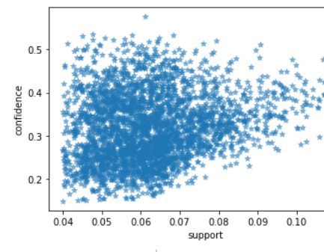
plotting support vs confidence

Slide 18
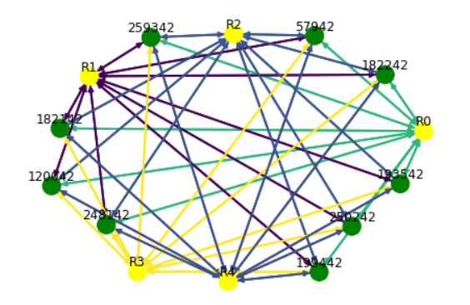
Graph illustrating association rules

Slide 19
Data preparation
Test Train data split
Feature Scaling using StandardScaler

Slide 20
Models Used
Linear Regression
Decision Tree Regressor
Random Forest Regressor
Gradiant Regressor

Slide 21
Model Evaluation
Metrics used:
  Mean Squared Error
  Root Mean Squared Error
  Mean Absolute Error
  Mean Absolute Percentage Error
  Mean Percentage Error
  R2 Score

Slide 22
Linear Regression
Mean Squared Error = 21833555.12237604
Root Mean Squared Error = 4672.64
Mean Absolute Error = 3585.793112672932
Mean Absolute Percentage Error = 104.48180869533046
Mean Percentage Error = -82.0371192444459
R2 Score = 0.13225572949762843
Linear Regressor score = 0.13601829276686428

Slide 23
Decision Tree Regressor
Mean Squared Error = 14272063.76155156
Root Mean Squared Error = 3777.84
Mean Absolute Error = 2648.505408402567
Mean Absolute Percentage Error = 37.54725821595969
Mean Percentage Error = -11.931785602064897
R2 Score = 0.43277668304972106
Decision Tree Regressor score = 1.0

Slide 24
Random Forest Regressor
Mean Squared Error = 7496028.737547494
Root Mean Squared Error = 2737.89
Mean Absolute Error = 2016.8997941474115
Mean Absolute Percentage Error = 30.090338837515173
Mean Percentage Error = -11.953363789868638
R2 Score = 0.7020807673294712
Random Forest Regressor score = 0.9584280887649734

Slide 25
Gradiant Regressor
Mean Squared Error = 8566584.107351104
Root Mean Squared Error = 2926.87
Mean Absolute Error = 2222.760330879881
Mean Absolute Percentage Error = 40.64600418139932
Mean Percentage Error = -23.143114072185437
R2 Score = 0.6595330336600891
Gradiant Regressor score = 0.9584280887649734

Slide 26
Results
Models Used | Mean Squared Error | Root Mean Squared Error | Mean Absolute Error | Mean Absolute Percentage Error | Mean Percentage Error | R2 Score | Gradiant Regressor score
Linear Regression | 21833555.12 | 4672.64 | 3585.79 | 104.48 | -82.03 | 0.13 | 0.13
Decision Tree Regressor | 14272063.76 | 3777.84 | 2648.50 | 37.54 | -11.93 | 0.43 | 1.0
Random Forest Regressor | 7496028.73 | 2737.89 | 2016.89 | 30.09 | -11.95 | 0.70 | 0.95
Gradiant Regressor | 8566584.10 | 2926.87 | 2222.76 | 40.64 | -23.14 | 0.65 | 0.95

Slide 27
Conclusion
To conclude, random forest and gradient regressor performs well enough in comparison to other models.
Gradient regressor works on the loss function and tends to get the optimized value when there is minimum loss.
However, the results can be further improved using other models.

Slide 28

Thank You

