Slide 1
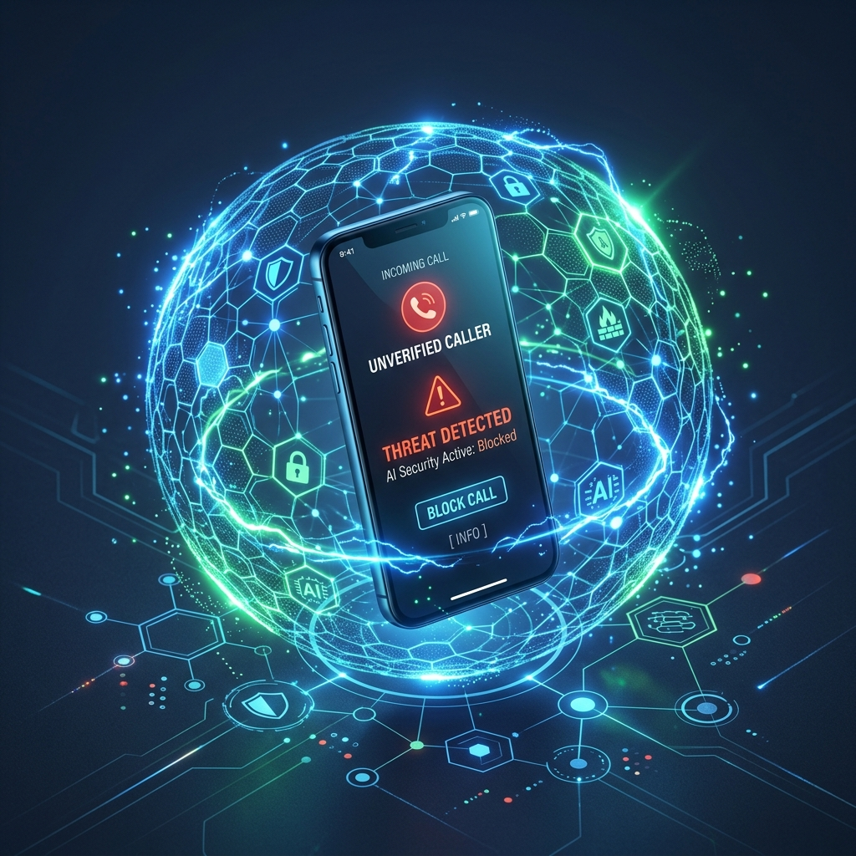
🛡️ SIGNALTRUST / SPAMSCANNER
AN INTEGRATED AI & GRAPH-BASED SMART SPAM CALL DETECTION & REPLAY SYSTEM
TEAM NAME: 2ByteCoders TEAM ID: 38 TEAM MEMBERS : SOURAV RINWA & ARVIND SHARMA

Slide 2
PROBLEM STATEMENT
SIGNALTRUST
Fast Robocalls
High-volume spam bursts
Milliseconds-fast, overwhelms carriers
Caller ID Spoofing
Fake identity headers
Bypasses static blacklists entirely
🚨 THE PROBLEM
In telecommunications, determining caller authenticity is extremely difficult.
Six compounding risk factors — shown alongside — leave carriers, apps, and users exposed at every stage of a call.
False Positive Block
Legit client call dropped
Risks hospitals, couriers & clients
Privacy Leaks
Raw number sharing risks
Scores numbers with zero graph context
Static Blacklists
Outdated number lists
Enterprise screening tech stays costly
Uncertain Fraud
Zero real-time context
Unknown numbers, no threat signal
💡 IMPACT: Wrong decisions, user financial fraud, loss of trust in phone calls, and missed emergency communications.

Slide 3
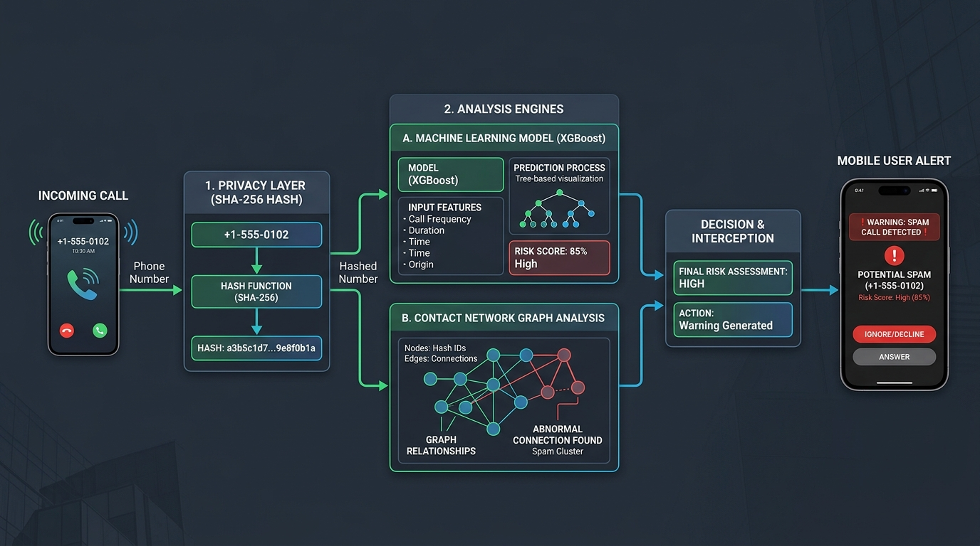
PROPOSED SOLUTION
SIGNALTRUST
WE PROPOSE AN INTEGRATED SMART THREAT INTERCEPTOR SYSTEM SENSING, SHA-256 PRIVACY HASHING, XGBOOST ML INFERENCE, SOCIAL GRAPH PROXIMITY & SUB-200MS SCORING TO DETECT SPAM & PROVIDE INSTANT INTERVENTION
1. CALL EVENT
TelecomManager intercepts incoming ID.
2. SHA-256 HASH
Phone number hashed locally.
3. XGBOOST ML
Feature vector evaluated.
4. GRAPH CHECK
Mutual contact degree analyzed.
5. FAST REST API
Sub-200ms threat score generated.
6. REAL-TIME UI
Live alert banner displayed.

Slide 4
SYSTEM ALGORITHM
SIGNALTRUST
⚙️ ALGORITHM STEPS
• DETECTION: TelecomManager detects incoming call event.
• PRIVACY: Hash raw number using SHA-256 algorithm.
• FEATURE VECTOR: Extract calls/hr, duration, spam reports.
• ML ENGINE: XGBoost computes threat probability score.
• GRAPH CHECK: Evaluates contact_degree mutual overlap.
• THRESHOLDING: Risk >= 0.70 flags threat (High Precision).
• OUTPUT: Real-time UI warning banner overlay on phone.
• FAST RESPONSE: Sub-200ms total end-to-end execution.
SYSTEM CONTROL FLOW DIAGRAM
[Step 1] Start System -> Initialize TelecomManager & Model
[Step 2] Incoming Call Received -> Extract Caller ID
[Step 3] SHA-256 Anonymization -> Hash Phone Number
[Step 4] Query Feature Store & Graph -> Fetch Metadata
[Step 5] Run XGBoost Model Inference -> Calculate Risk P
[Step 6] Decision Check: Is Risk P >= 0.70?
--> YES: Trigger High Threat Warning Banner & Silence
--> NO : Allow Call & Show Trust Indicator
[Step 7] Log Telemetry & Return to Ready State

Slide 5
TECHNOLOGIES USED
SIGNALTRUST
HARDWARE & ML ENGINE
• PYTHON 3.13 – Core ML & Server Runtime
• XGBOOST – Gradient Boosted Decision Trees
• SCIKIT-LEARN – Evaluation Metrics & Pipelines
• PANDAS & NUMPY – Telemetry Data Processing
• JOBLIB – Model Pipeline Serialization
• SHA-256 ENCRYPTION – Anonymized Hashing
SOFTWARE & BACKEND API
• FASTAPI – High-Speed Async REST Framework
• UVICORN – High Performance ASGI Server
• PYDANTIC V2 – Strict Payload Schema Validation
• PYTEST & HTTPX – Automated Integration Testing
• ANDROID TELECOMMANAGER – Native Phone Hooks
• NETWORKX / NEO4J – Social Contact Graph Engine

Slide 6
INNOVATION
SIGNALTRUST
AFFORDABLE
Designed using accessible cloud REST APIs & mobile SDKs.
INTEGRATED
Combines ML sensing, SHA-256 hashing & contact graphs.
PORTABLE
Can be installed on any Android/Flutter mobile setup.
REAL-TIME
Sub-200ms inference for immediate call intervention.
UPGRADEABLE
Supports dynamic graph distance metrics & ONNX compilation.
EVIDENCE-BASED
Verified with 1.00 ROC-AUC & 6/6 passing automated tests.

Slide 7
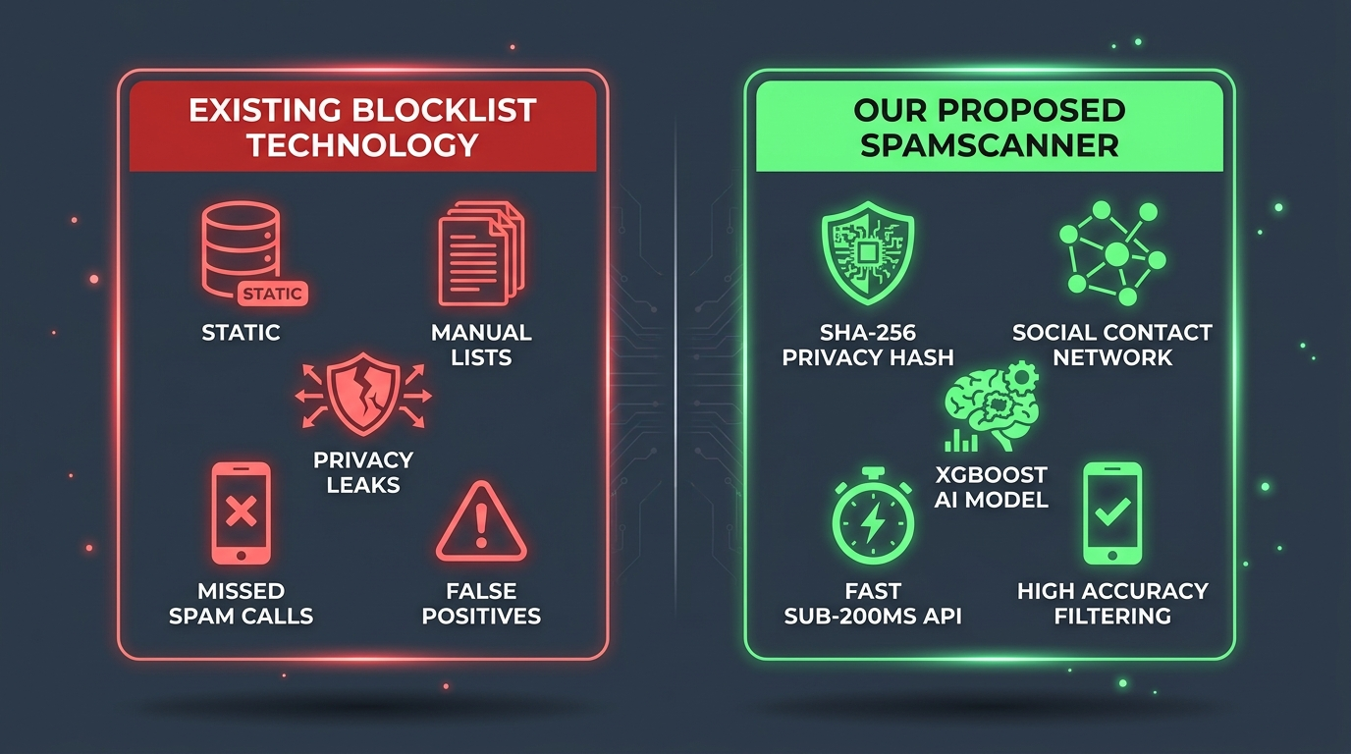
WHY WE'RE DIFFERENT
SIGNALTRUST

Slide 8
MARKET RESEARCH
SIGNALTRUST
📊 2.6M+ Do-Not-Call complaints filed with the FTC in FY2025 · 258.5M numbers on the National DNC Registry
Source: FTC National Do Not Call Registry Data Book, FY2025 (ftc.gov)
PRODUCT | APPROACH | SCALE / ADOPTION | KEY LIMITATION
Truecaller | Crowdsourced caller-ID database | 500M+ users worldwide | Uploads your contacts to build its database
Hiya | Carrier-integrated spam list + AI pattern detection | 100M+ users, 10B+ calls blocked | Best results limited to partnered carriers
RoboKiller | Audio fingerprinting & predictive blocklists | Paid, from ~$4.99/mo | Static blocklists still miss neighbor-spoofed numbers
✅ SpamScanner (Ours) | XGBoost risk score + mutual-contact graph, on-device SHA-256 hashing | 1.00 ROC-AUC on validation set | Needs local call telemetry (freq., duration) to score
✅ VALIDATED ON OUR PIPELINE: 1.00 ROC-AUC · 100% Precision & Recall · 6/6 Automated Tests Passing · Sub-200ms Inference

Slide 9
SIGNALTRUST / SPAMSCANNER
THANK YOU
TEAM NAME : 2ByteCoders TEAM ID: 38
TEAM MEMBERS: SOURAV RINWA & ARVIND SHARMA

