Slide 1
DevOps School – Diploma
Rinat Sadykov (sark@bk.ru)
Variant 7
January 2022
CONFIDENTIAL | © 25.12.21 EPAM Systems, Inc.

Slide 2
Task description
Variant 7
Task:
Using API https://www.metaweather.com/api/ get data about weather in Moscow for current month and store it into DB:
  id
  weather state name
  wind direction compass
  created
  applicable date
  min temp
  max temp
  the temp
Output the data by date (the date is set) in the form of a table and sort them by created in ascending order.
Application:
http://dev-epm-diploma-v7.westeurope.cloudapp.azure.com/
http://prod-epm-diploma-v7.westeurope.cloudapp.azure.com/
Grafana:
http://grafana-epm-diploma-v7.westeurope.cloudapp.azure.com/
GuthHb – application source code:
https://github.com/rinxster/epam-diploma-v7
GuthHb – Terraform IaC:
https://github.com/rinxster/epam-diploma-v7-IaC

Slide 3
Architecture Decisions
Domain | Related Course Module | Solution\tool used
SCM | Git | GitHub
Tests(optional) | CI/CD | N/A - Skipped as optional
Quality gate | CI/CD | SonarCloud + Azure Devops
IaC | Cloud, Terraform, Ansible | Terraform
Orchestration | Kubernetes | Azure Kubernetes Service (AKS)
Logging | Monitoring and Logging | Azure Monitor, LogAnalyticsWorkplace
Monitoring | Monitoring and Logging | Azure Monitor, Grafana
Runtime/Deployment | CI/CD | Azure Devops
Scalability/redundancy | Kubernetes | Azure Kubernetes Service (AKS)
Cloud and Cost efficiency** | Cloud | Azure costs management+Azure Budget

Slide 4

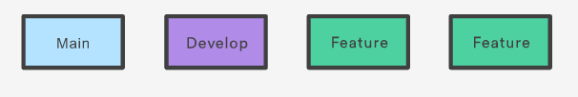
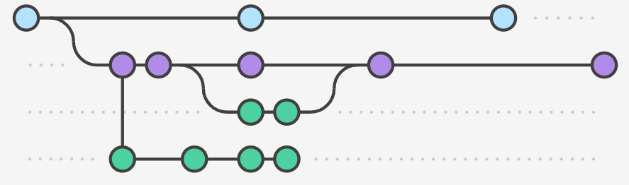
SCM - GitHub
GitFlow used as branching strategy
Main and develop are permanent branches.
Feature/fix branches are temprorary and deleted after merge.

Slide 5


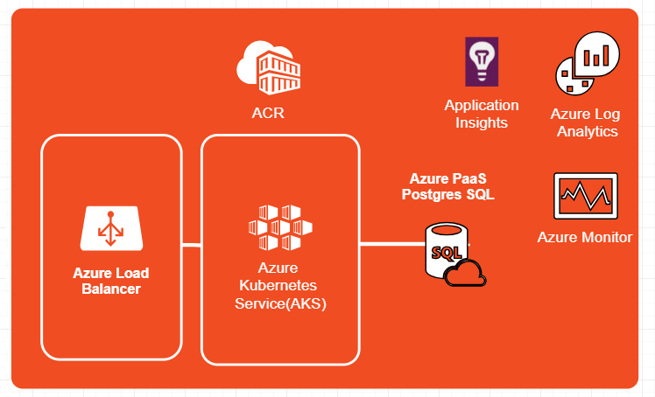
IaC – Terraform
GuthHb – Terraform IaC:
https://github.com/rinxster/epam-diploma-v7-IaC
IaC design deployed using Terraform in Azure
NB: Following resources are pre-deployed in advance manually:
  Storage Account(to store tfsate and run Azure Cloudshell)
  Resource Group
  Azure Key Vault(to prepare and store passwords for deployment)

Slide 6

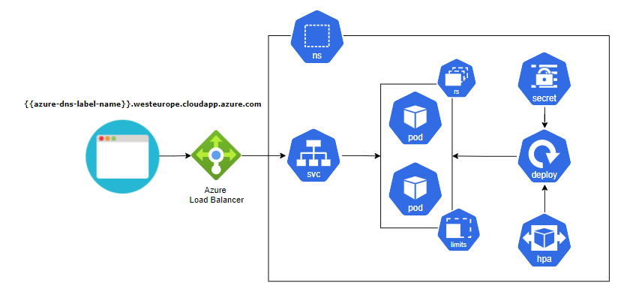
Orchestration - AKS
Prod\Dev namespace overview
2 namespaces: Prod and Dev
Secrets file generated with data from Azure KeyVault
Horizontal pod autoscaler configured.
1 separate namespace for Grafana: “Monitoring”
Grafana (deployed separately using helm chart).

Slide 7


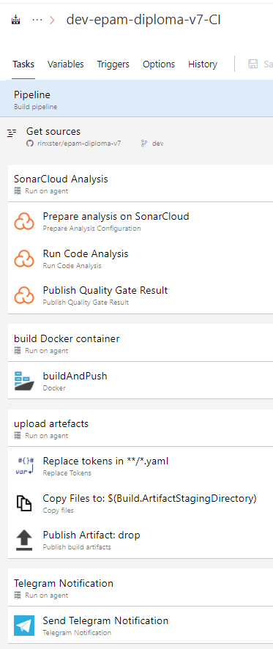
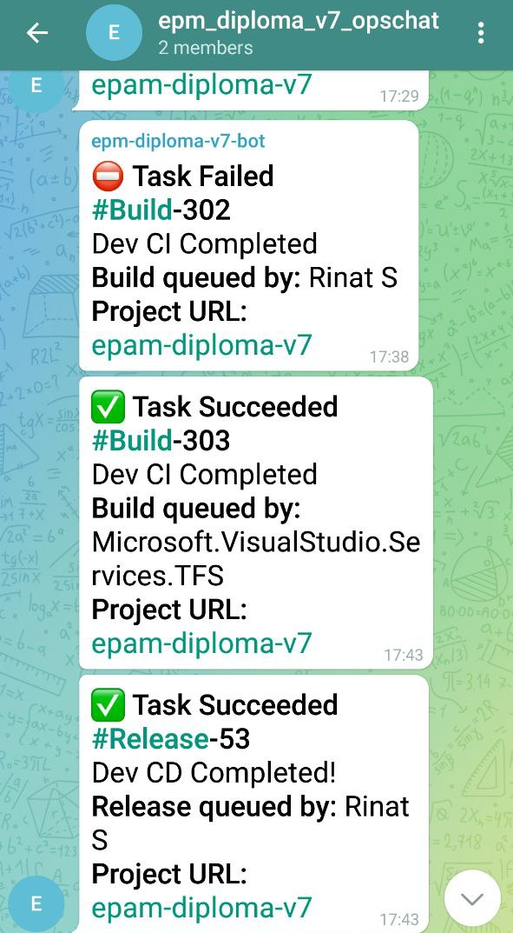
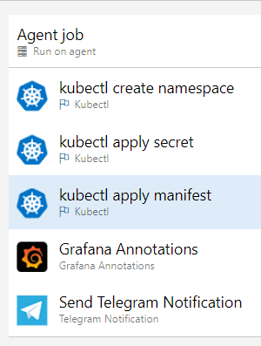
Runtime/Deployment - CI\CD
CI Pipeline
Telegram notifications example
CD Pipeline
Separate CI\CD pipelines for DEV and PROD.
Dev\Prod CI triggered by commit in Dev\Main branches
Dev\Prod CD triggered once appropriate Dev\Prod CI pipeline completed successfully.
Azure KeyVault used to store passwords and keys securely for the files that are prepared and published during CI
CD has Quality Gate enabled (SonarCloud)
Annotations added to Grafana dashboard upon Prod\Dev CD completion.
Telegram notifications sent upon CI\CD completion(whether failed or succeeded)

Slide 8
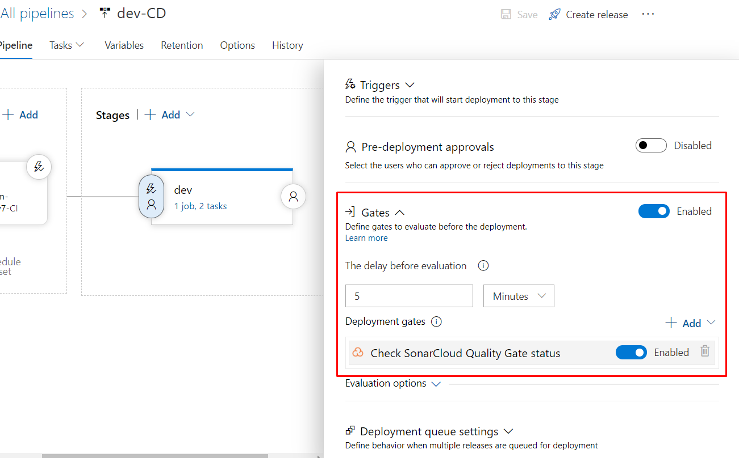
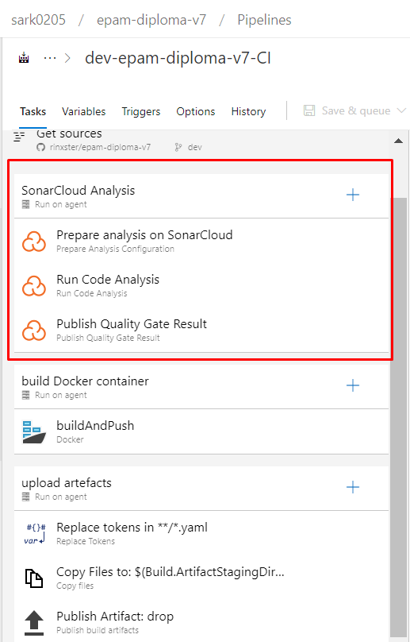

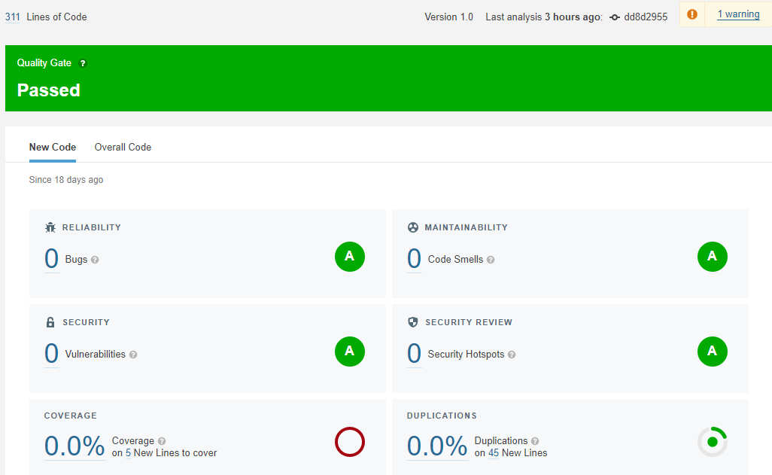
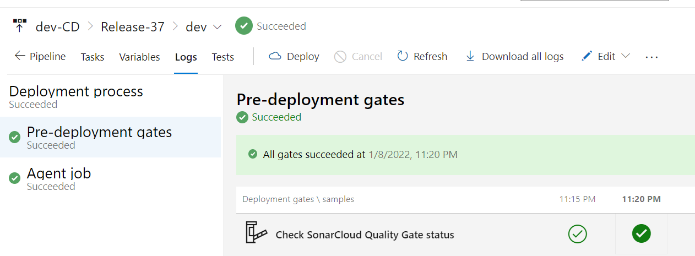
Quality Gate
CD Pipeline
CI Pipeline
Results published

Slide 9
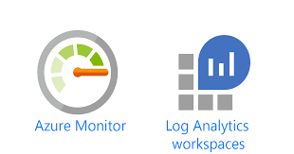
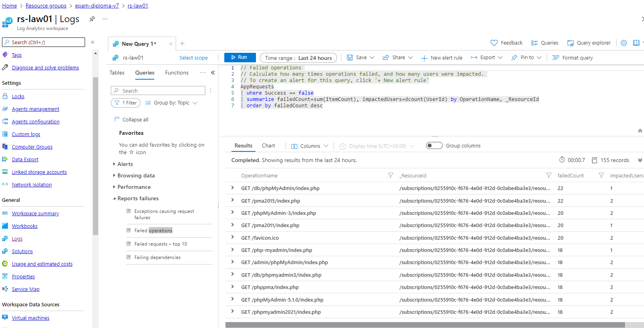
Logging – Azure Monitor and Log Analytics Workplace

Slide 10
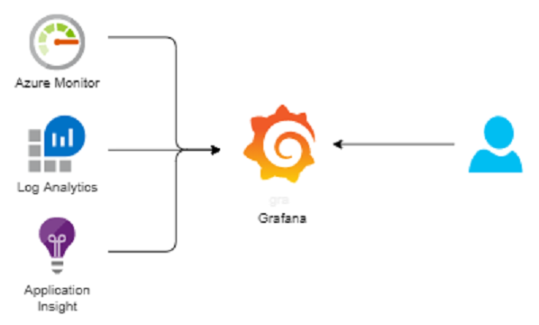
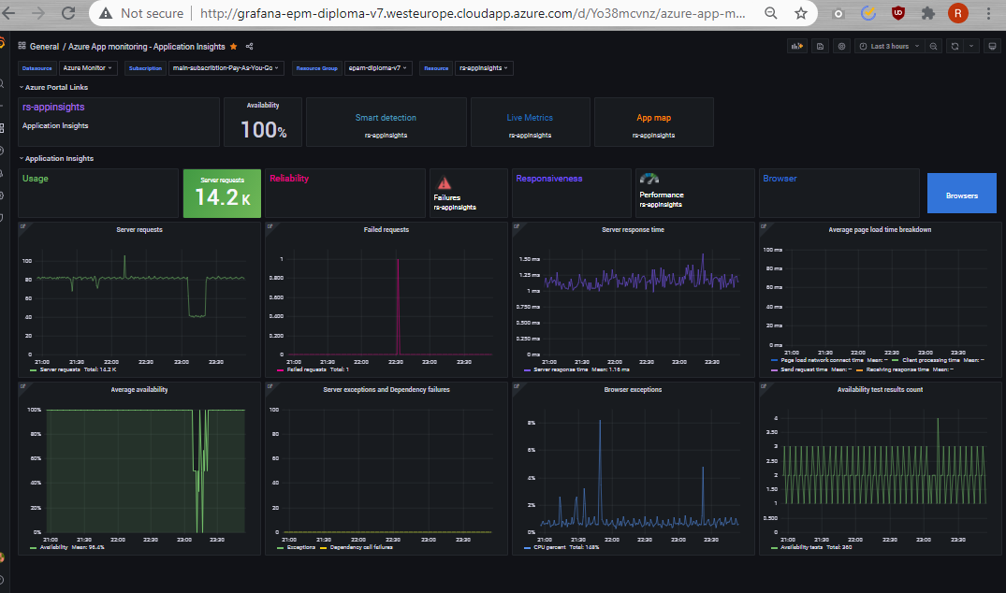
Monitoring with Grafana and Azure Monitor
Application Monitoring:
“appinsights” python module used to report data to Azure Application Insighs(integrated into app.py and index.html template)
Notes:
Monitoring Python Applications with Azure App Insights
https://docs.microsoft.com/en-us/archive/blogs/najib/monitoring-python-applications-with-azure-app-insights
Grafana installation via helm:
helm repo add grafana https://grafana.github.io/helm-charts
helm repo update
kubectl create namespace monitoring
helm install grafana grafana/grafana \
--namespace monitoring \
--set persistence.storageClassName="default" \
--set persistence.enabled=true \
--set adminPassword='Yourfavpassword' \
--set service.type=LoadBalancer

Slide 11
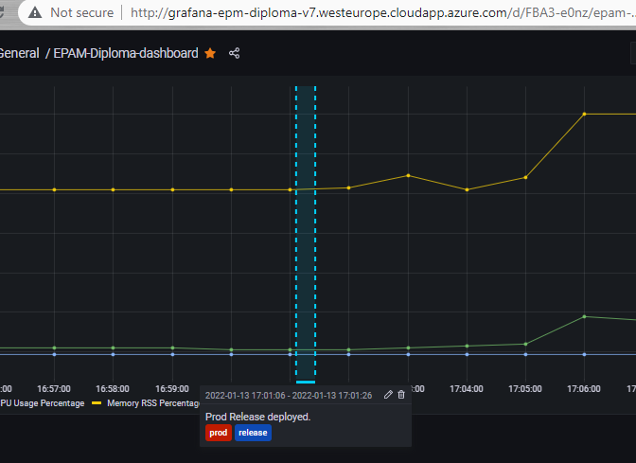

Azure DevOps Webhooks and Grafana CD Release annotations
Webhook

Slide 12
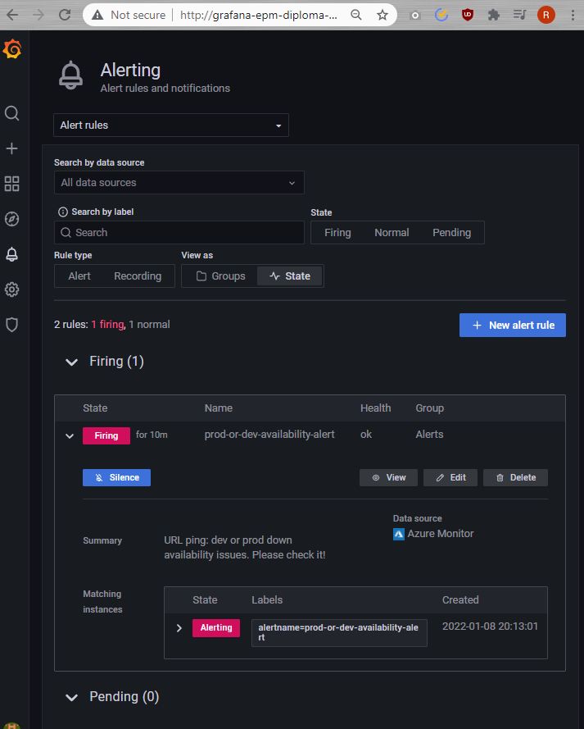
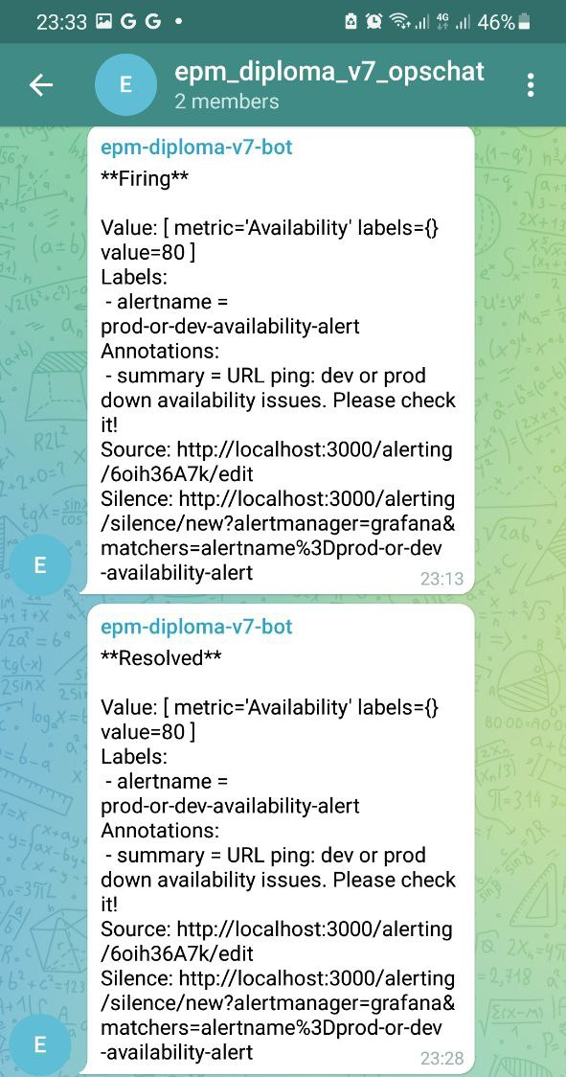


Alerting with Grafana and Telegram
http://dev-epm-diploma-v7.westeurope.cloudapp.azure.com/
http://prod-epm-diploma-v7.westeurope.cloudapp.azure.com/

Slide 13
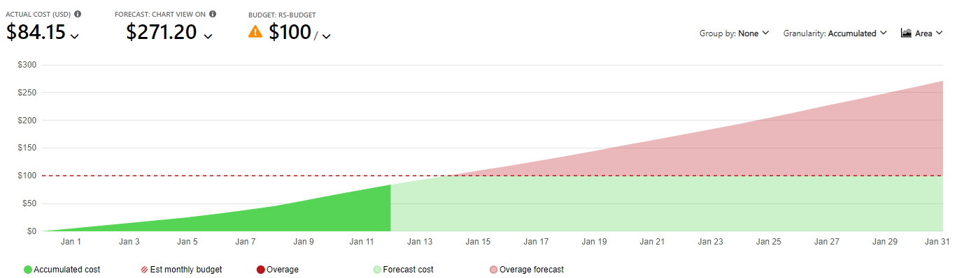
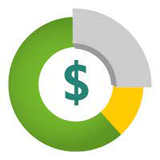
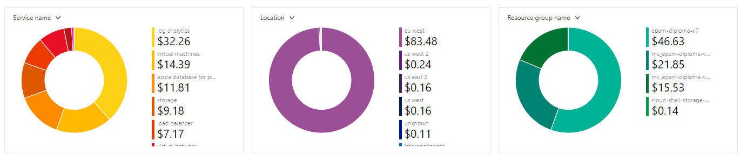
Costs
NB: Application Monitoring: Personal (non Epam) Azure account and subscription used for this diploma to save time for resource limitations and access troubleshooting and fixing.

Slide 14
Demo
Application demo
Terraform plan&apply
K8s HPA Demo – cpu load and autoscaling
Pipelines demo
Telegram notifications/Grafana annotations

Slide 15
Q&A
Notes:
Interesting findings:
Python Ap insigts module
Telegram integration with Azure
Grafana Annotations from Azure Devops -> showing pipeline actions on time graphs!
Grafana alerts notifications to Telegram
azure-dns-label-name – nice tool to get dns name for development app!
Lessons learnt:
Not able to create ns via terraform -> created via K8s
Had issues with app availability during deployment -> “readinessProbe” solved issue

