Slide 1
Hi

Slide 2

MAKE-WAY
By Rio Roy

Slide 3
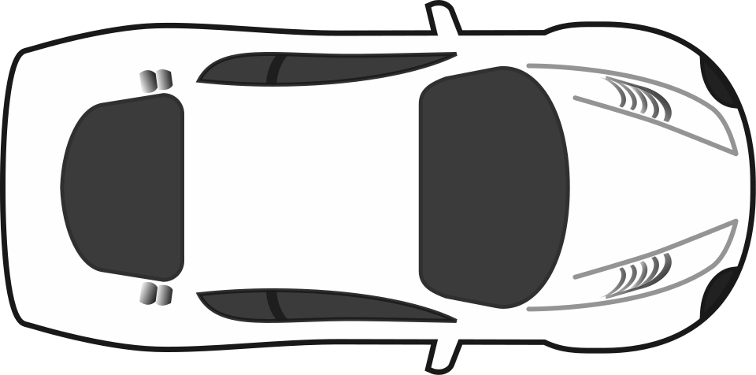

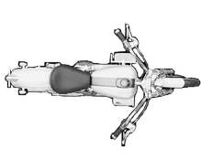


THE
SOLUTION
  Completely Offline
  Proactive driver notifications
  No additional hardware required
  Low overhead communication
  Uses very less power

Slide 4
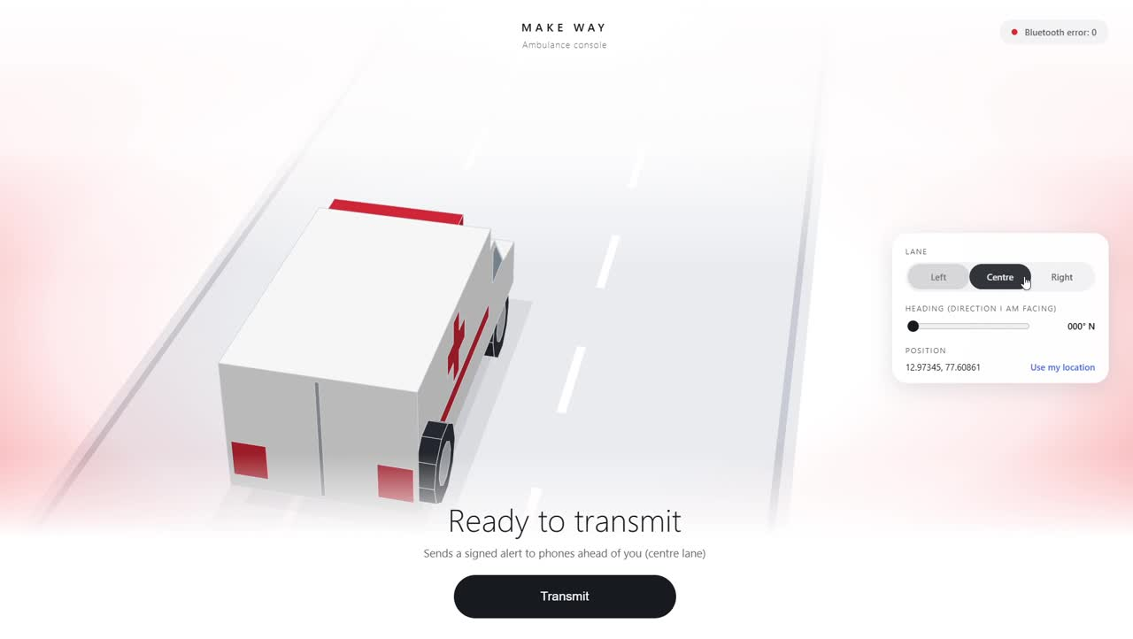
AMBULANCE DASHBOARD
Can select and switch lanes which is reflected in the broadcast message
Send out GPS coordinates and direction along with the message
Starts transmitting when ‘Trandmit’ is pressed

Slide 5
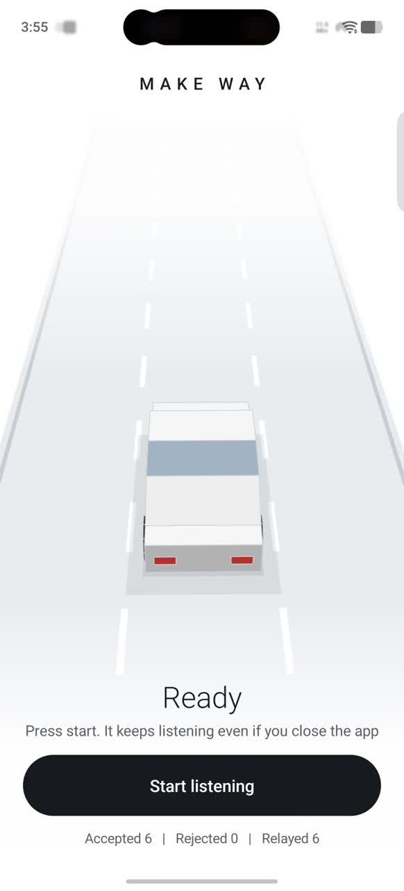
RECEIVER END
Receives the bluetooth transmission
Determines whether it is relevant to the user
Broadcasts the message if relevant
And transmits a similar signal forward
Can run in low energy mode in the background

Slide 6


WHO IS GOING TO INSTALL AN APP?
Spoiler alert: nobody(including me)

Slide 7
Lets MAKE WAY....
... to save a life

