Slide 1
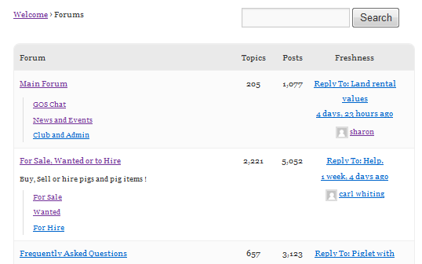
1
5
4
3
3
3
2
3
3
5
6
9
12
13
1
7
10
8
1
11
2

Slide 2
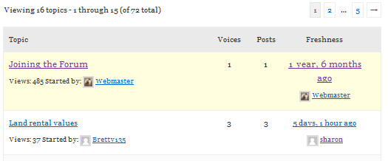

2
2
2
2
12
10
11
1
13
13
13
13
3
4
9
2
2
8
14
7
5
6
7
7

Slide 3
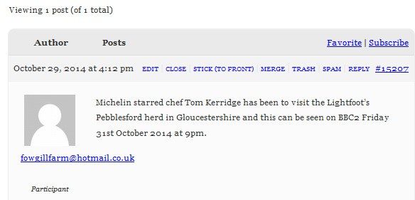

This box is styled in Topics Index 10, 11 & 12
10
10
5
2
11
8
6
1
7
3
12
4
9

Slide 4
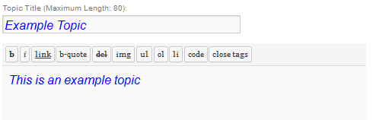
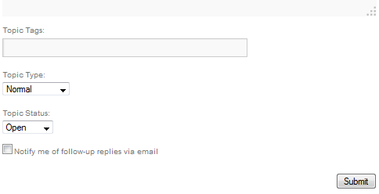
1
3
2
4
2
3
2
1
3
2
1
1
6
1
5

Slide 5
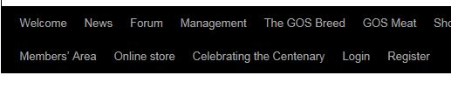


Slide 6
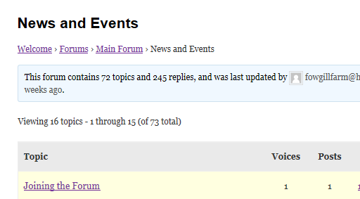
Home
Root
Current
Breadcrumbs

Slide 7
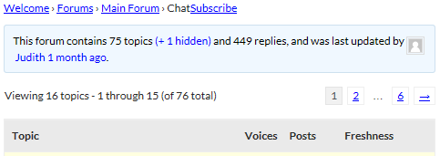
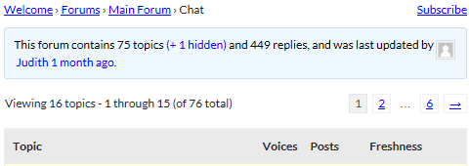

Slide 8

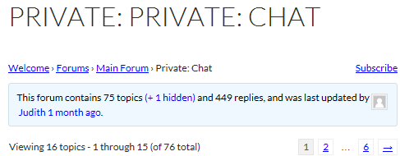
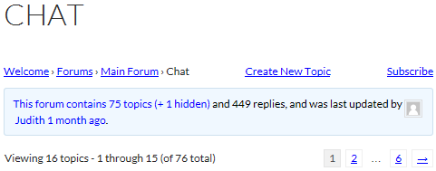

Slide 9
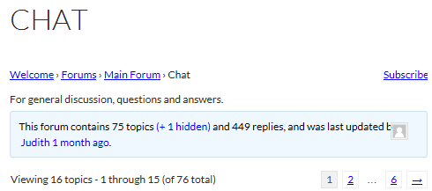
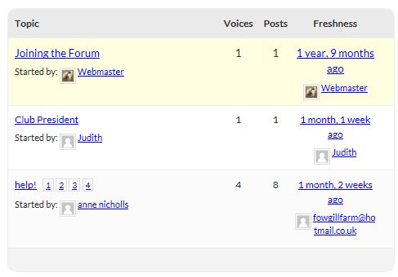

Slide 10
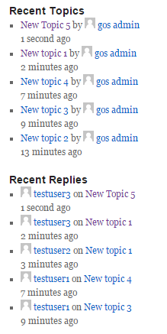
Original topic author always shown
Repeated topics for multiple replies

Slide 11
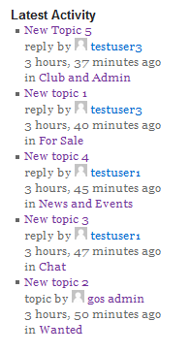

Slide 12
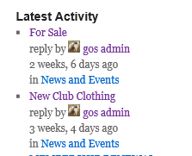
1
2
3
4
5
3
6

Slide 13
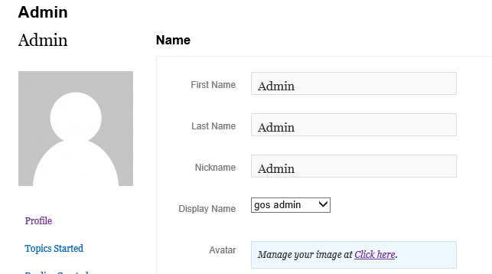
1
2
4
3
The url this links to

