Slide 1
{{customer_name}} Go-To-Market Blueprint
Value Accelerator Program Date: {{document_date}} Version: {{document_version}}

Slide 2
ABOUT THIS DOCUMENT
For any question reach out to: info@value-accelerator.io
Why do we need a GTM Blueprint?
to have a sales system where marketing and sales use the same value-based narrative.
How did we create this Blueprint?
2-days in person GTM Foundation Workshop with marketing, sales and product) consolidated with AI.
How to use this document?
This is the foundation to build your sales playbook and marketing campaigns.

Slide 3
GO-TO-MARKET BLUEPRINT OVERVIEW six building blocks of a value-based go-to-market system
Ideal Customer Profile
“What company is the most likely to buy from you?”
Customer Mental Model
“How do your customers think about their own business?”
Go-To-Market
Foundation
Persona & Buying Group
Who are the key decision makers and what do they aim for?
Unique Selling Points
“Why should customers buy from you and not from competitors?”
Value Proposition
“Why do customers buy offerings like your?”
Commercial Insight
“How do you effectively communication your unique value?”

Slide 4
Ideal Customer Profile (ICP)
"Who is the most likely to buy from you?"

Slide 5
IDEAL CUSTOMER PROFILE (ICP)
Industry
Geography
Company Size
{{icp_industry}}
{{icp_geography}}
{{icp_company_size}}
Buying Group
Maturity Level
[custom field]
{{icp_buying_group}}
{{icp_maturity_level}}
{{icp_custom_field}}

Slide 6
Persona & Buying Group
"Who are the key decision makers and what do they aim for?"

Slide 7
Business Objectives & KPIs
{{persona_role_name}}
Photo
{{persona_obj1_title}}
{{persona_obj2_title}}
Description: {{persona_obj1_desc}}
KPI 1: {{persona_obj1_kpi1}}
KPI 2: {{persona_obj1_kpi2}}
KPI 3: {{persona_obj1_kpi3}}
Pain Point 1: {{persona_obj1_pain1}}
Pain Point 2: {{persona_obj1_pain2}}
Winning Trigger: {{persona_obj1_trigger}}
Description: {{persona_obj2_desc}}
KPI 1: {{persona_obj2_kpi1}}
KPI 2: {{persona_obj2_kpi2}}
KPI 3: {{persona_obj2_kpi3}}
Pain Point 1: {{persona_obj2_pain1}}
Pain Point 2: {{persona_obj2_pain2}}
Winning Trigger: {{persona_obj2_trigger}}
Name: {{persona_name}}
Role: {{persona_role}}
Age: {{persona_age}}
Education: {{persona_education}}
Location: {{persona_location}}
Industry: {{persona_industry}}
Education: …
Location: …
Industry: …
{{persona_obj3_title}}
{{persona_obj4_title}}
Description: {{persona_obj3_desc}}
KPI 1: {{persona_obj3_kpi1}}
KPI 2: {{persona_obj3_kpi2}}
KPI 3: {{persona_obj3_kpi3}}
Pain Point 1: {{persona_obj3_pain1}}
Pain Point 2: {{persona_obj3_pain2}}
Winning Trigger: {{persona_obj3_trigger}}
Description: {{persona_obj4_desc}}
KPI 1: {{persona_obj4_kpi1}}
KPI 2: {{persona_obj4_kpi2}}
KPI 3: {{persona_obj4_kpi3}}
Pain Point 1: {{persona_obj4_pain1}}
Pain Point 2: {{persona_obj4_pain2}}
Winning Trigger: {{persona_obj4_trigger}}
Responsibilities
{{persona_resp_1}}
{{persona_resp_2}}
{{persona_resp_3}}
Communication Channels:
{{persona_channels}}

Slide 8
TOP SHARED OBJECTIVES
Shared Outcome | Linked Personas | Avg. Outcome Priority %

Slide 9
Value Proposition
"Why do customers buy offerings like your?"

Slide 10
VALUE PROPOSITION
What is your product/service?
{{vp_what_is}}
What does your product/service do?
{{vp_what_does}}
How does it work? (In simple terms)
{{vp_how_works}}
What is the value to the customer?
{{vp_value}}

Slide 11
SLOGAN
1
Slogan 1
{{slogan_1}}
2
Slogan 2
{{slogan_2}}
3
Slogan 3
{{slogan_3}}

Slide 12
Customer Mental Model
"How do your customers think about their own business?"

Slide 13
CUSTOMER MENTAL MODEL
{{cmm_persona}}
Business Objective
Driving Factors
Pain Points
Use Cases
{{cmm_objective}}
{{cmm_driving_factor_1}}
{{cmm_pain_point_1}}
{{cmm_use_case_1}}
{{cmm_driving_factor_2}}
{{cmm_pain_point_2}}
{{cmm_use_case_2}}

Slide 14
Unique Selling Points (USPs)
"Why should customers buy from you and not from competitors?"

Slide 15
UNIQUE SELLING POINTS (USPs)
{{usp_1_title}}
{{usp_2_title}}
{{usp_3_title}}
{{usp_1_body_1}}
{{usp_1_body_2}}
{{usp_1_body_3}}
{{usp_2_body_1}}
{{usp_2_body_2}}
{{usp_2_body_3}}
{{usp_3_body_1}}
{{usp_3_body_2}}
{{usp_3_body_3}}

Slide 16
Commercial Insight
"How do you effectively communication your unique value?”?"

Slide 17
COMMERCIAL INSIGHT
Business Objective
Pain Point
Use Case
USP
{{ci_objective}}
{{ci_pain_point}}
{{ci_use_case}}
{{ci_usp}}
{{ci_title}}
{{ci_narrative_1}}
{{ci_narrative_2}}
{{ci_narrative_3}}

Slide 18


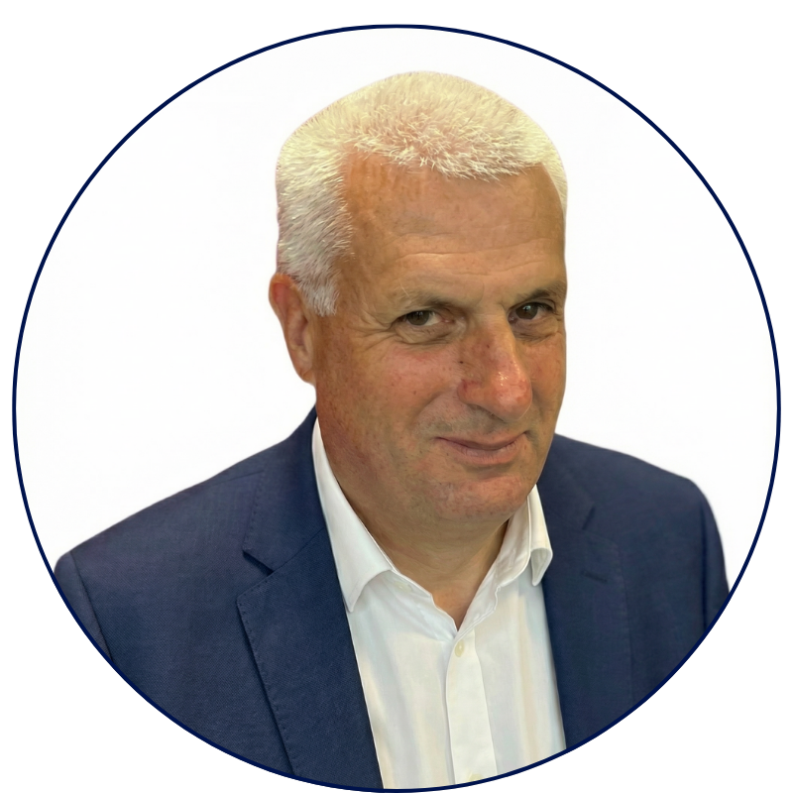



THE VALUE ACCELERATOR TEAM
Built by people who have done the job.
70+ years of B2B tech sales and marketing experience in SMB and Enterprise.
STEFANO SILVANI
MICHAEL OKOLI
CHRISTOPH CONRAD
Enterprise GTM leader with 10+ years scaling value-based enterprise sales.
Tech sales leader in enterprise. Coach 50+ sales reps in value-selling.
Advisory board member.
40+ years in B2B sales & marketing.
Value Accelerator GmbH
Grabenstrasse 11b
6340 Baar, Switzerland
E-Mail: info@value-accelerator.io
Website: www.value-accelerator.io
GABRIELE PERRONE
ROSARIO LAFACE
Enterprise software architect with
10+ years in software development.
Enterprise AI system architect. 10+ years in AI models development.

