Slide 1
Acme RenewablesGo-To-Market Blueprint
Value Accelerator ProgramDate: 05.06.2026Version: 1.0

Slide 2
ABOUT THIS DOCUMENT
For any question reach out to: info@value-accelerator.io
Why do we need a GTM Blueprint?
to have a sales system where marketing and sales use the same value-based narrative.
How did we create this Blueprint?
2-days in person GTM Foundation Workshop with marketing, sales and product) consolidated with AI.
How to use this document?
This is the foundation to build your sales playbook and marketing campaigns.

Slide 3
GO-TO-MARKET BLUEPRINT OVERVIEW six building blocks of a value-based go-to-market system
Ideal Customer Profile
“What company is the most likely to buy from you?”
Customer Mental Model
“How do your customers think about their own business?”
Go-To-Market
Foundation
Persona & Buying Group
Who are the key decision makers and what do they aim for?
Unique Selling Points
“Why should customers buy from you and not from competitors?”
Value Proposition
“Why do customers buy offerings like your?”
Commercial Insight
“How do you effectively communication your unique value?”

Slide 4
Ideal Customer Profile (ICP)
"Who is the most likely to buy from you?"

Slide 5
IDEAL CUSTOMER PROFILE (ICP)
Industry
Geography
Company Size
Renewable Energy, Asset Management
DACH, Benelux, UK
50–500 employees, €10M–€500M AUM
Buying Group
Maturity Level
[custom field]
C-Level, Operations Manager, IT Lead
Digital-first, growth stage
Min. portfolio: 5 MW

Slide 6
Persona & Buying Group
"Who are the key decision makers and what do they aim for?"

Slide 7
Business Objectives & KPIs
Head of Asset Management
Photo
Portfolio Performance
Operational Efficiency
Description: Maximize ROI across all managed assets with real-time visibility.
KPI 1: Portfolio uptime > 98%
KPI 2: Energy yield vs budget
KPI 3: O&M cost per MWh
Pain Point 1: Fragmented data across spreadsheets and tools
Pain Point 2: No single source of truth for portfolio status
Winning Trigger: Can NUO replace 5 disconnected tools?
Description: Reduce manual reporting effort and streamline workflows.
KPI 1: Report generation time < 2h
KPI 2: Issue resolution SLA < 24h
KPI 3: FTE hours saved per month
Pain Point 1: Analysts spend 60% of time on manual data aggregation
Pain Point 2: No automated alerting on underperformance
Winning Trigger: Automated reporting saves 20h/month per analyst
Name: Thomas Müller
Role: Head of Asset Management
Age: 42
Education: MSc Engineering / MBA
Location: Munich, Germany
Industry: Renewable Energy
Education: …
Location: …
Industry: …
Governance & Compliance
Scalability
Description: Maintain audit trails and meet regulatory requirements.
KPI 1: 100% audit-ready documentation
KPI 2: Zero compliance breaches
KPI 3: Stakeholder report turnaround < 24h
Pain Point 1: Manual processes create compliance gaps
Pain Point 2: Investor reporting is time-consuming and error-prone
Winning Trigger: One-click investor-ready reports
Description: Grow portfolio without proportional increase in headcount.
KPI 1: Assets per FTE ratio
KPI 2: Onboarding time for new assets < 2 weeks
KPI 3: Platform cost vs headcount cost
Pain Point 1: Every new asset requires additional manual effort
Pain Point 2: No standardized onboarding playbook
Winning Trigger: Add 10 assets with the same team size
Responsibilities
Optimize portfolio performance across 20+ wind/solar assets
Ensure regulatory compliance and governance
Drive cost reduction and operational efficiency
Communication Channels:
LinkedIn | Industry conferences | Email newsletters

Slide 8
TOP SHARED OBJECTIVES
Shared Outcome | Linked Personas | Avg. Outcome Priority %

Slide 9
Value Proposition
"Why do customers buy offerings like your?"

Slide 10
VALUE PROPOSITION
What is your product/service?
NUO is a SaaS platform for renewable energy asset portfolio management.
What does your product/service do?
It centralizes asset data, automates performance monitoring, and generates investor-ready reports.
How does it work? (In simple terms)
Connect your data sources, define KPIs, and get real-time dashboards and automated alerts.
What is the value to the customer?
Reduce manual reporting effort by 60%, improve portfolio uptime, and scale without adding headcount.

Slide 11
SLOGAN
1
Slogan 1
From data chaos to portfolio control – in days, not months.
2
Slogan 2
The operating system for renewable energy asset managers.
3
Slogan 3
Scale your portfolio. Not your team.

Slide 12
Customer Mental Model
"How do your customers think about their own business?"

Slide 13
CUSTOMER MENTAL MODEL
Head of Asset Management
Business Objective
Driving Factors
Pain Points
Use Cases
Maximize portfolio ROI with minimal operational overhead
Investor pressure for transparent, real-time reporting
Fragmented tools create data silos and manual reconciliation
Centralized performance monitoring dashboard
Growing portfolio complexity across geographies
Slow reporting cycles miss critical performance issues
Automated stakeholder reporting

Slide 14
Unique Selling Points (USPs)
"Why should customers buy from you and not from competitors?"

Slide 15
UNIQUE SELLING POINTS (USPs)
Renewable Energy Native
Platform + Expert Services
Rapid Time-to-Value
Built specifically for wind, solar, and storage asset management
Pre-built KPI frameworks aligned to industry standards
No generic ERP adaptation required
Combine software automation with Vector's AM expertise
DIY, hybrid, or fully outsourced operating model
Single vendor for software and advisory
Operational in weeks, not months
Templated onboarding and data migration support
Measurable ROI from day one

Slide 16
Commercial Insight
"How do you effectively communication your unique value?”?"

Slide 17
COMMERCIAL INSIGHT
Business Objective
Pain Point
Use Case
USP
Maximize portfolio ROI
Fragmented tools and manual reporting
Centralized performance monitoring
Renewable Energy Native platform
The Control Tower Insight
We work with asset managers that want to maximize portfolio ROI but face fragmented tools and manual reporting that slow them down.
Most teams try to solve this with more analysts or custom spreadsheets, but the issue is better solved with a centralized performance monitoring platform.
NUO is uniquely positioned to deliver this as the only renewable energy-native SaaS platform combining software automation with deep asset management expertise.

Slide 18


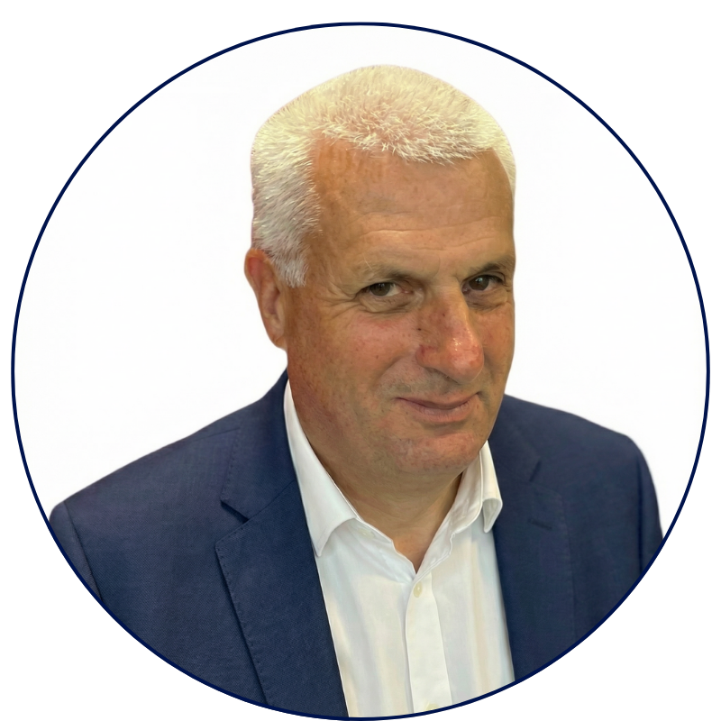


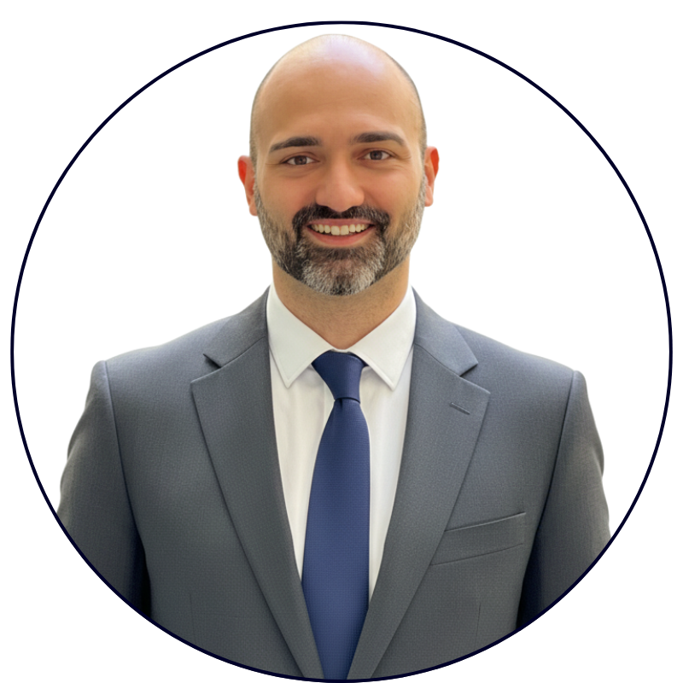
THE VALUE ACCELERATOR TEAM
Built by people who have done the job.
70+ years of B2B tech sales and marketing experience in SMB and Enterprise.
STEFANO SILVANI
MICHAEL OKOLI
CHRISTOPH CONRAD
Enterprise GTM leader with 10+ years scaling value-based enterprise sales.
Tech sales leader in enterprise. Coach 50+ sales reps in value-selling.
Advisory board member.
40+ years in B2B sales & marketing.
Value Accelerator GmbH
Grabenstrasse 11b
6340 Baar, Switzerland
E-Mail: info@value-accelerator.io
Website: www.value-accelerator.io
GABRIELE PERRONE
ROSARIO LAFACE
Enterprise software architect with
10+ years in software development.
Enterprise AI system architect. 10+ years in AI models development.

