Slide 1
Sales Assessment Report
Value Accelerator ProgramDate: Version: 1.0

Slide 2
ASSESSMENT SCOPE SUMMARY
Assessment Overview
Total Interviews
Total Document Reviewed
Assessment Period
Interviewee Name | Title | Interview Date
{{interviewee_row_1_name}} | {{interviewee_row_1_function}} | {{interviewee_row_1_date}}
{{interviewee_row_2_name}} | {{interviewee_row_2_function}} | {{interviewee_row_2_date}}
{{interviewee_row_3_name}} | {{interviewee_row_3_function}} | {{interviewee_row_3_date}}
{{interviewee_row_4_name}} | {{interviewee_row_4_function}} | {{interviewee_row_4_date}}
{{interviewee_row_5_name}} | {{interviewee_row_5_function}} | {{interviewee_row_5_date}}
Document Analyzed
{{document_analyzed_1_name}}
{{document_analyzed_2_name}}
{{document_analyzed_3_name}}
{{document_analyzed_4_name}}
{{document_analyzed_5_name}}

Slide 3
SWOT ANALYSIS
STRENGTHS
WEAKNESSES
When prospects engage deeply, NUO can win because the reported win rate suggests the offer resonates when supported by personalized attention and a disciplined evaluation process.
The most acute internal weakness is sales capacity because a one-person global sales model prevents sufficient market coverage and makes revenue generation fragile.
NUO has a structured sales process that already reflects several core SaaS selling disciplines, including qualification, staged demos, technical validation, tailored offers, and trial-based risk reduction.
The selling motion is overly reliant on individualized seller expertise, making it difficult for other Vector reps to sell NUO consistently or confidently.
The team has a clear understanding of deal-level unit economics and is willing to disqualify unprofitable opportunities, which protects margin and prevents inefficient growth.
High onboarding effort and engineering dependency constrain commercial flexibility, require long commitments, and reduce the attractiveness of smaller deals.
NUO can combine executive-level selling with technical validation by involving Customer Success in deeper product evaluations.
The product experience is not yet aligned with modern SaaS buyer expectations, creating friction in demonstrations and undermining perceived value.
OPPORTUNITIES
THREATS
NUO can expand coverage quickly by building a virtual NUO sales team of selected internal reps with stronger incentives, enablement, and dotted-line accountability.
More mature SaaS competitors may win on modern UX, implementation confidence, roadmap velocity, and perceived platform credibility.
Clarifying the relationship between NUO and Asset Management can turn internal conflict into a portfolio advantage through explicit DIY, outsourced, and hybrid commercial pathways.
Rising buyer expectations for cybersecurity, modern SaaS standards, and technical reliability could turn current product debt into a disqualifying purchase barrier.
A stricter ICP and qualification model can focus resources on portfolios with sufficient scale, urgency, data readiness, and multi-year commitment potential.
Internal portfolio conflict with Vector Asset Management may continue to dilute market focus and create confusing buyer messages if incentives and positioning remain unresolved.
Standardizing onboarding through templates, automation, and tiered implementation packages would improve unit economics, shorten time-to-value, and potentially create room for more flexible commercial terms.
Long and variable sales cycles expose NUO to budget changes, shifting buyer priorities, stakeholder turnover, and competitor displacement.

Slide 4
SALES DEEP DIVE
KEY FINDINGS
STRENGHTS & OPPORTUNITIES
A stricter ICP and qualification model can focus sales resources on portfolios with sufficient scale, urgency, data readiness, and multi-year commitment potential.
NUO can expand coverage quickly by building a virtual NUO sales team of selected internal reps with stronger incentives, enablement, and dotted-line accountability.
NUO already has a structured sales process with qualification, staged demos, technical validation, tailored offers, and trial-based risk reduction that can be codified for additional sellers.
THREATS & BARRIERS
The one-person global sales model prevents sufficient market coverage and makes revenue generation fragile.
High onboarding effort and engineering dependency constrain commercial flexibility, require long commitments, and reduce the attractiveness of smaller deals.
Internal incentives and positioning between NUO and Vector Asset Management are misaligned, reducing cross-sell motivation and creating potential cannibalization concerns.

Slide 5
MARKETING DEEP DIVE
KEY FINDINGS
STRENGHTS & OPPORTUNITIES
A more modern demand-generation program can create qualified inbound pipeline and reduce dependence on one seller’s prospecting capacity.
THREATS & BARRIERS
Marketing lacks demand-generation rigor and differentiation, leaving sales under-supported and limiting inbound pipeline creation.

Slide 6
PRODUCT DEEP DIVE
KEY FINDINGS
STRENGHTS & OPPORTUNITIES
Modernizing the product experience and publishing a credible roadmap would reduce sales friction and strengthen NUO’s ability to compete as a SaaS platform rather than a bespoke internal tool.
Standardizing onboarding through templates, automation, and tiered implementation packages would improve unit economics, shorten time-to-value, and potentially create room for more flexible commercial terms.
NUO can combine executive-level selling with technical validation by involving Customer Success in deeper product evaluations.
THREATS & BARRIERS
More mature SaaS competitors may win on modern UX, implementation confidence, roadmap velocity, and perceived platform credibility.
Rising buyer expectations for cybersecurity, modern SaaS standards, and technical reliability could turn current product debt into a disqualifying purchase barrier.
Product development appears reactive and client-funded rather than roadmap-led, which risks creating a bespoke-services perception and slowing scalable product maturation.

Slide 7
STRATEGY DEEP DIVE
KEY FINDINGS
STRENGHTS & OPPORTUNITIES
Clarifying the relationship between NUO and Asset Management can turn internal conflict into a portfolio advantage through explicit DIY, outsourced, and hybrid commercial pathways.
NUO can expand coverage quickly by building a virtual NUO sales team of selected internal reps with stronger incentives, enablement, and dotted-line accountability.
A stricter ICP and qualification model can focus resources on portfolios with sufficient scale, urgency, data readiness, and multi-year commitment potential.
THREATS & BARRIERS
The one-person global sales model prevents sufficient market coverage and makes revenue generation fragile.
Internal portfolio conflict with Vector Asset Management may continue to dilute market focus and create confusing buyer messages if incentives and positioning remain unresolved.
Long and variable sales cycles expose NUO to budget changes, shifting buyer priorities, stakeholder turnover, and competitor displacement.

Slide 8
RECOMMENDED PATH FORWARD
STRATEGY
SALES
MARKETING
PORTFOLIO
Recommendation 1: [Specific, actionable priority grounded in findings. Reference the gap or opportunity it addresses.]
Recommendation 1: [Specific, actionable priority grounded in findings. Reference the gap or opportunity it addresses.]
Recommendation 1: [Specific, actionable priority grounded in findings. Reference the gap or opportunity it addresses.]
Recommendation 1: [Specific, actionable priority grounded in findings. Reference the gap or opportunity it addresses.]
Recommendation 2: [Specific, actionable priority grounded in findings. Reference the gap or opportunity it addresses.]
Recommendation 2: [Specific, actionable priority grounded in findings. Reference the gap or opportunity it addresses.]
Recommendation 2: [Specific, actionable priority grounded in findings. Reference the gap or opportunity it addresses.]
Recommendation 2: [Specific, actionable priority grounded in findings. Reference the gap or opportunity it addresses.]
Recommendation 3: [Specific, actionable priority grounded in findings. Reference the gap or opportunity it addresses.]
Recommendation 3: [Specific, actionable priority grounded in findings. Reference the gap or opportunity it addresses.]
Recommendation 3: [Specific, actionable priority grounded in findings. Reference the gap or opportunity it addresses.]
Recommendation 3: [Specific, actionable priority grounded in findings. Reference the gap or opportunity it addresses.]

Slide 9
GO / NO-GO RECOMMENDATION
FORMAL DECISION
CONDITIONS (if applicable)
✓ PROCEED
If Proceed with conditions: list each condition explicitly. For each — what must happen, who is responsible, and by when. Delete this box if not applicable.
The organization has sufficient alignment, readiness, and commitment to begin GTM Foundation work immediately. The Value Accelerator team recommends proceeding to Step 1 on the agreed timeline.
⚠ PROCEED WITH CONDITIONS
RATIONALE FOR THE RECOMMENDATION
The organization can proceed but specific conditions must be met before or alongside Step 1. Conditions are documented in the box below — they must be confirmed before work begins.
Summarize in 3–5 sentences why this recommendation was reached. Reference the readiness ratings, key blockers or strengths, and the degree of executive sponsorship observed.
✗ DO NOT PROCEED
The assessment has identified blockers significant enough to make starting GTM work premature. The blockers and the path to resolving them are documented in this report.
GOING FORWARD
State the concrete next steps: what happens in the first 2 weeks after this report is accepted. Who does what. What the Value Accelerator team will deliver and when.

Slide 10
APPENDIX A Interviewee List
Name (optional) | Role / Title | Function | Interview Date | Notes
{{appendix_a_row_1_name}} | {{appendix_a_row_1_role}} | {{appendix_a_row_1_function}} | {{appendix_a_row_1_date}}
{{appendix_a_row_2_name}} | {{appendix_a_row_2_role}} | {{appendix_a_row_2_function}} | {{appendix_a_row_2_date}}
{{appendix_a_row_3_name}} | {{appendix_a_row_3_role}} | {{appendix_a_row_3_function}} | {{appendix_a_row_3_date}}
{{appendix_a_row_4_name}} | {{appendix_a_row_4_role}} | {{appendix_a_row_4_function}} | {{appendix_a_row_4_date}}
{{appendix_a_row_5_name}} | {{appendix_a_row_5_role}} | {{appendix_a_row_5_function}} | {{appendix_a_row_5_date}}
{{appendix_a_row_6_name}} | {{appendix_a_row_6_role}} | {{appendix_a_row_6_function}} | {{appendix_a_row_6_date}}
{{appendix_a_row_7_name}} | {{appendix_a_row_7_role}} | {{appendix_a_row_7_function}} | {{appendix_a_row_7_date}}
{{appendix_a_row_8_name}} | {{appendix_a_row_8_role}} | {{appendix_a_row_8_function}} | {{appendix_a_row_8_date}}
{{appendix_a_row_9_name}} | {{appendix_a_row_9_role}} | {{appendix_a_row_9_function}} | {{appendix_a_row_9_date}}
{{appendix_a_row_10_name}} | {{appendix_a_row_10_role}} | {{appendix_a_row_10_function}} | {{appendix_a_row_10_date}}
{{appendix_a_row_11_name}} | {{appendix_a_row_11_role}} | {{appendix_a_row_11_function}} | {{appendix_a_row_11_date}}
{{appendix_a_row_12_name}} | {{appendix_a_row_12_role}} | {{appendix_a_row_12_function}} | {{appendix_a_row_12_date}}

Slide 11
APPENDIX B Suggested Workshop Participants For Phase 2
The participants below are recommended based on the assessment findings. Final list to be confirmed with the customer sponsor before the workshop.
# | Name | Role / Title | Function | Rationale for inclusion
1 | [Name] | [Role / Title] | [Function] | [Why this person must be in the room for the GTM Foundation workshop]
2 | [Name] | [Role / Title] | [Function] | [Why this person must be in the room for the GTM Foundation workshop]
3 | [Name] | [Role / Title] | [Function] | [Why this person must be in the room for the GTM Foundation workshop]
4 | [Name] | [Role / Title] | [Function] | [Why this person must be in the room for the GTM Foundation workshop]
5 | [Name] | [Role / Title] | [Function] | [Why this person must be in the room for the GTM Foundation workshop]
6 | [Name] | [Role / Title] | [Function] | [Why this person must be in the room for the GTM Foundation workshop]
7 | [Name] | [Role / Title] | [Function] | [Why this person must be in the room for the GTM Foundation workshop]
8 | [Name] | [Role / Title] | [Function] | [Why this person must be in the room for the GTM Foundation workshop]
9 | [Name] | [Role / Title] | [Function] | [Why this person must be in the room for the GTM Foundation workshop]
10 | [Name] | [Role / Title] | [Function] | [Why this person must be in the room for the GTM Foundation workshop]

Slide 12
APPENDIX C Documents Reviewed
# | Document Name | Type | Source / Function | Relevance to Assessment
1 | {{appendix_c_row_1_name}} | {{appendix_c_row_1_type}} | {{appendix_c_row_1_function}} | {{appendix_c_row_1_relevance}}
2 | {{appendix_c_row_2_name}} | {{appendix_c_row_2_type}} | {{appendix_c_row_2_function}} | {{appendix_c_row_2_relevance}}
3 | {{appendix_c_row_3_name}} | {{appendix_c_row_3_type}} | {{appendix_c_row_3_function}} | {{appendix_c_row_3_relevance}}
4 | {{appendix_c_row_4_name}} | {{appendix_c_row_4_type}} | {{appendix_c_row_4_function}} | {{appendix_c_row_4_relevance}}
5 | {{appendix_c_row_5_name}} | {{appendix_c_row_5_type}} | {{appendix_c_row_5_function}} | {{appendix_c_row_5_relevance}}
6 | {{appendix_c_row_6_name}} | {{appendix_c_row_6_type}} | {{appendix_c_row_6_function}} | {{appendix_c_row_6_relevance}}
7 | {{appendix_c_row_7_name}} | {{appendix_c_row_7_type}} | {{appendix_c_row_7_function}} | {{appendix_c_row_7_relevance}}
8 | {{appendix_c_row_8_name}} | {{appendix_c_row_8_type}} | {{appendix_c_row_8_function}} | {{appendix_c_row_8_relevance}}
9 | {{appendix_c_row_9_name}} | {{appendix_c_row_9_type}} | {{appendix_c_row_9_function}} | {{appendix_c_row_9_relevance}}
10 | {{appendix_c_row_10_name}} | {{appendix_c_row_10_type}} | {{appendix_c_row_10_function}} | {{appendix_c_row_10_relevance}}
11 | {{appendix_c_row_11_name}} | {{appendix_c_row_11_type}} | {{appendix_c_row_11_function}} | {{appendix_c_row_11_relevance}}
12 | {{appendix_c_row_12_name}} | {{appendix_c_row_12_type}} | {{appendix_c_row_12_function}} | {{appendix_c_row_12_relevance}}

Slide 13


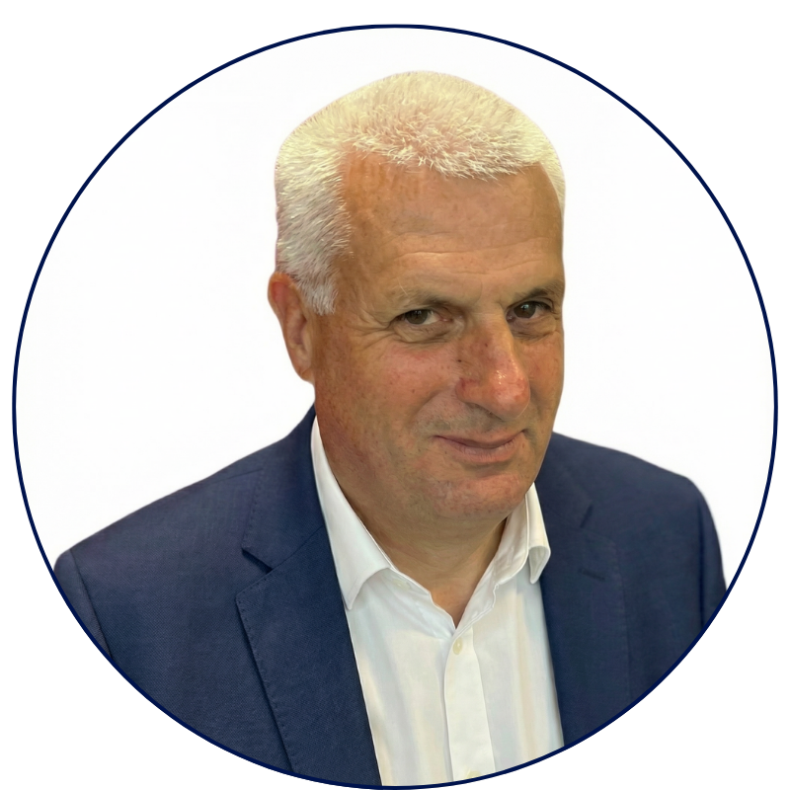

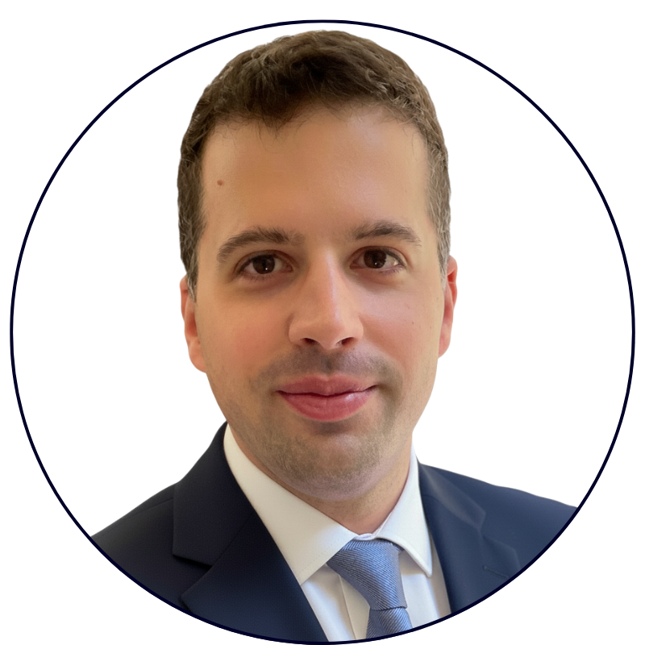
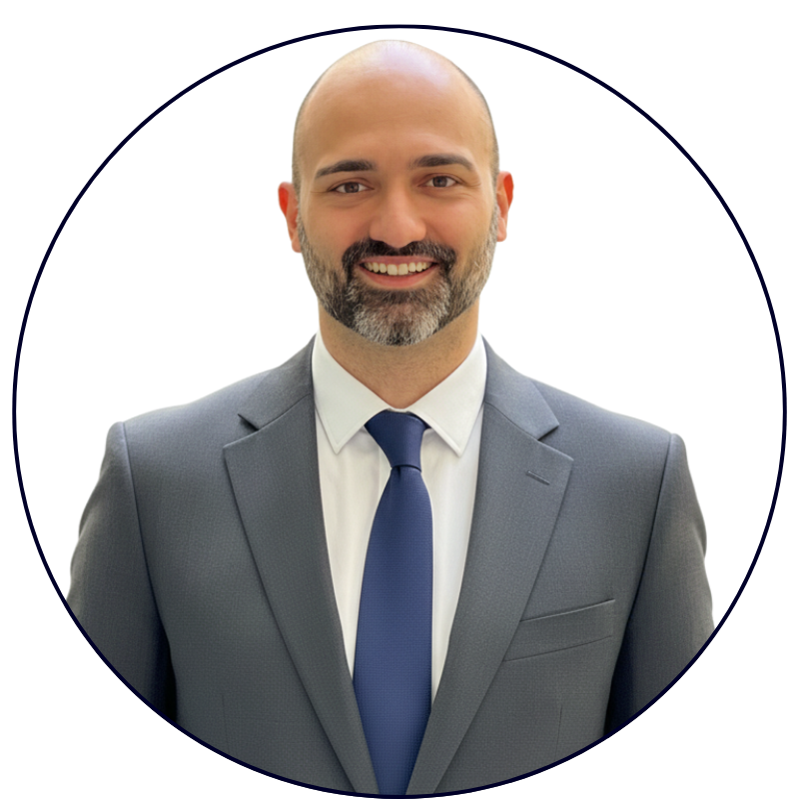
Value Accelerator
Built by People Who've Done the Job.
70+ years of B2B tech sales and marketing experience in SMB and Enterprise.
STEFANO SILVANI
MICHAEL OKOLI
CHRISTOPH CONRAD
10+ years sales experience in B2B IoT platforms.
50+ reps coached in value-selling for B2B tech.
40+ years in B2B sales and marketing leadership.
Value Accelerator GmbH
Grabenstrasse 11b
6340 Baar, Switzerland
E-Mail: info@value-accelerator.io
Website: www.value-accelerator.io
GABRIELE PERRONE
ROSARIO LAFACE
10+ years experience in building B2B software.
Scaled three tech startups based on AI agents.

