Slide 1
{{customer_name}} Sales Assessment Report
Value Accelerator Program Date: {{document_date}} Version: {{document_version}}

Slide 2
ASSESSMENT SCOPE SUMMARY
Assessment Overview
Total Interviews
Total Document Reviewed
Assessment Period
{{total_interviews}}
{{total_document_reviewed}}
{{assessment_period}}
Interviewee Name | Title | Interview Date
{{interviewee_row_1_name}} | {{interviewee_row_1_function}} | {{interviewee_row_1_date}}
{{interviewee_row_2_name}} | {{interviewee_row_2_function}} | {{interviewee_row_2_date}}
{{interviewee_row_3_name}} | {{interviewee_row_3_function}} | {{interviewee_row_3_date}}
{{interviewee_row_4_name}} | {{interviewee_row_4_function}} | {{interviewee_row_4_date}}
{{interviewee_row_5_name}} | {{interviewee_row_5_function}} | {{interviewee_row_5_date}}
Document Analyzed
{{document_analyzed_1_name}}
{{document_analyzed_2_name}}
{{document_analyzed_3_name}}
{{document_analyzed_4_name}}
{{document_analyzed_5_name}}

Slide 3
SWOT ANALYSIS
STRENGTHS
WEAKNESSES
{{swot_strength_1}}
{{swot_weakness_1}}
{{swot_strength_2}}
{{swot_weakness_2}}
{{swot_strength_3}}
{{swot_weakness_3}}
{{swot_strength_4}}
{{swot_weakness_4}}
OPPORTUNITIES
THREATS
{{swot_opportunity_1}}
{{swot_threat_1}}
{{swot_opportunity_2}}
{{swot_threat_2}}
{{swot_opportunity_3}}
{{swot_threat_3}}
{{swot_opportunity_4}}
{{swot_threat_4}}

Slide 4
SALES DEEP DIVE
KEY FINDINGS
STRENGHTS & OPPORTUNITIES
{{sales_so_finding_2}}
{{sales_so_finding_1}}
{{sales_so_finding_3}}
{{sales_so_finding_8}}
{{sales_so_finding_9}}
{{sales_so_finding_4}}
{{sales_so_finding_5}}
THREATS & BARRIERS
{{sales_tb_finding_1}}
{{sales_so_finding_6}}
{{sales_tb_finding_2}}
{{sales_so_finding_7}}
{{sales_tb_finding_3}}

Slide 5
MARKETING DEEP DIVE
KEY FINDINGS
STRENGHTS & OPPORTUNITIES
{{marketing_so_finding_2}}
{{marketing_so_finding_1}}
{{marketing_so_finding_3}}
{{marketing_so_finding_8}}
{{marketing_so_finding_9}}
{{marketing_so_finding_4}}
{{marketing_so_finding_5}}
THREATS & BARRIERS
{{marketing_tb_finding_1}}
{{marketing_so_finding_6}}
{{marketing_tb_finding_2}}
{{marketing_so_finding_7}}
{{marketing_tb_finding_3}}

Slide 6
PRODUCT DEEP DIVE
KEY FINDINGS
STRENGHTS & OPPORTUNITIES
{{product_so_finding_2}}
{{product_so_finding_1}}
{{product_so_finding_3}}
{{product_so_finding_8}}
{{product_so_finding_9}}
{{product_so_finding_4}}
{{product_so_finding_5}}
THREATS & BARRIERS
{{product_tb_finding_1}}
{{product_so_finding_6}}
{{product_tb_finding_2}}
{{product_so_finding_7}}
{{product_tb_finding_3}}

Slide 7
STRATEGY DEEP DIVE
KEY FINDINGS
STRENGHTS & OPPORTUNITIES
{{strategy_so_finding_2}}
{{strategy_so_finding_1}}
{{strategy_so_finding_3}}
{{strategy_so_finding_8}}
{{strategy_so_finding_9}}
{{strategy_so_finding_4}}
{{strategy_so_finding_5}}
THREATS & BARRIERS
{{strategy_tb_finding_1}}
{{strategy_so_finding_6}}
{{strategy_tb_finding_2}}
{{strategy_so_finding_7}}
{{strategy_tb_finding_3}}

Slide 8
RECOMMENDED PATH FORWARD
STRATEGY
SALES
MARKETING
PORTFOLIO
Recommendation 1: [Specific, actionable priority grounded in findings. Reference the gap or opportunity it addresses.]
Recommendation 1: [Specific, actionable priority grounded in findings. Reference the gap or opportunity it addresses.]
Recommendation 1: [Specific, actionable priority grounded in findings. Reference the gap or opportunity it addresses.]
Recommendation 1: [Specific, actionable priority grounded in findings. Reference the gap or opportunity it addresses.]
Recommendation 2: [Specific, actionable priority grounded in findings. Reference the gap or opportunity it addresses.]
Recommendation 2: [Specific, actionable priority grounded in findings. Reference the gap or opportunity it addresses.]
Recommendation 2: [Specific, actionable priority grounded in findings. Reference the gap or opportunity it addresses.]
Recommendation 2: [Specific, actionable priority grounded in findings. Reference the gap or opportunity it addresses.]
Recommendation 3: [Specific, actionable priority grounded in findings. Reference the gap or opportunity it addresses.]
Recommendation 3: [Specific, actionable priority grounded in findings. Reference the gap or opportunity it addresses.]
Recommendation 3: [Specific, actionable priority grounded in findings. Reference the gap or opportunity it addresses.]
Recommendation 3: [Specific, actionable priority grounded in findings. Reference the gap or opportunity it addresses.]

Slide 9
GO / NO-GO RECOMMENDATION
FORMAL DECISION
CONDITIONS (if applicable)
✓ PROCEED
If Proceed with conditions: list each condition explicitly. For each — what must happen, who is responsible, and by when. Delete this box if not applicable.
The organization has sufficient alignment, readiness, and commitment to begin GTM Foundation work immediately. The Value Accelerator team recommends proceeding to Step 1 on the agreed timeline.
⚠ PROCEED WITH CONDITIONS
RATIONALE FOR THE RECOMMENDATION
The organization can proceed but specific conditions must be met before or alongside Step 1. Conditions are documented in the box below — they must be confirmed before work begins.
Summarize in 3–5 sentences why this recommendation was reached. Reference the readiness ratings, key blockers or strengths, and the degree of executive sponsorship observed.
✗ DO NOT PROCEED
The assessment has identified blockers significant enough to make starting GTM work premature. The blockers and the path to resolving them are documented in this report.
GOING FORWARD
State the concrete next steps: what happens in the first 2 weeks after this report is accepted. Who does what. What the Value Accelerator team will deliver and when.

Slide 10
APPENDIX A Interviewee List
Name (optional) | Role / Title | Function | Interview Date | Notes
{{appendix_a_row_1_name}} | {{appendix_a_row_1_role}} | {{appendix_a_row_1_function}} | {{appendix_a_row_1_date}}
{{appendix_a_row_2_name}} | {{appendix_a_row_2_role}} | {{appendix_a_row_2_function}} | {{appendix_a_row_2_date}}
{{appendix_a_row_3_name}} | {{appendix_a_row_3_role}} | {{appendix_a_row_3_function}} | {{appendix_a_row_3_date}}
{{appendix_a_row_4_name}} | {{appendix_a_row_4_role}} | {{appendix_a_row_4_function}} | {{appendix_a_row_4_date}}
{{appendix_a_row_5_name}} | {{appendix_a_row_5_role}} | {{appendix_a_row_5_function}} | {{appendix_a_row_5_date}}
{{appendix_a_row_6_name}} | {{appendix_a_row_6_role}} | {{appendix_a_row_6_function}} | {{appendix_a_row_6_date}}
{{appendix_a_row_7_name}} | {{appendix_a_row_7_role}} | {{appendix_a_row_7_function}} | {{appendix_a_row_7_date}}
{{appendix_a_row_8_name}} | {{appendix_a_row_8_role}} | {{appendix_a_row_8_function}} | {{appendix_a_row_8_date}}
{{appendix_a_row_9_name}} | {{appendix_a_row_9_role}} | {{appendix_a_row_9_function}} | {{appendix_a_row_9_date}}
{{appendix_a_row_10_name}} | {{appendix_a_row_10_role}} | {{appendix_a_row_10_function}} | {{appendix_a_row_10_date}}
{{appendix_a_row_11_name}} | {{appendix_a_row_11_role}} | {{appendix_a_row_11_function}} | {{appendix_a_row_11_date}}
{{appendix_a_row_12_name}} | {{appendix_a_row_12_role}} | {{appendix_a_row_12_function}} | {{appendix_a_row_12_date}}

Slide 11
APPENDIX B Suggested Workshop Participants For Phase 2
The participants below are recommended based on the assessment findings. Final list to be confirmed with the customer sponsor before the workshop.
# | Name | Role / Title | Function | Rationale for inclusion
1 | [Name] | [Role / Title] | [Function] | [Why this person must be in the room for the GTM Foundation workshop]
2 | [Name] | [Role / Title] | [Function] | [Why this person must be in the room for the GTM Foundation workshop]
3 | [Name] | [Role / Title] | [Function] | [Why this person must be in the room for the GTM Foundation workshop]
4 | [Name] | [Role / Title] | [Function] | [Why this person must be in the room for the GTM Foundation workshop]
5 | [Name] | [Role / Title] | [Function] | [Why this person must be in the room for the GTM Foundation workshop]
6 | [Name] | [Role / Title] | [Function] | [Why this person must be in the room for the GTM Foundation workshop]
7 | [Name] | [Role / Title] | [Function] | [Why this person must be in the room for the GTM Foundation workshop]
8 | [Name] | [Role / Title] | [Function] | [Why this person must be in the room for the GTM Foundation workshop]
9 | [Name] | [Role / Title] | [Function] | [Why this person must be in the room for the GTM Foundation workshop]
10 | [Name] | [Role / Title] | [Function] | [Why this person must be in the room for the GTM Foundation workshop]

Slide 12
APPENDIX C Documents Reviewed
# | Document Name | Type | Source / Function | Relevance to Assessment
1 | {{appendix_c_row_1_name}} | {{appendix_c_row_1_type}} | {{appendix_c_row_1_function}} | {{appendix_c_row_1_relevance}}
2 | {{appendix_c_row_2_name}} | {{appendix_c_row_2_type}} | {{appendix_c_row_2_function}} | {{appendix_c_row_2_relevance}}
3 | {{appendix_c_row_3_name}} | {{appendix_c_row_3_type}} | {{appendix_c_row_3_function}} | {{appendix_c_row_3_relevance}}
4 | {{appendix_c_row_4_name}} | {{appendix_c_row_4_type}} | {{appendix_c_row_4_function}} | {{appendix_c_row_4_relevance}}
5 | {{appendix_c_row_5_name}} | {{appendix_c_row_5_type}} | {{appendix_c_row_5_function}} | {{appendix_c_row_5_relevance}}
6 | {{appendix_c_row_6_name}} | {{appendix_c_row_6_type}} | {{appendix_c_row_6_function}} | {{appendix_c_row_6_relevance}}
7 | {{appendix_c_row_7_name}} | {{appendix_c_row_7_type}} | {{appendix_c_row_7_function}} | {{appendix_c_row_7_relevance}}
8 | {{appendix_c_row_8_name}} | {{appendix_c_row_8_type}} | {{appendix_c_row_8_function}} | {{appendix_c_row_8_relevance}}
9 | {{appendix_c_row_9_name}} | {{appendix_c_row_9_type}} | {{appendix_c_row_9_function}} | {{appendix_c_row_9_relevance}}
10 | {{appendix_c_row_10_name}} | {{appendix_c_row_10_type}} | {{appendix_c_row_10_function}} | {{appendix_c_row_10_relevance}}
11 | {{appendix_c_row_11_name}} | {{appendix_c_row_11_type}} | {{appendix_c_row_11_function}} | {{appendix_c_row_11_relevance}}
12 | {{appendix_c_row_12_name}} | {{appendix_c_row_12_type}} | {{appendix_c_row_12_function}} | {{appendix_c_row_12_relevance}}

Slide 13

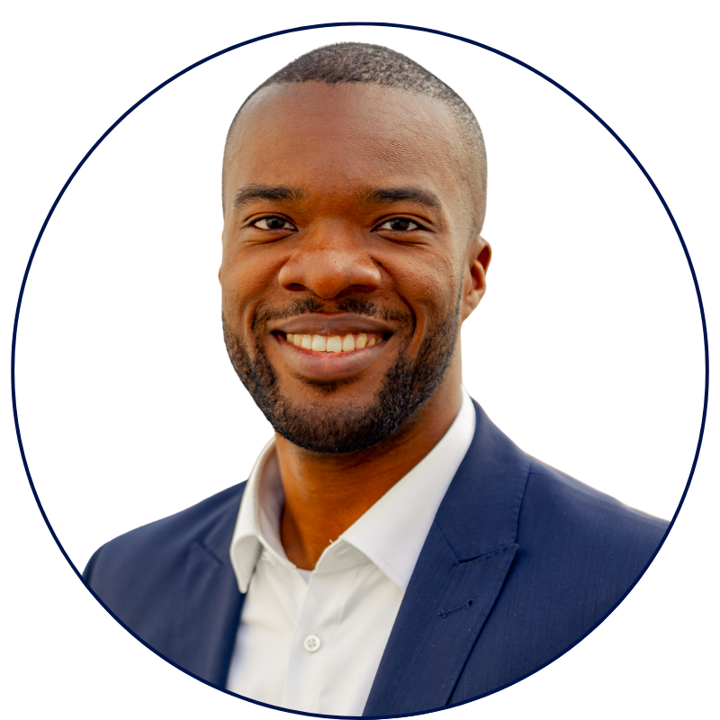
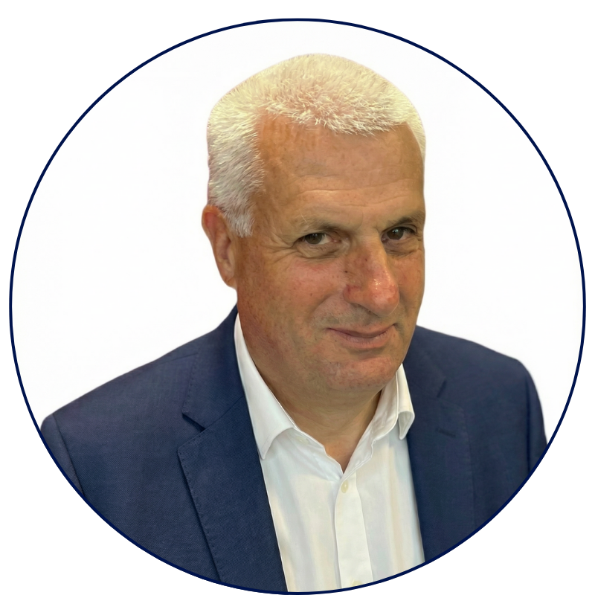

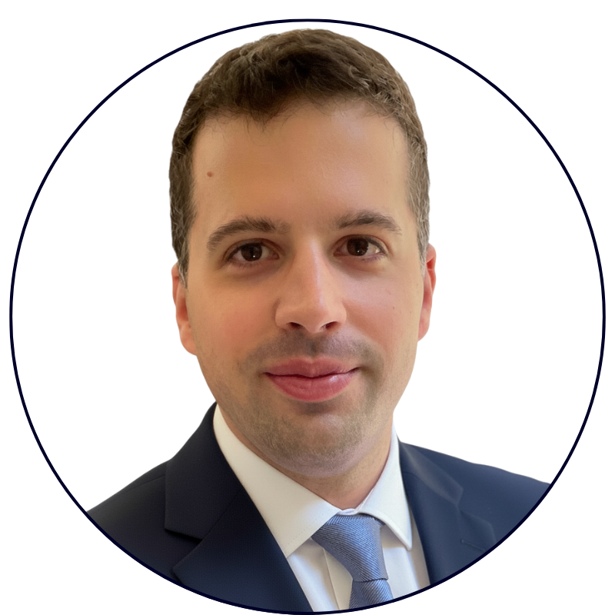
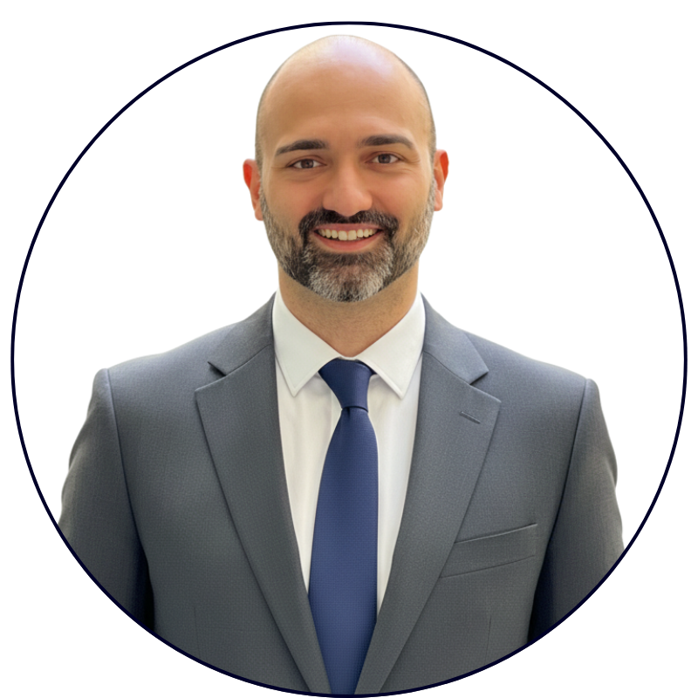
Value Accelerator
Built by People Who've Done the Job.
70+ years of B2B tech sales and marketing experience in SMB and Enterprise.
STEFANO SILVANI
MICHAEL OKOLI
CHRISTOPH CONRAD
10+ years sales experience in B2B IoT platforms.
50+ reps coached in value-selling for B2B tech.
40+ years in B2B sales and marketing leadership.
Value Accelerator GmbH
Grabenstrasse 11b
6340 Baar, Switzerland
E-Mail: info@value-accelerator.io
Website: www.value-accelerator.io
GABRIELE PERRONE
ROSARIO LAFACE
10+ years experience in building B2B software.
Scaled three tech startups based on AI agents.

