Slide 1

Fast Approximation of Betweenness Centrality through Sampling
M. Riondato,E. Kornaropoulos,E. Upfal
Brown University
Computer Science
Padova – May 24th, 2013
Riondato et al. – Fast Approximation of Betweenness Centrality Through Sampling

Slide 2

Fast Approximation of Betweenness Centrality through Sampling
M. Riondato,E. Kornaropoulos,E. Upfal
Brown University
Computer Science
Padova – May 24th, 2013
Riondato et al. – Fast Approximation of Betweenness Centrality Through Sampling

Slide 3

Motivation
Why is it interesting?
Riondato et al. – Fast Approximation of Betweenness Centrality Through Sampling

Slide 4

Online Social Networks
Riondato et al. – Fast Approximation of Betweenness Centrality Through Sampling

Slide 5
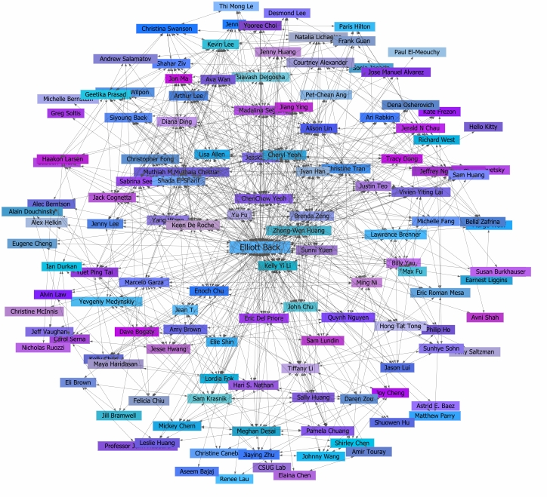
Relationship Graph
Riondato et al. – Fast Approximation of Betweenness Centrality Through Sampling

Slide 6
Motivation
Prolification of online social networks
Social Network Analysis pre-existed them
Core task:
      Find the most important players
Riondato et al. – Fast Approximation of Betweenness Centrality Through Sampling

Slide 7
Motivation
Prolification of online social networks
Social Network Analysis pre-existed them
Core task:
      Find the most important players
Why?
      To target them (rumors spreading, connectivity, promotions, …)
Riondato et al. – Fast Approximation of Betweenness Centrality Through Sampling

Slide 8
Motivation
Prolification of online social networks
Social Network Analysis pre-existed them
Core task:
      Find the most important players
Why?
      To target them (rumors spreading, connectivity, promotions, …)
Not just social networks: road networks (used in GPS navs), computer networks (Autonomous Systems), protein networks
Riondato et al. – Fast Approximation of Betweenness Centrality Through Sampling

Slide 9
Motivation
Prolification of online social networks
Social Network Analysis pre-existed them
Core task:
      Find the most important players
Why?
      To target them (rumors spreading, connectivity, promotions, …)
Not just social networks: road networks (used in GPS navs), computer networks (Autonomous Systems), protein networks
Not well defined.
What is “important”?
Riondato et al. – Fast Approximation of Betweenness Centrality Through Sampling

Slide 10
Centrality Indices
Centrality indices measure the relative importance of vertices in a graph
Introduced in sociology literature, '70s
Riondato et al. – Fast Approximation of Betweenness Centrality Through Sampling

Slide 11
Centrality Indices
Centrality indices measure the relative importance of vertices in a graph
Introduced in sociology literature, '70s
Different flavours of importance
  Many definitions of centrality indexes
Most are based on shortest paths
  Intuition: information “spreads” along shortest paths (probably not true)
Can be extended to include routing info
Riondato et al. – Fast Approximation of Betweenness Centrality Through Sampling

Slide 12
Computing Centrality
Today's networks have 10^8 vertices
Exact computation requires many runs of Single Source Shortest Paths (SSSP)
Too expensive, despite tricks to speed up the computation [Brandes01]
Riondato et al. – Fast Approximation of Betweenness Centrality Through Sampling

Slide 13
Computing Centrality
Today's networks have 10^8 vertices
Exact computation requires many runs of Single Source Shortest Paths (SSSP)
Too expensive, despite tricks to speed up the computation [Brandes01]
Sampling can help:
  trade-off accuracy for speed
Riondato et al. – Fast Approximation of Betweenness Centrality Through Sampling

Slide 14
Outline
Motivationü
Definition and settings
Exact and simple sampling algorithms
Our result: a fast sampling algorithm
Better approximation for the top-K vertices
Experiments
Conclusions
Riondato et al. – Fast Approximation of Betweenness Centrality Through Sampling

Slide 15
Graph
Graph
  ,
  Can be weighted:
  Can be directed
  No loops
  No multiple edges
Riondato et al. – Fast Approximation of Betweenness Centrality Through Sampling

Slide 16
(Shortest) Paths
Path ordered tuple of vertices
End points of :
Internal vertices:
: Set of shortest paths from to
: no. of shortest paths from to
: all shortest paths in
Riondato et al. – Fast Approximation of Betweenness Centrality Through Sampling

Slide 17
Betweenness Centrality
The betwenness centrality of a vertex measures (roughly) the fraction of shortest paths going through
Riondato et al. – Fast Approximation of Betweenness Centrality Through Sampling

Slide 18
Betweenness Centrality
The betweenness centrality of a vertex measures (roughly) the fraction of shortest paths going through
Let
Betweenness centrality of
k-betweenness: local variant, consider only shortest paths of length up to k
Riondato et al. – Fast Approximation of Betweenness Centrality Through Sampling

Slide 19
Vertex Diameter
The vertex diameter of is the maximum size of a shortest path between a pair of vertices of :
If the graph is not weighted:
No relationship in general if is weighted
Riondato et al. – Fast Approximation of Betweenness Centrality Through Sampling

Slide 20
Outline
Motivationü
Definition and settingsü
Exact and simple sampling algorithm
Our result: a fast sampling algorithm
Better approximation for the top-K vertices
Experiments
Conclusions
Riondato et al. – Fast Approximation of Betweenness Centrality Through Sampling

Slide 21
Exact Algorithm
Naïve exact algorithm for betweenness:
  All Pair Shortest Paths + Computation
  The computation part dominates
  Complexity:
Riondato et al. – Fast Approximation of Betweenness Centrality Through Sampling

Slide 22
Exact Algorithm
Naïve exact algorithm for betweenness:
  All Pair Shortest Paths + Computation
  The computation part dominates
  Complexity:
[Brandes01]:
  split computation in smaller parts by considering partial contributions
  Complexity: or
Riondato et al. – Fast Approximation of Betweenness Centrality Through Sampling

Slide 23
Exact Algorithm
Naïve exact algorithm for betweenness:
  All Pair Shortest Paths + Computation
  The computation part dominates
  Complexity:
[Brandes01]:
  split computation in smaller parts by considering partial contributions
  Complexity: or
This is still too much for
large networks
Riondato et al. – Fast Approximation of Betweenness Centrality Through Sampling

Slide 24
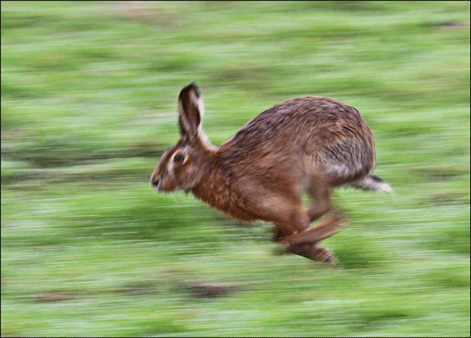
Sampling to the Rescue
Solution: use sampling!
Trade off accuracy for speed
Can guarantee high quality approximations with high confidence
...especially when the analysis
is tight!
Riondato et al. – Fast Approximation of Betweenness Centrality Through Sampling

Slide 25
Sampling to the Rescue
Solution: use sampling!
Trade off accuracy for speed
Can guarantee high quality approximations with high confidence
...especially when the analysis
is tight!
Key questions:
What should we sample?
How much should we sample?
Riondato et al. – Fast Approximation of Betweenness Centrality Through Sampling

Slide 26
Guarantees
We want (probabilistic) guarantees on the approximation
Riondato et al. – Fast Approximation of Betweenness Centrality Through Sampling

Slide 27
Guarantees
We want (probabilistic) guarantees on the approximation
An -approximation for the betweenness is a set of estimations for all such that
controls the accuracy
controls the confidence
Trade-off: Higher accuracy and/or confidence requires more samples!
Riondato et al. – Fast Approximation of Betweenness Centrality Through Sampling

Slide 28
Simple Sampling Algorithm
[BrandesPich07] inspired by[EppsteinWang01]
The algorithm:
For times do
Sample random vertex
Compute SSSP from
Perform partial computation for
Riondato et al. – Fast Approximation of Betweenness Centrality Through Sampling

Slide 29
Simple Sampling Algorithm
[BrandesPich07] inspired by[EppsteinWang01]
The algorithm:
For times do
Sample random vertex
Compute SSSP from
Perform partial computation for
Like exact algorithm
[Brandes01]
Riondato et al. – Fast Approximation of Betweenness Centrality Through Sampling

Slide 30
Simple Sampling Algorithm
[BrandesPich07] inspired by[EppsteinWang01]
The algorithm:
For times do
Sample random vertex
Compute SSSP from
Perform partial computation for
At each step, the algorithm computes many shortest paths (at least n-1 for a connected, undirected graph)
Like exact algorithm
[Brandes01]
Riondato et al. – Fast Approximation of Betweenness Centrality Through Sampling

Slide 31
Simple Sampling Algorithm
[BrandesPich07] inspired by[EppsteinWang01]
The algorithm:
For times do
Sample random vertex
Compute SSSP from
Perform partial computation for
At each step, the algorithm computes many shortest paths (at least n-1 for a connected, undirected graph)
Sample size
How to choose it?
Trade off between
accuracy/confidence
and speed
Like exact algorithm
[Brandes01]
Riondato et al. – Fast Approximation of Betweenness Centrality Through Sampling

Slide 32
Sample Size Derivation
How to compute ?
Riondato et al. – Fast Approximation of Betweenness Centrality Through Sampling

Slide 33
Sample Size Derivation
How to compute ?
Use Hoeffding bound (method of bounded differences) to bound deviation of estimated betweenness from exact value for a single vertex:
Riondato et al. – Fast Approximation of Betweenness Centrality Through Sampling

Slide 34
Sample Size Derivation
How to compute ?
Use Hoeffding bound (method of bounded differences) to bound deviation of estimated betweenness from exact value for a single vertex:
Use union bound over all vertices
Riondato et al. – Fast Approximation of Betweenness Centrality Through Sampling

Slide 35
Sample Size Derivation
How to compute ?
Use Hoeffding bound (method of bounded differences) to bound deviation of estimated betweenness from exact value for a single vertex:
Use union bound over all vertices
Sample size for -approximation:
Riondato et al. – Fast Approximation of Betweenness Centrality Through Sampling

Slide 36
Drawbacks
The sample size depends on
  Obtained from the union bound: loose!
Riondato et al. – Fast Approximation of Betweenness Centrality Through Sampling

Slide 37
Drawbacks
The sample size depends on
  Obtained from the union bound: loose!
  Is this the right quantity?
    We believe not
    It should be a characteristic quantity of the graph
Riondato et al. – Fast Approximation of Betweenness Centrality Through Sampling

Slide 38
Drawbacks
The sample size depends on
  Obtained from the union bound: loose!
  Is this the right quantity?
    We believe not
    It should be a characteristic quantity of the graph
At each sample, “heavy” computation (SSSP)
  Touch a lot of edges, has low “locality”
Riondato et al. – Fast Approximation of Betweenness Centrality Through Sampling

Slide 39
Outline
Motivationü
Definition and settingsü
Exact and simple sampling algorithmsü
Our result: a fast sampling algorithm
Better approximation for the top-K vertices
Experiments
Conclusions
Riondato et al. – Fast Approximation of Betweenness Centrality Through Sampling

Slide 40
Fast Sampling Algorithm
Our algorithm solves the drawbacks:
  Does not use the union bound
      use VC-dimension
  Its sample size depends on a characteristic quantity of the graph (the vertex-diameter)
      Not on number of vertices
  Performs a single s-t shortest path computation per sample
    Fewer edges touched, better locality
Riondato et al. – Fast Approximation of Betweenness Centrality Through Sampling

Slide 41
Fast Sampling Algorithm
The algorithm:
For times do
    Sample a random pair of vertices
    Compute ,all shortest paths from to
    Select a path uniformly at random from
    For each
Riondato et al. – Fast Approximation of Betweenness Centrality Through Sampling

Slide 42
Vertex Diameter
The vertex diameter of is the maximum size of a shortest path between a pair of vertices of :
If the graph is not weighted:
No relationship in general if is weighted
Riondato et al. – Fast Approximation of Betweenness Centrality Through Sampling

Slide 43
Analysis
Theorem:
Given , if
then
We have an -approximation
Riondato et al. – Fast Approximation of Betweenness Centrality Through Sampling

Slide 44
Analysis
Theorem:
Given , if
then
We have an -approximation
Always less than n
Riondato et al. – Fast Approximation of Betweenness Centrality Through Sampling

Slide 45
Analysis
Theorem:
Given , if
then
We have an -approximation
For the proof, we use VC-Dimension
Always less than n
Riondato et al. – Fast Approximation of Betweenness Centrality Through Sampling

Slide 46
VC-Dimension
[VapnikChervonenkis71]
Combinatorial property of a collection of subsets from a domain
Measures the “richness”, “expressivity” of the subsets
Given a probability distribution on the domain, if we know the VC-dim of a collection of subsets, we can compute the sample size sufficient to approximate the probability mass of each subsets using a sample and the empirical average
Riondato et al. – Fast Approximation of Betweenness Centrality Through Sampling

Slide 47
Range Sets
VC-Dimension is defined on range sets
: Domain
: collection of subsets from (ranges)
No restrictions:
  can be infinite
  can be infinite
  can contain infinitely-large subsets of
Riondato et al. – Fast Approximation of Betweenness Centrality Through Sampling

Slide 48
VC-Dimension
Range set on domain
For any , define
is shattered if
The VC-Dimension of is the size of the largest shattered subset of
Riondato et al. – Fast Approximation of Betweenness Centrality Through Sampling

Slide 49
Example of VC-Dimension
y
x
Riondato et al. – Fast Approximation of Betweenness Centrality Through Sampling

Slide 50
Example of VC-Dimension
= all axis-aligned rectangles in
y
x
Riondato et al. – Fast Approximation of Betweenness Centrality Through Sampling

Slide 51
Example of VC-Dimension
= all axis-aligned rectangles in
Shattering 4 points: Easy
  Take any 4 points s.t. no 3 of
  them are aligned
y
x
y
x
Riondato et al. – Fast Approximation of Betweenness Centrality Through Sampling

Slide 52
Example of VC-Dimension
= all axis-aligned rectangles in
Shattering 4 points: Easy
  Take any 4 points s.t. no 3 of
  them are aligned
y
x
y
Need 16 rectangles
to shatter them
x
Riondato et al. – Fast Approximation of Betweenness Centrality Through Sampling

Slide 53
Example of VC-Dimension
= all axis-aligned rectangles in
Shattering 5 points?
y
x
Riondato et al. – Fast Approximation of Betweenness Centrality Through Sampling
Notes:
Internal to the convex hull of the other four

Slide 54
Example of VC-Dimension
= all axis-aligned rectangles in
Shattering 5 points: impossible
y
x
Riondato et al. – Fast Approximation of Betweenness Centrality Through Sampling
Notes:
Internal to the convex hull of the other four

Slide 55
Example of VC-Dimension
y
= all axis-aligned rectangles in
Shattering 5 points: impossible
  Take any 5 points
  One of them that is contained in all rectangles containing the other four
  Impossible to find a rectangle containing only the other four
y
x
Riondato et al. – Fast Approximation of Betweenness Centrality Through Sampling
Notes:
Internal to the convex hull of the other four

Slide 56
VC-Dimension
[Vapnik and Chervonenkis 71]
Combinatorial property of a collection of subsets from a domain
Measures the “richness”, “expressivity” of the subsets
Given a probability distribution on the domain, if we know the VC-dim of a collection of subsets, we can compute the sample size sufficient to approximate the probability mass of each subsets using a sample and the empirical average
Riondato et al. – Fast Approximation of Betweenness Centrality Through Sampling

Slide 57
Sample Theorem
Let have
Let be a probability distribution on
Let be the probability mass of
Given ,let be a collection of samples from
If
  then,
Riondato et al. – Fast Approximation of Betweenness Centrality Through Sampling
Notes:
Sample size may not depend on number of sets

Slide 58
Sample Theorem
Let have
Let be a probability distribution on
Let be the probability mass of
Given ,let be a collection of samples from
If
  then,
Empirical Average
Riondato et al. – Fast Approximation of Betweenness Centrality Through Sampling
Notes:
Sample size may not depend on number of sets

Slide 59
Roadmap
We are going to build a range set for the problem and show an upper bound to its VC-dimension
We define a probability distribution and use it to sample elements of the domain
The sample theorem gives us the amount of samples we need to draw to obtain a good approximation of the betweenness of all vertices
Riondato et al. – Fast Approximation of Betweenness Centrality Through Sampling

Slide 60
Shortest Path Range Set
Range set associated to shortest paths
Domain: , all shortest paths in
Contains one range per vertex
Riondato et al. – Fast Approximation of Betweenness Centrality Through Sampling

Slide 61
Shortest Path Range Set
Range set associated to shortest paths
Domain: , all shortest paths in
Contains one range per vertex
All shortest paths v
is internal to
Riondato et al. – Fast Approximation of Betweenness Centrality Through Sampling

Slide 62
Shortest Path Range Set
Range set associated to shortest paths
Domain: , all shortest paths in
Contains one range per vertex
Sampling probability distribution on
The algorithm samples paths according to
All shortest paths v
is internal to
Riondato et al. – Fast Approximation of Betweenness Centrality Through Sampling

Slide 63
Bounding the VC-Dimension
Theorem:
Riondato et al. – Fast Approximation of Betweenness Centrality Through Sampling

Slide 64
Bounding the VC-Dimension
Theorem:
Proof:
Riondato et al. – Fast Approximation of Betweenness Centrality Through Sampling

Slide 65
Bounding the VC-Dimension
Theorem:
Proof: To shatter a set of paths, , we need different ranges
Riondato et al. – Fast Approximation of Betweenness Centrality Through Sampling

Slide 66
Bounding the VC-Dimension
Theorem:
Proof: To shatter a set of paths, , we need different ranges
  Any must appear in different ranges
Riondato et al. – Fast Approximation of Betweenness Centrality Through Sampling

Slide 67
Bounding the VC-Dimension
Theorem:
Proof: To shatter a set of paths, , we need different ranges
  Any must appear in different ranges
  appears only in the 's of the
Riondato et al. – Fast Approximation of Betweenness Centrality Through Sampling

Slide 68
Bounding the VC-Dimension
Theorem:
Proof: To shatter a set of paths, , we need different ranges
  Any must appear in different ranges
  appears only in the 's of the
  appears in ranges
Riondato et al. – Fast Approximation of Betweenness Centrality Through Sampling

Slide 69
Bounding the VC-Dimension
Theorem:
Proof: To shatter a set of paths, , we need different ranges
  Any must appear in different ranges
  appears only in the 's of the
  appears in ranges
  For to be shattered, must be
  Implies the thesis
Riondato et al. – Fast Approximation of Betweenness Centrality Through Sampling

Slide 70
Back to the algorithm
Recall the algorithm:
For times do
    Sample a random pair of vertices
    Compute ,all shortest paths from to
    Select a path uniformly at random from
    For each
Riondato et al. – Fast Approximation of Betweenness Centrality Through Sampling

Slide 71
Back to the algorithm
Recall the algorithm:
For times do
    Sample a random pair of vertices
    Compute ,all shortest paths from to
    Select a path uniformly at random from
    For each
Sampling from pi
Riondato et al. – Fast Approximation of Betweenness Centrality Through Sampling

Slide 72
Back to the algorithm
Recall the algorithm:
For times do
    Sample a random pair of vertices
    Compute ,all shortest paths from to
    Select a path uniformly at random from
    For each
Sampling from pi
Empirical
Average
Riondato et al. – Fast Approximation of Betweenness Centrality Through Sampling

Slide 73
Correctness
From the sample theorem we get that if
then the returned collection of is an
-approximation:
Riondato et al. – Fast Approximation of Betweenness Centrality Through Sampling

Slide 74
Correctness
From the sample theorem we get that if
then the returned collection of is an
-approximation:
In real world social networks,
the diameter is usually very small
(small wold phenomenon)
Definitively smaller than n
Riondato et al. – Fast Approximation of Betweenness Centrality Through Sampling

Slide 75
Corollaries
If there is a unique shortest path for each pair of vertices then
Riondato et al. – Fast Approximation of Betweenness Centrality Through Sampling

Slide 76
Corollaries
If there is a unique shortest path for each pair of vertices then
  This “collapse” of the VC-dimension to a constant is somewhat surprising
  Suggests that there may be other characteristic quantities of the graph that control the VC-Dimension
Riondato et al. – Fast Approximation of Betweenness Centrality Through Sampling

Slide 77
Corollaries
If there is a unique shortest path for each pair of vertices then
  This “collapse” of the VC-dimension to a constant is somewhat surprising
  Suggests that there may be other characteristic quantities of the graph that control the VC-Dimension
k-betweenness: if we only consider shortest paths of size up to k, then
Riondato et al. – Fast Approximation of Betweenness Centrality Through Sampling

Slide 78
Diameter Approximation
Computing exactly would require APSP
  Defeat the purpose of sampling
Riondato et al. – Fast Approximation of Betweenness Centrality Through Sampling

Slide 79
Diameter Approximation
Computing exactly would require APSP
  Defeat the purpose of sampling
We need an approximation of
Can be constant approx, we use log anyway!
Riondato et al. – Fast Approximation of Betweenness Centrality Through Sampling

Slide 80
Diameter Approximation
Computing exactly would require APSP
  Defeat the purpose of sampling
We need an approximation of
Can be constant approx, we use log anyway!
Undirected && unweighted:2-approx using BFS
All other cases: ???
  Return the size of the largest WCC (< n)
Riondato et al. – Fast Approximation of Betweenness Centrality Through Sampling

Slide 81
Top-K Betweenness
Often interest is top-K players in the network, and in their ranking
Let be the ^{th} highest betweenness (ties broken arbitrarily)
Goal:
  find the set :
Riondato et al. – Fast Approximation of Betweenness Centrality Through Sampling

Slide 82
Top-K Betweenness
Often interest is top-K players in the network, and in their ranking
Let be the ^{th} highest betweenness (ties broken arbitrarily)
Goal:
  find the set :
Similar to definition of
top-K Frequent Itemsets
Riondato et al. – Fast Approximation of Betweenness Centrality Through Sampling

Slide 83
Top-K Betweenness
“Two phases” sampling algorithm for high-quality approximation of the betweenness of the top-K vertices
Riondato et al. – Fast Approximation of Betweenness Centrality Through Sampling

Slide 84
Top-K Betweenness
“Two phases” sampling algorithm for high-quality approximation of the betweenness of the top-K vertices
  1st phase: compute lower bound to using “standard” sample theorem
  2nd phase: Use relative variant of the sample theorem to compute superset of
Riondato et al. – Fast Approximation of Betweenness Centrality Through Sampling

Slide 85
Top-K Betweenness
“Two phases” sampling algorithm for high-quality approximation of the betweenness of the top-K vertices
  1st phase: compute lower bound to using “standard” sample theorem
  2nd phase: Use relative variant of the sample theorem to compute superset of
For all vertices in output we have
  with probability at least
Riondato et al. – Fast Approximation of Betweenness Centrality Through Sampling

Slide 86
Top-K Betweenness
“Two phases” sampling algorithm for high-quality approximation of the betweenness of the top-K vertices
  1st phase: compute lower bound to using “standard” sample theorem
  2nd phase: Use relative variant of the sample theorem to compute superset of
For all vertices in output we have
  with probability at least
Multiplicative factor
(rather than addictive)
Riondato et al. – Fast Approximation of Betweenness Centrality Through Sampling

Slide 87
Outline
Motivationü
Definition and settingsü
Exact and simple sampling algorithmsü
Our result: a fast sampling algorithmü
Better approximation for the top-K vertices
Experiments
Conclusions
✓
Riondato et al. – Fast Approximation of Betweenness Centrality Through Sampling

Slide 88
Experimental Evaluation
Goals:
  Evaluate accuracy of our algorithms
  Compare running time, accuracy, and locality with exact and simple sampling algorithms
Riondato et al. – Fast Approximation of Betweenness Centrality Through Sampling

Slide 89
Experimental Evaluation
Goals:
  Evaluate accuracy of our algorithms
  Compare running time, accuracy, and locality with exact and simple sampling algorithms
Implementation:
  C extension of igraph (igraph.sf.net)
  Exposed through Python3 API
  Available from GitHub (not yet)
Riondato et al. – Fast Approximation of Betweenness Centrality Through Sampling

Slide 90
Experimental Evaluation
Goals:
  Evaluate accuracy of our algorithms
  Compare running time, accuracy, and locality with exact and simple sampling algorithms
Implementation:
  C extension of igraph (igraph.sf.net)
  Exposed through Python3 API
  Available from GitHub (not yet)
Datasets:
  Real networks (social, road, citation, …) from SNAP (snap.stanford.edu)
Riondato et al. – Fast Approximation of Betweenness Centrality Through Sampling

Slide 91
Results
Very preliminary results
>3x speedup compared to simple sampling
>10x speedup compared to exact algorithm
Always within from real value
Accuracy even better than guaranteed, better than simple sampling algorithm
Riondato et al. – Fast Approximation of Betweenness Centrality Through Sampling

Slide 92
Tightness
We proved the upper bound
Is it tight?
Riondato et al. – Fast Approximation of Betweenness Centrality Through Sampling

Slide 93
Tightness
We proved the upper bound
Is it tight?
We believe so (no formal proof yet)
There are graphs with
Riondato et al. – Fast Approximation of Betweenness Centrality Through Sampling

Slide 94
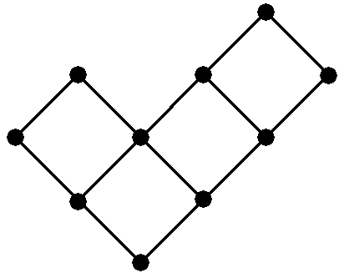
Tightness
We proved the upper bound
Is it tight?
We believe so (no formal proof yet)
There are graphs with
Example:
Riondato et al. – Fast Approximation of Betweenness Centrality Through Sampling

Slide 95
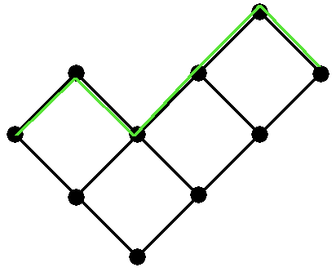
Tightness
We proved the upper bound
Is it tight?
We believe so (no formal proof yet)
There are graphs with
Example:
Riondato et al. – Fast Approximation of Betweenness Centrality Through Sampling

Slide 96
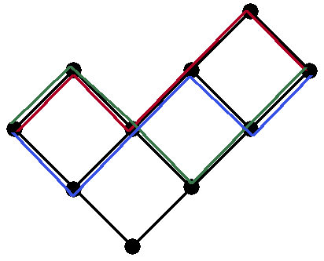
Tightness
We proved the upper bound
Is it tight?
We believe so (no formal proof yet)
There are graphs with
Example:
Riondato et al. – Fast Approximation of Betweenness Centrality Through Sampling

Slide 97
Conclusions
We presented two sampling-based randomized algorithms to approximate the betweenness of (top-K) vertices in huge graphs
The algorithms offer probabilistic guarantees on the accuracy of the approximations, using much fewer samples and performing fewer computations than previous available algorithms
Experimental evaluation shows that the algorithm outperforms previous works in terms of execution time and accuracy
Riondato et al. – Fast Approximation of Betweenness Centrality Through Sampling

Slide 98
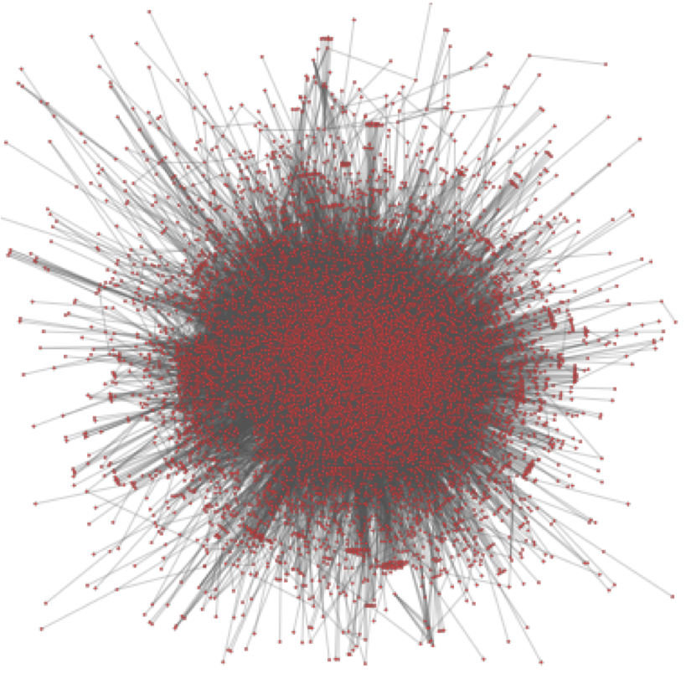
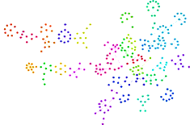

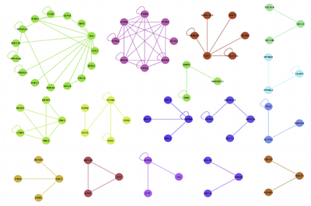
The End
Questions or comments?
matteo@cs.brown.edu
http://bigdata.cs.brown.edu
Riondato et al. – Fast Approximation of Betweenness Centrality Through Sampling

Slide 99
Bibliography
[Brandes01] A faster algorithm for betweenness centrality, J. Math. Sociol., 2001
[BrandesPich07] Centrality estimation in large networks, Intl. J. Bifurc. Chaos, 2007
[EppsteinWang01] Fast approximation of centrality, J. Graph Alg. and App., 2001
[VapnikChervonenkis71] On the uniform convergence of relative frequencies of events to their probabilities, Th. Prob. and its Appl., 1971
Riondato et al. – Fast Approximation of Betweenness Centrality Through Sampling

