Slide 1

Fast Approximation of Betweenness Centrality through Sampling
Matteo Riondato and
Evgenios M. Kornaropoulos
Brown University
WSDM – February 27th 2014
Matteo Riondato et al. – Estimation of Betweenness Centrality through Sampling

Slide 2
Who is important?
Key question in graph analysis:
  Which vertices are important?
Betweenness centrality of vertex :
= fraction of Shortest Paths going through
Need formal
definition
Matteo Riondato et al. – Estimation of Betweenness Centrality through Sampling
Notes:
Key question
many different definitions
Conjecture: information spread along shortest paths
Talk about nodes, but everything can be extended to edges
Let's be more formal

Slide 3
Formally...
Graph
Betweenness of :
: all SPS in
: SPs from to ( )
Matteo Riondato et al. – Estimation of Betweenness Centrality through Sampling
Notes:
graph can be directed, weighted
path as ordered tuple of vertices

Slide 4
Computing betweenness
Exact algorithm [Brandes01]:
Idea: use sampling!
Goal: compute -approximation
  set of estimations for all such that
  [BrandesPich07]: use samples
too much for
large networks
Matteo Riondato et al. – Estimation of Betweenness Centrality through Sampling

Slide 5
Computing betweenness
Exact algorithm [Brandes01]:
Idea: use sampling!
Goal: compute -approximation
  set of estimations for all such that
  [BrandesPich07]: use samples
too much for
large networks
Still too much!
Matteo Riondato et al. – Estimation of Betweenness Centrality through Sampling

Slide 6
Our algorithm
Samples shortest paths
No. samples independent from (VC-dimension)
For times do
    Sample random pair
    Compute (all SPs from to )
    Select a SP uniformly at random from
    For each
Relatively easy,
see paper
Matteo Riondato et al. – Estimation of Betweenness Centrality through Sampling

Slide 7
Computing the sample size
We use VC-dimension [VapnikChervonenkis71]
  notion from Statistical Learning Theory
  given domain , measures “richness” of
  combinatorial property of
  useful to approximate probability masses of subsets in using samples from
Matteo Riondato et al. – Estimation of Betweenness Centrality through Sampling

Slide 8
Sampling theorem
s
Assume we know that
Let be a probability distribution on
Given ,let be a collection of samples from
If
  then
Empirical Average
Matteo Riondato et al. – Estimation of Betweenness Centrality through Sampling
Notes:
Sample size may not depend on number of sets

Slide 9
In our case...
(all shortest paths in )
( = all SPs going through )
Probability distribution on :
Our algorithm
  samples SPs according to
  compute empirical average
Matteo Riondato et al. – Estimation of Betweenness Centrality through Sampling

Slide 10
Sample size
Define vertex diameter:
  if not weighted:
  can be estimated efficiently
Theorem:
Sample size for -approximation:
Independent from
Matteo Riondato et al. – Estimation of Betweenness Centrality through Sampling

Slide 11
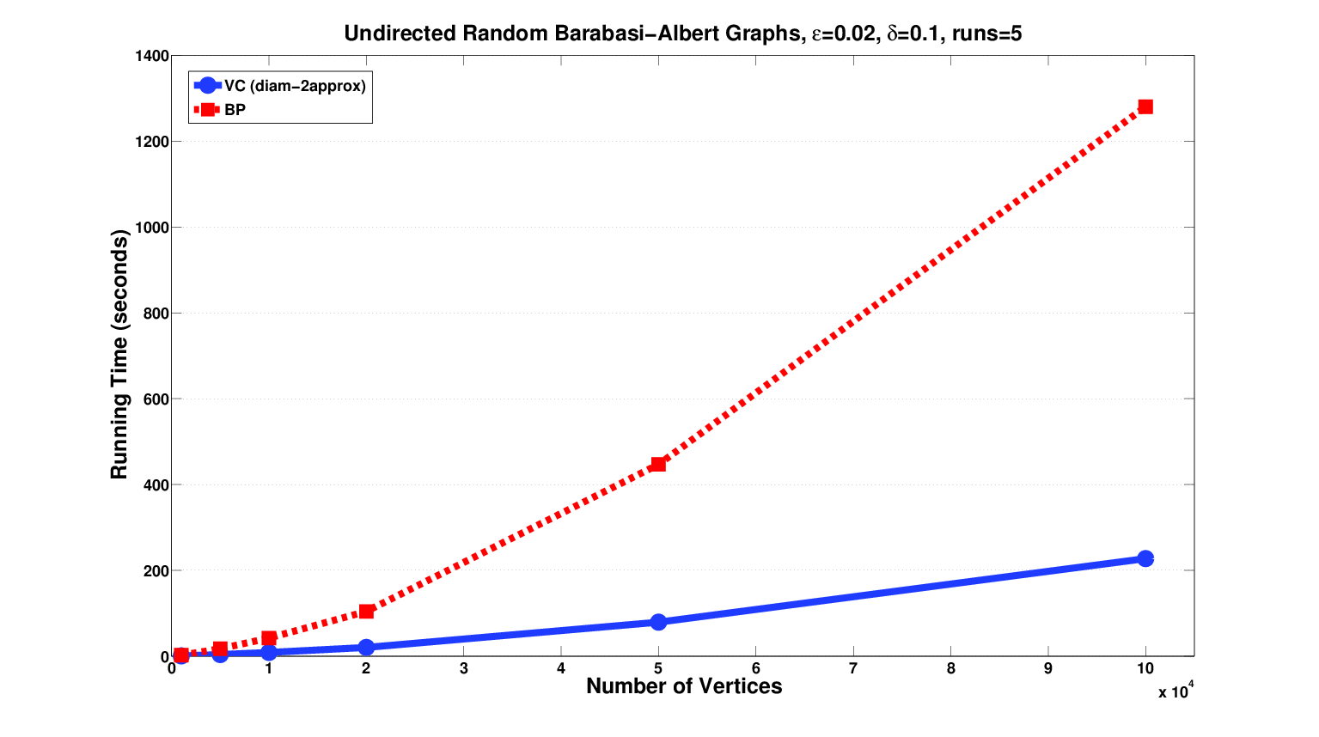
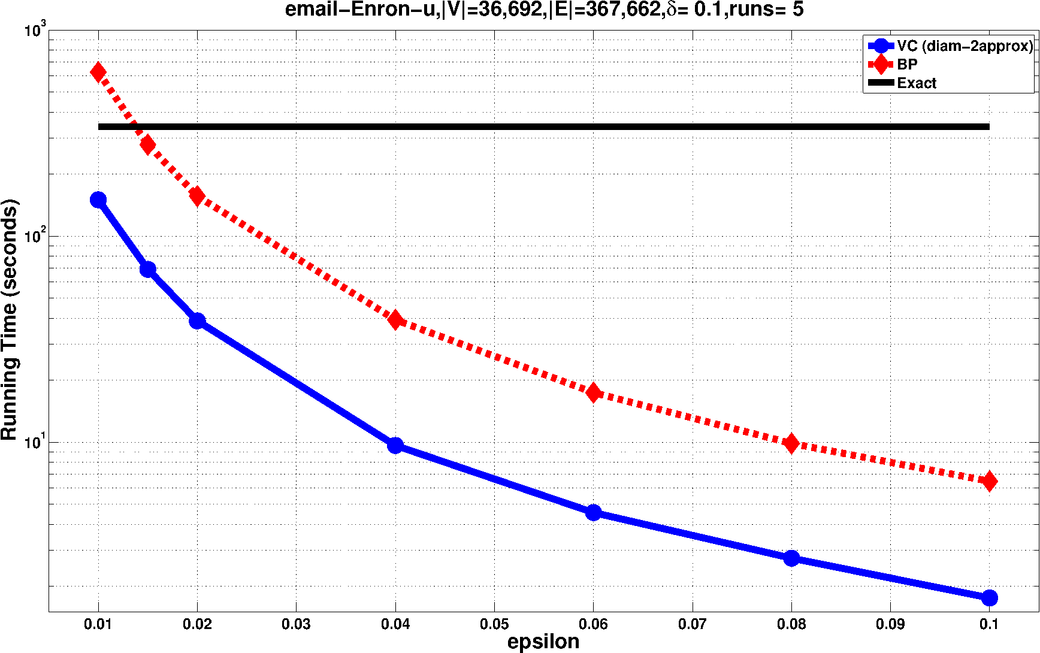
Speedup Results
~8x faster than [BrandesPich07]
Scales better as grows
Matteo Riondato et al. – Estimation of Betweenness Centrality through Sampling

Slide 12

I'm graduating soon!
Looking for exciting postdoc opportunities
Matteo Riondato
  @riondabsd
  http://cs.brown.edu/~matteo
  matteo@cs.brown.edu
Matteo Riondato et al. – Estimation of Betweenness Centrality through Sampling

Slide 13
Bibliography
[Brandes01] A faster algorithm for betweenness centrality, J. Math. Sociol., 2001
[BrandesPich07] Centrality estimation in large networks, Intl. J. Bifurc. Chaos, 2007
[EppsteinWang01] Fast approximation of centrality, J. Graph Alg. and App., 2001
[VapnikChervonenkis71] On the uniform convergence of relative frequencies of events to their probabilities, Th. Prob. and its Appl., 1971
Matteo Riondato et al. – Estimation of Betweenness Centrality through Sampling

