Slide 1
ECE Stockroom Web Application
Group Members: Joaquin Rosendo & Camron Capps
Sponsor: Richard Woodcock

Slide 2
Project Description
Our project is recreating the stockroom website in order to make it modular for future implementations, thoroughly documented, organized, user friendly, mobile friendly, reliable security and overall more efficient.

Slide 3
Advisor Meeting
Safety Hazard Reporting
- Users can anonymously report safety hazards as observed either in the lab or around the ECE building.
Add a disclaimer for every part/equipment checked out that a student must read and agree to.
“Your use, your use only, and your responsibility”
Demonstrate the acceptable and non acceptable use visually.

Slide 4
Timeline
Login page/User creation
Safety Hazard Reporting
Stockroom Management
News Feed
Group Management
Orders (greenboard/parts)
Safety Quiz
Chat Room

Slide 5
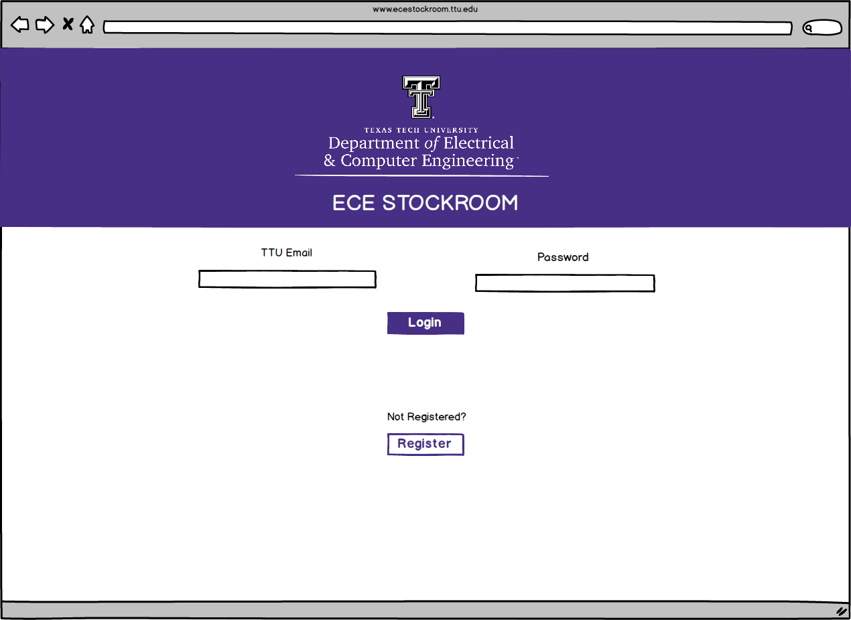
Mockup – Login Page

Slide 6
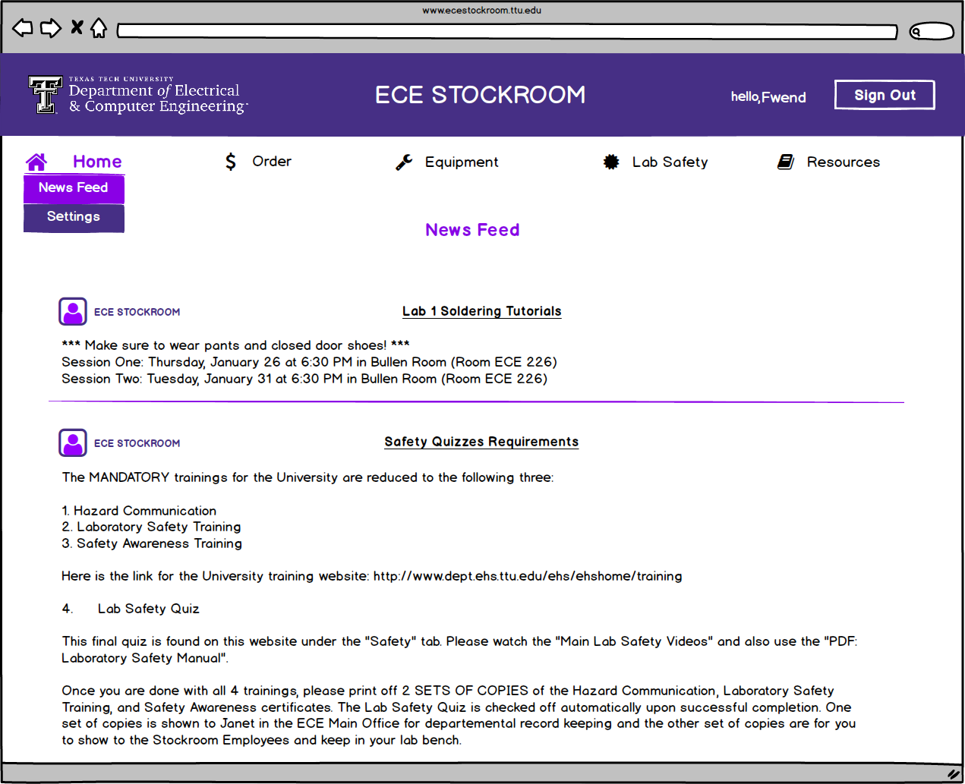
Mockup – Home-Newsfeed

Slide 7
Software Tools
SourceTree
File management program to keep track of changes in code made by developers
Django
Web framework that uses Python for backend and redesigning the framework of the website for efficiency and also handles SQL queries
Bootstrap
API developed by Twitter that uses HTML, CSS, & JavaScript for frontend user interface and interaction
Mobile first design, adjusts webpage automatically to any screen
MySQL Workbench
User interface for database
Balsamiq Mockups 3
Wireframe software used to create a visual mockup of the web application
Notepad++
Text editor for editing code
Google Chrome
Web browser for displaying results of the web application as it’s being built

Slide 8
SourceTree
Placed on the ECE Stockroom server.
Work remotely and have files updated automatically so they’re on the server.
Once finalized developments/updates have been finished, they can be published with ease to the website.

Slide 9
SQL Database Plans

Slide 10
Budget
Tools & Labor | Cost
SourceTree | Free
Django | Free
Bootstrap | Free
MySQL Workbench | Free
Notepad++ | Free
Google Chrome | Free
Balsamiq Mockups 3 | $80
10-15 Hours Per Week for 2 Developers | ~$3,000.00
Total | ~$3,080.00

Slide 11
Bi-Weekly Input

