Slide 1
ECE Stockroom Web Application
Group Members: Joaquin Rosendo & Camron Capps
Sponsor: Richard Woodcock

Slide 2
Project Description
Our project is recreating the stockroom website in order to make it modular for future implementations, thoroughly documented, organized, user friendly, mobile friendly, reliable security and overall more efficient.

Slide 3
Advisor Meeting
Login page verified
Discussed issues with current/legacy website
Main issue is with TTU virtual server
Several issues with users fixed

Slide 4
Additional Software Tools
XAMPP
website server running on TTU virtual server
GitHub
Private Repository

Slide 5
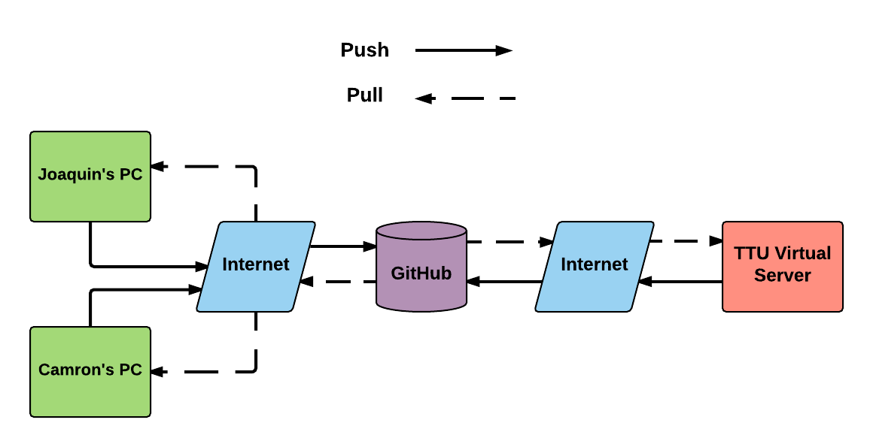
GitHub Private Repository

Slide 6
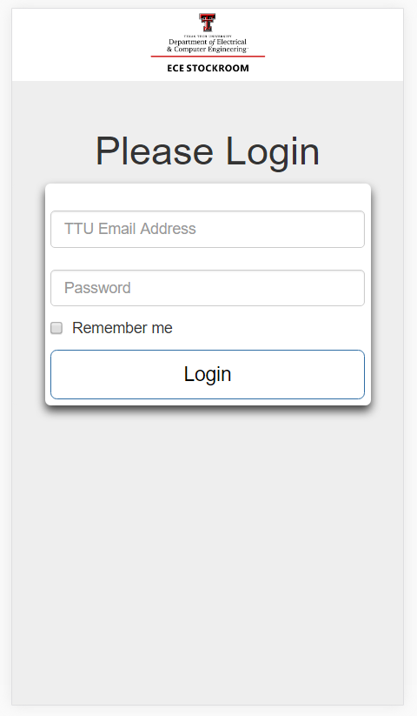
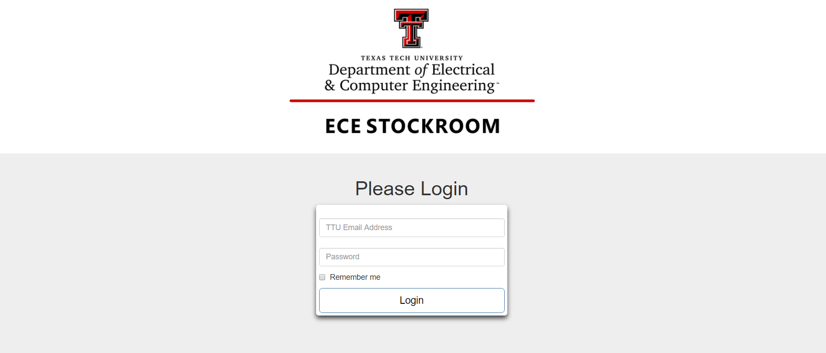
Login Page Using Bootstrap
Desktop Computer
Smartphone

Slide 7
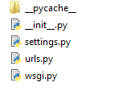
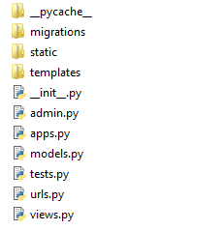
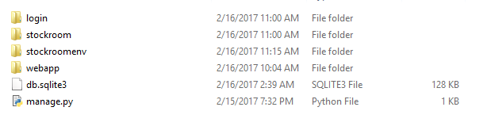
Website File Hierarchy
Stockroom
Login
urls.py
views.py

Slide 8
Budget
Tools & Labor | Cost
Week 1-2 | $100 (10 hours)
Week 2-3 | $70 (7 hours)
Week 3-4 | $90 (9 hours)
Week 4-5 | $50 (5 hours)
Week 5-6 | --
Week 6-7 | --
Week 7-8 | --
Week 8-9 | --
Expected Total | ~$3000
Total | $310

Slide 9
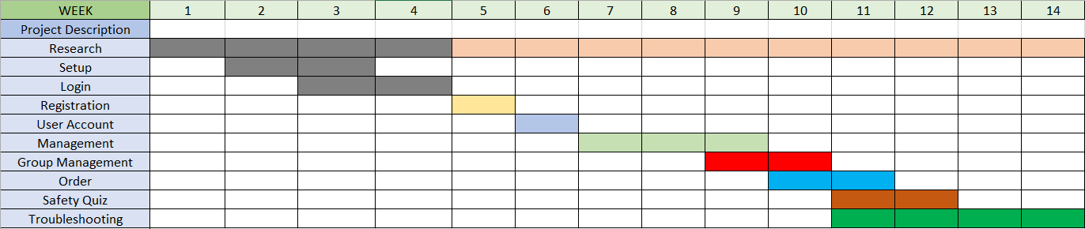
Gantt Chart

Slide 10
Bi-Weekly Deliverable
Completed
Some research
Setup software
Login page
Next deliverables
Registration page
User account

Slide 11
Live Demo*
* If TTU network is working!
http://ecestockroom.ece.ttu.edu/dev/login.html

Slide 12
Questions?

