Slide 1
ECE Stockroom Web Application
Group Members: Joaquin Rosendo & Camron Capps
Sponsor: Richard Woodcock

Slide 2
Project Description
Our project is recreating the stockroom website in order to make it modular for future implementations, thoroughly documented, organized, user friendly, mobile friendly, reliable security and overall more efficient.

Slide 3

Reconstructing the Database

Slide 4
Reconstructing the Database
Real Name | Lab # | Password | Email | Classification | Phone # | R# | Lab Safety | Hazzard Communication | Safety Awareness | Lab Teacher | Budget

Slide 5
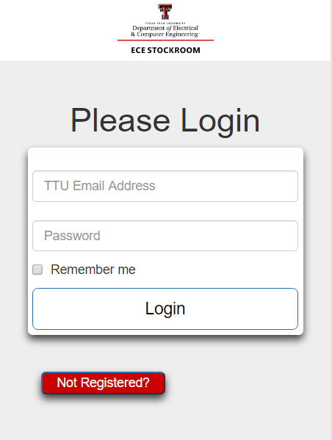
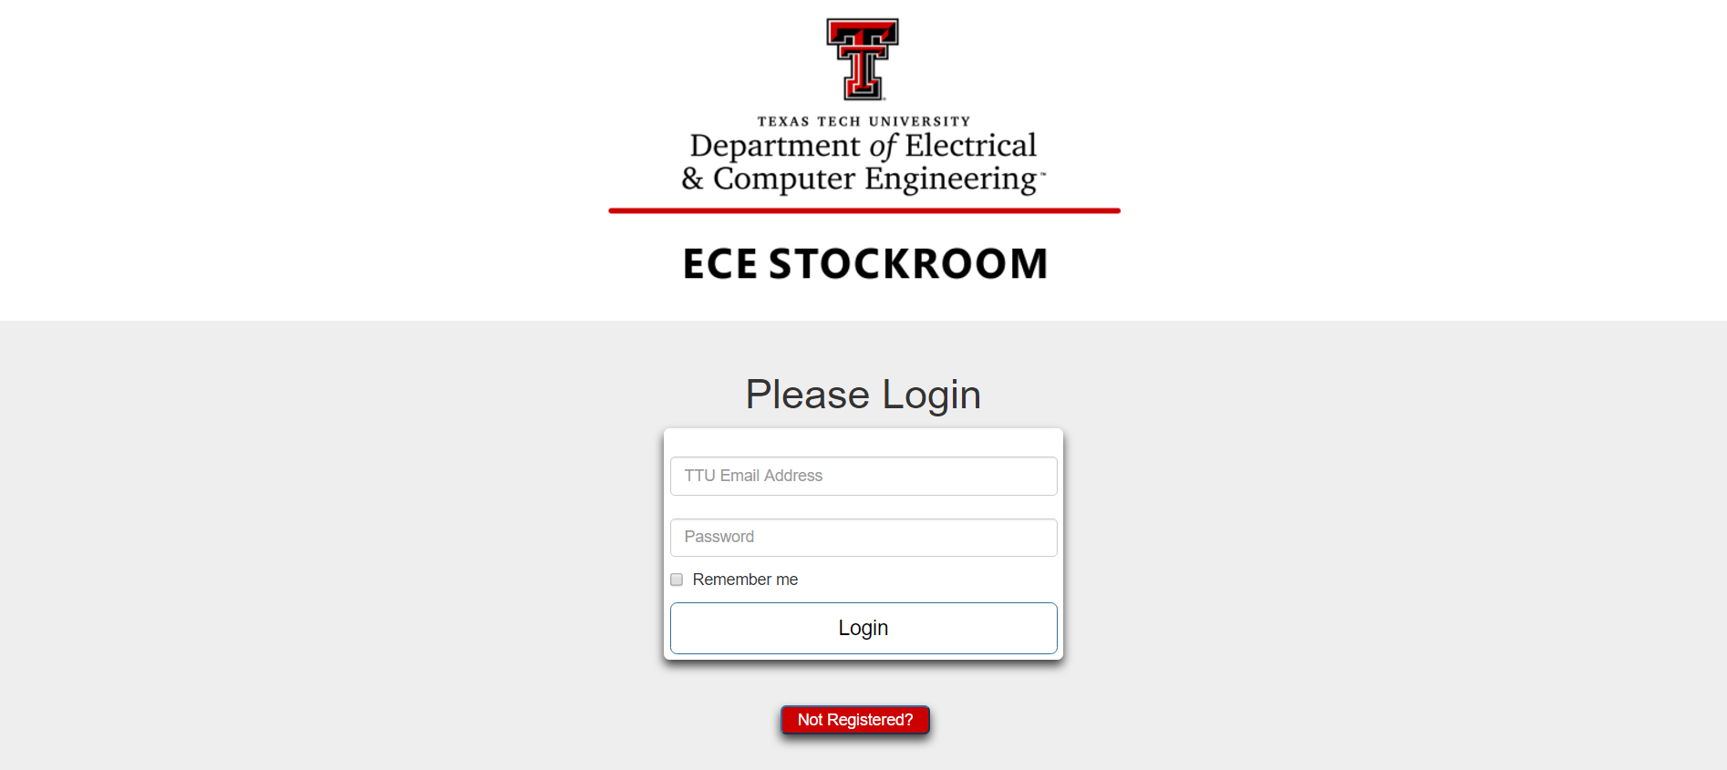
Login Page - Register Button Added
Desktop Computer
Smartphone

Slide 6
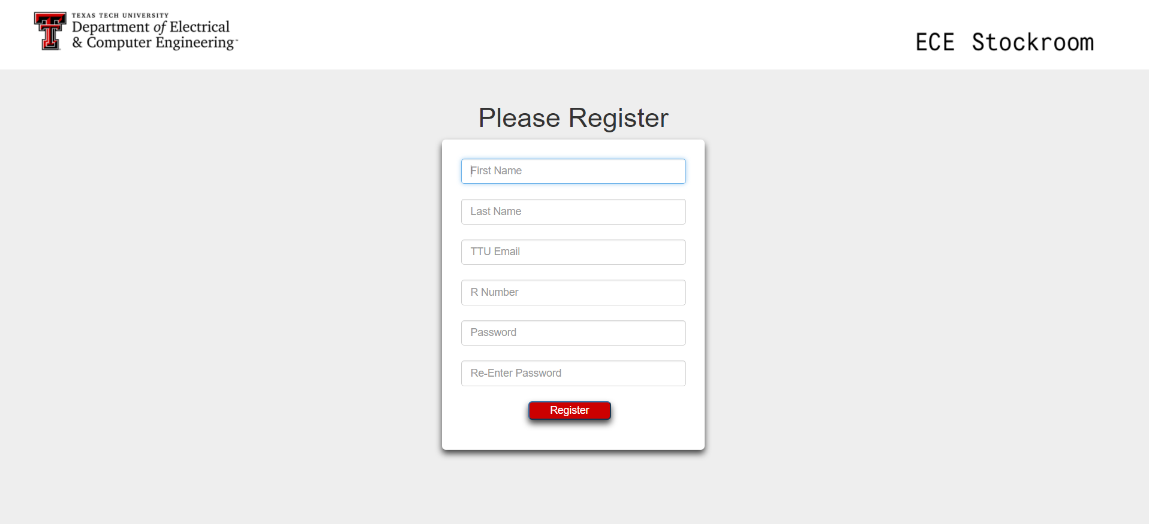
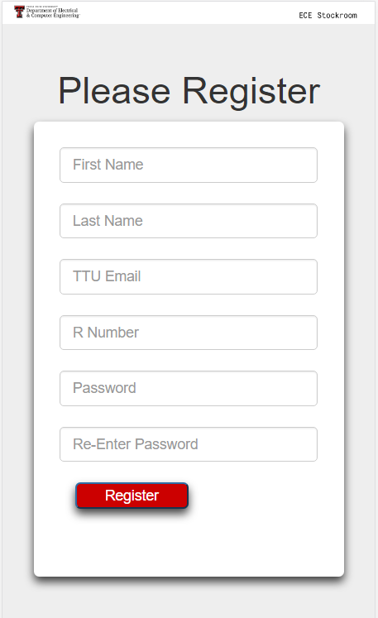
Registration Page
Desktop Computer
Smartphone

Slide 7
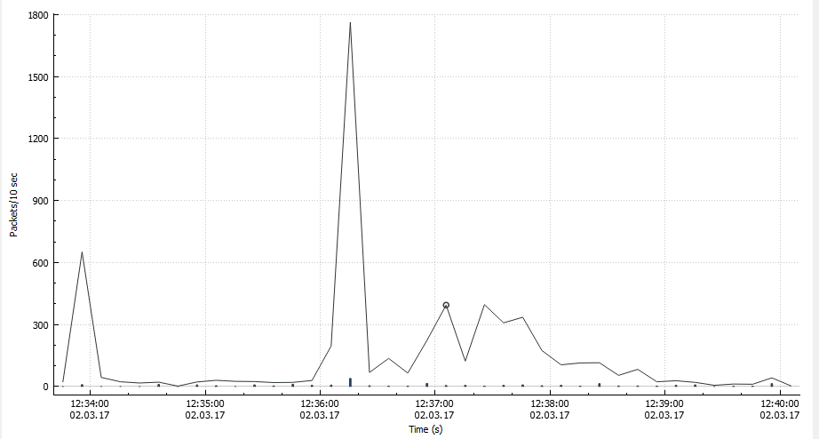

Statistics
Used to sniff packets in order to gather information pertaining to site traffic.
Has graphing capabilities (packets over time).

Slide 8
Advisor Meeting
Issues with layering the new design over the old.
- Wouldn’t be able to communicate between the old design due to Django.
Will be a fully published project in the end.
- This means we all have to start over. (Just user creation)
Joaquin’s schedule readjusted for more web development time.

Slide 9
Budget
Tools & Labor | Cost
Week 1-2 | $100 (10 hours)
Week 2-3 | $70 (7 hours)
Week 3-4 | $90 (9 hours)
Week 4-5 | $50 (5 hours)
Week 5-6 | $40 (4 hours)
Week 6-7 | $50(5 hours)
Week 7-8 | --
Week 8-9 | --
Expected Total | ~$3000
Total | $400

Slide 10
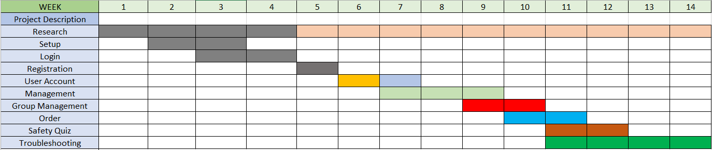
Gantt Chart

Slide 11
Bi-Weekly Deliverable
Completed
Registration Page
Next deliverables
User account
Management
User Patient 0

Slide 12
Questions?

