Slide 1
ECE Stockroom Web Application
Group Members: Joaquin Rosendo & Camron Capps
Sponsor: Richard Woodcock

Slide 2
Project Description
Our project is recreating the stockroom website in order to make it modular for future implementations, thoroughly documented, organized, user friendly, mobile friendly, reliable security and overall more efficient.

Slide 3

Design Changes: Django to NodeJS
Switched from Django to NodeJS
Unlike Django, NodeJS is not restrictive in the way you design the backend.
There is no ‘best way’ to do something. It is very flexible.
It is much easier to understand and learn. (future developers)
More stable than XAMPP. NodeJS has it’s own web server framework that is built to handle strenuous traffic.
https://en.wikipedia.org/wiki/Node.js

Slide 4
Mid-Semester Design Changes: MySQL to MongoDB
Removing XAMPP/MySQL
Tedious layering of user-made software to integrate Django with XAMPP/MySQL.
Implementing NoSQL MongoDB
Specifically designed with NodeJS in mind.
Can switch between raw SQL or use NoSQL.

Slide 5
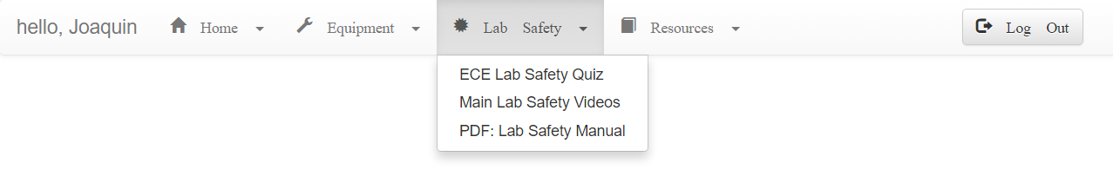
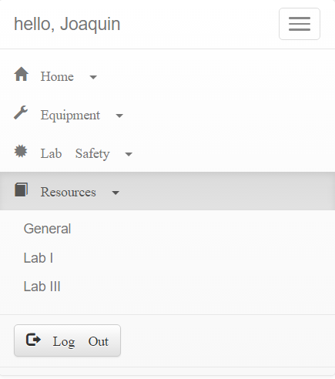
Navigation Bar
Desktop
Mobile

Slide 6
Directory Map
*On Microsoft Publisher file

Slide 7

Reconstructing the Database

Slide 8
Reconstructing the Database
Real Name | Lab # | Password | Email | Classification | Phone # | R# | Lab Safety | Hazzard Communication | Safety Awareness | Lab Teacher | Budget

Slide 9
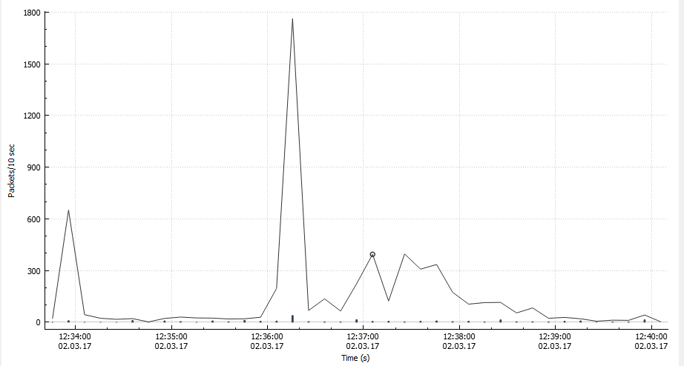

Statistics
Used to sniff packets in order to gather information pertaining to site traffic.
Has graphing capabilities (packets over time).
Ability to export data into a CSV file format.

Slide 10
Budget
Tools & Labor | Cost
Week 1-2 | $200 (10 hours)
Week 2-3 | $140 (7 hours)
Week 3-4 | $180 (9 hours)
Week 4-5 | $100 (5 hours)
Week 5-6 | $80 (4 hours)
Week 6-7 | $100(5 hours)
Week 7-8 | $0 (0 hours)
Week 8-9 | $120 (6 hours)
Expected Total | ~$3000
Total | $920

Slide 11
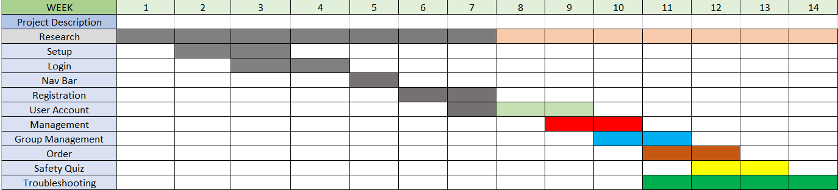
Gantt Chart

Slide 12
Questions?

