Slide 1
ECE Stockroom Web Application
Group Members: Joaquin Rosendo & Camron Capps
Sponsor: Richard Woodcock

Slide 2
Project Description
Our project is recreating the stockroom website in order to make it modular for future implementations, thoroughly documented, organized, user friendly, mobile friendly, reliable security and overall more efficient.

Slide 3
Progress Report
Documentation
SSL Certificate & Key
Cookies/Sessions
Navigation (routing)
Redesign of the equipment database due to problems with previous solution

Slide 4
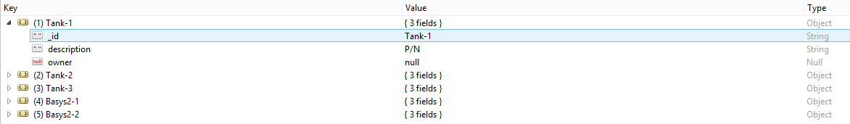
New Equipment JSON Database Format

Slide 5
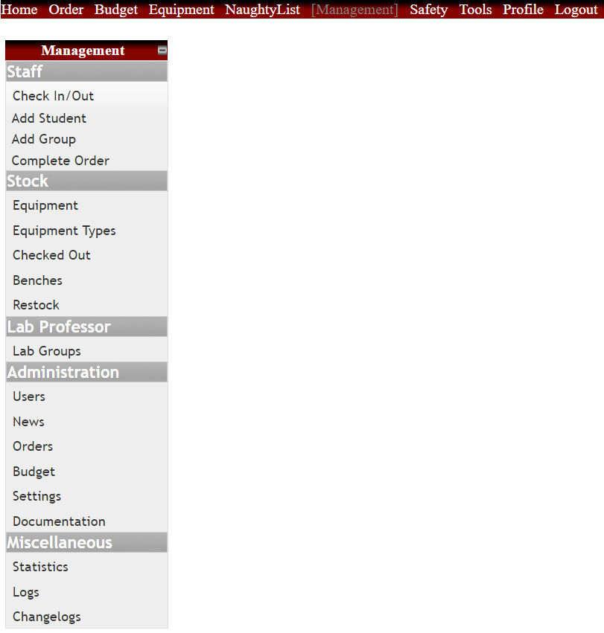
Management - Legacy Website
Removing
Add Student & Group
Complete Order
Equipment Types
Checked Out
Restock
News
Documentation
Statistics
Logs
Changelogs

Slide 6
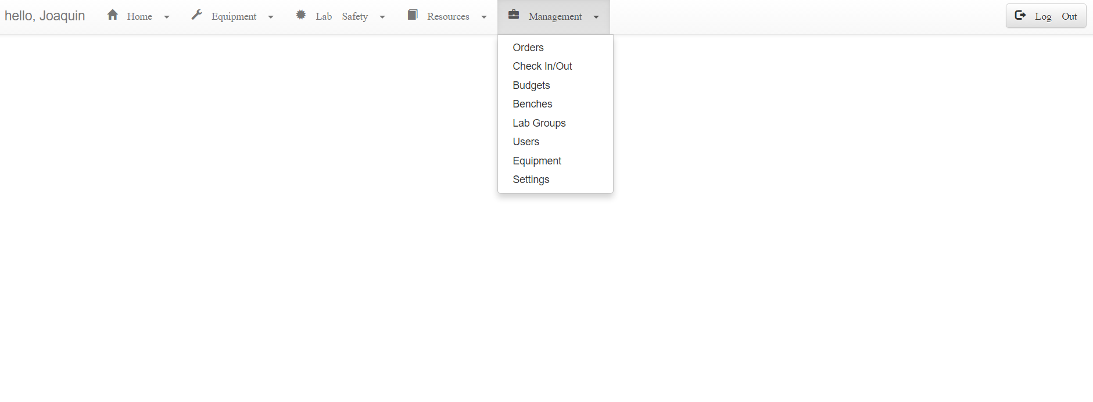
Management - Revision Website
Keeping
Orders
Check In/Out
Budgets
Lab Groups
Users
Equipment
Settings
Ordered by most used

Slide 7
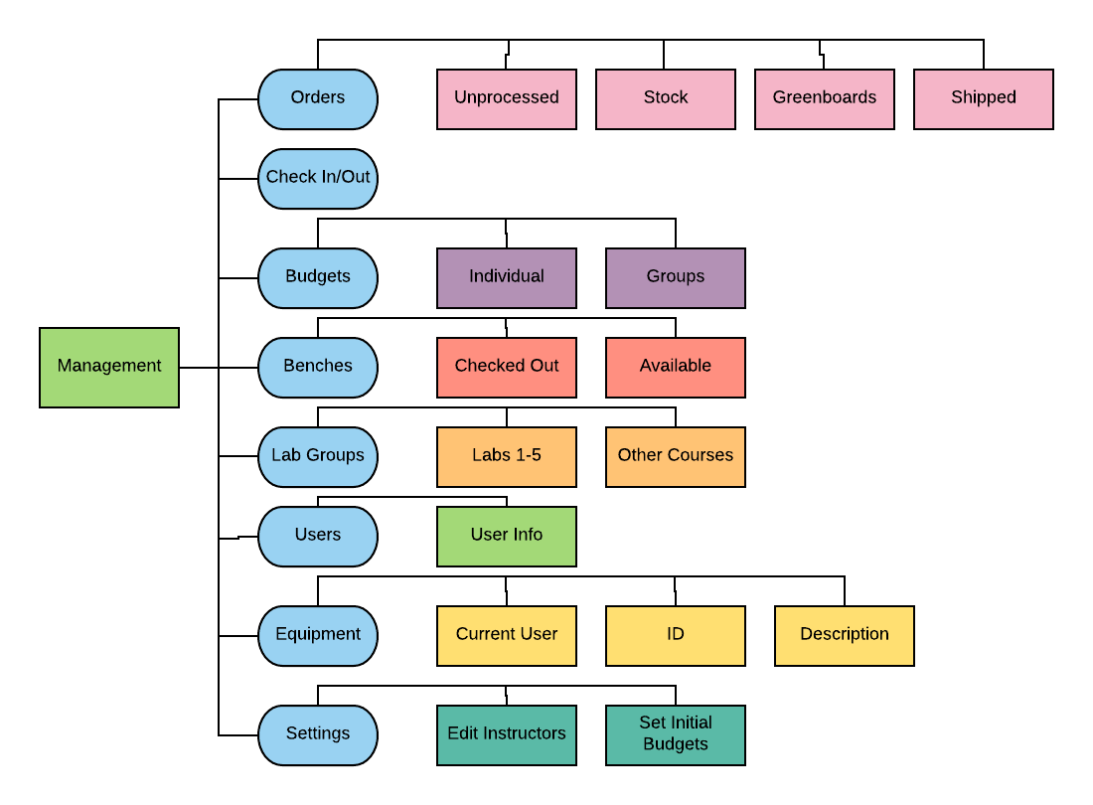
Management Outline

Slide 8
Routing
Server.js
Navigation.js
Login.js
Equipment.js
Orders.js
...
...

Slide 9
Budget
Tools & Labor | Cost
Week 1-2 | $100 (10 hours)
Week 2-3 | $70 (7 hours)
Week 3-4 | $90 (9 hours)
Week 4-5 | $50 (5 hours)
Week 5-6 | $40 (4 hours)
Week 6-7 | $50(5 hours)
Week 7-8 | $40 (4 hours)
Week 8-9 | --
Expected Total | ~$3000
Total | $440

Slide 10
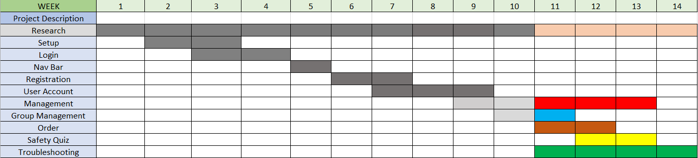
Gantt Chart

Slide 11
Questions?

