Slide 1
ECE Stockroom Web Application
Group Members: Joaquin Rosendo & Camron Capps
Sponsor: Richard Woodcock

Slide 2
Project Description
Our project is recreating the stockroom website in order to make it modular for future implementations, thoroughly documented, organized, user friendly, mobile friendly, reliable security and overall more efficient.

Slide 3
Advisor Meeting
Summer I, 2017 planned beta launch
Decided to use Open SSL
Possible use of 3rd party server
Hashing R Numbers
Awaiting approval from IT

Slide 4
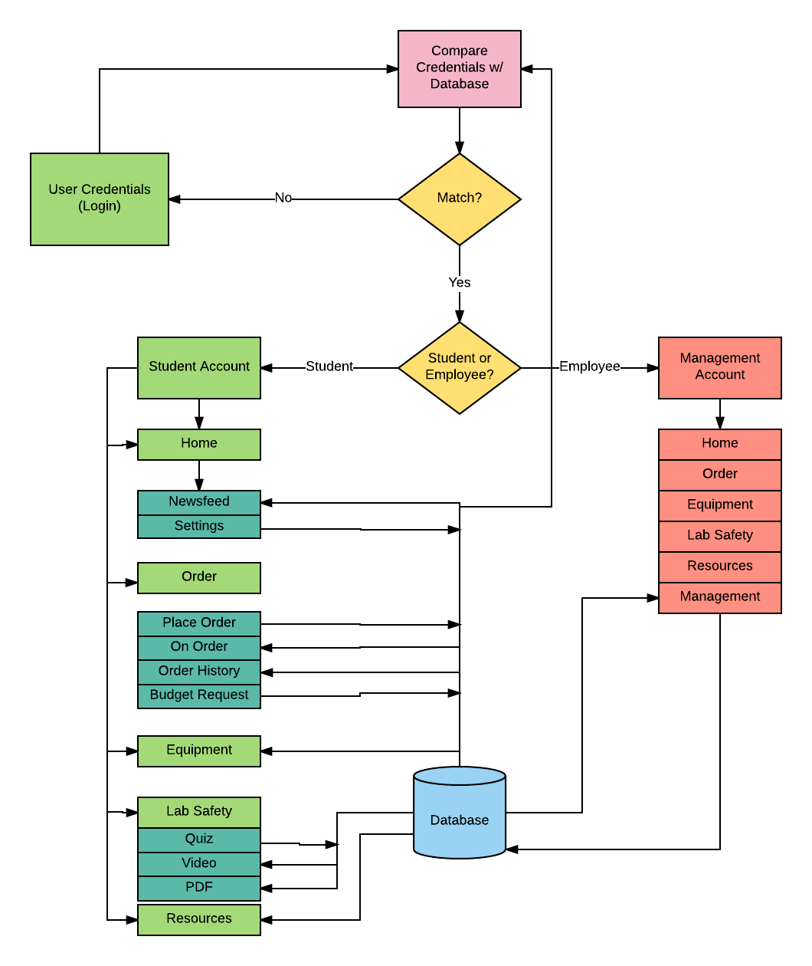
Flow Chart

Slide 5
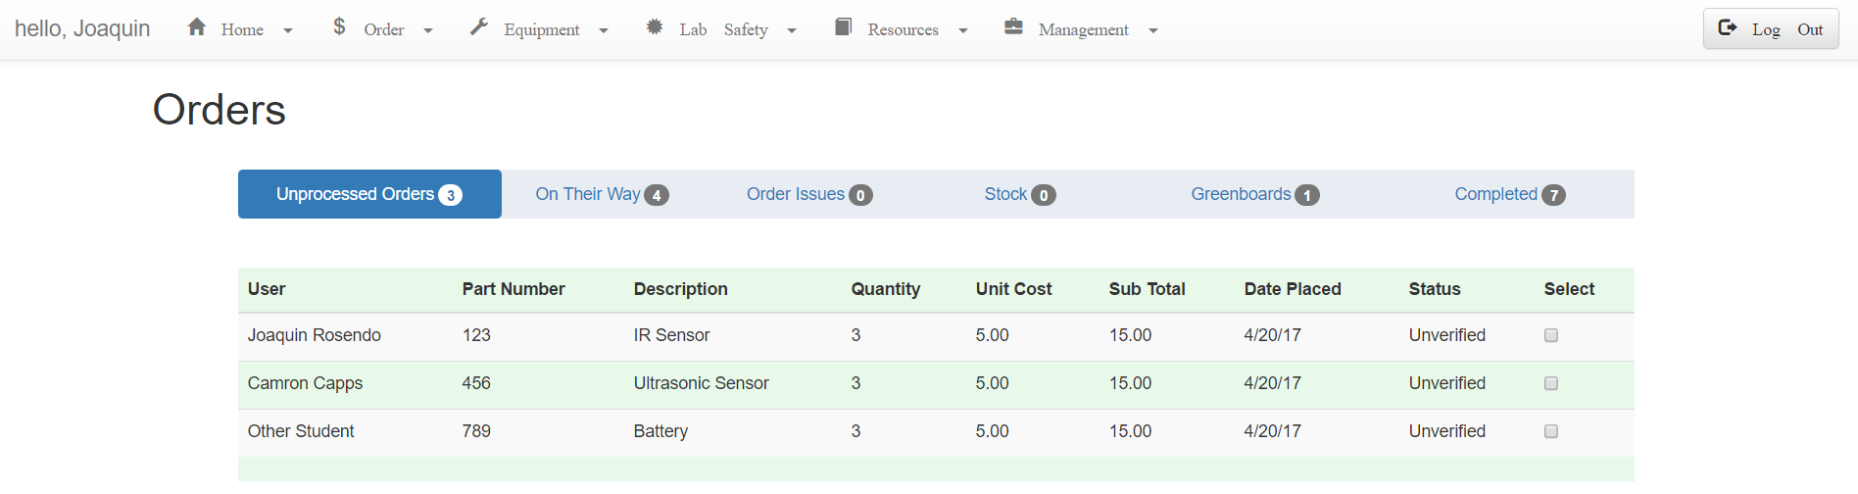
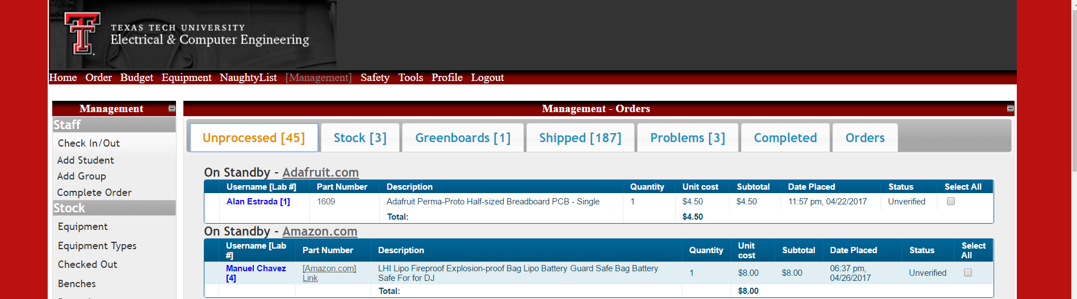
Management - Orders Page on Web

Slide 6
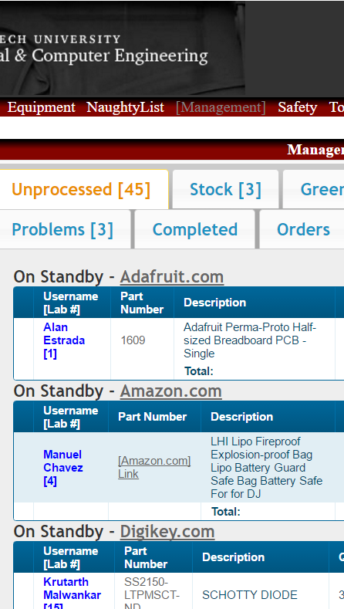
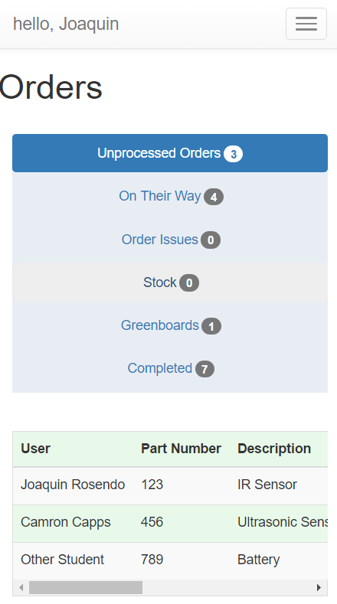
Management - Orders Page on Mobile

Slide 7
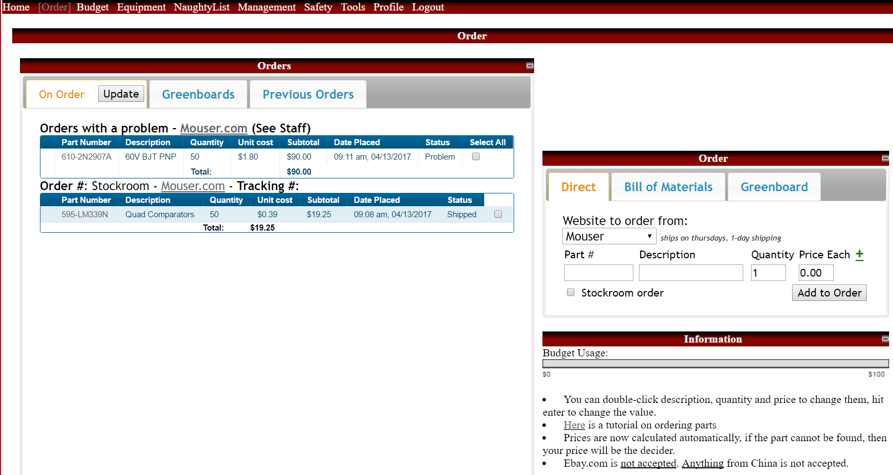
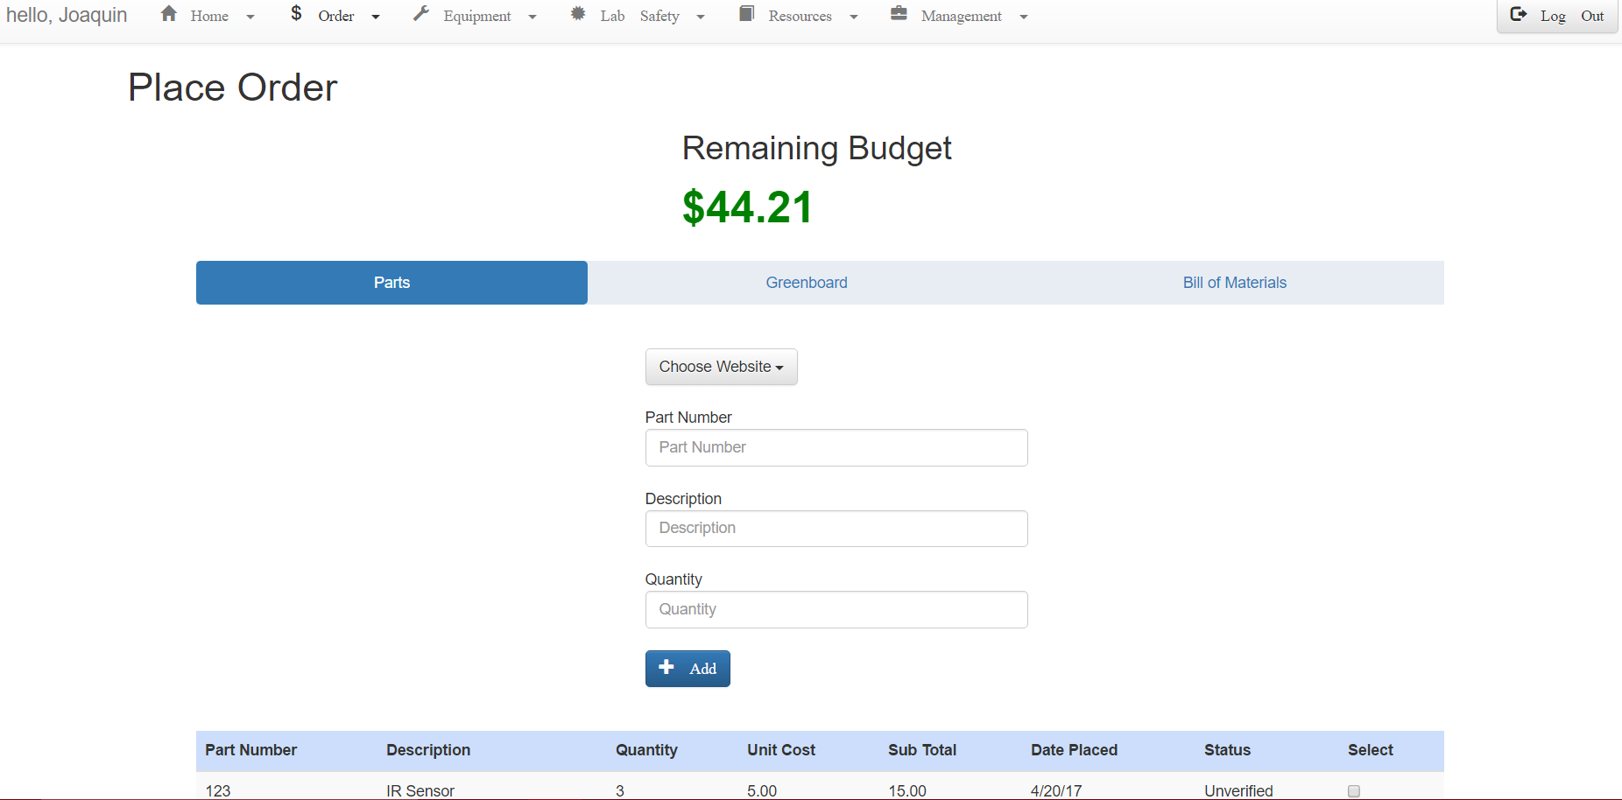
Student - Order Page on Web

Slide 8
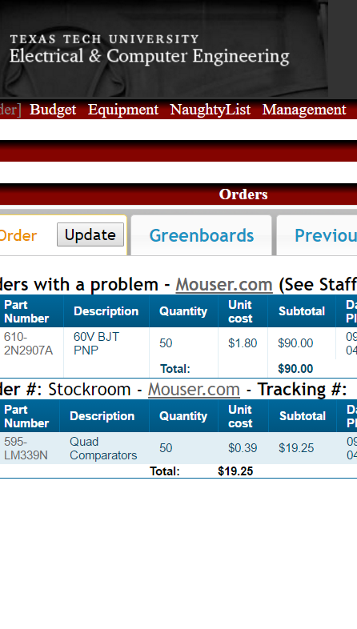
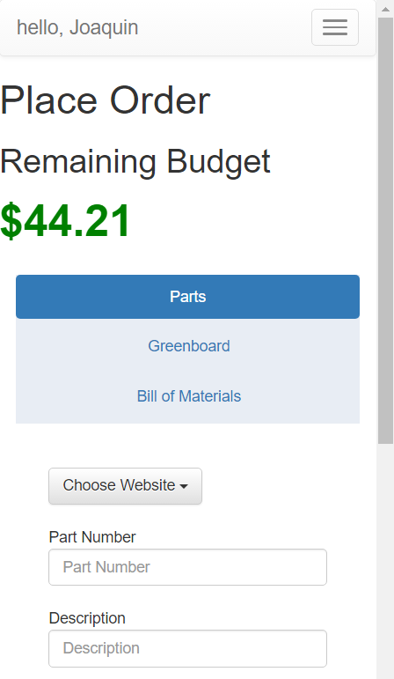
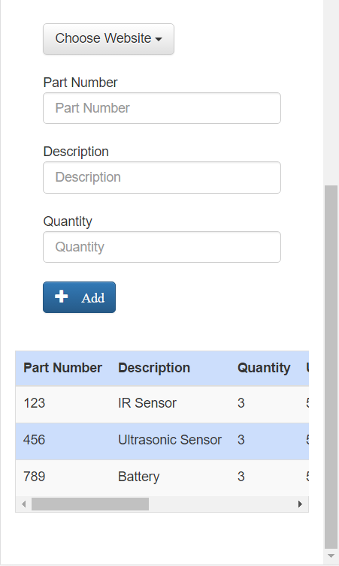
Student - Order Page on Mobile

Slide 9
Budget
Tools & Labor | Cost
Week 1-2 | $200 (10 hours)
Week 2-3 | $140 (7 hours)
Week 3-4 | $180 (9 hours)
Week 4-5 | $100 (5 hours)
Week 5-6 | $80 (4 hours)
Week 6-7 | $100(5 hours)
Week 7-8 | $80 (4 hours)
Week 8-9 | $140 (7 hours)
Expected Total | ~$3000
Total | $1020

Slide 10
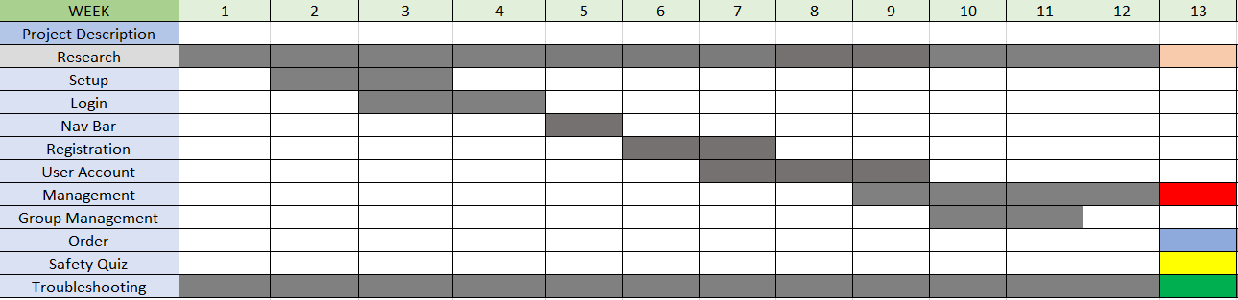
Gantt Chart

Slide 11
Questions?

