Slide 1
ECE Stockroom Web Application
Group Members: Joaquin Rosendo & Camron Capps
Sponsor: Richard Woodcock

Slide 2
Project Description
Our project is recreating the stockroom website in order to make it modular for future implementations, thoroughly documented, organized, user friendly, mobile friendly, reliable security and overall more efficient.

Slide 3
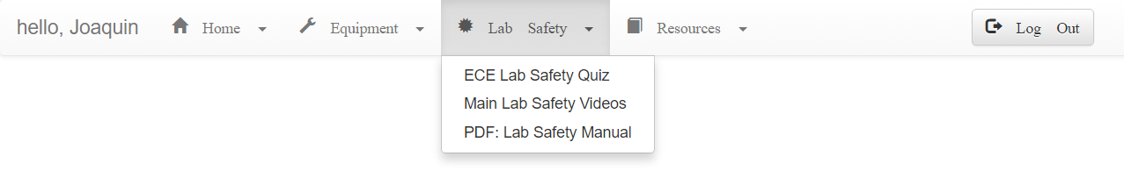
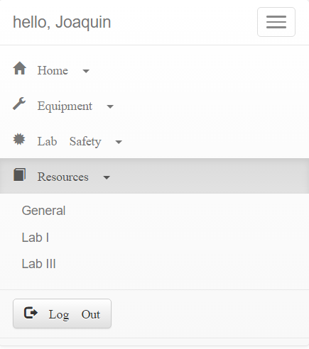
Navigation Bar
Desktop
Mobile

Slide 4
Directory Map
*On Microsoft Publisher file

Slide 5
Budget
Tools & Labor | Cost
Week 1-2 | $200 (10 hours)
Week 2-3 | $140 (7 hours)
Week 3-4 | $180 (9 hours)
Week 4-5 | $100 (5 hours)
Week 5-6 | $80 (4 hours)
Week 6-7 | $100(5 hours)
Week 7-8 | $0 (0 hours)
Week 8-9 | $120 (6 hours)
Expected Total | ~$3000
Total | $920

Slide 6
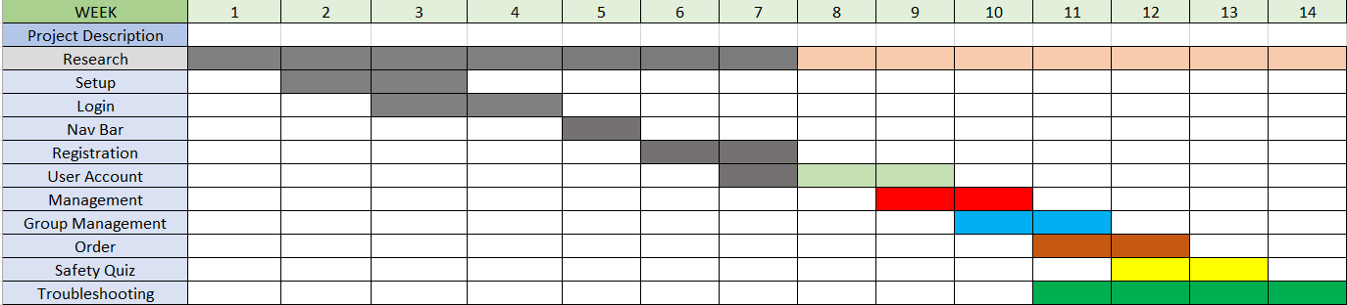
Gantt Chart

Slide 7
Bi-Weekly Deliverable
Completed
Navigation Bar
Next deliverables
Finish remainder of user account
Begin Management
User Patient 0

Slide 8
Questions?

