Slide 1
World Development Measurement Prediction
Karan Joliya
Preeti Ronghe

Slide 2
Details
Business Objective: Creating clusters on global development measurement dataset
Data Set Details:
The dataset has information about important economic and development metrics related to various countries across the globe.
Variable Description:
Birth Rate, Business tax, CO2emissions, Country, Days to start business, Ease of business, energy usage, GDP, healthexp%GDP, health exp/capita, hours to do tax, infant mortality, internet usage, lending rate, life expectancy female, etc.
Acceptance Criterion:
Work on different clustering models, do a comparative analysis and need to deploy the clustering application on stream lit, flask etc.

Slide 3
Technologies Used
CSS
Python (Libraries)
Pandas
NumPy
Scikit-Learn
Matplotlib
Seaborn
Joblib
Streamlit
Version control – Git
IDE - VSCode

Slide 4
Problem Definition
Overview: Countries differ widely in terms of economic strength, health infrastructure, technology adoption, and population structure. This project aims at applying an unsupervised machine learning to identify patterns in these indicators and group countries into meaningful development clusters.
Outcome: The results help categorize countries into different development levels such as:
Developed Countries
Emerging Economies
Developing Countries
Underdeveloped Countries

Slide 5
Dataset Details
Source: World_development_measurement.csv
Size: 2704 rows, 25 columns
Features: 'Birth Rate', 'Business Tax Rate', 'CO2 Emissions', 'Country', 'Days to Start Business', 'Ease of Business', 'Energy Usage', 'GDP’, 'Health Exp % GDP', 'Health Exp/Capita', 'Hours to do Tax’, 'Infant Mortality Rate', 'Internet Usage', 'Lending Interest', 'Life Expectancy Female', 'Life Expectancy Male', 'Mobile Phone Usage', 'Number of Records', 'Population 0-14', 'Population 15-64','Population 65+', 'Population Total', 'Population Urban', 'Tourism Inbound', 'Tourism Outbound'
Classification: 1.Developed Countries 2. Developing Countries 3.Emerging Countries 4.Underdeveloped Countries

Slide 6
Exploratory Data Analysis (EDA)
Data Cleaning Identified the datatypes, Removed missing values, handled duplicates, removed columns with zero Variance, removed Symbols like % and $ from the columns to make it numeric
Null Value Handling
Removed columns with missing values >35%.Filled the columns with lesser missing values with mean and median
Columns with Zero Variance
Dropped Columns with Zero Variance

Slide 7
Exploratory Data Analysis (EDA)
Outlier Analysis Detected extreme values in columns with outliers with heavily influence the model and lead to biased predictions.
Outlier Capping/ Treatment
Treated the outliers with quartile range.Filled the columns with outliers with Quartiles
Correlation Metrics
Used to identify the positive, negative or no correlation between the variables.
ignore Diagonal Variables strong correlation as their correlation with self is one

Slide 8
Data Preprocessing
Min-Max Normalization: Scales data into a fixed range, usually 0 to 1.
Z-Score Normalization: Transforms data using mean and standard deviation.
Log Transformation: Reduces data skewness using logarithmic scaling.
One-Hot Encoding: Converts categories into binary columns.
Label Encoding: Assigns numeric labels to categorical values.
Label Encoding was used to convert Categorical columns into Numeric

Slide 9
Correlation Matrix
 | Birth Rate | CO2 Emissions | Days to Start Business | Energy Usage | GDP | Health Exp % GDP | Health Exp/Capita | Infant Mortality Rate | Internet Usage | Lending Interest | Life Expectancy Female | Life Expectancy Male | Mobile Phone Usage | Population 0-14 | Population 15-64 | Population 65+ | Population Total | Population Urban | Tourism Inbound | Tourism Outbound
Birth Rate | 1.00 | -0.35 | 0.26 | -0.28 | -0.41 | -0.24 | -0.59 | 0.87 | -0.62 | 0.42 | -0.87 | -0.82 | -0.54 | 0.94 | -0.91 | -0.74 | 0.01 | -0.59 | -0.51 | -0.45
CO2 Emissions | -0.35 | 1.00 | -0.07 | 0.83 | 0.73 | 0.06 | 0.32 | -0.30 | 0.19 | -0.25 | 0.31 | 0.30 | 0.14 | -0.40 | 0.37 | 0.34 | 0.63 | 0.30 | 0.61 | 0.69
Days to Start Business | 0.26 | -0.07 | 1.00 | -0.15 | -0.21 | -0.23 | -0.31 | 0.26 | -0.39 | 0.21 | -0.30 | -0.31 | -0.32 | 0.31 | -0.27 | -0.29 | 0.01 | -0.23 | -0.26 | -0.23
Energy Usage | -0.28 | 0.83 | -0.15 | 1.00 | 0.80 | 0.11 | 0.34 | -0.22 | 0.28 | -0.27 | 0.26 | 0.25 | 0.20 | -0.34 | 0.29 | 0.32 | 0.71 | 0.25 | 0.65 | 0.74
GDP | -0.41 | 0.73 | -0.21 | 0.80 | 1.00 | 0.24 | 0.56 | -0.39 | 0.49 | -0.34 | 0.42 | 0.43 | 0.41 | -0.51 | 0.42 | 0.50 | 0.61 | 0.41 | 0.85 | 0.93
Health Exp % GDP | -0.24 | 0.06 | -0.23 | 0.11 | 0.24 | 1.00 | 0.43 | -0.21 | 0.35 | -0.06 | 0.22 | 0.23 | 0.20 | -0.30 | 0.10 | 0.50 | -0.02 | 0.19 | 0.30 | 0.26
Health Exp/Capita | -0.59 | 0.32 | -0.31 | 0.34 | 0.56 | 0.43 | 1.00 | -0.61 | 0.77 | -0.49 | 0.59 | 0.62 | 0.58 | -0.66 | 0.54 | 0.66 | 0.00 | 0.57 | 0.60 | 0.61
Infant Mortality Rate | 0.87 | -0.30 | 0.26 | -0.22 | -0.39 | -0.21 | -0.61 | 1.00 | -0.62 | 0.44 | -0.92 | -0.90 | -0.57 | 0.81 | -0.80 | -0.62 | 0.06 | -0.60 | -0.47 | -0.43
Internet Usage | -0.62 | 0.19 | -0.39 | 0.28 | 0.49 | 0.35 | 0.77 | -0.62 | 1.00 | -0.47 | 0.64 | 0.66 | 0.74 | -0.68 | 0.59 | 0.62 | -0.03 | 0.53 | 0.55 | 0.53
Lending Interest | 0.42 | -0.25 | 0.21 | -0.27 | -0.34 | -0.06 | -0.49 | 0.44 | -0.47 | 1.00 | -0.45 | -0.48 | -0.41 | 0.44 | -0.42 | -0.35 | -0.04 | -0.32 | -0.42 | -0.39
Life Expectancy Female | -0.87 | 0.31 | -0.30 | 0.26 | 0.42 | 0.22 | 0.59 | -0.92 | 0.64 | -0.45 | 1.00 | 0.98 | 0.55 | -0.81 | 0.78 | 0.64 | -0.03 | 0.62 | 0.49 | 0.45
Life Expectancy Male | -0.82 | 0.30 | -0.31 | 0.25 | 0.43 | 0.23 | 0.62 | -0.90 | 0.66 | -0.48 | 0.98 | 1.00 | 0.55 | -0.77 | 0.75 | 0.59 | -0.04 | 0.62 | 0.50 | 0.46
Mobile Phone Usage | -0.54 | 0.14 | -0.32 | 0.20 | 0.41 | 0.20 | 0.58 | -0.57 | 0.74 | -0.41 | 0.55 | 0.55 | 1.00 | -0.61 | 0.58 | 0.49 | -0.06 | 0.46 | 0.46 | 0.43
Population 0-14 | 0.94 | -0.40 | 0.31 | -0.34 | -0.51 | -0.30 | -0.66 | 0.81 | -0.68 | 0.44 | -0.81 | -0.77 | -0.61 | 1.00 | -0.93 | -0.84 | -0.04 | -0.60 | -0.59 | -0.54
Population 15-64 | -0.91 | 0.37 | -0.27 | 0.29 | 0.42 | 0.10 | 0.54 | -0.80 | 0.59 | -0.42 | 0.78 | 0.75 | 0.58 | -0.93 | 1.00 | 0.58 | 0.00 | 0.59 | 0.48 | 0.45
Population 65+ | -0.74 | 0.34 | -0.29 | 0.32 | 0.50 | 0.50 | 0.66 | -0.62 | 0.62 | -0.35 | 0.64 | 0.59 | 0.49 | -0.84 | 0.58 | 1.00 | 0.09 | 0.46 | 0.59 | 0.53
Population Total | 0.01 | 0.63 | 0.01 | 0.71 | 0.61 | -0.02 | 0.00 | 0.06 | -0.03 | -0.04 | -0.03 | -0.04 | -0.06 | -0.04 | 0.00 | 0.09 | 1.00 | -0.05 | 0.47 | 0.51
Population Urban | -0.59 | 0.30 | -0.23 | 0.25 | 0.41 | 0.19 | 0.57 | -0.60 | 0.53 | -0.32 | 0.62 | 0.62 | 0.46 | -0.60 | 0.59 | 0.46 | -0.05 | 1.00 | 0.44 | 0.46
Tourism Inbound | -0.51 | 0.61 | -0.26 | 0.65 | 0.85 | 0.30 | 0.60 | -0.47 | 0.55 | -0.42 | 0.49 | 0.50 | 0.46 | -0.59 | 0.48 | 0.59 | 0.47 | 0.44 | 1.00 | 0.89
Tourism Outbound | -0.45 | 0.69 | -0.23 | 0.74 | 0.93 | 0.26 | 0.61 | -0.43 | 0.53 | -0.39 | 0.45 | 0.46 | 0.43 | -0.54 | 0.45 | 0.53 | 0.51 | 0.46 | 0.89 | 1.00

Slide 10
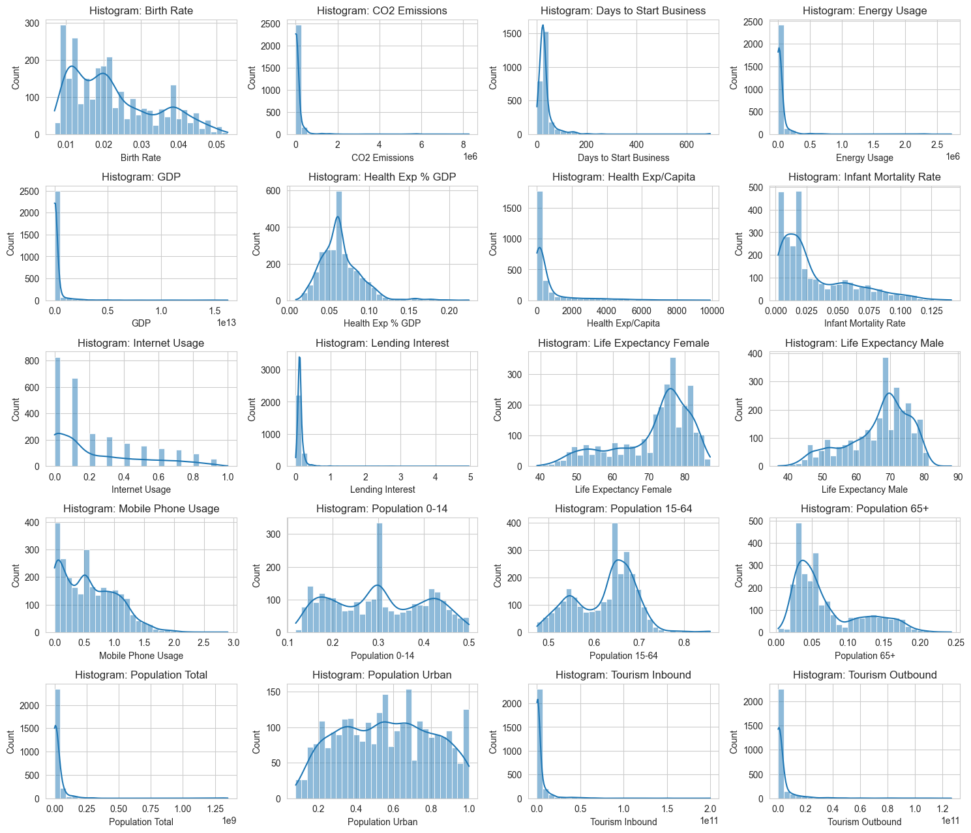
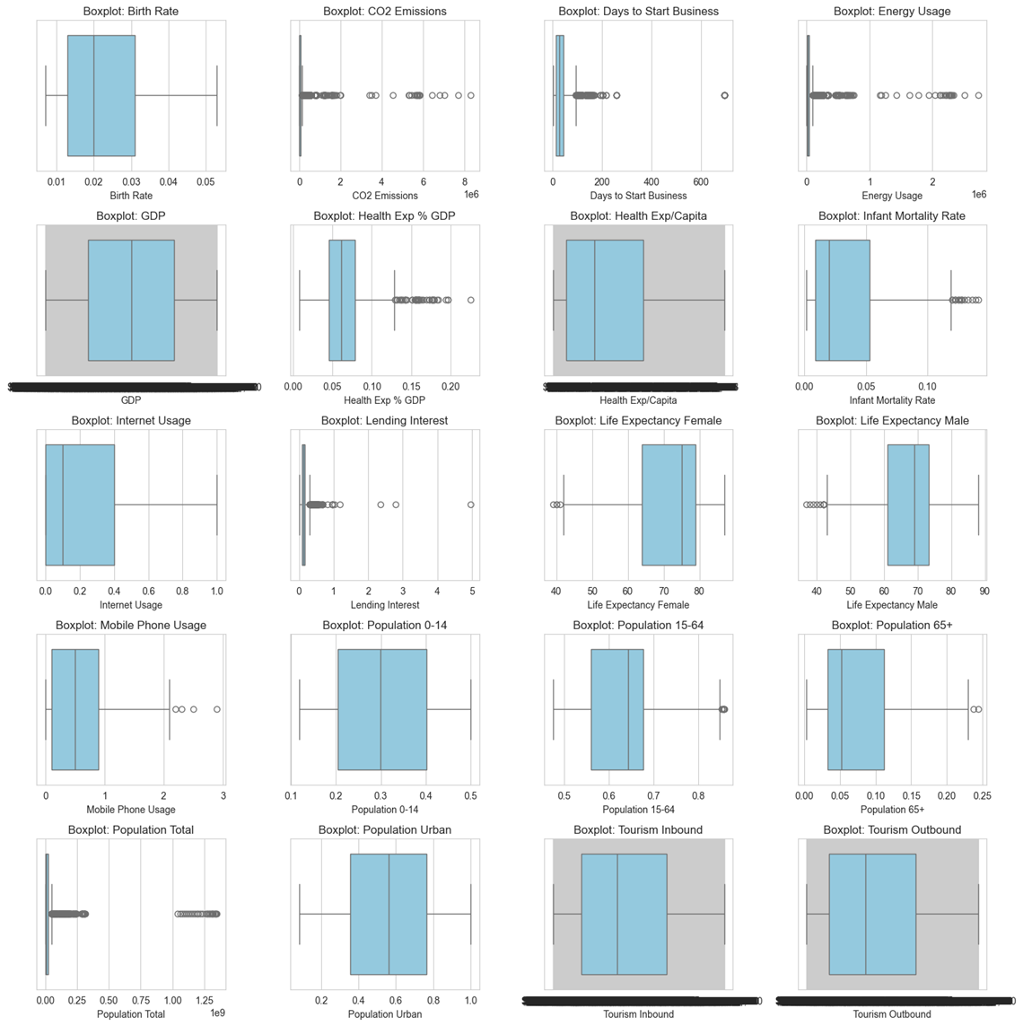
Feature Distribution
-for more info…List location or contact for specification (or other related documents)

Slide 11
Data Scaling
Data preprocessing is one of the most important steps in any machine learning pipeline. Raw data often comes with different scales, units and distributions, which can lead to poor performance of models.
To handle this, feature scaling is applied. We will explore two of the most used scaling techniques provided by scikit-learn:
StandardScaler: Standardizes features to zero mean and unit variance.
MinMaxScaler: Rescales features to a specific range (default [0,1]).
In this project we have used StandardScaler [ values varying between -3 to +3]

Slide 12
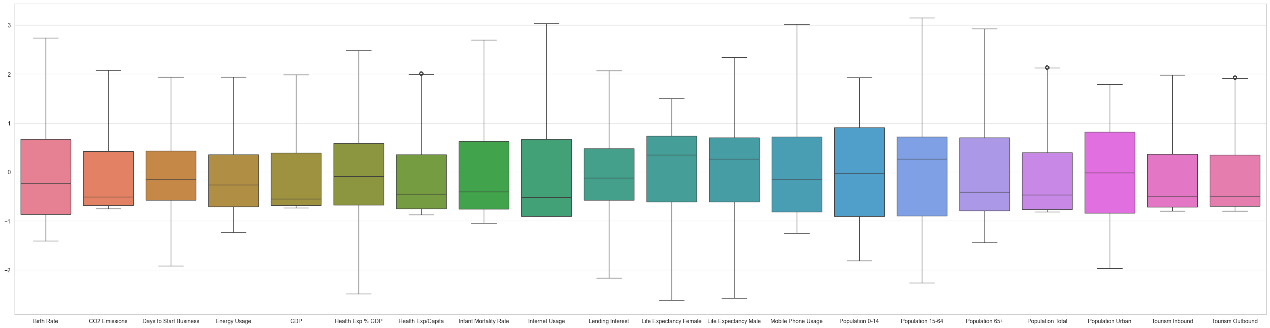
Scaled Data
 | Birth Rate | CO2 Emissions | Days to Start Business | Energy Usage | GDP | Health Exp % GDP | Health Exp/Capita | Infant Mortality Rate | Internet Usage | Lending Interest | Life Expectancy Female | Life Expectancy Male | Mobile Phone Usage | Population 0-14 | Population 15-64 | Population 65+ | Population Total | Population Urban | Tourism Inbound | Tourism Outbound
0 | -0.23 | 1.66 | -0.15 | 0.59 | -0.06 | -1.27 | -0.75 | 0.09 | -0.91 | -0.53 | -0.03 | 0.04 | -1.25 | 0.38 | -0.09 | -0.68 | 1.09 | 0.15 | -0.75 | -0.67
1 | 2.47 | -0.49 | -0.15 | -0.73 | -0.62 | -1.31 | -0.83 | 2.70 | -0.91 | 2.07 | -2.33 | -2.47 | -1.25 | 1.70 | -1.89 | -0.98 | 0.02 | -0.98 | -0.78 | -0.70
2 | 1.84 | -0.70 | -0.15 | -1.10 | -0.70 | -0.90 | -0.85 | 2.08 | -0.91 | -0.12 | -1.38 | -1.49 | -1.25 | 1.48 | -1.62 | -0.89 | -0.40 | -0.74 | -0.77 | -0.77
3 | 0.40 | -0.63 | -0.15 | -1.11 | -0.66 | -0.72 | -0.54 | 0.80 | -0.91 | 0.60 | -1.86 | -1.93 | -1.03 | 0.79 | -0.57 | -0.89 | -0.71 | -0.13 | -0.70 | -0.66
4 | 2.11 | -0.72 | -0.15 | -0.27 | -0.70 | -0.54 | -0.85 | 2.29 | -0.91 | -0.12 | -1.86 | -1.93 | -1.25 | 1.62 | -1.80 | -0.92 | -0.12 | -1.57 | -0.79 | -0.78

Slide 13
Principal Component Analysis(PCA)
PCA (Principal Component Analysis) is a dimensionality reduction technique and helps us to reduce the number of features in a dataset while keeping the most important information. It changes complex datasets by transforming correlated features into a smaller set of uncorrelated components.
📉 High-dimensional data is often hard to visualize and process.
⚡ Reduces computational cost by lowering the number of features.
🎯 Removes noise and focuses on the most important patterns.
📊 Improves visualization by projecting data into 2D or 3D.
🤖 Prevents overfitting by eliminating redundant features.

Slide 14
Feature Selection
The initial data set contained 25 features.
During Data cleaning 5 features were dropped.
We selected 6 features out of the 20 features after applying PCA as it captured 95% of the variance in the data.
Covariance Matrix : Covariance: tied, Clusters: 4, Score: 0.353. the covariance was maximum for cluster size 4.
 | PC1 | PC2 | PC3 | PC4 | PC5 | PC6 | PC7 | PC8 | PC9 | PC10 | PC11 | PC12 | PC13 | PC14 | PC15 | PC16 | PC17 | PC18 | PC19 | PC20
0 | 0.84 | 1.33 | -2.15 | -0.19 | -0.94 | -0.60 | 0.94 | -0.42 | -0.77 | 0.21 | 0.48 | 0.13 | -0.12 | 0.44 | -0.33 | 0.00 | -0.29 | -0.35 | -0.11 | 0.01
1 | 5.98 | 1.68 | 1.13 | -0.45 | -0.44 | 1.28 | -0.50 | -0.92 | 0.65 | 0.85 | 0.37 | 0.24 | 0.04 | 0.33 | -0.16 | 0.30 | -0.04 | 0.25 | 0.13 | -0.01
2 | 4.66 | 0.48 | 0.72 | -1.08 | -0.03 | -0.30 | 0.52 | -0.66 | 0.65 | 0.14 | 0.27 | 0.27 | 0.15 | 0.26 | -0.38 | 0.40 | -0.09 | 0.07 | 0.19 | 0.00
3 | 3.52 | -0.22 | 0.21 | -0.25 | -0.19 | 0.44 | 0.01 | -1.44 | 0.55 | 0.07 | -0.19 | -0.39 | -0.34 | 0.10 | -0.10 | -0.79 | -0.26 | -0.38 | -0.05 | 0.00
4 | 5.12 | 1.30 | 1.21 | -1.03 | -0.10 | -0.80 | 0.06 | -0.59 | 0.19 | 0.33 | 0.12 | 0.11 | 0.29 | -0.07 | 0.00 | 0.28 | -0.02 | 0.18 | 0.14 | 0.01

Slide 15
Model Building Methods
1. Partitioning Clustering
1.1 K-Means Clustering
1.2 K-medoids Clustering
2. Hierarchical Clustering
2.1 Agglomerative Clustering
2.2 Divisive Clustering
3. Density Based Clustering
3.1 DBSCAN Clustering Algorithm

Slide 16
Model Building Methods
4. Model-Based Clustering
4.1 Gaussian Mixture Models (GMMs)
5. Fuzzy Clustering
5.1 Fuzzy C-Means Algorithm

Slide 17
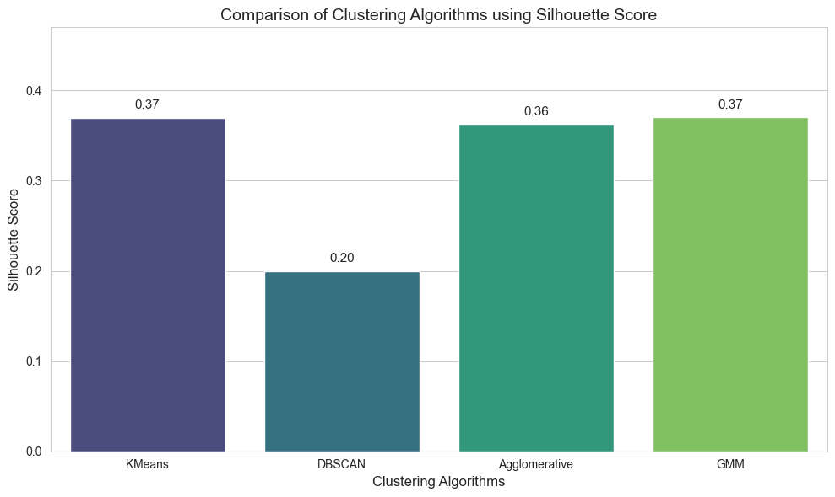
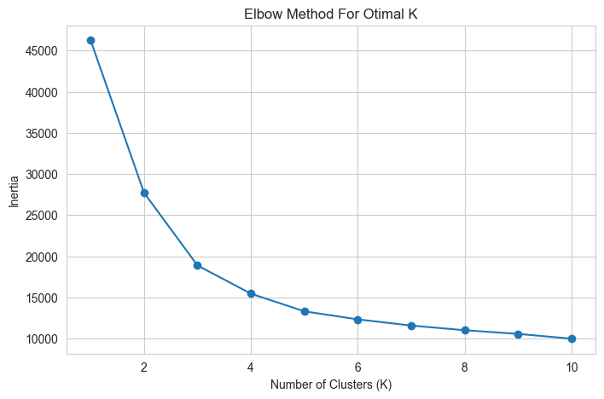
Model Selection Metric
Silhouette Score and Elbow Curve

Slide 18
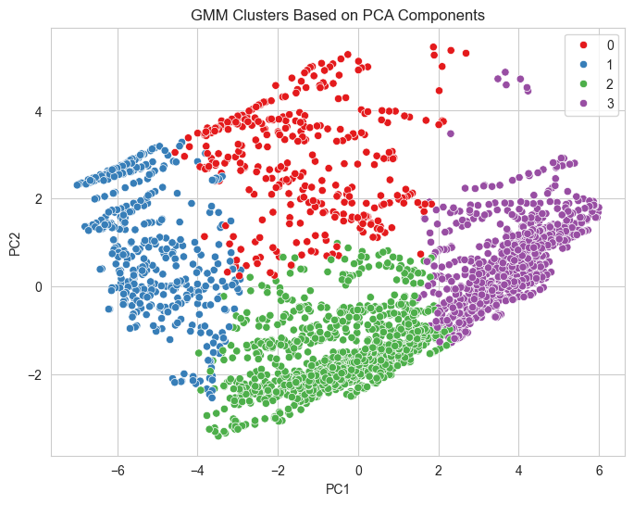
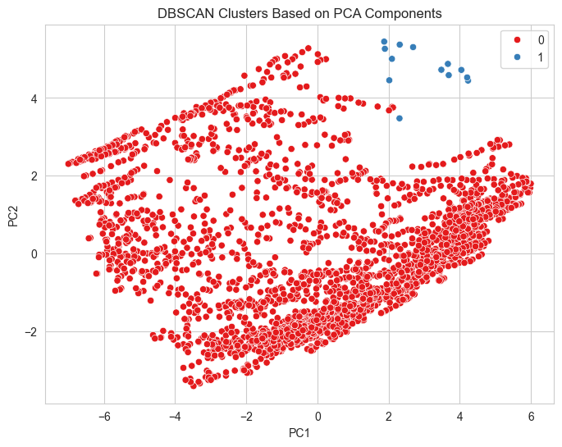
Clustering Based on PCA Components
-for more info…List location or contact for specification (or other related documents)

Slide 19
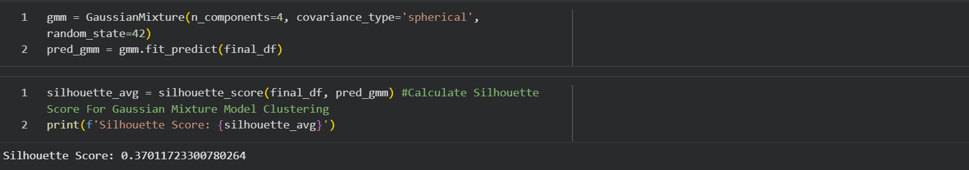
Model Selection & Fitting

Slide 20
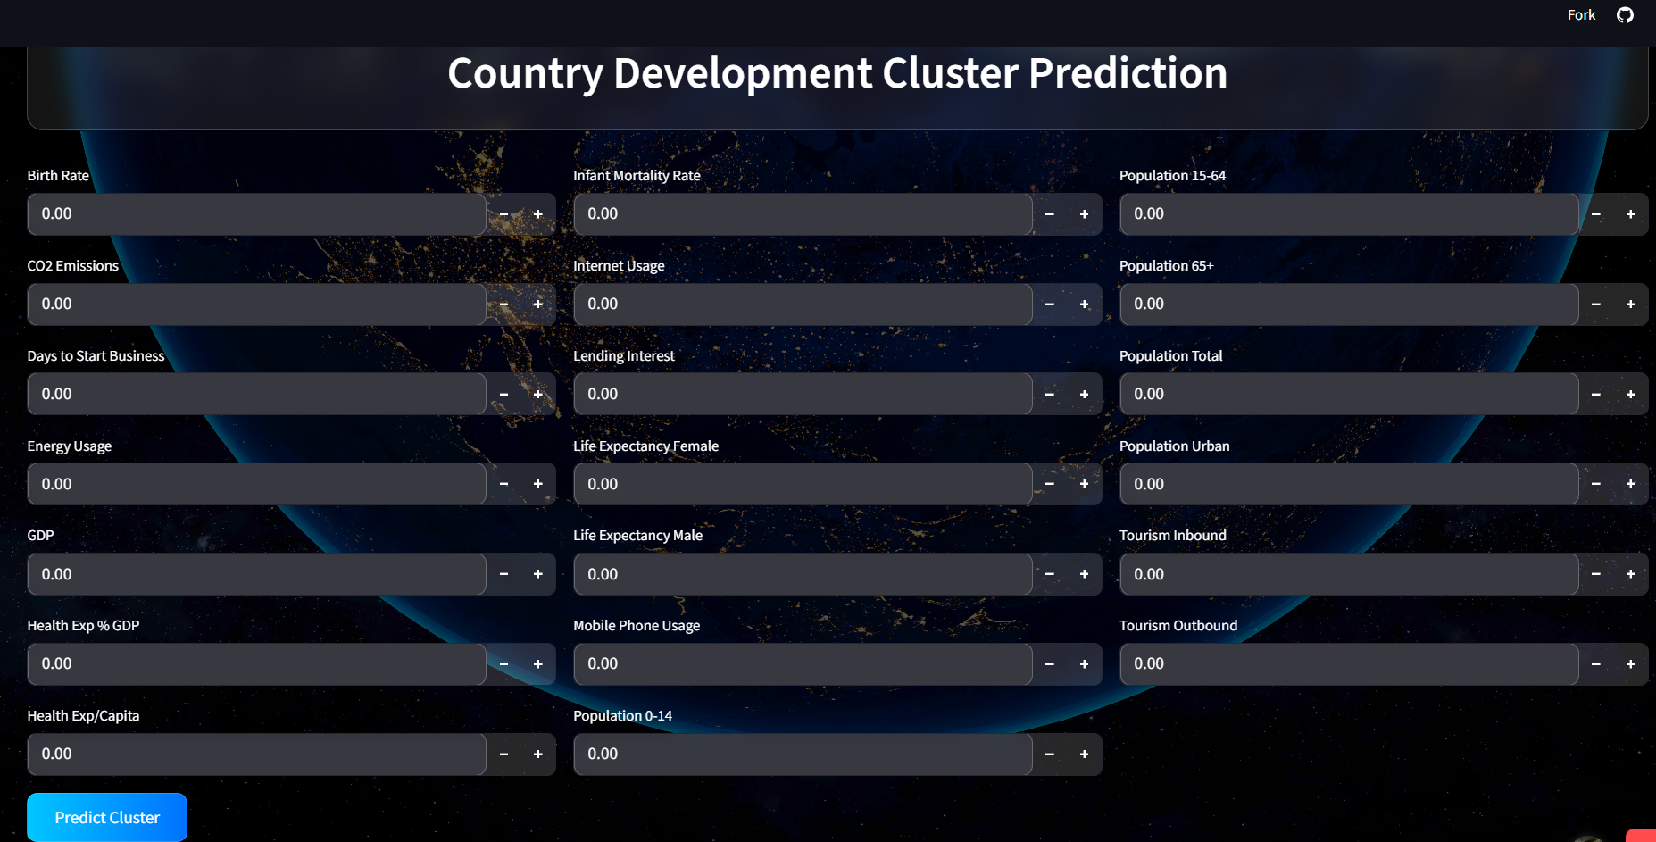
UI and Output

Slide 21
Deployment
Deployment Platform: Streamlit – A Python-based framework for creating interactive web apps quickly.
User Interface : Built using CSS and HTML.
Model Building Workflow:
Model Saving – Trained ML models (K-means, DBSCAN, Hierarchical Clustering - Agglomerative , Gaussian Mixture Model
GMM Clustering ) saved using pickle or joblib.
Web Interface – Built input forms for financial ratios, allowing users to enter company data easily.
Prediction Logic – User inputs processed and passed to the selected ML model to classify the countries
Results Display – The countries were classified into 4 clusters
Model Deployment URL : https://country-classification-project-mxns2yb6emum74pbyvrgbk.streamlit.app

Slide 22
Appendix

