Slide 1

Library Management System Database Systems 6622
Team – Infosec
Team Members
- Ritesh Kumar Parmar
- Udaypratap Rathore
- Anuj Rane
- Kunal Dhanaitkar

Slide 2
Introduction
The Objective of the Library Management System is to handle the entire activity of the Library.
Maintenance of all the information manually is a very complex task and with the advancement of technology, this Library Management System is developed to computerize and automate the everyday Library transactions easily.
The Application keeps track of all the information about the Books and their complete detail. It also provides the Admin and Students with a Login interface in order to view their activities of the Library.

Slide 3
Scope of Project
Our vision is to create a Library Management System, to keep track of all the Books, Employees and the Students in the Library.
Under the proposed scheme, Each user will obtain an identification login that will be used to look for a Book in the Library, issue a Library Book and Maintain Cart. Also, Admin and Staff users can record all of the transactions in the Library.

Slide 4
Software Development Life-Cycle
Information Gathering
In this initial phase of the Database Project, we understand and identify the project's technical requirements and proceed with a well-defined plan.
Planning
The Planning phase creates the foundation of the Project. During this phase, we describe a Conceptual Design, Logical Design and finally the Physical Design of the System.
Architectural Design
Data Architecture design is important for creating a vision of interactions occurring between the Data Systems and it helps in design, developments, implementation and maintenance of the Database.

Slide 5
SOFTWARE DEVELOPMENT LIFE-CYCLE
Software Development
Phase 1: After the Architectural design was developed, we started working on creating the Database for our project using Structured Query Language (SQL) and for this we used MySQL Workbench.
Phase 2: In this Phase of the Project, we developed a Graphical User Interface for our Database in order to manipulate the Data easily and effectively.
Testing
The Testing Process focuses on ensuring that all the statements and the Application program have been tested and to conduct any uncovered errors.
Deployment
The project for library management system was successfully designed and deployed by following all the necessary steps to meet the requirements of the project.

Slide 6
Entity-Relationship Diagram
The Entity-Relationship Diagram shows the workflow of our Library Management System which was used to identify the relationship between the entities.
Library Management System consisted of different entities such as Student, Book, Admin, Staff, Checkout Cart, Payment, and Authentication System.
Each entity constitutes of different attributes and classifying the attributes based on different factors such as attribute, key attribute, multi-valued attribute.

Slide 7
Creation of the Database
Creation of Database included a four-step process which includes creating the database, using the created database, creating tables for the database, and pushing the data into the database.
Step 1: Creating the Database - This was initial step towards the creation of database where we created our database by the name "libpos".
Step 2: Using the Created Database - The second step included using the created database

Slide 8
Creation of the Database
Step 4: Pushing data into database - This was the final step of creation of database which involved pushing the data into the database where the data was insert according to the column names and their associated data.
Step 3 : Creating Tables for the database - The third step involved creating tables for our database where we created multiples table for our database such Admin, Student, Staff, Payment, Book, Checkout_Cart, and book_registry.

Slide 9
Application Development
After the Process of creation of Database, we now implement the Graphical User Interface (GUI) which involves several operations such as Insert Record, Update Record, Search for all the Books, etc.
The Graphical User Interface will connect with the Database and will allow configuring all the CURD Operations.

Slide 10
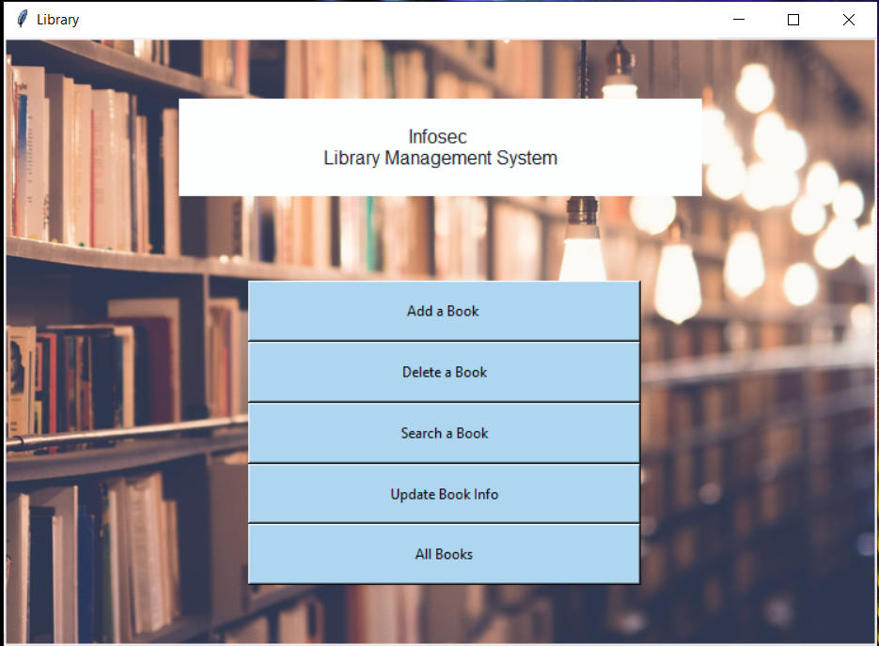
Application Development
Section 1: Creating the Graphical User Interface
In order to develop the Graphical User Interface, we will be using Python and a Python library tkinter.
Section 2: Connecting the GUI to the Database
The GUI needs to be connected to the Database in order to reflect all the changes in the records. This was acquired using Python package 'mysql.connector'.

Slide 11
Application Development
Section 3 : Creating CRUD Operations
This Section of our Application Development phase consisted of creating CRUD Operations which were configured for the Buttons of our Graphical User Interface. These Operations include:
Insert
Update
Delete
Search
Show All
Clear Data

Slide 12
Conclusion
This Database Project will provide a Computerized version of a Library Management System that will benefit the Students as well as the Staff of the Library.
Combined with the Front Desk Application and Platform, it provides a Robust and a Secure Database System which provides monitoring and maintaining the Data and the daily transactions of the Library properly and easily.

Slide 13
Future Scope
A Library Management System was developed and implemented in this Database Project. We plan to add the following new features in this System:
Provide a Recommendation Page to the User Interface such that Students can view, and reserve books related to their curriculum.
Facility to provide Students with Online Delivery for the Books.
Provide methods for adjusting account settings and a mechanism to reset password in case the User forgets it.

Slide 14
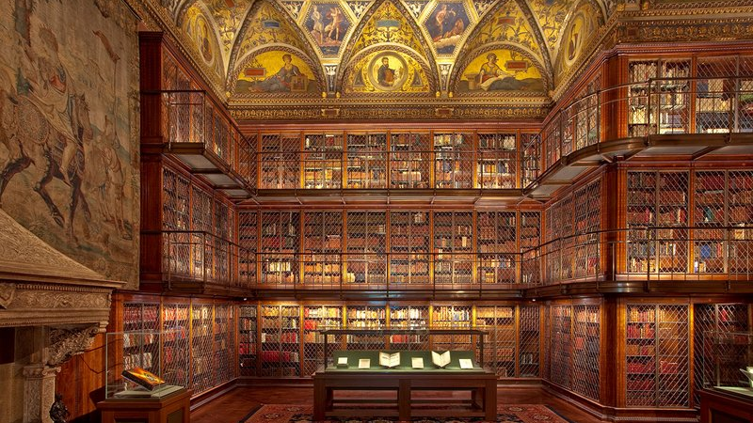
Thank you

