Slide 1
LESSON 6
THE ACT OF PROCLAMATION OF THE INDEPENDENCE OF THE FILIPINO PEOPLE
GE 2
ISAIAH EZEKIEL L. OASNON
DANIELA B. MORANO
CARL CHRISTIAN DUMAGSANG LOQUIAS

Slide 2
DECEMBER 1897

Slide 3
First phase of the Philippine Revolution ended in stalemate between the Spaniards and the Filipino rebels
Truce was declared between the two forces with the Filipino leaders, led by Gen. Emilio Aguinaldo
Truce – agreement between the Spaniards and Filipinos (Filipinos voluntarily asked the Spaniards to be exiled in Hong Kong.
Spaniards paid an indemnity of P400,000 for the damages caused as a result of the conflict.

Slide 4
SPANISH-AMERICAN WAR IN 1898

Slide 5
Arrival of the Americans as the new colonizer of the Philippines.

Slide 6
BEFORE THE BATTLE OF MANILA 1898

Slide 7
Aguinaldo had already been meeting with the Americans in Singapore
Aguinaldo talked with consul E. Spencer Pratt regarding the US-Filipino collaboration against the Spaniards before he went back to Hong Kong to meet up with Commodore George Dewey (commander of the Asiatic Fleet).-
Dewey had already left for the Philippines to attach the Spanish fleet following America’s declaration of war against Spain in April.
Aguinaldo met Rounseville Wildman (American consul general) and paid P117,000 to purchase rifles and ammunition. A first shipment worth P50,000 was made and the other half was never delivered.

Slide 8
MAY 19, 1898

Slide 9
Aguinaldo returned to the Philippines on board the U.S. cruiser McCulloch.
Aguinaldo conferred with Dewey on Philippine conditions and was supplied with arms captured from the Spaniards.
From Aguinaldo’s headquarters in Cavite, he announced the resumption of the revolution against the Spaniards = Beginning the second phase of the revolution.
- Aguinaldo was in command of an army of 12,000 troops.

Slide 10
MAY 28, 1898

Slide 11
Filipino forces won their first victory in Alapan, Imus.
The newly made Filipino flag was hoisted in Alapan then later unfurled at the Teatro Caviteño Nuevo (Cavite City).

Slide 12

Filipino flag was designed by Emilio
- sewed by:
Marcela Agoncillo (wife of friend of Rizal),
Lorenza Agoncillo (daughter of Marcela) and
Delfina Herbosa de Natividad (niece of Rizal).
Filipino flag was approved by the government February 12, 1998.

Slide 13
SYMBOLISM OF
PHILIPPINE FLAG

Slide 14
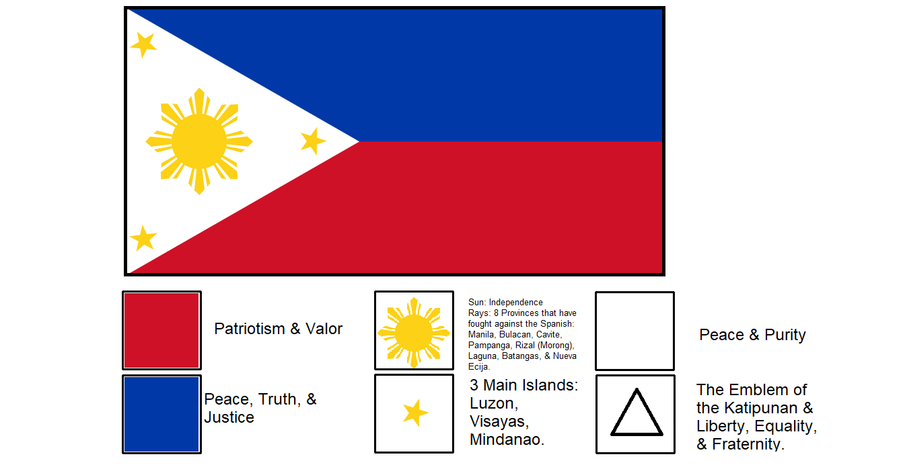
Symbolism of Philippine Flag:
White equilateral triangle = liberty, equality, and fraternity
Horizontal blue stripe = peach, truth, justice, and sacrifice
Horizontal red stripe = valor, courage, and patriotism
Sun = freedom, unity, democracy, and sovereignty
Rays = Manila, Bulacan, Pampanga ,Nueva Ecija, Morong, Laguna, Batangas, and Cavite
Stars = Luzon, Visayas (Panay Island),and Mindanao

Slide 15
JUNE 12, 1898

Slide 16
Aguinaldo declared Philippine independence from Spanish rule at a ceremony in his house in Kawit, Cavite.-Ambrosio Rianzares Bautista read the declaration that was signed by 177 persons (176 Filipinos and 1American military officer, L.M Johnson).- Philippine National Anthem, then known as “Marcha Nacional Filipina,” composed by Julian Felipe, was played by the Banda de San Francisco de Malabon and the Philippine flag was again unfurled

Slide 17
WHO IS EMILIO AGUINALDO?

Slide 18
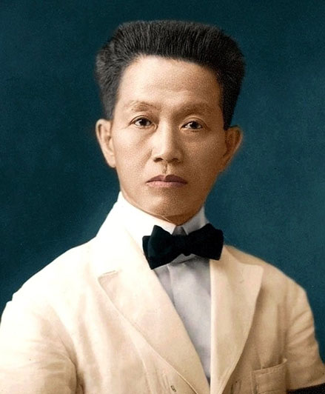
Born: March 22, 1869 in Kawit, Cavite (Cavite el Viejo)
Second to the youngest of eight children of Carlos Aguinaldo and Trinidad Famy.
Aguinaldo Family: Wealthy and Influential Family
Carlos Aguinaldo (Father) was gobernadorcillo for several times and was died on 1883.
Emilio Aguinaldo was a capitan municipal of Kawit in 1894.
He joined the Katipunan choosing the name Magdalo, a name that was also given to another branch of Katipunan(the other was the Magdiwang) which he set up in his province.
When the revolution began in 1896, the Katipunan in Cavite succeeded in driving away the Spaniards from the province. But territorial and logistical problems between the two groups soon forced Aguinaldo to ask for help from Supremo Andres Bonifacio in settling the conflict. Bonifacio’s intervention, however, only worsened the situation and the only solution the two factions saw was to create are volutionary government.

Slide 19
PAMAHALAANG PANGHIHIMAGSIK

Slide 20
Because of the protest regarding Bonifacio’s educational qualification for such a position, Bonifacio angrily declared the result of the election null and Void and walked out
When Bonifacio tried to put up his own government with an armed group, he was arrested and tried for sedition. Found guilty, Andres Bonifacio and Procopio Bonifacio(his brother) were executed on May 10, 1897.
Andres Bonifacio was arrested then charged with reason (pagtataksil) against the new government.
The internal dissent caused by Bonifacio’s death weakened the Katipunan further.
Spaniards soon realized that going after the rebels in their mountain hideout was futile. A stalemate ensued broken only by a truce proposal to which the rebels agreed. In exchange for an indemnity, amnesty, and colonial reform, Aguinaldo and his officers went into exile in Hong Kong in December1897.
MARCH 22, 1897:
Elections were held in Barrio Tejeros, San Francisco de Malabon (General Trias).
President: Emilio Aguinaldo
Vice President: Mariano Trias
Captain-General: Artemio Ricarte
Director of War: Emiliano Riego de Dios
Director of the Interior: Andres Bonifacio

Slide 21
Spanish-American War in 1898 changed Philippine history. After the Americans won the Battle of Manila Bay in 1898, Aguinaldo returned to the Philippines with their help and announced the resumption of the revolution against Spain. After winning several victories against the Spaniards, he declared Philippine independence on June 12, 1898.
Filipinos soon realized that the Americans were to become their new colonizers. After the Spanish defeat in 1898, the United States began to send fresh troops to the Philippines. In 1899, Aguinaldo convened a Congress in Malolos, Bulacan in which the delegates wrote a Constitution and established the Philippine Republic with Aguinaldo as President in January 1899.
Malolos Congress was written by Felipe Calderon y Roca and Felipe Buencamino.

Slide 22
1901

Slide 23
1901: Philippine-American War ended with the capture of Aguinaldo.
Soon after, Aguinaldo pledged allegiance to the United States and returned to private life on his family farm. He briefly hugged the limelight when he ran for the presidency of the Philippine Commonwealth but lost to Manuel L. Quezon.
Aguinaldo was charged with collaboration by the Americans for helping the Japanese during World War II but was later freed in a general amnesty. As a private citizen, he devoted his time to the cause of veteran revolucionarios until his death at the age of 94 on February 6, 1964.
- Cause of death: Chronic Thrombosis

