Slide 1
How/Why PLT Combines Teaching with Research
Matthias Felleisen

Slide 2
The Human-Language Interface
Matthias Felleisen

Slide 3
Rough Outline
Learning to Program: A New Look
The HLI Problem
A Solution
Research Problems

Slide 4
Learning to Program

Slide 5


Learning to Program: A Place in the Sun
Syntax
Errors
Type
Errors
Division
by 0 Error
compile
link
run

Slide 6

Learning to Program: A Place in the Sun?
Syntax
Errors
Type
Errors
Division
by 0 Error
input &
output
compile
link
run
debug
project
GUIs

Slide 7

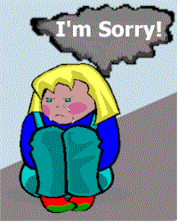
Learning to Program: A Place in the Rain?
Syntax
Errors
Type
Errors
Division
by 0 Error
input &
output
compile
link
run
debug
project
GUIs

Slide 8
Learning to Program
programming concepts: design … test
language concepts: public, static, void, main …
compilation: syntax & type errors, …
execution: the program vs the machine
debugging: what’s a stack? …
projects, files, libraries: don’t ask

Slide 9
Learning to Program
talented students drop out
  girls
  students in general
many go away with bad feelings
graduates can’t recognize the essence
experienced programmers don’t understand the programming philosophy

Slide 10
Do we accept this?
Or, do we do something about it?

Slide 11
What is the problem?

Slide 12
TheHuman-Language Interface Problem

Slide 13
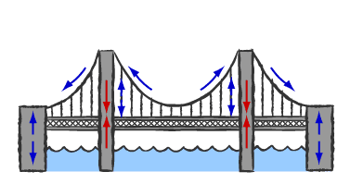
HLI
the programming language
programmer
machine

Slide 14
HLI
a bridge is symmetric
programmer writes in language
compiler translates language to machine
but where is all the research?

Slide 15
HLI
``[m]illions for compilers, but hardly a penny for
understanding human programming language use.
Now, programming languages are obviously
symmetrical, the computer on one side, the human
on the other. In an appropriate science of computer
languages, one would expect that half the effort
would be on the computer side, understanding how
to translate the languages into executable form,
and half on the human side, understanding how
to design languages that are easy or productive to use.''
John Pane, 1985
as quoted in Newell and Card

Slide 16
HLI: The Reality of Research
parsers
type systems and type checkers
semantics and logic
compiler organization
register allocation
instruction pipelining
memory locality
…

Slide 17
HLI
parsers
type systems and type checkers
semantics and logic
compiler organization
register allocation
instruction pipelining
memory locality
…
syntax errors
type errors & inference
value flow explanations
???
???
???
???
???
???

Slide 18
HLI
learning curve for conventional language

Slide 19
HLI
learning curve for conventional language

Slide 20
HLI
learning curve for conventional language
syntax
prog principles
computation
debugging
libraries

Slide 21
HLI
learning curve for alternative languages

Slide 22
HLI
learning curve for alternative languages

Slide 23
HLI: The HLI Problem
alternative learning curve for conventional language

Slide 24
HLI
HCI: human-computer
computer software
graphical interfaces
cognitive model of I/O
HLI: human-language
computer language:
  computational concepts
  programming concepts
two interfaces
  implementation (PDE)
  conceptual (programming)
educational model

Slide 25
PLT’s Solution to the HLI Problem

Slide 26
Interfaces for PLs
language concepts
Programming
Language
programming
concepts
implementation
environment

Slide 27
Interfaces for PL
a gradual introduction to programming
a gentle slope for language concepts
a kind and simple technology

Slide 28
Interfaces for PL
many increasingly complex interfaces for
  programming
  language concepts
and an implementation of all these interfaces that enforce and exploit them

Slide 29
Interfaces for PL
many discrete interfaces to get to the same point

Slide 30
Interfaces for PLs
With so many languages around, what do you do?
Eiffel
Simula67
Pascal
Algol60
SmallTalk
VB
BASIC
ML
Tcl/Tk
Fortran
Logo
Scheme
Haskell
Perl
ASM
C
C++
Python
Java
C#
Pick one that you believe in, and work with it honestly.

Slide 31
Interfaces for Scheme
introducing program design with Scheme
introducing language concepts of Scheme and with Scheme
experiences and first evaluation

Slide 32
How to Design Programs
A New Interface to Programming

Slide 33
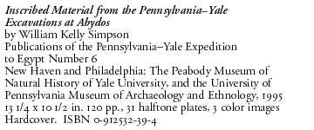
HtDP: The Analysis
Programming
; DATA Definition:
(define-struct posn (x y))
; Posn = (make-posn Number Number)
; PROGRAM
; Posn -> Number
(define (distance-to-origin p)
(sqrt
(+ (sq (posn-x p))
(sq (posn-y p)))))
; Number -> Number
(define (sq x)
(* x x))
; TESTS
(distance-to-origin (make-posn 3 4))
= 5
(distance-to-origin (make-posn 12 5))
= 13
; DATA Definition:
(define-struct posn (x y))
; Posn = (make-posn Number Number)
; PROGRAM
; Posn -> Number
(define (distance-to-origin p)
(sqrt
(+ (sq (posn-x p))
(sq (posn-y p)))))
; Number -> Number
(define (sq x)
(* x x))
; TESTS
(distance-to-origin (make-posn 3 4))
= 5
(distance-to-origin (make-posn 12 5))
= 13

Slide 34
HtDP: What’s wrong with this picture?
;; Number -> Number
(define (add-one given-value)
(let ([x given-value])
(cond
[(<= given-value 0) (set! x (+ x 1))]
[(>= given-value 0) (set! x (+ x 1))])
x))
define
let
cond
set!
+, -, >=, …

Slide 35
HtDP: What’s wrong with this picture?
;; Number -> Number
(define (add-one given-value)
(let ([x given-value])
(cond
[(<= given-value 0) (set! x (+ x 1))]
[(>= given-value 0) (set! x (+ x 1))])
x))
define
let
cond
set!
+, -, >=, …

Slide 36
HtDP: What’s wrong with this picture?
;; Number -> Number
(define (add-one x)
(+ x 1))
;; Number -> Number
(define (add-one given-value)
(let ([x given-value])
(cond
[(<= given-value 0) (set! x (+ x 1))]
[(>= given-value 0) (set! x (+ x 1))])
x))
But why not, professor?
IT WORKS!

Slide 37
HtDP: The Analysis
state explicit design principles & process
each step produces intermediate products
following produces good outcome
not following process bad outcome
series of increasingly complex design principles
as little domain knowledge as possible

Slide 38
HtDP: The Insight
data plays a central role
  in functional programming
  in object-oriented programming
  so data-based program design scales
program form follows data form
  the pieces are dictated by the data that we process

Slide 39
HtDP: The Idea
plain
structured
mixtures
unlimited size
functions
analysis/definition
complexity of data
signature/purpose stmt.
(behavioral) examples
templates
definitions
tests
design recipe steps

Slide 40
HtDP: The Design Recipe Steps
problem analysis & data definition
contract, purpose statement, function header
examples of data, behavioral examples
function template
function body
tests

Slide 41
HtDP: Complexity of Data Definitions
type Pesos = Number
type Dollar = Number
;; exchange : Dollar -> Pesos
atomic forms of data
functions as composities of atomic ops

Slide 42
HtDP: Complexity of Data Definitions
type Dog = struct{name:String,
age:Number,
neutered:Boolean}
Dog
name : String
age : Number
neutered : Boolean
structures, plain classes

Slide 43
HtDP: Complexity of Data Definitions
type Posn = struct{x:Number, y:Number}
type Circle = struct{radius:Number, center:Posn, color:String}
Circle
Posn
radius : Number
center : Posn
color : String
x : Number
y : Number
containment (has-a)

Slide 44
HtDP: Complexity of Data Definitions
type Shape = Circle of … | Square of … | Line of … | …
Shape
Circle
Square
Line
superclasses (is-a)

Slide 45
HtDP: Complexity of Data Definitions
type Shape = Circle of … | Square of … | Union of Shape * Shape
Shape
Circle
Square
Union
recursive data descriptions
(mixing has-a/is-a)

Slide 46
HtDP: Complexity o f Data Definitions
type Shape = Circle of … | Square of … | Union of ShapeList
and ShapeList = empty | cons of Shape * ShapeList
Shape
ShapeL
mutual references

Slide 47
HtDP: Complexity of Data Definitions
fun f_and_g(delta1, delta2) = fn s => …
functional abs.
fun f(s) = …
fun g(s) = …
f() { … }
template and hook
f() { … }
g() { … }

Slide 48
HtDP : In Action
Data Definition:
type Shape = Circle of Position * Number
| Square of Position * Number
| Line of Position * Position
Examples:
(make-circle (make-posn 3 4) 17)
(make-square (make-posn 3 4) 10)
(make-line (make-posn 3 4) (make-posn 12 5))

Slide 49
HtDP : In Action
type Shape = Circle of center:Position * radius:Number
| Square of nw:Position * size:Number
| Line of one:Position * two:Position
Template:
;; f : Shape -> ???
(define (f s)
(cond
[(circle? s) .. (shape-center s) … (shape-radius s) …]
[(square? s) … (square-nw s) … (square-size s) …]
[(line? s) … (line-one s) … (line-two s) …]))

Slide 50
HtDP : In Action
type Shape = Circle of center:Position * radius:Number
| Square of nw:Position * size:Number
| Line of one:Position * two:Position
Contract, Purpose, Header:
;; measure : Shape -> Number
;; to measure the size of Shape s
(define (measure s) …)
;; distance : Shape -> Number
;; to measure the distaceto the origin
(define (distance s) …)

Slide 51
HtDP : In Action
type Shape = Circle of center:Position * radius:Number
| Square of nw:Position * size:Number
| Line of one:Position * two:Position
Examples (for distance):
(make-circle (make-posn 3 4) 17) should produce 5
(make-square (make-posn 3 4) 10) should produce 5
(make-line (make-posn 3 4) (make-posn 12 5))
should produce 13, because .. 12 * 12 + 5 * 5 …

Slide 52
HtDP : In Action
type Shape = Circle of center:Position * radius:Number
| Square of nw:Position * size:Number
| Line of one:Position * two:Position
Coding:
now, and only now, students may code up
the function body … I.e., “program”

Slide 53
HtDP: In Action
And now don’t forget to
TEST
with the examples.

Slide 54
One Scheme, Many Schemes
A New Interface to Scheme

Slide 55
Many Schemes: The Analysis
The Big Problem:
The syntax of all programming languages
is too flexible for novices. Period.

Slide 56
Many Schemes: The Analysis
Let’s illustrate the point with C++ first:
main() {
double price;
double no_pieces;
double total;
…
price * no_pieces = total;
… }
compile!
LHS Value expected!

Slide 57
Many Schemes:The Analysis
So how about Scheme?
(define (length a-list)
(cond
[(empty? a-list) 0]
[else 1 + (length (rest a-list))]))
ready? always!
test, interactively:
> (length empty)
0
> (length (list 1))
0
> (length (list 1 2 3 4 5))
0
No error message at all!
It’s syntactically correct
-- implicit begin

Slide 58
Many Schemes:The Analysis
So how about Scheme?
(define (length a-list)
(cond
[empty?(a-list) 0]
[else (+ 1 (length (rest a-list))]))
load and evaluate!
test, interactively:
> (length empty)
empty is not a function
> (length (list 1))
(list 1) is not a function
It’s syntactically correct
-- run-time error about
higher-order functions
which isn’t in your vocab yet

Slide 59
Many Schemes: The Insight
Social Theorem: Beginners make mistakes.
Social Corollary:
What matters is how a “system” reacts to errors.

Slide 60
Many Schemes:The Idea
One Scheme is not enough to report errors.
We provide 5 Scheme languages, each more complex than the previous one.
Each language represents a level of knowledge and corresponds to a stage in the curriculum. Each reports errors appropriately.

Slide 61
Many Schemes:The Idea
Beginning Student
  First-order FP, with structures
Beginning Student with List Abbreviations
Intermediate Student
  Lexical scope, First-class named functions
Intermediate Student with Lambda
Advanced Student
  Variable Assignment, Structure Mutation

Slide 62

Many Schemes: More Analysis
(define (f x) (+ (* 5 x) 23))
(f 7)
58
registers
stack
copy values
…
Why?

Slide 63
Many Schemes: The Insight
conventional explanations mix syntax, compilation, and machine concepts
… but beginners know little more than syntax and syntactic relationships (plug in and evaluate)

Slide 64
Many Schemes: The Idea
Execution:
Evaluation:
(define (f x) (+ (* 5 x) 23))
(f 7)
58
(define (f x) (+ (* 5 x) 23))
(f 7)
= (+ (* 5 7) 23)
= (+ 35 23)
= 58
The semantics also needs two interfaces.

Slide 65
Many Schemes
We need more than one interface to the syntax of a language.
We need more than one interface to the semantics of a language.
We need to match them with the design philosophy.

Slide 66
DrScheme
The Program Development Environment

Slide 67
DrScheme: TheGoals
Language designers must specify:
  a series of design principles
  a series of sublanguages
The PDE/IDE must enforce the sublanguages and report errors in a level-specific manner. It should also support design.
The PDE/IDE must explain the program’s behavior.

Slide 68
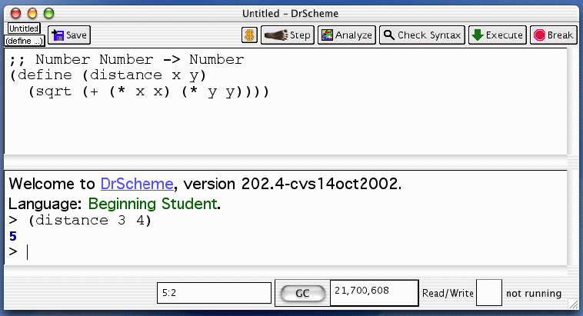
DrScheme: Overview of PDE
scope-sensitive syntax checker
algebraic stepper
syntax-sensitive editor
teaching languages
interactive (algebraic) evaluator

Slide 69
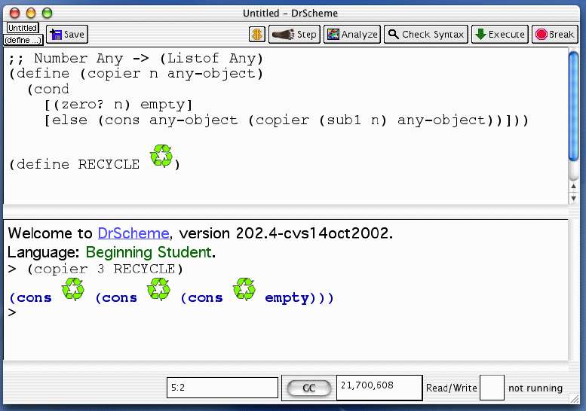
DrScheme: Interactive (Algebraic) Evaluation

Slide 70
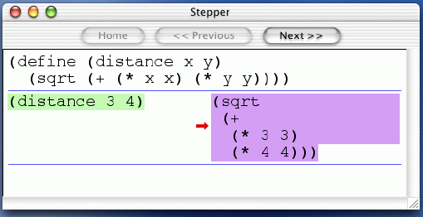
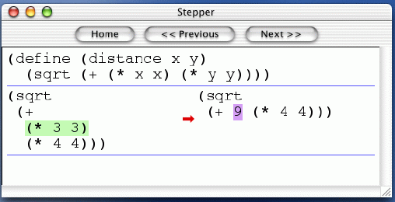
DrScheme: Algebraic Stepping

Slide 71
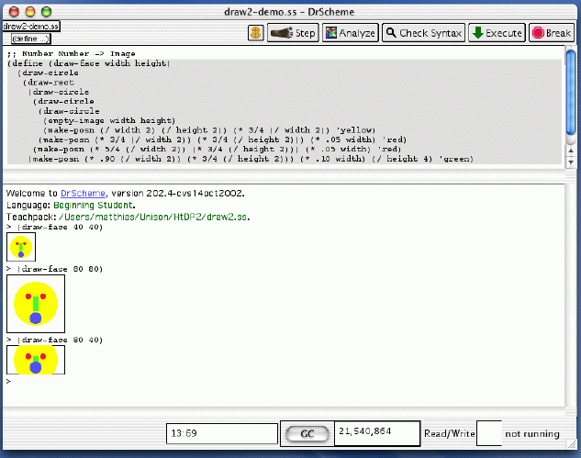
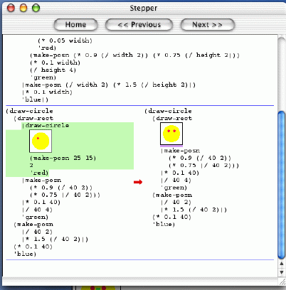
DrScheme: Language Levels and Fun

Slide 72
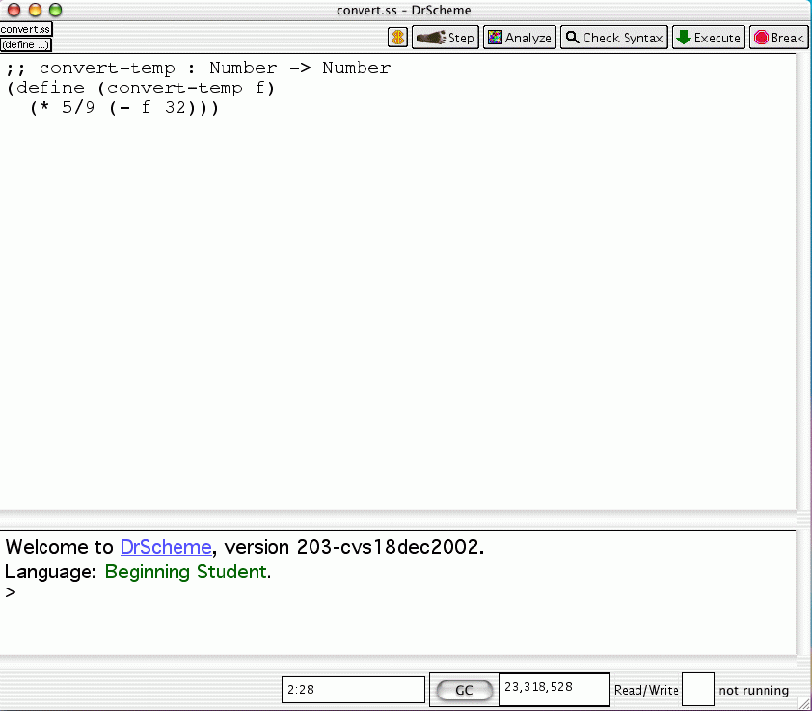
DrScheme: Design & Tests

Slide 73
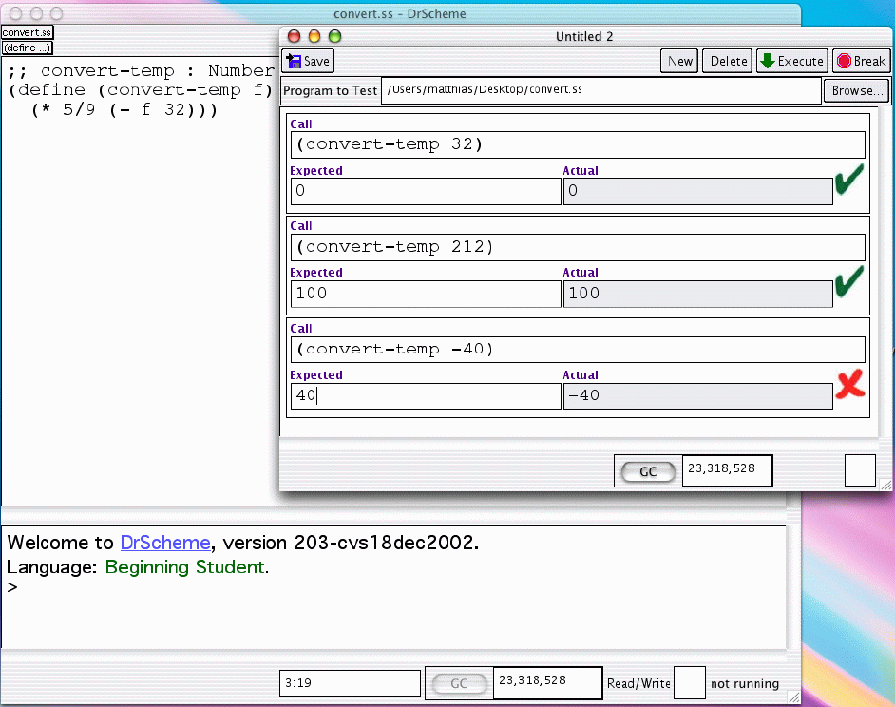
DrScheme: Design & Tests

Slide 74
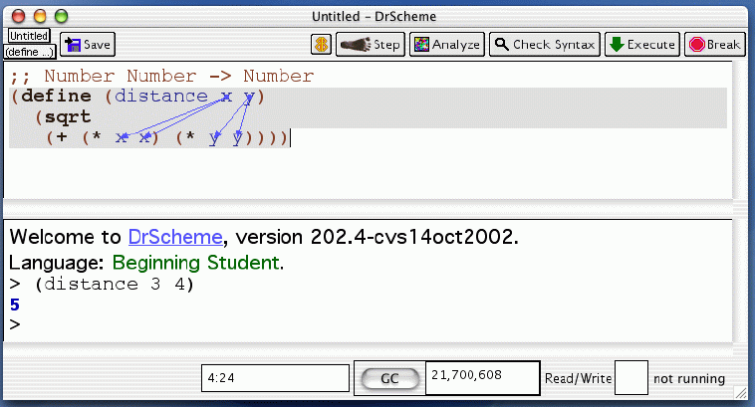
DrScheme: Scope-sensitive Syntax Check

Slide 75
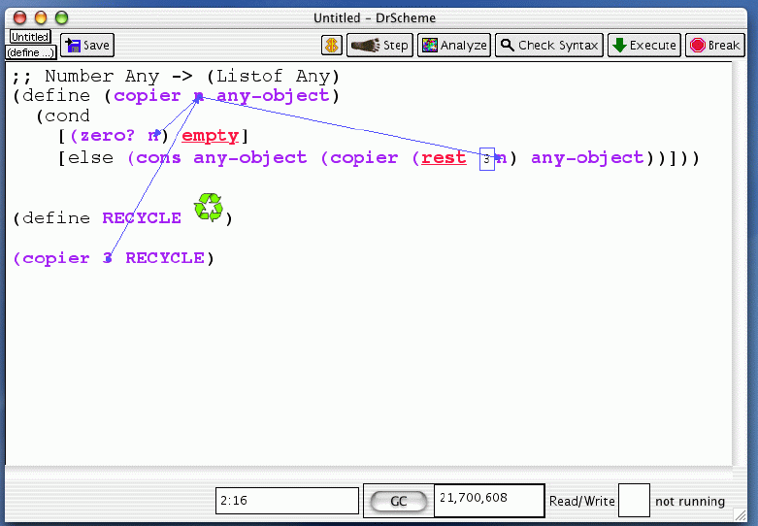
DrScheme: Types and Static Debugging

Slide 76
Evaluation and Experiences
Adding a “human” element means
adding measurements

Slide 77
Experiences: The Rice Experiment
second semester: OOP, classical data structures, patterns
CompSci 210:
TeachScheme curriculum
good evaluation
huge growth, diversific.
many different teachers
CAAM 210:
C/C++ curriculum
weak evaluations
little growth
several teachers
beginners: no experience, up to three years of experience

Slide 78
Experiences: University
Systems and Algorithmics faculty members for second course confirm that “Scheme programmers are better C++ programmers.”
  Scheme + Java is far better than C++ + Java (and now Java/Java)
The course grew by almost twice as much as other TX universities in the same time period (WSJ).
The course population diversified tremendously, attracting many more women.

Slide 79
Experiences: University
The experiment has been repeated at Adelphi University (measured results).
GA Tech has used the curriculum and compared to pre-existing pre/post conditions for freshmen course. Happy!

Slide 80
Experiences: High School Teachers
I spent the first six weeks of this year teaching Scheme
to my beginning AP class. We worked through the
first 10 sections of the book [HtDP], and then moved to C++.
In the past four weeks this group of students has completed
Part 1 of the marine biology case study and the equivalent
of eight chapters of the C++ textbook. There have been NO
problems understanding the concepts of functions, parameters,
or classes--topics I've had to teach and reteach in prior years.
… these students "think" more productively: they write modular
programs naturally and test pieces thoroughly. They use new
classes with little or no instruction from me.

Slide 81
Experiences: High School Teachers
All I have left to teach are matrices and Part 2 of the case study,
and I have almost two months left! In addition, my students
already understand lists and recursion. These topics aren't usually
covered until the second AP course. This is the first AP course,
and I have almost two months left!
Renee Ciezki
October 22, 2002

Slide 82
Research for HLI

Slide 83
Research
Edu Eval
Programming
Languages
HLI
Operating
Systems
Software
Engineering

Slide 84
PL Research: A Series of Languages

Slide 85
PL Research: A Series of Languages
understanding extensible languages means studying and understanding extensible systems
modules and classes for Scheme
glueing modules together safely
macro systems for modules

Slide 86
PL Research: Execution, Evaluation
P
P1
P2
P3
P4
Pn
compile
interpret
Obj
Ans

Slide 87
PL Research: Execution, Evaluation
connecting two evaluation mechanisms correctly
designing a purely syntax-based explanation for full Scheme or Java or …

Slide 88
OS Research: Plug and Administrate
DrScheme
client program
tool extension

Slide 89
OS Research: Plug and Administrate
security for all components: DrS, plug-ins
resource administration: time, memory, files, network connections, db handles, …
event administration & redirection

Slide 90
Conclusions

Slide 91
Conclusion: Improving the HLI
a gradual introduction to program desin
a gentle slope to language concepts
P Development Environment

Slide 92
Conclusion: Experiences
the experiences are positive
we don’t have enough evidence yet
we need more direct comparisons

Slide 93
Conclusions: What about Java
Java: designing class hierarchies
Java: classes, interfaces, abstractions
Java: interactive, incremental evaluation
Java: syntactic method stepping

Slide 94
Conclusions
Human-Language Interface deserves attention
We have done the first few steps.
More research must be done. Join us.

Slide 95
The End

Slide 96
The People
language designer
environmental engineer
software engineer
the big foot
webbing it
analysist one
analysist two
background productions
matthew flatt
robby findler
shriram krishnamurthi
john clements
paul graunke
cormac flanagan
philippe meunier
paul steckler

