Slide 1

From POPL to the Classroom and Back
Matthias Felleisen

Slide 2
Classroom
research seminar
graduate course on popl
undergraduate course on pl
introductory programming/college
introductory programming/high school

Slide 3
Research and Teaching
The TeachScheme! Project
The DrScheme Project
… and how they inspire research

Slide 4
Research and Teaching
The TeachScheme! Project:
  from 3 teachers to 100 per summer
  some 230 total, over 120 active teachers
  four workshop sites in US
  also in: Germany, Israel, Philippines
The DrScheme Project:
  200,000 lines of C++, 200,000 lines of Scheme
  between 300 and 450 Windows downloads per day, plus a few dozen Unix and Mac OS
  6 graduate students, 1 researcher, 1 faculty for some 5, 6 years

Slide 5
Research and Teaching
Programming in High School
DrScheme and TeachScheme!
Some Technical Challenges
Conclusions on POPLs and POPs

Slide 6
How It All Started

Slide 7



How It All Started
On the way back from POPL 95:
Yours
Truly
Cormac
Flanagan

Slide 8
How It All Started
Matthias answers:
There is really neat
research out there,
and nobody cares.
Even Freshmen think
they know better
in this day and age.
Cormac wonders:
What do you dislike most
about your work?

Slide 9
How It All Started
No way. Just think about
it. We have all these neat things
like lists and trees and closures.
We know how to design
programs. When we evaluate
programs, it’s just high school
algebra.
Perhaps they do. Isn’t
easier to learn to program
in BASIC than in Scheme?

Slide 10
How It All Started
Cormac wonders:
Oh yeah? I don’t
believe that.
Matthias answers:
I’ll show you!

Slide 11

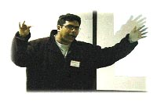
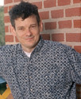
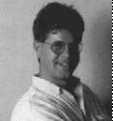
How It All Started: 1995
No more POPL papers
Let’s do “real” programming language work instead
  design language
  design environment
  investigate what’s out in high schools: students, teachers, standards

Slide 12
Programming in High School

Slide 13
Programming in High School
No true standards
  AP’s de facto normative power
  “AP tests in C++, we must teach C++”
  vague state guidelines
No well-trained teachers
  well-trained teachers move to industry
No uniform curriculum

Slide 14
Programming in High School
How do teachers teach programming? how do students learn?
What kind of programming languages do they use
What kind of programming environments?

Slide 15
Programming in High Schools
How to program:
  copy and modify examples
  compile until it’s okay
  test until you see decent results
  the lucky ones: analyze the algorithm
  the luckiest ones: cover some basic set of data structures and algorithms

Slide 16
Programming in High School
Programming languages:
  Pascal for the longest time
  C++ via AP, Java next year
    AP C++ and AP Java are subsets of C++ and Java
  Basic, QucikBasic, VB6.8
Programming environments:
  Visual Builder 17.86 Education Edition

Slide 17
Programming in High School
We can’t blame the students.
We can’t blame the teachers.
We can’t blame the schools, …

Slide 18
Programming in High School
We shouldn’t blame people for not knowing a fashion-driven field …
because what do we know?
because what do we do?
Susan Horwitz (AP C++ Guide)
Jon Riecke (NJ Schools)

Slide 19
Overview: DrScheme and TeachScheme!

Slide 20
DrScheme and TeachScheme!
With so many languages around, what do you do?
Eiffel
Simula67
Pascal
Algol60
SmallTalk
VB
BASIC
ML
Tcl/Tk
Fortran
Logo
Scheme
Haskell
Perl
C
C++
Python
Java
C#
Pick one that you believe in, and evaluate it honestly.

Slide 21
DrScheme
Why we believe in Scheme
Scheme has a simple syntax
easy-to-teach Scheme subsets
interactive evaluation
wonderful PDE: Emacs
exciting things to teach: lists, trees, EE math from SICP, …

Slide 22
DrScheme: Scheme is Dead, Long Live Scheme
How is Scheme per se as a teaching language?
How is Emacs as a PDE?
Scheme is a failure. We won’t talk Emacs.
No gloating: C++, Java, ML, Haskell,
and you-name-it fail as well.
So we built DrScheme and a good teaching language:
Scheme.

Slide 23
DrScheme
The Big Problem:
Scheme’s syntax is too flexible.
More or less, everything is correct syntax,
whether or not students know about a
specific construct or class of values.

Slide 24
DrScheme
Let’s illustrate the point with C++ first:
main() {
double price;
double no_pieces;
double total;
…
price * no_pieces = total;
… }
compile!
LHS Value expected!

Slide 25
DrScheme
So how about Scheme?
(define (length a-list)
(cond
[(empty? a-list) 0]
[else 1 + (length (rest a-list))]))
ready? always!
test, interactively:
> (length empty)
0
> (length (list 1))
0
> (length (list 1 2 3 4 5))
0
No error message at all!
It’s syntactically correct
-- implicit begin

Slide 26
DrScheme
So how about Scheme?
(define (length a-list)
(cond
[empty?(a-list) 0]
[else (+ 1 (length (rest a-list))]))
load and evaluate!
test, interactively:
> (length empty)
empty is not a function
> (length (list 1))
(list 1) is not a function
It’s syntactically correct
-- run-time error about
higher-order functions
which isn’t in your vocab yet

Slide 27
DrScheme
Social Theorem 1: Beginners make mistakes.
Social Corollary 1:
What matters is how a “system” reacts to errors.

Slide 28
DrScheme
A curriculum must specify a series of subsets of the chosen language.
The PDE/IDE must enforce the subsets and report errors in a level-specific manner.
The PDE/IDE must collaborate with the run-time system to explain the program’s behavior.

Slide 29
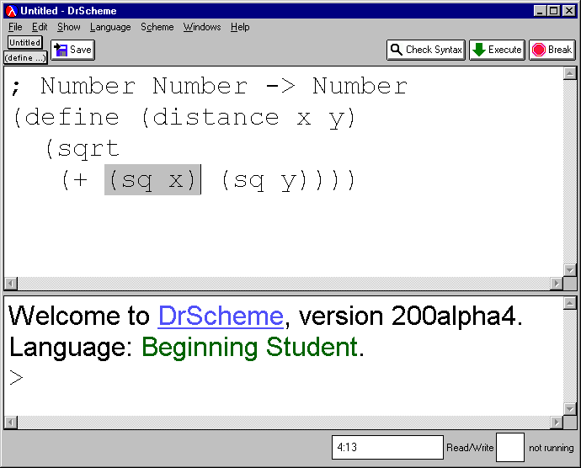
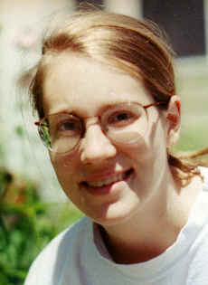
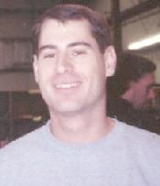
DrScheme
scope-sensitive syntax checker
syntax-sensitive editor
static debugger
algebraic stepper
interactive evaluator

Slide 30
DrScheme
DrScheme has 5 teaching levels:
  Beginner: 1 FP with structures
  Beginner with List Abbreviations
  Intermediate: Lexical Scope
  Intermediate with Lambda
  Advanced: Structure Mutation
Well-defined and enforced sublanguages
help with syntax errors.

Slide 31
DrScheme
DrScheme runs student programs under its own control:
  no switching between compile/link/run
  run-time error reporting is integrated
  safety checks paint soure of run-time error
Integrating safety monitors and the PDE
help with run-time errors.

Slide 32
DrScheme
DrScheme can explain computations
  computation: when programs perform work
  a model based on simple algebra
  an algebraic stepper: integrated
Integrated algebraic stepping explains
run-time behavior and logical errors

Slide 33
DrScheme
Beginners need a simple model of computation:
(sqrt (+ (* 3 3) (* 4 4)))
(sqrt (+ (* 3 3) (* 4 4)))
(sqrt (+ 9 (* 4 4)))
arithmetic
(sqrt (+ 9 16))
(sqrt 25)

Slide 34
DrScheme
Beginners need a simple model of computation:
(define (distance x y)
(sqrt (+ (* x x) (* y y))))
(distance 3 4)
pre-algebra
(sqrt (+ (* 3 3) (* 4 4)))

Slide 35
DrScheme
Detecting logical errors with an algebraic stepper:
(define (distance x y)
(sqrt (+ (* x y) (* x y))))
(distance 3 4)
detect where calculations
go wrong .. in process
(sqrt (+ (* 3 4) (* 3 4)))

Slide 36
So much for the PDE, how about teaching?

Slide 37
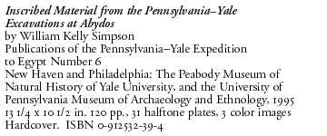
TeachScheme!
How about programming?
; DATA Definition:
(define-struct posn (x y))
; Posn = (make-posn Number Number)
; PROGRAM
; Posn -> Number
(define (distance-to-origin p)
(sqrt
(+ (sq (posn-x p))
(sq (posn-y p)))))
; Number -> Number
(define (sq x)
(* x x))
; TESTS
(distance-to-origin (make-posn 3 4))
= 5
(distance-to-origin (make-posn 12 5))
= 13

Slide 38
TeachScheme!
How do we teach program design?
How do we explain errors? obscurity?
How do we ensure that it scales to TCFPL?
(the currently fashionable programming language)

Slide 39
TeachScheme!
Focus on data and classes of data
Show how data determines program structure (and how that helps)
Fix which intermediate products a student must show:
  partial credit
  pedagogic interventions

Slide 40
TeachScheme! -- The Design Recipes
problem statement
data analysis
problem analysis
problem illustration
organization
do it
reality check
data definition
purpose, contract
i/o (effects) examples
program template
the program
tests and results

Slide 41
TeachScheme!
naïve set theory
  basic sets: numbers, chars, booleans
  intervals
  (labeled) products, that is, structures
  (tagged) unions
  self-references
  mutual references
  vectors (natural numbers)
Data definitions specify classes of data with stylized English:

Slide 42
TeachScheme!
basic data, intervals of numbers
structure definitions
definitions of union
self-reference in class description
mutual references in descriptions
generative recursion
special attributes:
  accumulators
  effects
abstraction of designs

Slide 43
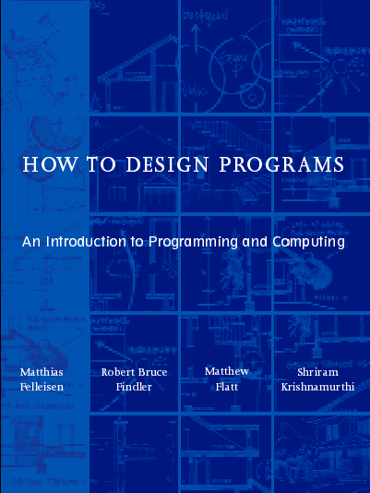
DrScheme and TeachScheme!
Warning:
This is a commercial plug.
Dewarning:
The whole book is on-line.
PLT is not about making money.

Slide 44
Technical Challenges

Slide 45
Technical Challenges: Scheme is Dead, Long Live ...
Is Scheme per se a good implementation language?
Scheme is a failure.
No gloating: nobody has built anything
comparable for Java, ML, Haskell, …
So we built a better Scheme and used it instead.

Slide 46
Technical Challenges: Language Design
R5RS Scheme is a good core language
It lacks support for
  some basics (structures, exceptions)
  foreign-function calls
  class-oriented programming
  components
  modular macros
  lightweight inspection of continuations
  types

Slide 47
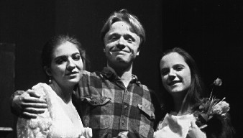
Technical Challenge: Language Design
How we conducted language design experiments:
“Students”
DrScheme
MzScheme
Lula
theater lighting system:
see ICFP 2001

Slide 48
Technical Challenge:
FFIs: Classes and callbacks:
Large C++ code basis (1995):
  basic Scheme interpreter (lib scheme)
  huge, portable GUI library (wx)
  code in classes, call-backs
Most natural connection to Scheme:
  class extensions for C++ in Scheme
  call backs via closures

Slide 49
Technical Challenge: Language Design
Classes for Scheme, closures for call-backs:
C++ code base
Callbacks via closures
Scheme extensions

Slide 50
Technical Challenge: Language Design
Getting class hierarchies right:
x
x
same code in both class extensions
same class extension with
  - different superclasses
  - name resolution in hierarchy

Slide 51
Technical Challenge: Language Design
(map add-class-extension
a-list-of-classes-with-certain-interface)
one piece of functionality,
one point of control

Slide 52
Technical Challenge: Language Design
N versions of the class system (POPL98)
Multiple inheritance
  pain to implement, reason about
Single inheritance with parameterized superclass (mixin)
  resolving name conflicts
Classes: organization tool for closures now: true methods

Slide 53
Technical Challenges: Language Design
Components:
View
Model
mutual export-import

Slide 54
Technical Challenges: Language Design
Components:
DrScheme
Extensions
dynamic linking
plug-in at run-time

Slide 55
Technical Challenges: Language Design
Components:
same module,
different imports
modules are values,
linking is external

Slide 56
Technical Challenges: Language Design
Components are plain old values with
… external linking
… graphical linking
… dynamic linking

Slide 57
Technical Challenge: Language Design
N versions of the component system (PLDI 98)
units: first-class, flexible linking
units with signatures
2001/02: units are not modules
v200 has units and modules

Slide 58
Technical Challenges: Language Design
Dynamic extensibility and resources:
DrScheme

Slide 59
Technical Challenges: Language Design
Dynamic extensibility and resources:
how to stop plug-ins?
how to administrate their resources?
how to manage their GUIs?

Slide 60
Technical Challenges: Language Design
Dynamic extensibility and resources:
independent execution: threads
resource control: custodians
GUI administration: event spaces
in short: DrScheme is a little OS

Slide 61
Technical Challenges: Language Design
Dynamic extensibility and resources:
Flatt, Findler, Krishnamurthi, Fellleisen High-Level Operating Systems (ICFP 99)
Graunke, Krishnamurthi, Felleisen Scheme Continuations to CGI(ESOP 01)

Slide 62
Technical Challenges: Language Design
Separating tools from compilers:
many language implementations integrate tools (steppers, debuggers)
difficult to port, difficult to maintain for evolving language

Slide 63
Technical Challenges: Language Design
Separating tools from compilers:
key bottleneck: inspecting the stack
Scheme’s calls is too heavy
added: continuation marking

Slide 64
Technical Challenges: Language Design
Separating tools from compilers:
CM for reconstructing the stack for stepper and debugger (ESOP 01)
CM for maintaining security information
CM for adding aspectual information: aspects = CM + macros

Slide 65
So much for language design, how about design principles

Slide 66
Technical Challenges: Design Principles
Functional (“compostional”) design works but …
we needed more:
  understanding black-box extensibility
  monitoring component contracts
  a framework for testing GUI’s

Slide 67
Technical Challenges: Design Principles
The extensibility problem:
M ::= x | (fn x => M) | (M M)
eval : M T
pretty: M S
(let (x M) M) | (rec (x M) M)
eval : M …
pretty : M …
alpha : M M
Challenge: Do not edit
as you extend. Keep
single point of control

Slide 68
Technical Challenges: Design Principles
The extensibility problem:
OO works for horizontal extensions
FP works for vertical extensions
Neither works for both -- easily

Slide 69
Technical Challenges: Design Principles
The extensibility problem:
Krishnamurthi, Felleisen, Friedman: Extensible Visitor Pattern (ECOOP98)
Findler & Flatt: Units and Classes or Component Programming (ICFP 98)
Krishnamurthi & Felleisen: Theory of Black Box Extensibility (FSE 99)

Slide 70
Technical Challenges: Design Principles
Monitoring component contracts:
f : (listof Number) --> Void
(define (f percentages)
… (= (sum percentages) 100) … )

Slide 71
Technical Challenges: Design Principles
Monitoring component contracts:
specify weak invariants (beyond types)
monitor them
challenges:
  class and interface hierarchies
  first-class functions

Slide 72
Technical Challenges: Design Principles
Monitoring component contracts:
pinpoint faulty components
  crucial for debugging
class and interface hierarchies:
  enforce behavioral subtyping
first-class functions
  function properties not computable
  delay checks via proxies

Slide 73
Technical Challenges: Design Principles
Findler, Latendress, Felleisen: Contracts in OO Context (FSE 01, OOPSLA 01)
Findler, Felleisen: Contracts for Higher-Order Functions

Slide 74
Technical Challenges: Design Principles
Testing GUIs:
Design components with tests
Problem: GUIs
  user events at all levels (bits, buttons)
  GUI effects
Solution:
  simulate user events at high level
  check for effects by program and hand

Slide 75
Conclusions and Experiences

Slide 76
Conclusions and Experiences
designing languages, designing systems
teaching programming
creating outreach programs

Slide 77
Experiences: Language Design, System Design
Language Design
System Building
Extract Design Principle
Not compilers or interpreters

Slide 78
Conclusions: POPL and Programming
Programming language researchers explore
programming languages.
Do they know how to design a programming language
that people can use?

Slide 79
Conclusions: POPL and Programming
Do people who study programming languages
know how to write programs?
Do they know how to program well and
can they can teach it to novices?
If we don’t, who will study these questions?

Slide 80
Experiences: Introductory Programming
Introductory programming requires a trinity:
How to Program
Programming Language
Programming Environment

Slide 81
Conclusions: Introductory Programming
It does not suffice to pick a random programming language.
It does not suffice to define/use subsets of programming languages.
It does not suffice to teach “by example”.

Slide 82
Conclusions: Introductory Programming
Pick a language that de-emphasizes syntactic rules.
Enforce pedagogically chosen subsets of programming languages.
Teach programming as a process with well-defined intermediate points.

Slide 83
Experiences: Outreach Programs
It is difficult to work with teachers:
  technical training: math, comp sci
  psychology
  sociology
It is difficult to build a technically deep outreach program:
  money
  organization

Slide 84
Experiences: Outreach Programs
The rewards:
Joe's teaching Java this semester in 202,
after teaching HtDP last semester in 201.
Each day after lab, he likes to drop by and
complain about JBuilder (the Java environment).
He's been spoiled by DrScheme.
People get a lot out of a
well-designed pedagogical PDE.

Slide 85
Experiences: Outreach Programs
The rewards:
My students have never understood
programs like this before. This is
unbelievable. One of them reported
that he is using the six-step recipe
in his writing courses.
Not just future programmers
get something out of the
first course. We’re not just
a “geek science”.

Slide 86
Experiences: Outreach Programs
From David.Demko@Mentisys.com
To: matthias@ccs.neu.edu
Subject: why Scheme rules (reason #1023)
Date: Wed, 16 Jan 2002 12:11:42 -0500
Dr. Felleisen,
Last night my son had to calculate some statistics from data heobserved for a science fair project. He wasn't sure he remembered howto use the stats features on his calculator. I said, "Let's just write a program."

Slide 87
Experiences: Outreach Programs
Yes, I realize that there are probably Scheme math libraries available that already do what I needed.
Our little experience last night and the pedagogy behind Dr Scheme (TeachScheme, HtDP) make me hopeful that soon a generation of students will consider writing a quick program as natural as drawing a pencil sketch or using a ruler while solving a problem.

Slide 88
Conclusion: Outreach Programs
It’s a LOT of work.
Eventually all the work pays off.
Computing & programming will make it into
the liberal arts curriculum.
The technical challenges are non-trivial
and help push the real science.

Slide 89
Conclusion
The conclusion
Errors are important. Students make
even more mistakes than ordinary
programmers. The PDE and the
design pedagogy must react
gracefully to programmer errors.

Slide 90
Conclusion
A bit shorter, and more direct:
The design of the PDE and the design
of the pedagogy must take into account
errors from the very beginning.

Slide 91
Conclusion
Very short:
Errors matter.
Explaining errors matters even more.

Slide 92
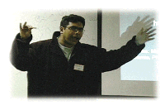


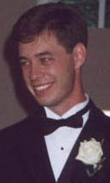
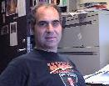
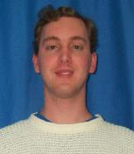
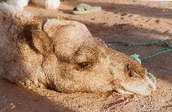
Thank You to a Fantastic Team
John Clements
Shriram, Brown
Matthew, Utah
Robby Findler
Cormac, SRC
Paul Steckler, NEU
Paul Graunke
Philippe Meunier

Slide 93
Appendix: If errors matter, why not use types?

Slide 94
Types and Beginner Mistakes
queens_kill :: Int -> [Int] -> Bool
-- determine whether a queen can be placed in file lcon,
-- places the preceding files of the board
queens_kill locn places =
helper places 1
where
helper [] _ = False
helper (hd:tl) offset = lcon == hd || -- same file
lcon == hd + offset || -- right diagonal
lcon == hd - offset || -- left diagonal
helper tl offset+1

Slide 95
Types and Beginner Mistakes
Reading file: `nq.hs`:
Type checking
ERROR : `nq.hs` (line 6): Bool is not an instance of class `Num`
line 6:
helper [] _ = False

Slide 96
Types and Beginner Mistakes
queens_kill :: Int -> [Int] -> Bool
-- determine whether a queen can be placed in file lcon,
-- places the preceding files of the board
queens_kill locn places =
helper places 1
where
helper [] _ = false
helper (hd:tl) offset = lcon == hd || -- same file
lcon == hd + offset || -- right diagonal
lcon == hd - offset || -- left diagonal
helper tl offset+1

Slide 97
Types and Beginner Mistakes
queens_kill :: Int -> [Int] -> Bool
-- determine whether a queen can be placed in file lcon,
-- places the preceding files of the board
queesn_kill locn places =
helper places 1
where
helper [] _ = false
helper (hd:tl) offset = lcon == hd || -- same file
lcon == hd + offset || -- right diagonal
lcon == hd - offset || -- left diagonal
helper tl (offset + 1)

Slide 98
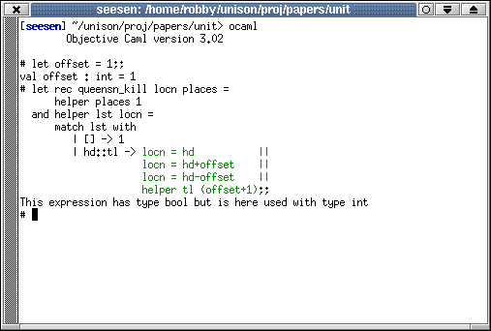
Types and Errors
So much for Haskell, and now on to OCaml:

Slide 99
Types and Beginner Mistakes
Social Theorem 2:
To beginners, it’s about two things:
the computer and the human.
Social Corollary 2:
Adding intermediate layers doesn’t help.

