Slide 1

Please remove your earplugs :-)

Slide 2
Program Analyses: A Consumer’s Perspective
Matthias Felleisen
Rice University
Houston, Texas

Slide 3
History: Successes, Failures, Lessons
soft typing (Wright)
synchronization of futures (Flanagan)
static debugging (Flanagan)
optimizations (Flatt and Steckler)
theory of analyses (with Amr Sabry)
RICE PLT

Slide 4
The Guiding Ideas
is it there a need?
is it useful?
is it sound?
motivation & goal
analysis
implementation
experiences
problems

Slide 5
Soft Typing: Goals & Motivation
infer types for Scheme programs
insert checks where conflicts:
  program must run
  program must respect types
use type information:
  within compiler
  as feedback for user

Slide 6
Soft Typing: Example
(define (foldr a-function e alist)
(cond
[(empty? alist) e]
[else (a-function (first alist)
(foldr a-function e (rest alist)))]))
is it a function?
is it a list?
(foldr (lambda (x y) (printf "~s~n" x)) void '(1 2 3))
(foldr “this is not a function” void '(1 2 3))

Slide 7
Soft Typing: Another Example
;; form = boolean | (boolean -> form)
;; taut : form -> boolean
;; to determine whether _a-form_ is a tautology
(define (taut a-form)
(cond
[(boolean? a-form) a-form]
[else (and (taut (a-form true)) (taut (a-form false)))]))
(taut true)
(taut (lambda (x) (or (not x) x)))
(taut not) ;; re-use pre-existing functions as “form”s
(taut taut) ;; even use taut on itself

Slide 8
Soft Typing: The Analysis
Hindley-Milner with recursive types, unions, and some subtyping
type algebra of records a la D. Remy
add “slack variables” to unions so that unification always succeeds -- produce run-time checks for non-empty slack variables

Slide 9
Soft Typing: Implementation
Soft Scheme covers all of R4RS
some 6,000 lines of code
analyzes itself
is reasonably fast

Slide 10
Soft Typing: Experience w/ Optimizations
copes with entire GAMBIT suite
inserts few checks (down to 80% or less of Scheme w/o soft typing)
caution: it leaves checks that are dynamically critical
time savings for average program: 15%
but: in some large examples: less than 5%

Slide 11
Soft Typing: Experience w/ Programmers
can’t analyze programs in an incremental or a modular fashion
imprecise on “practical” parts of Scheme: apply, append, values, …
understanding types (size!)
understanding casts --- as difficult as understanding ML type errors
  works well for very small programs
  nearly unusable for programs with 100s loc
  reverse flow of information!

Slide 12
Soft Typing: The Lesson
adapt and extend Hindley-Milner
get all the “good” and the “bad” and
some “more bad” from the result
NO SURPRISE HERE

Slide 13
Part II: Optimizing Future Synchronization

Slide 14
Futures: Motivation
applying soft typing to non-type problems while building on success of the work (optimization)
exploring alternatives to Hindley-Milner:
  Peter Lee and Nevin Heintze
  Amr Sabry on Shiver’s dissertation
futures: semantics, analysis, compilation
  Bert Halstead

Slide 15
Futures: Goal
slatex a preprocessor for type-setting Scheme, written in Scheme
the little Schemer: 10 chapters, 2hrs
code is mostly FP, with few set!
ideal for Scheme with futures

Slide 16
Futures: Functional Parallelism
functional programs provide too much parallelism
add future annotations so compilers know where to start parallel threads (if resources are available)
make strict primitive functions synchronize with “future values”

Slide 17
Futures: A Silly Example
;; fib : number -> number
(define (fib n)
(cond
[(= n 0) 1]
[(= n 1) 2]
[else (+ (future (fib (- n 1)))
(future (fib (- n 2))))]))
the + operation synchronizes: 1,000,000 times for (fib 25)

Slide 18
Futures: A Large Example
(future (process-file “chapter1.tex”))
Value flow across procedure & module boundaries etcetc
(post-process x (size x))
Control flow
(for-each integrate (list x … ))

Slide 19
Futures: Semantics and Analysis
developed a series of equivalent reduction semantics for future until synchronization parts was exposed
defined an optimizing transformation assuming an “oracle” about value flow and control flow information
proved soundness wrt sound oracle

Slide 20
Futures: Semantics and Analysis
An oracle is a subset of future-strict program positions
An oracle is valid for an execution state if every future-value
is associated with a program position in the oracle.
An oracle is always valid for a program if it is
valid for all reachable execution states.
THEOREM: If P is a program, O is an always valid program
for P, then eval(P) = eval(optimize(P,O))
PROOF: compare two reduction semantics

Slide 21
Futures: Analysis
based on Heintze’s set-based analysis, derive constraints
  syntax-directed manner
  interpret program operations in a naïve set-based manner
future creates an abstract placeholder
close constraints under “transitive closure through constructors”

Slide 22
Futures: Use, Soundness of Analysis
solve constraints:
soundness:
oracle(P) = { program-point |
placeholder is in closed(SBA-constraints)
of program-point }
Fix program-points in P and copy thru reduction.
Consider a reduction sequence of a program:
P -> P1 -> P2 -> … -> Pn
At each stage, program-points are associated with
values. The oracle correctly predicts placeholders.

Slide 23
Futures: Implementation
implemented analysis and optimizer for purely functional Scheme without any extras
extended Gambit Scheme (by Marc Feeley)
benchmarked the Gambit suite on a BBN with 1, 4, and 16 processors

Slide 24
Futures: Experiences with FP Programs
benchmarks with 100 to 1,000 loc
reasonably fast analysis
measurements produce great results
  reduce number of synchronization operations from ~90% to ~10%
  huge win for sequential execution
  time savings of between 35% for 4 processors to 20% for 16 processors

Slide 25
Futures: … with mostly-FP Programs
the benchmark suite (and slatex) contains
  larger programs
  programs with variable assignment and structure mutation
the analysis didn’t scale to these programs on our machines:
  space (500MB)
  time (a night)
  precision (interpretation of set!)
  feedback (why is a synchronization still here?)

Slide 26
Futures: The Lessons
set-based analysis works really well for toy functional programs
set-based analysis doesn’t seem to scale to real programs that needed optimizations of the synchronization operations
but: not everything is lost …

Slide 27
Part III: On to Static Debugging

Slide 28
Static Debugging: Motivation
what can SBA find out about mostly functional programs?
can we turn SBA information into useful feedback for the programmer?
does SBA scale to large programs?

Slide 29
Static Debugging: Goal
DrScheme: a programming environment for Scheme
written in an extension of Scheme
Can we scale SBA to the full language so that it yields useful results?
Can we improve the performance so that the analysis copes with the entire code?
Can we provide feedback, find bugs?

Slide 30
Static Debugging: Set-Based Analysis
extend SBA to R4RS and DrScheme
  variable number of arguments, apply
  multiple values
  exceptions
  objects
  first-class classes
  first-class modules
  threads (unsound)
  staged computation (macros)

Slide 31
Static Debugging: Set-Based Analysis
modify SBA to cope with
  if (if-splitting)
  control (flow sensitivity)
  Scheme’s large constants (quote)
  tracking individual constants
  Scheme’s form of polymorphism
  a modicum of arithmetic

Slide 32
Static Debugging: Set-Based Analysis
enrich SBA for programmer feedback
  check all primitive operations: acceptable vs inferred sets of values
  high-light mismatch
  display analysis results (as types)
  illustrate potentially flawed data flow (as flow graph/path)

Slide 33
Static Debugging: Implementation
two versions: browser-based and DrScheme-based
runs efficiently on the sample programs
provides decent feedback

Slide 34
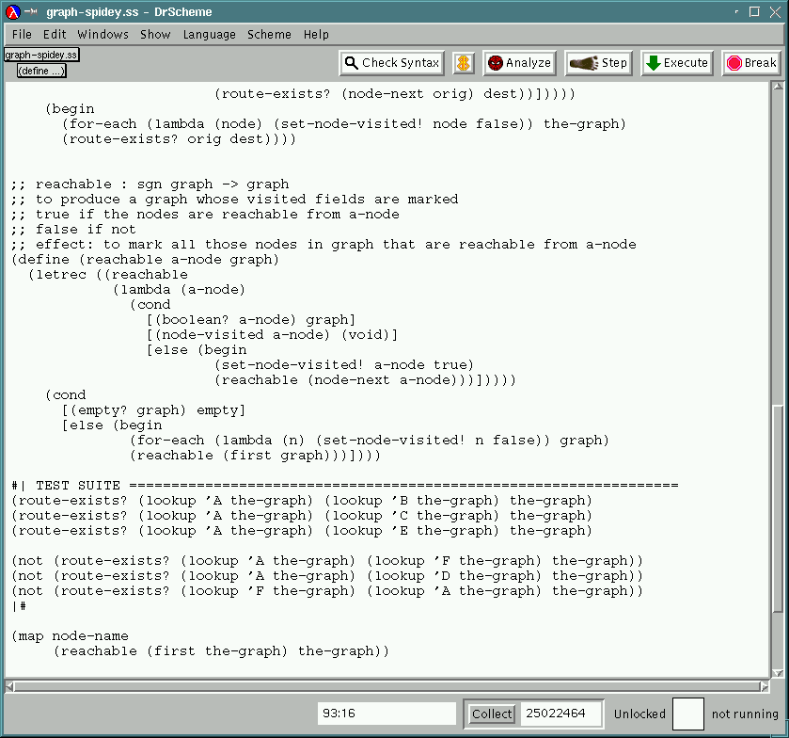
Static Debugging: Feedback 1
structure mutation
higher-order functions

Slide 35
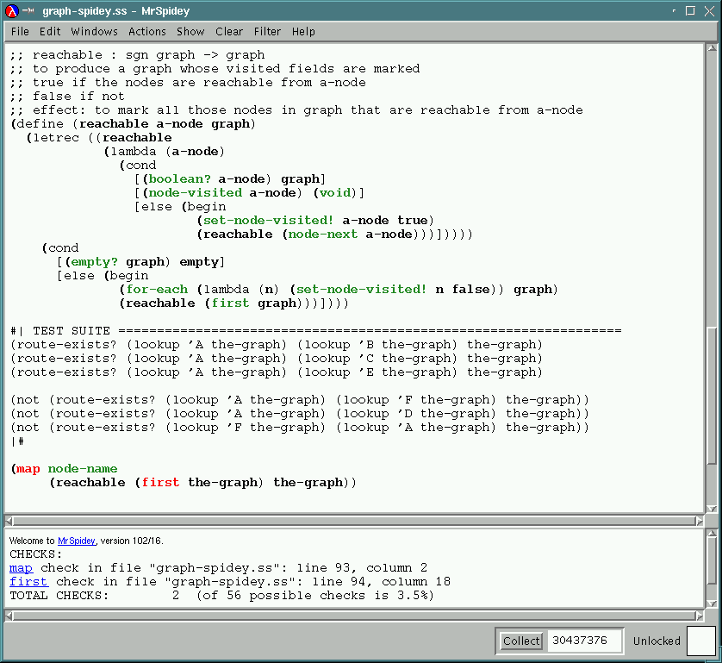
Static Debugging: Feedback 2
potential conflicts

Slide 36
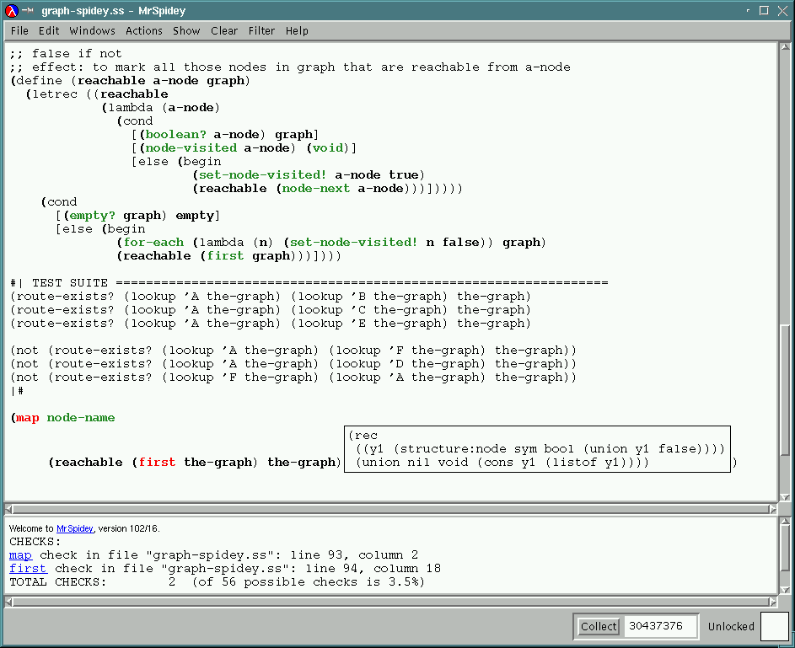
Static Debugging: Feedback 3
void might flow here

Slide 37
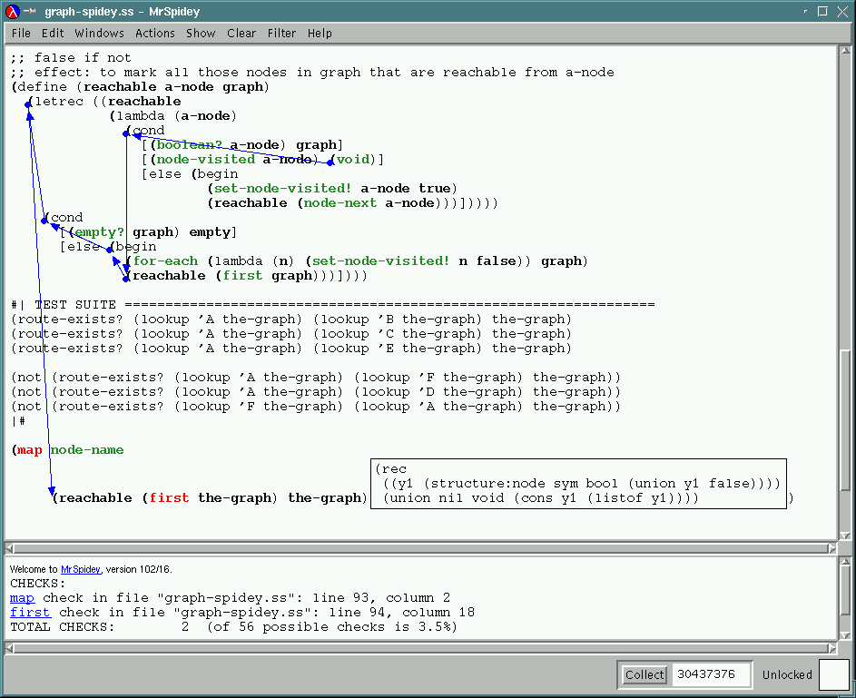
Static Debugging: Feedback 4
the source of the problem
the potential data flow

Slide 38
Static Debugging: Experience 1
easy to use for class-size programs: parsers, interpreters, type checkers
student experiment: controlled experiment; MrSpidey wins
the team members don’t use it

Slide 39
Static Debugging: Problems 1
the analysis can’t analyze programs with more than 3,000 loc
the analysis can’t cope with units (at that point)
the analysis isn’t “incremental”

Slide 40
Static Debugging: Componential SBA
analyzing units relative to
  imports
  exports
determining smaller, observationally equivalent set constraints
re-calculate with full sets on demand

Slide 41
Static Debugging: Componential Analysis
Focus Unit
Othr Unit
YA Unit
constraints
constraints
constraints
simplified
simplified
Solution

Slide 42
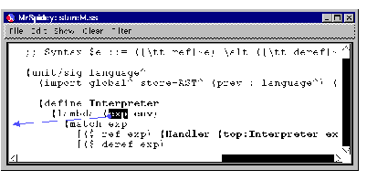
Static Debugging: Feedback 5
function is used externally
click and re-compute focus

Slide 43
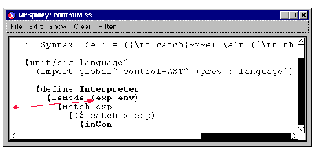
Static Debugging: Feedback 6
MrSpidey shows source unit

Slide 44
Static Debugging: Implementation 2
implemented componential analysis
for all of DrScheme
analyzed system on itself in a few hours (50,000 loc)

Slide 45
Static Debugging: Experience 2
analyzed the run-time system:
  found few problems, few bugs
  noticed imprecision
conducted experiment with course:
  worked well on small multi-unit projects
  worked badly for large multi-unit projects that required several stages

Slide 46
Static Debugging: Problems 2
comprehending static analyses across modules is difficult
“real-world” features make analysis too imprecise
imperative features demand more flow-sensitivity than SBA offers
if-splitting is too weak

Slide 47
Static Debugging: Problems w/ Arity
Scheme supports rest, default, list parameter specifications
So: functions consume one argument
applications package arguments as lists
function bodies tease lists apart with selectors

Slide 48
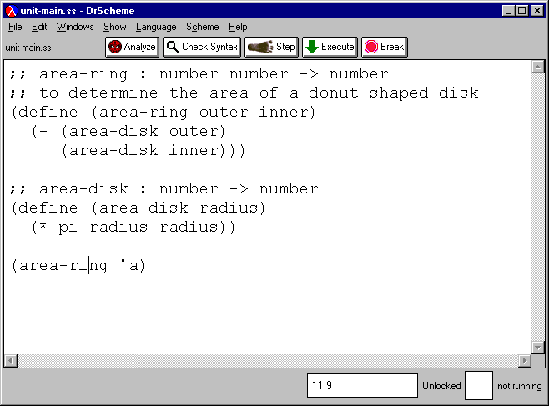
Static Debugging: Problems w/ Arity
too few arguments
wrong kind of argument

Slide 49
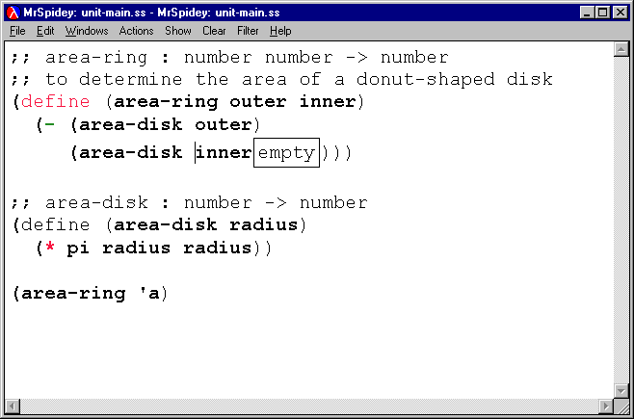
Static Debugging: Problems with Arity
… but computes data flow
reports arity mismatch
… and thus pollutes rest of program with bad warnings

Slide 50
Static Debugging: The Lesson
static debugging is worth pursuing
we are not even close to a fully useful system
we need
  analyses tools for “real” languages
  analyses that provide visual feedback
  analyses for modular programs

Slide 51
Part IV: Optimizing Closure Allocation

Slide 52
Closures: Motivation
Is information out of SBA good for back-end purposes? (back to static typing)
Can we optimize heavily functional (closure intense) programs?
  Steckler’s light-weight closure conversion

Slide 53
Closures: Goal
modify SBA in support of light-weight closure conversion
extend mzc compiler (mzscheme-c)
apply to key modules in DrScheme
  GUI front-end parser
  mzc

Slide 54
Closures: An Example
(let* ([x (g 13)]
[f (lambda (y) (+ x 20))])
(if (> (f 65) 0)
(/ 1 (f 65))
0))
free variable: x
calls to f are within
lexical scope of x
(let* ([x (g 13)]
[f (lambda (x y) (+ x 20))])
(if (> (f x 65) 0)
(/ 1 (f x 65))
0))
new call protocol for f
no closure allocation

Slide 55
Closures: Avoid Allocation
determine whether free variables are available at call site of closure
transform all closures called there to accept additional arguments
avoid closure allocation
save > 50% on example [Wand & Steckler]

Slide 56
Closures: Analysis
closure analysis -- which closures are called at a site
invariance analysis -- which variables are available at call site with proper value
protocol analysis -- which functions must share the extended protocol

Slide 57
Closures: Implementation 1
extend to full Scheme
  assignable variables
  letrec
separate analysis for units: prevent escape of procedures
… based on Componential SBA

Slide 58
Closures: Implementation 2
modified SBA consumed too much space and time (1 GB machine, 1 night) for benchmark programs
re-implemented three specialized analyses
extended mzc with analysis and transformation

Slide 59
Closures: Experiences 1
benchmarked Gambit programs: travl, maze, mandelbrot, earley, …
results are so-so:
  closure conversion is hardly ever possible even in closure-rich programs
  closure conversion doesn’t save much time -- in most cases < 5%
  only rare programs benefit with > 10%

Slide 60
Closures: Experiences 2
tested closure analysis/conversion on some key modules of the PLT Scheme suite
none showed any improvement at all

Slide 61
Closures: The Lesson
light-weight closure analysis and conversion works miracles on artificial example
… does a bit of good in some of the standard benchmark programs
… is a big disappointment for closure-intensive components

Slide 62
Part V: The Overall Lesson

Slide 63
General Guidelines
is the analysis useful?
  many dimensions
is the analysis sound?
  the core language needs a semantics [that is, a machine-independent mathematical model]
  the predictions of the analysis about the set of values generated by an expression must hold at run-time
[note: ignored theory!]

Slide 64
Guidelines on Usefulness
language: don’t do it for the core only
size of programs: don’t do it for toy programs
critical path: don’t do stand-alone analyses (even with optimizations)
other constructs are interesting, too
stress implementations with regularly used, “large” programs
pick an “end-to-end” application of the analysis (a context)

Slide 65
On the “Critical Path”
“The User”
“Real Programs
analysis
“The Program Run”

Slide 66
On the “Critical Path”
“The User”
find the bottleneck of the entire set-up
with respect to the static analysis:
does the analysis deliver information that is presentable to the user? what kind of user?
is the analysis precise on widely used frequently used constructs?
does it pay off to produce this information? (code improvement)
“Real Programs
analysis
“The Program Run”

Slide 67
Challenge
can we build an infrastructure for static analysis projects?
  open programming environments
  open compilers
  benchmarks of all sizes
  benchmarks of all kinds of programs
  records of measurements
  bottleneck problem statements

Slide 68
The Last Message:
SA must do well “in context”
set a concrete, reachable, ambitious goal
… and work out all the problems
others won’t do it for you

Slide 69
The End

Slide 70
Credits
Cartwright
Cousot
Charter
Fagan
Findler
Flanagan
Flatt
Krishnamurthi
Heintze
Lee
Sabry
Steckler
Wand
Wright

