Slide 1
Programming Interactive Web Scripts
Matthias Felleisen
Northeastern University

Slide 2
Web Scripts
What is a CGI script (servlet)? What are the new problems of CGI scripts?
Inventing a new language/server
Using FP techniques to solve the problems in existing context

Slide 3
Interactive Web Scripts
USA Today says: “… more than half the pages on the Web are generated on demand.” (july 2000)
Technology:
  CGI
  Java Servlets
  Active Server Pages, Java Server Pages

Slide 4
Interactive Web Scripts
Why generate Web pages on demand?
current information about server
connection to up-to-date database
determining consumer information
on-line experiments
games
… and many more reasons

Slide 5
Programming Interactive Scripts: Today

Slide 6
Interactive Web Scripts
a cgi script writes a page, terminates
to prompt the consumer, it writes a form and terminates
when the consumer replies, another (portion of the) script reads the form and performs the next step

Slide 7
Interactive Web Scripts: Hello World
(printf "My First CGI Page~n”)
(printf "Hello World")
(output-http-headers)
(write-xml/content
(xexpr->xml
'(html
(title "My First CGI Page")
(body
"Hello World"))))

Slide 8
Interactive Web Scripts: Status
(printf ”Server Status: ~a~n"
(read-line
(car
(process "uptime")))))))
(output-http-headers)
(write-xml/content
(xexpr->xml
`(html
(title "My Second CGI Page")
(body
(h1 "Server Status")
(br)
,(read-line
(car
(process "uptime")))))))

Slide 9
Interactive Web Scripts: Multiply by 10
(define (get-number)
(printf "Enter a number ")
(flush-output)
(read))
(output-http-headers)
(define (get-number) … bindings …)
(write-xml/content
(xexpr->xml
`(html
(title "The Multiply-by-10 Page")
(body
"the result is: "
,(* 10 (get-number)))))))
(printf "the result is: ~a"
(* (get-number) 10))

Slide 10

Interactive Web Scripts: Multiply by 10
(output-http-headers)
(define (get-number) .. binding …)
(write-xml/content
(xexpr->xml
`(html
(title "The Multiply Page")
(body
"the result is "
,(* (get-number)
(get-number)))))))
(define (get-number)
(printf "Enter a number ")
(flush-output)
(read))
(printf "the result is: ~a"
(* (get-number)
(get-number)))

Slide 11
Interactive Web Scripts: Multiply (Page 1)
<html>
<head>
<title>Multiply</title>
<body>
<h1>Multiply</h1>
<form method="get"
action="http://www. .../cgi-first.ss">
<input type="text" name="the-number" value="0">
</form>
</html>

Slide 12
Interactive Web Scripts: cgi-first.ss
(output-http-headers)
(write-xml/content
(xexpr->xml
`(html
(title "The Multiply Page")
(body
(form ([method "get"][action "http://.../cgi-second.ss"])
(p "Enter the second number: ")
(input ([type "hidden"][name "first"] [value ,(get-number)]))
(input ([type "text"] [name "second"][value "1"])))))))

Slide 13
Interactive Web Scripts: Multiply (Page 2)
<html>
<head>
<title>The Multiply Page</title>
<body>
<p>Enter the second number:</p>
<form method="get"
action="http://www. .../cgi-second.ss">
<input type=”hidden" name=“first" value=”...">
<input type="text" name=”second" value="0">
</form>
</html>

Slide 14
Interactive Web Scripts: cgi-second.ss
(output-http-headers)
(write-xml/content
(xexpr->xml
`(html
(title "The Multiply Page")
(body
"the result is: "
,(* (get-number 'first) (get-number 'second))))))))

Slide 15
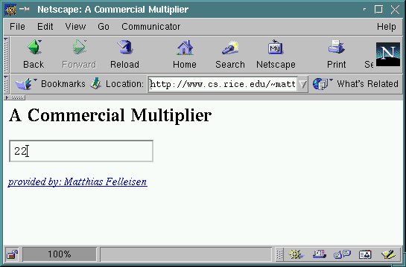
Interacting with Web Scripts

Slide 16
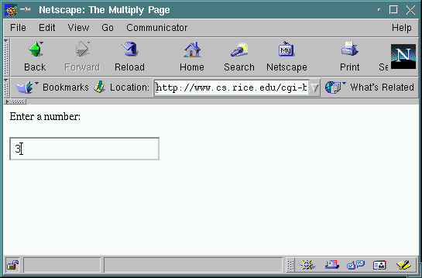
Interacting with Web Scripts

Slide 17
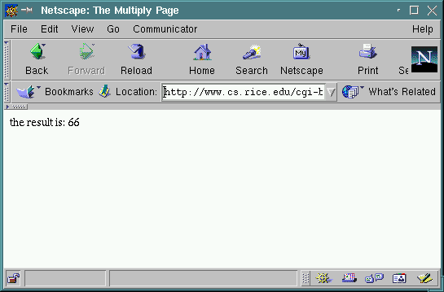
Interacting with Web Scripts

Slide 18
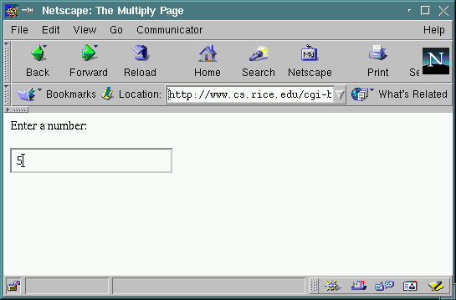
Interacting with Web Scripts
.. and back:

Slide 19

Interacting with Web Scripts

Slide 20
Interactive Web Scripts and Continuations
(define multiply
(lambda (x y)
(* x y)))
(define multiply
(lambda (x)
(lambda (y)
(* x y))))
(define multiply-by-22
(lambda (y)
(* 22 y)))

Slide 21
Interactive Web Scripts and Continuations
cgi script
consumer
cgi script
consumer
the back button

Slide 22
Interactive Web Scripts and Continuations
cgi script
consumer
cgi script
consumer
the back button
cloning

Slide 23
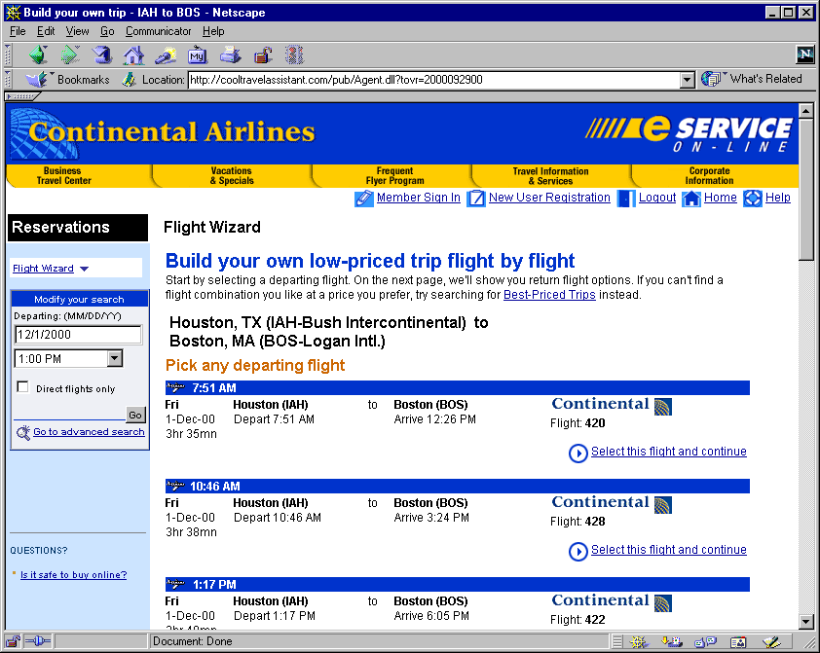
Interactive Web Scripts and Continuations

Slide 24
Interactive Web Scripts and Continuations
start
restart
search first leg
search second leg
restart
search second leg
…
search … leg

Slide 25
Interactive Web Scripts and Continuations
The back button turns cgi scripts into
coroutines with multiply resumable
interaction points. Each interaction
represents a continuation grabbed
and saved for future resumption by
the consumer.
Christian Queinnec, ICFP’00

Slide 26
Interactive Web Scripts and Continuations
Corollary: Scripting languages should
support resumable continuations so that
programmers don’t have to implement
them by hand.

Slide 27
The Custom Server Solution
Graunke, Krishnamurthi, Felleisen: “Programming the Web with High-Level Programming Languages”.
European Symposium on Programming 2001.

Slide 28

Building a Custom Server
server
www
browser
socket
back, forth, …
script

Slide 29
Building a Custom Server
cgi scripts are separate programs
  server inherits administration
  “thin” communication
Server
CGI 1
CGI 2
CGI 3
The Operating System

Slide 30
Building a Custom Server
The Server
CGI Script

Slide 31
Building a Custom Server
The Server
CGI Script
The server is an operating system.
CGI scripts are applications, which
are dynamically linked into the server.

Slide 32
Building a Custom Server
The Server
CGI Script
Server and script can exchange
values -- “thick” communication.

Slide 33
Building a Custom Server: How It Works
(define-signature cgi^
method ; (union ‘get ‘post)
url ; URL
headers ; (listof (cons Symbol String))
bindings ; (listof (cons Symbol String))
… )
(unit/sig () ; exports
(import cgi^) ; imports
(define title “My First Script”)
`(html
(title ,title)
(body
(h1 ,title)
“Hello World”)))
(write-xml
(xexpr->xml
(invoke-unit/sig
(load-unit (url->cgi url))
cgi^)))

Slide 34
Building a Custom Server
The Server
CGI Script
units are first-class values:
load, cache, evaluate on demand.

Slide 35
Building a Custom Server
The Server
CGI Script
CGI Script
Retrieve from cache, link in -- yields
expressive power.

Slide 36
Building a Custom Server
(let ([counter 0])
(unit/sig () ; exports
(import cgi^) ; imports
(set! counter (add1 counter))
`(html
(body
,(format “This page has been visited ~a times.”
,counter)))))
maintaining memory across cgi script invocations

Slide 37
Building a Custom Server
(let ([data … ]
[lock … ])
`((add . ,(unit/sig () (import cgi^) … )
(del . ,(unit/sig () (import cgi^)
(acquire lock)
(set! data … )
(release lock)))))
exchanging values between cgi scripts

Slide 38
Building a Custom Server: How It Works
(define-signature cgi^
…
send/suspend
; (String -> XHTML) ->* Method Url Bindings
send/finish
; XHTML -> Void
… )

Slide 39
Building a Custom Server
(unit/sig ()
(import cgi^)
(define (get-number which)
(send/suspend
(lambda (query-url) …)))
`(html
(title "The Multiply Page")
(body
"the result is "
,(format "the result is: ~a"
(* (get-number “first”)
(get-number “second”)) )))
define get-number in
terms of send-suspend
suspending cgi scripts via continuations

Slide 40
Building a Custom Server
The Server
continuation
send/suspend
query-url
CGI Script
Server stores continuations for scripts.

Slide 41
Building a Custom Server: Positive Results
implementing cgi scripts as first-class values adds lots of expressive power:
  memo for values
  exchanging values
  suspending and resuming threads
    natural structure for interactive programs
performance is first-rate:
  static content: 80% of Apache
  dynamic content: 4 to 5 times as fast
  beats FastCGI by 20 to 40%

Slide 42
Building a Custom Server: Problems
Problem: server must provide OS-style services to CGI extensions:
  protection
  resource administration
Solution: Flatt et al., “Programming Languages as Operating Systems”, ICFP 1999

Slide 43
Building a Custom Server: Problems
Problem: server provides storage for continuations; distributed and symbolic garbage collection
Solution: time-out; imperfect
Problem: must install a new server, use a specific language, ditch existing infrastructure
Solution: coming soon …

Slide 44
The Preprocessor Solution
Graunke, Findler, Krishnamurthi, Felleisen: “How to Design and Generate CGI Programs”.
Automated Software Eng. 2001

Slide 45
Interaction from Preprocessing
act as if your favorite language could grab continuations and send them to client-agent
use continuation passing transformation to eliminate these non-features
use closure conversion/lifting to eliminate higher-order functions
now send continuation records to client

Slide 46
Interaction from Preprocessing
(define (get-number which)
(printf "enter the ~a number " which)
(flush-output)
(read))
(format "the result is: ~a"
(* (get-number "first")
(get-number "second")))
interaction functions are
“continuation grabbers”
use CPS to map it away!

Slide 47
Interaction from Preprocessing
(get-number-cps
"first"
(lambda (first)
(get-number-cps
"second"
(lambda (second)
(format "the result is: ~a"
(* first second))))))
higher-order functions:
- not in all PLs
- can’t send them to client
close with free variables

Slide 48
Interaction from Preprocessing
(get-number-cps
"first"
[apply
(lambda ()
(lambda (first)
(get-number-cps
"second"
[apply
(lambda (first)
(lambda (second)
(format "the result is: ~a"
(* first second))))
(list first)])))
'()])
lift and collect in vector
functions no longer
depend on lexical scope

Slide 49
Interaction from Preprocessing
(define CLOSURES
(vector
;; closure 1
(lambda ()
(lambda (first)
(get-number-cps
"second"
[apply (vector-ref CLOSURES 1) (list first)])))
;; closure 2
(lambda (first)
(lambda (second)
(format "the result is: ~a"
(* first second))))))
(get-number-cps "first" [apply (vector-ref CLOSURES 0) '()])
we’re still using Scheme’s
first-class closures
use structs instead!

Slide 50
Interaction from Preprocessing
read can send them to client
closures (continuations) are
now first-order data
(define-struct closure (code env))
(define (apply-closure x the-arg)
((apply (vector-ref CLOSURES (closure-code x)) (closure-env x))
the-arg))
(define CLOSURES .
(vector (lambda () … [make-closure 1 (list first)] … )
(lambda (first) … )))
(get-number-cps "first" [make-closure 0 '()])

Slide 51
Interaction from Preprocessing: Dispatcher
send closure to client-agent
(cond
[(null? bindings)
(get-number-cps "first " (make-closure 0 '()) )]
[(string=? (extract-bindings/single 'cont bindings) "0")
(apply-closure
(make-closure 0 (extract-bindings/single 'env bindings))
(extract-binding/single 'response bindings))]
[(string=? (extract-bindings/single 'cont bindings) "1")
… ])
receive closure from client and reconstruct

Slide 52
Interaction from Preprocessing: Summary
consider a form of “read” as a coroutine resumption point
compile away with cps, closure passing, closure lifting
add dispatching code

Slide 53
Interaction from Preprocessing: Problem
Problem: closure-continuations contain the values of free variables. That may include such information as the current account balance.
Solution: encrypt the closure as it is send to the client. Decrypt when it comes back.

Slide 54
Interaction from Preprocessing: Problem
Problem: closure-continuations are large pieces of data.
Solution: compress the closure as it is send to the client. Decompress when it comes back. Or, build VM that executes compressed byte codes.

Slide 55
Interaction from Preprocessing: Problem
Problem: Many PLs encourage stateful programming. Where does the state of mutable variables and mutable records go?
Solution 1: use the store-passing transformation to make store explicit. Pass it along with continuation to client (as hidden field in web form).

Slide 56
Interaction from Preprocessing: Problem
Problem: Consumers can clone browser windows, copy pages, … and with it the store.
Solution 2: register cells (store) and move it over as a cookie.
Solution 2 (refined): add a sequence number to decide ordering of requests with same store. NOTE: Reintroduces server side storage.

Slide 57
Interaction from Preprocessing: Problem
Problem: The code that is executed is radically different from the code that the programmer keyed in. How does the programmer debug such code?
Solution: In general, this is an open question.
Solution: In Scheme, use call/cc and hook up the IDE to a Web browser.

Slide 58
Summary

Slide 59
Summary: Interactive CGI Scripts
both customer server and preprocessors vastly increase expressive power for Web scripting languages
both enable programmers to write scripts with a natural structure
both enable programmers to write more complex scripts than current technology

Slide 60
Summary: Interactive CGI Scripts
the custom server
easy-to-develop scripts
“thin” connection to consumer
fast
works for special language only
the preprocessor
works in general
“fat” connection to consumer
slow
difficult-to-develop scripts in general

Slide 61
Summary: Future Work
programming Web interactions is not a simple problem
besides type for secure data communications, …
… we also need a better understanding of the web’s control structure

Slide 62
The End
Thank You
Robby Findler (Rice, NU)
Paul Graunke (NU)
Shriram Krishnamurthi (Brown)
Steve van der Hoeven (Nice, France)

