Slide 1

Audio/Video and The New York Public Library
Prepared by James Murdock
February 2, 2011

Slide 2
I. Overview

Slide 3
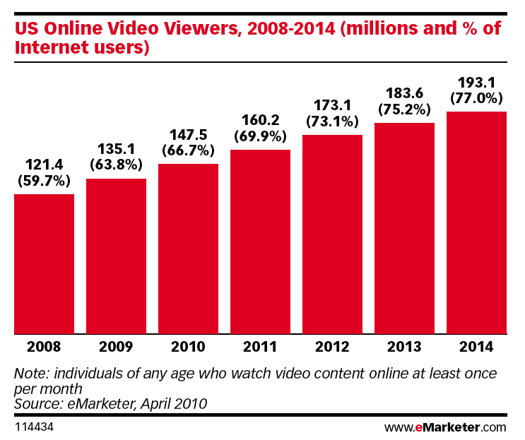
Web Video is Growing:

Slide 4
A/V and NYPL’s Mission:
Audio and video recordings of public programs, such as LIVE from the NYPL, attract more online streams/downloads than the number of people who attend these events in person:
The most an event can accommodate is 500 people seated in Bartos Forum, but the average recording of an event is streamed/downloaded 1,675 times during the first few months after it is uploaded to the Web—that’s 335% more.
The most-watched LIVE from the NYPL program, a debate between Christopher Hitchens and Al Sharpton, boasts nearly 500,000 cumulative views and downloads since 2007.
These numbers suggest that the true audience for many NYPL public programs lies online.
Another example of video’s importance to the Library is the 2010 Advocacy campaign, which made use of video in several ways. The “Who You Gonna Call” video, produced in partnership with Improv Everywhere, went viral and attracted more than 2 million views.

Slide 5
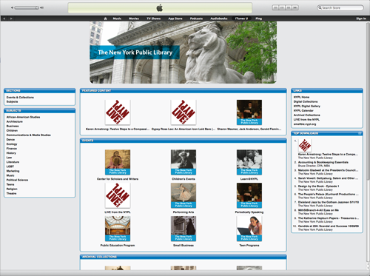
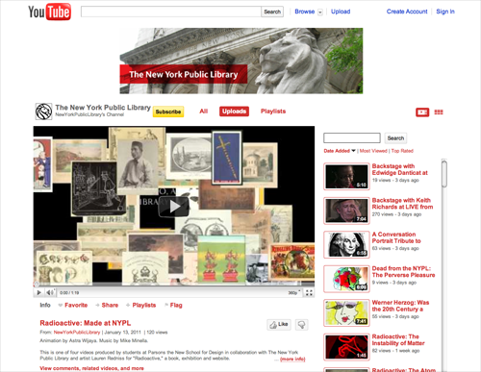
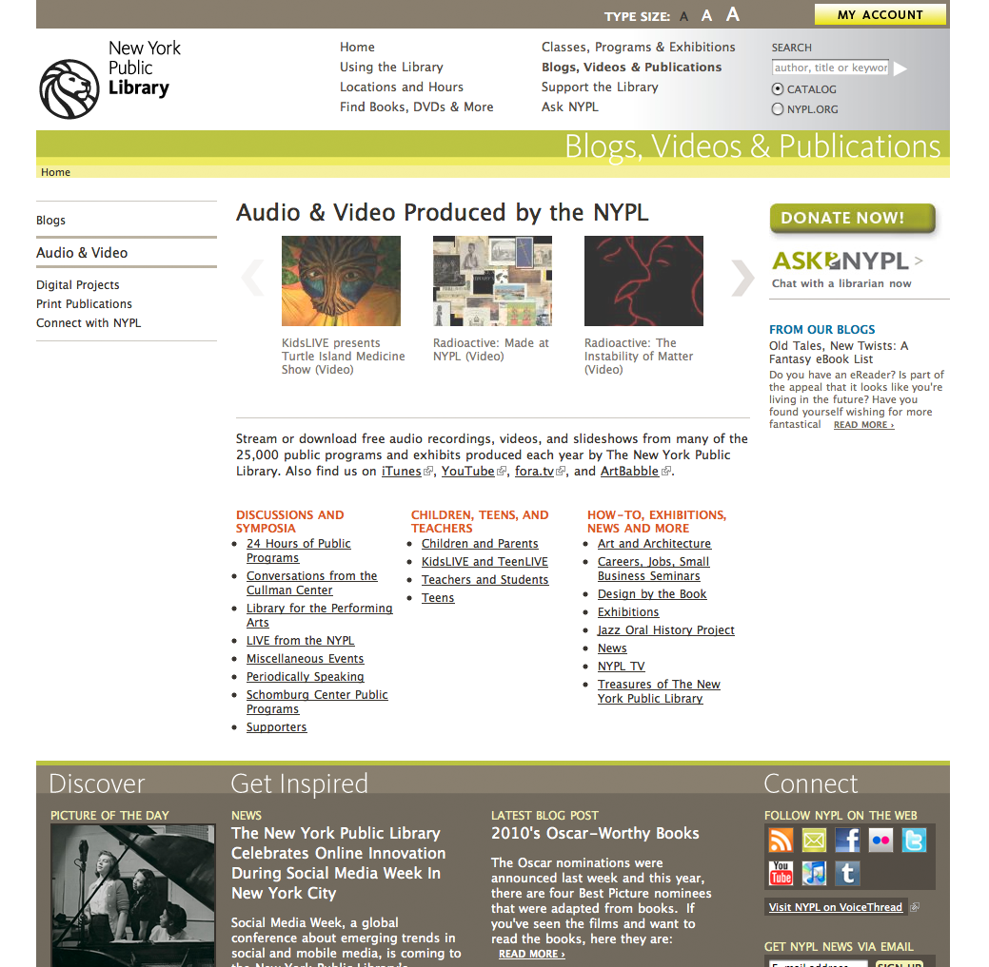
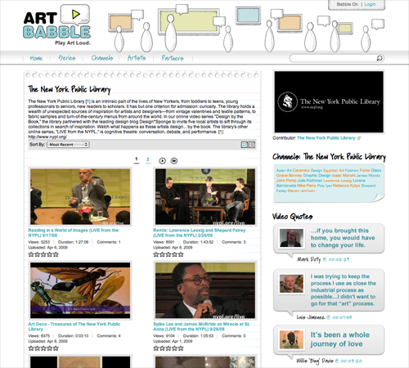
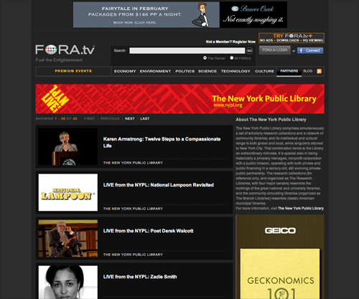
NYPL’s Web A/V Presence:

Slide 6
Examples:
LIVE from the NYPL
Backstage at LIVE from the NYPL
Mounseer Nongtongpaw
Scriptorium videos
Anti-Prom series
KidsLIVE & TeenLIVE

Slide 7
Digital Content Creation Kits:
Allow any staff member to record and edit audio and video with high-quality, easy-to-use tools.
Piloted one kit in fall 2008; soft launch with five more kits in fall 2010.
Since fall 2010, 150 videos have been created—resulting in 26,686 views and downloads—of everything from public programs, such as a “Whose Poem Is It?” slam, to teen-created content for HomeworkNYC.

Slide 8
II. Results

Slide 9
Overall Traffic:
Note: This chart includes audio and video, both downloads and streams. The data set for years 2005 – 2010 on nypl.org is incomplete. Fora.tv numbers for each year are unavailable.

Slide 10
Deeper Dive into the Numbers:
On nypl.org and iTunes, which offer both downloads and streams of the same content, downloads are more popular—by a significant margin.
Note: Data here is from 2010 only

Slide 11
On nypl.org, audio files are more popular than video files of the same content*.
* This includes both downloads and streams; video streams were under-counted in 2009 but we might have under-counted audio streams in 2010.

Slide 12
Top 10 Downloads on nypl.org in 2010:
Content | Format | Series | Date | Downloads
Keith Richards | Video | LIVE from the NYPL | 10/29/10 | 41,648
"Anger Management," Turn It Up @ Muhlenberg | Audio | Teens | 12/1/07 | 18,746
The Moth | Audio | LIVE from the NYPL | 10/12/07 | 7,192
George Carlin Tribute | Audio | LIVE from the NYPL | 3/24/10 | 6,880
"All Eyes on Me," Turn It Up @ 96th Street | Audio | Teens | 8/30/08 | 5,933
JayZ and Cornell West | Video | LIVE from the NYPL | 11/15/10 | 5,718
Reading in a World of Images | Video | LIVE from the NYPL | 9/17/08 | 4,769
ReMix: Lawrence Lessig, Shepard Fairey | Audio | LIVE from the NYPL | 2/26/09 | 4,531
Side Effects: Adam Phillips | Audio | LIVE from the NYPL | 5/4/07 | 3,910
Barbara Cook Master Class | Video | LPA | 2/21/06 | 3,850
Jon Waters | Video | LIVE from the NYPL | 6/7/10 | 3,029
Patti Smith | Video | LIVE from the NYPL | 4/29/10 | 2,749

Slide 13
Top 10 Streams* on nypl.org in 2010:
Content | Series | Date | Streams
Keith Richards | LIVE from the NYPL | 10/29/10 | 7,433
Velvet Underground Reunion | LIVE from the NYPL | 12/8/09 | 5,165
NYPL's New Sorter | COMM | 4/22/10 | 2,037
Meet Khalil Muhammed | COMM | 11/17/10 | 1,383
David Remnick and Ta-Nehisi Coates | LIVE from the NYPL | 4/6/10 | 1,108
Three Faiths Scriptorium Parchment video | Exhibitions | 10/19/10 | 1,091
JayZ and Cornell West | LIVE from the NYPL | 11/15/10 | 774
Bernard Henri Levy & Slavoj Zizek | LIVE from the NYPL | 9/16/08 | 709
Three Faiths Scriptorium Illumination video | Exhibitions | 10/19/10 | 698
Three Faiths Scriptorium Writing video | Exhibitions | 10/19/10 | 650
* Video

Slide 14
Top Videos on YouTube in 2010:
Video | Series | Year | Percentage | Views
Mounseer Nongtongpaw | Exhibitions | 2010 | 11.6 | 32,747
Tillman Skates for Libraries | COMM | 2010 | 8.8 | 25,084
Summer Reading 2010 | Kids | 2010 | 5.1 | 14,445
Art Deco | Treasures of the NYPL | 2008 | 3.8 | 10,659
Patti Smith Backstage | LIVE from the NYPL | 2010 | 2.9 | 8,179
Wes Anderson & Noah Baumbach Backstage | LIVE from the NYPL | 2009 | 2.4 | 6,858
Velvet Underground Backstage | LIVE from the NYPL | 2009 | 2.2 | 6,392
Ryan Adams Reading “White Diamond” | LIVE from the NYPL | 2009 | 2.1 | 6,085
Mapping the Hudson - NYC Flyover | Exhibitions | 2009 | 1.9 | 6,014
Jon Faddis - Jazz Oral History | Jazz Oral Histories | 2008 | 1.9 | 5,326
These 10 videos accounted for 42.7 percent of all traffic to NYPL’s YouTube channel in 2010.
Our other 205 videos accounted for the remaining 57.3 percent of traffic.

Slide 15
Programs Recorded:
Series | FY 2008 | FY 2009 | FY 2010 | FY 2011 to date | FY 2011 upcoming*
LIVE from the NYPL | 43 | 35 | 29 | 18 | 20
Misc. Events** | 2 | 7 | 31 | 50 | 37
Supporters | 11 | 25 | 18 | 10 | 10
COMM | 12 | 22 | 14 | 6 | 5
SIBL | 0 | 1 | 13 | 10 | 20
Cullman Center | 8 | 10 | 6 | 5 | 8
LPA | 11 | 11 | 6 | 0 | 0
Teens | 3 | 6 | 12 | 3 | 4
Exhibitions | 0 | 3 | 10 | 8 | 5
Periodically Speaking | 4 | 6 | 7 | 3 | 4
Children & Parents | 2 | 7 | 8 | 0 | 1
OSD | 0 | 5 | 8 | 2 | 2
KidsLIVE/TeenLIVE | 0 | 0 | 0 | 4 | 4
NYPL TV*** | 8 | 0 | 0 | 0 | 0
Schomburg | 0 | 0 | 7 | 0 | 0
Teaching & Learning | 0 | 0 | 2 | 1 | 2
Totals: | 104 | 138 | 171 | 242
* Estimates based on existing requests for programs to be recorded, or based on fall 2010 season.
** One-off lectures, panel discussions, and other public programs that are not part of a series.
*** NYPL TV was a catch-all category for miscellaneous content and is no longer used.

Slide 16
III. Challenges

Slide 17
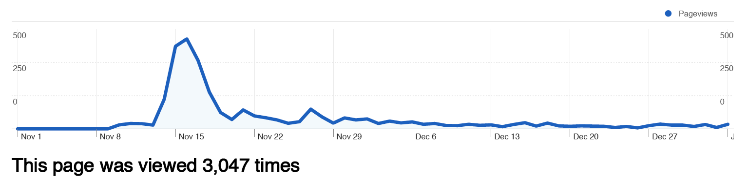
Importance of Timeliness:
With few exceptions, most traffic to our a/v assets, regardless of platform, occurs within the first few days after an event (or after the video is uploaded). Take the Keith Richards video:

Slide 18
But the Keith Richards video was posted much later than it should have been, November 8 v. November 2 (the date the contract says it should have been completed), costing us both press coverage and Web traffic.
The JayZ video suffered from an even longer production delay and its traffic suffered substantially.
Audience members often shoot their own videos (on phones) and these, despite their poor quality, get more views because they’re uploaded first.

Slide 19
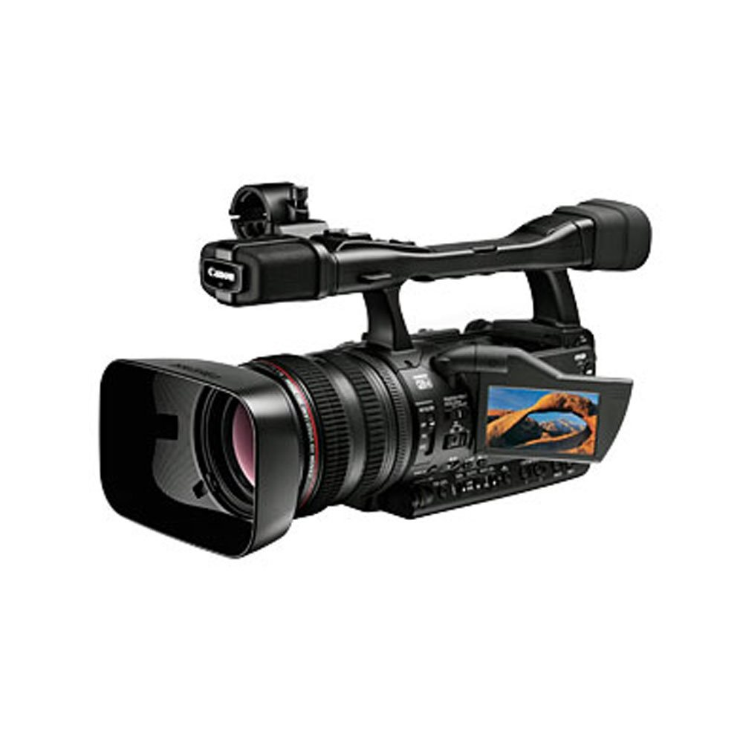
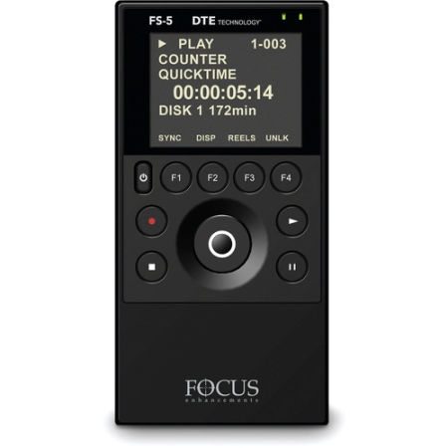
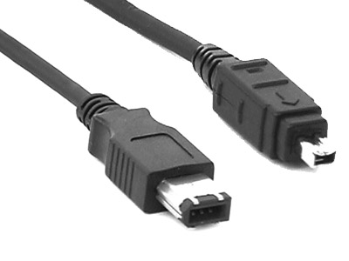
Equipment:
NYPL’s existing cameras and recording devices are dying—not to mention obsolete—and are costly to fix.
x 3
Camera Firewire cable External hard drive / CF card

Slide 20
People:
High-quality video production currently requires lots of people both to film and to edit—and this significantly increases production costs.
Recording audio is significantly cheaper than video (and we know audio gets more traffic), so we’ve already scaled back what we film in favor of recording audio only.

Slide 21
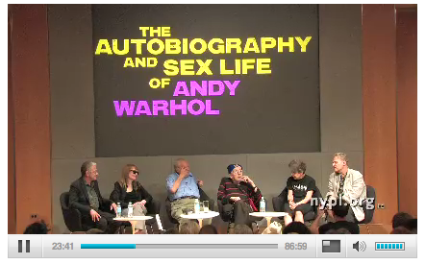
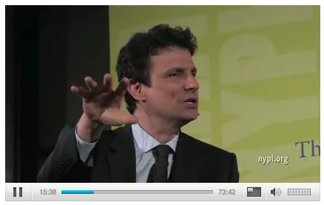
Quality:
The existing range in production quality makes an (unintentionally) negative statement about which programs the library does and does not value.
v.

Slide 22
IV. Needs and Opportunities

Slide 23
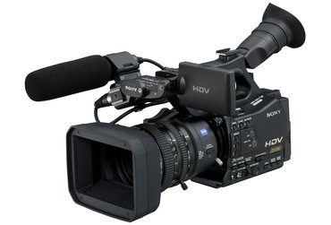
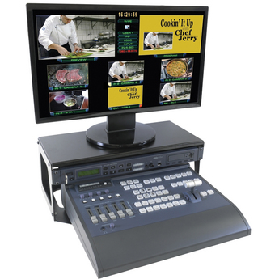
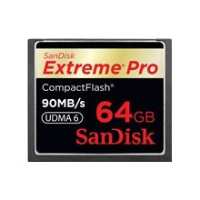
Equipment:
We still need more people to help film and edit—but better technology would both eliminate the need for hiring as many videographers and would slash editing time dramatically.
Camera
Internal CF cards
Switcher

Slide 24
Transcription:
Transcription meets NYPL’s mission to serve all populations—including those with visual and hearing impairments.
Some programs are transcribed, such as LIVE, but we’ve had requests for everything else to be transcribed.
Transcripts can also be used to make content searchable on the Web, which increases traffic to nypl.org.

Slide 25
Donor Recognition Ideas:
All videos could begin and end with a brief animation reflecting the sponsor name (just as the KidsLIVE and TeenLIVE videos do now).
All audio files could begin and end with sponsor recognition.
Sponsorship for individual series, for example, “Periodically Speaking is brought to you through the generosity of…”
Sponsorship for backstage and/or highlights videos.
Sponsorship of NYPL’s a/v page and/or other online presences such as YouTube and iTunes U.
Transcription sponsorship.

