Slide 1



Carbon Risk
AEA 2019
Atlanta, GA
January 4-6, 2019
Maximilian Görgen/Andrea Jacob/Martin Nerlinger/
Ryan Riordan/Martin Rohleder/Marco Wilkens
University of Augsburg, Queen‘s University

Slide 2
Outline
Motivation
Carbon Risk Factor Construction
Applications of Carbon Beta
Summary

Slide 3
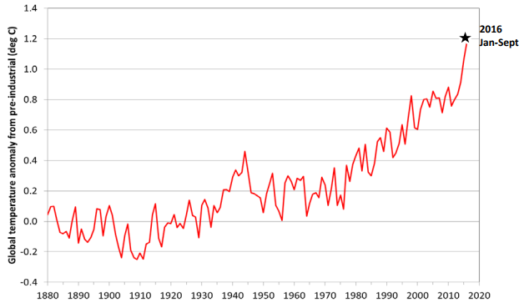
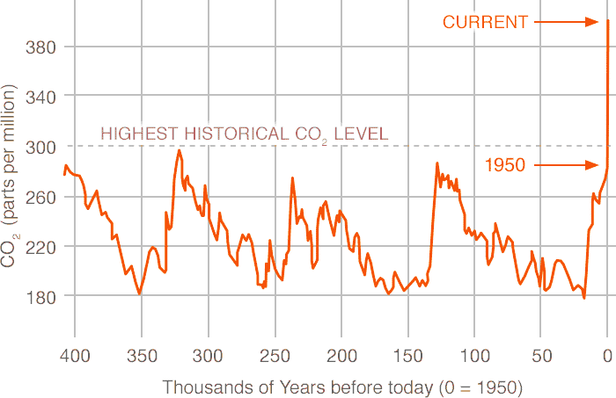
Motivation - Climate Change
Temperature anomaly is continually increasing
Atmospheric CO₂ emissions are rising rapidly
Source: NOAA, NASA, UK Met Office/CRU (2017); climate.nasa.gov (2018)

Slide 4


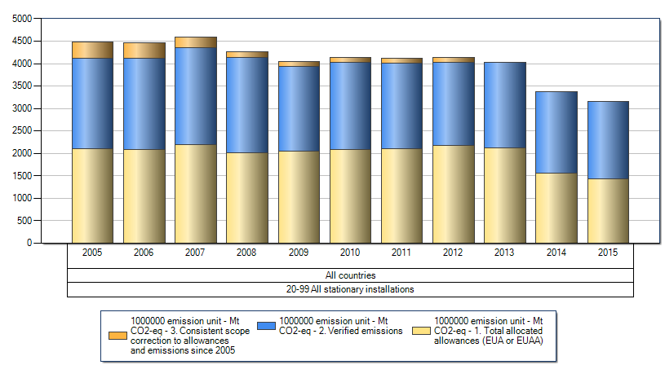





Motivation - Industry Transition Process
New agreements
Shift of interests
Changing business’ financials
e.g. Paris Agreement
e.g. Divestment movement
e.g. Emission certificates
Definition: Carbon Risk results from the transition process from a carbon-intensive brown economy to a low-carbon green economy.
Source: NY Times (2009), EEA (2015), thenation.com (2015), unepfi.org (2017), Fossil Free (2018) various

Slide 5
Motivation - Related Literature
Climate change as a general source of uncertainty for society as a whole
(e.g. Stern, 2008, AER; Dietz et al., 2016, Nat. Clim. Change; Diffenbaugh et al., 2018, Sci. Adv.)
Assessment of the effects of global warming on the world economy
(e.g. Nordhaus, 1993, Resour. Energy Econ.; Nordhaus/Yang, 1996, AER; Rogelj et al., 2018, Nat. Clim. Change)
Optimal policy for climate change and policy implications
(e.g. Fowlie et al., 2016, JPE; Lemoine/Rudik, 2017, AER; Mardones/Flores, 2018, Energy Econ.)
Carbon emissions and their impact on the value of a firm
(e.g. Haszeldine, 2009, Science; Krüger, 2015, JFE; Acemoglu et al., 2016, JPE; Fernando et al., 2017, JFQA)
Carbon emissions and their impact on the performance of a firm
(e.g. El Ghoul et al., 2011, JBF; Flammer, 2013, AMJ; Oestreich/Tsiakas, 2015, JBF)

Slide 6
Motivation - Contribution
Our Contribution
Development of a Carbon Risk Factor
Quantification of Carbon Risk with Carbon Beta
Provision of Carbon Beta applications and demonstration of their implications on various stakeholders

Slide 7
Outline
Motivation
Carbon Risk Factor Construction
Applications of Carbon Beta
Summary

Slide 8
Carbon Risk Factor
Carbon Risk Factor
Brown-minus-Green
Carhart model
Carbon Beta
Carbon Risk Factor is constructed controlling for size in analogy to, e.g., the HML factor (Fama and French, 1993, JFE)

Slide 9
Concept for identifying carbon risk firms
∆ Transition Process
Risk sources
New agreements
Shift of interests
Changing business’ financials
Carbon Risk Score
(CRS)
Risk indicators
Value Chain
Public Perception
Adaptability
Risk factor
Carbon Risk Factor (BMG)

Slide 10
Carbon Risk Score (CRS) data sample
Our unique data sample comprises four major databases:
  Carbon Disclosure Project (CDP)
  MSCI ESG Stats and IVA ratings
  Sustainalytics ESG Ratings
  Thomson Reuters ESG dataset
41,752 → 1,637 firms in 43 countries
785 → 55 carbon risk proxies
2010 to 2016
Financial data from Thomson Reuters Datastream

Slide 11
Determination of 55 Carbon Risk proxies & 3 subscores
Value Chain Subscore
Public Perception Subscore
Adaptability Subscore
Energy Use Total
CO₂ Equivalents Emission Total
Clean Technology
Renewable Energy Use
Sustainable Supply Chain
Carbon Intensity
Renewable Energy Use
Supplier Environmental Programmes
Sustainable Products & Services
Greenhouse Gas Emissions
Regulatory Opportunities Sources
Climate related Opp. Sources
Regulatory Risks Sources
Climate related Risks Sources
Opportunities in Clean Tech
Energy Efficiency
Opportunities Renewable Energy
Carbon Emissions
Regulatory Compliance
Emission Reduction Score
Resource Reduction Score
Environmental Score
Emissions Score Overall ESG Score
Scope of GHG Reporting
Disclosure Score
Performance Band
Climate Change Controversies
Industry-adjusted Overall Score
Emission Reduction Prod. Process
Climate Change Risks/Opportunities
Energy Efficiency Policy
Emission Reduction Target/Objective
Energy Efficiency Target/Objective
Environmental Investments Initiatives
Environmental Expenditures Investment
Environmental Expenditures
Environmental Partnerships
Environmental Provisions
Policy Emissions
Environmental R&D Expenditures
Innovation Score
Renewable Energy Programmes
Environmental Management System
Air Emissions Programmes
Environmental Policy
Green Procurement Policy
Regulatory Opportunities
Climate related Opportunities
Regulatory Risks
Climate related Risks
Emission Reduction Target
Carbon Emissions Score
Climate Change Theme Score
Environmental Pillar Score
Carbon Risk Score
(CRS)
Selection and assignment of Carbon Risk proxies evaluated by a workshop with climate and finance experts

Slide 12
Descriptive Statistics
Low correlations between factors
Factor | Mean excess return (%) | SD (%) | T-stat. | Correlations
 |  |  |  | BMG | er_{M} | SMB | HML | WML
BMG | –0.25 | 1.95 | –1.17 | 1.00
er_{M} | 0.76 | 4.02 | 1.74 | 0.09 | 1.00
SMB | 0.06 | 1.39 | 0.37 | 0.20 | –0.02 | 1.00
HML | 0.00 | 1.68 | –0.02 | 0.27 | 0.19 | –0.06 | 1.00
WML | 0.57 | 2.53 | 2.06 | –0.24 | –0.20 | 0.00 | –0.41 | 1.00

Slide 13
Test of factor relevance in CRS sample
Carbon Risk Factor shows expected signs on a significant basis and significant increase in adj. R²
 | 5F model including BMG
 | Alpha | er_{M} | SMB | HML | WML | BMG | adj. R² (%) | ∆ adj. R² (%)¹⁾
Low CRS | –0.001 | 1.143*** | 0.142* | –0.062 | –0.159*** | –0.328*** | 95.32 | 1.60***
2 | 0.001 | 1.012*** | 0.105 | 0.018 | –0.078* | –0.288*** | 95.61 | 1.58***
3 | 0.002** | 1.028*** | 0.169** | –0.055 | –0.116** | –0.143** | 94.59 | 0.32**
4 | 0.001 | 1.046*** | 0.171** | –0.023 | –0.077 | –0.096 | 94.06 | 0.09
5 | 0.000 | 1.011*** | 0.142 | 0.006 | –0.101* | –0.015 | 93.55 | –0.08
6 | 0.001 | 0.945*** | 0.200** | 0.060 | –0.094* | 0.127** | 93.99 | 0.26**
7 | 0.001 | 0.991*** | 0.212** | –0.007 | –0.074 | 0.415*** | 94.06 | 3.12***
8 | 0.000 | 1.084*** | 0.226** | 0.022 | –0.195*** | 0.448*** | 94.45 | 2.93***
9 | –0.003** | 1.078*** | 0.085 | –0.035 | –0.072 | 0.688*** | 93.06 | 6.88***
High CRS | –0.001 | 1.092*** | 0.214* | –0.008 | –0.165** | 1.019*** | 91.52 | 12.47***
¹⁾ Significance levels are based on an F-test for nested models

Slide 14
Data
Full sample
39,537 firms in 111 countries
2010 to 2016
Financial data from Morningstar Direct and Thomson Reuters Datastream

Slide 15
Comparison of common factor models in the full sample
BMG enhances explanatory power at a larger extent than common risk factors
Single stock regressions
 | Avg. ∆ adj. R² (%) | F-test at sign. level 5% (%)
(1) Fama/French vs. Carhart | 0.10 | 5.98
(2) Fama/French vs. Fama/French + BMG | 0.71 | 11.55
(3) CAPM vs. Fama/French | 1.02 | 11.49
(4) CAPM vs. CAPM + BMG | 0.84 | 12.05
(5) Carhart vs. Carhart + Pastor/Stambaugh factor | 0.01 | 5.01
(6) Carhart vs. Carhart + BMG | 0.69 | 11.55

Slide 16

Robustness Asset Pricing
Equal-weighted and value-weighted factor calculations
Different factor models (Fama/French, 1993; Carhart, 1997; Asness/Frazzini, 2013; Frazzini/Pedersen, 2013; Fama/French, 2015; Hou/Xue/Zhang, 2015)
Democratic orthogonalization of factors (Klein/Chow, 2013)
Decomposition of R² (Klein/Chow, 2013)
Factor spanning tests and split sample tests for deciles-table (Fama/French, 1993)
Various test asset portfolios and combined test asset portfolios (size/value, size/profitability, size/investment, sector portfolios, industry portfolios) (Lewellen/Nagel/Shanken, 2010)
Further Asset Pricing tests (Gibbons/Ross/Shanken, 1989; Fama/French, 2016; Barillas/Shanken, 2017, Fama/French, 2017; Hou/Xue/Zhang, 2017)

Slide 17
Outline
Motivation
Carbon Risk Factor Construction
Applications of Carbon Beta
Summary

Slide 18
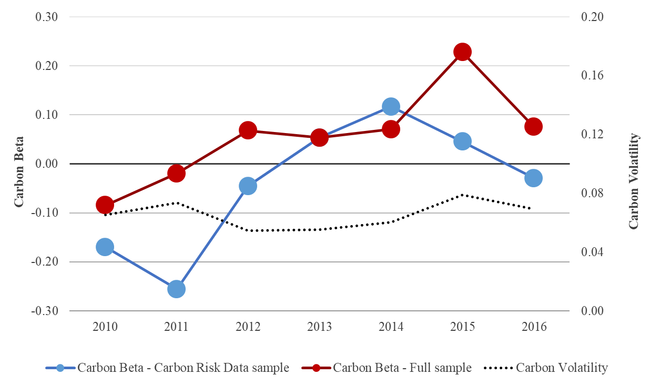
Carbon Beta over time
Carbon Beta is increasing over time from 2010 to 2016

Slide 19
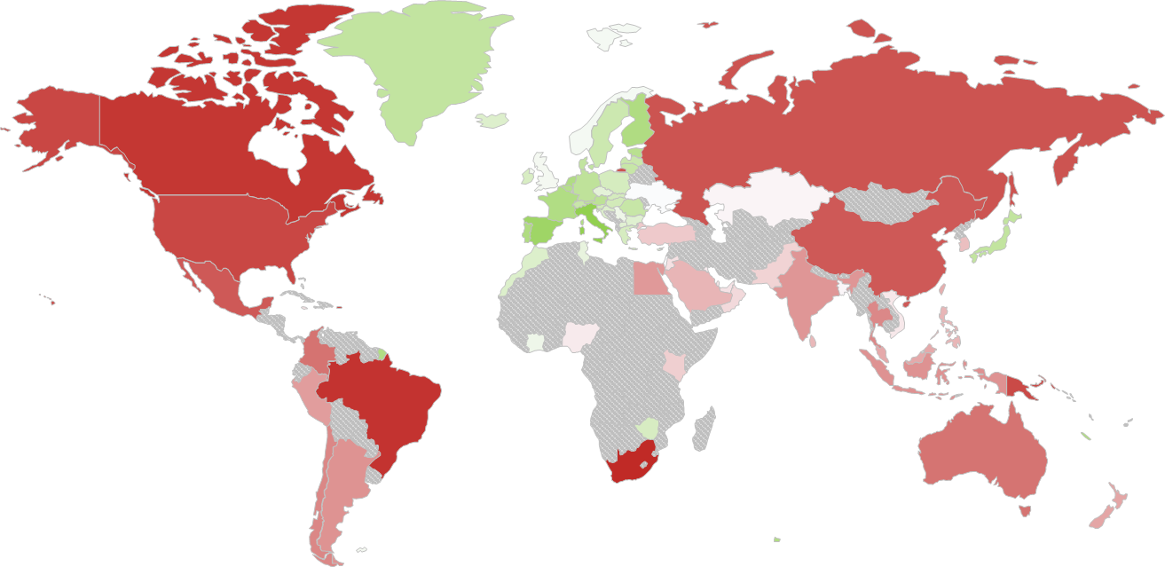

Carbon Beta landscape
Carbon Betas are widely distributed across the world with different country exposures

Slide 20
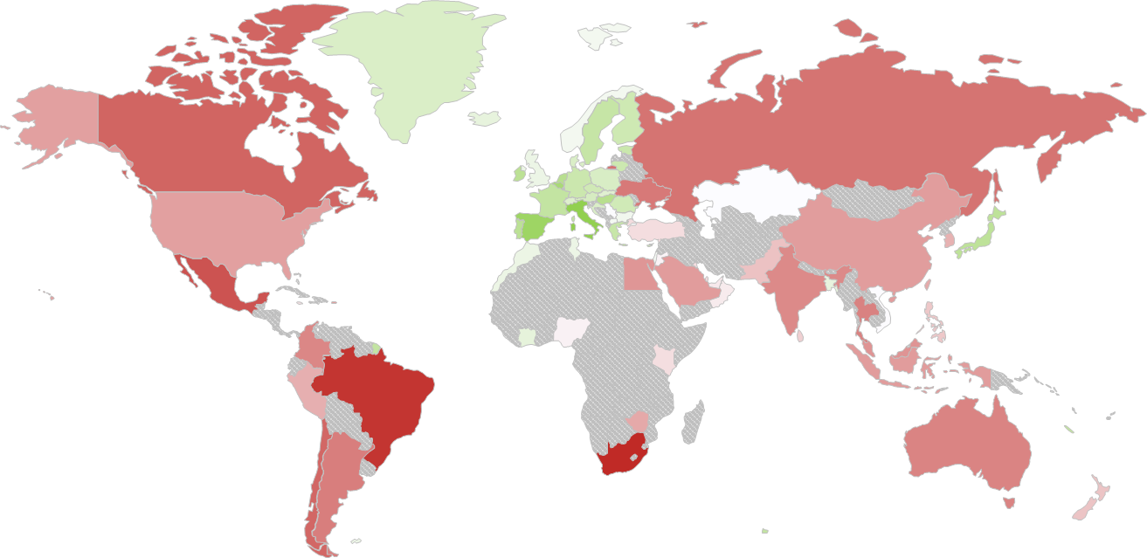
Carbon Beta in the financial industry
The financial industry has a direct role to play via the financing of firms

Slide 21
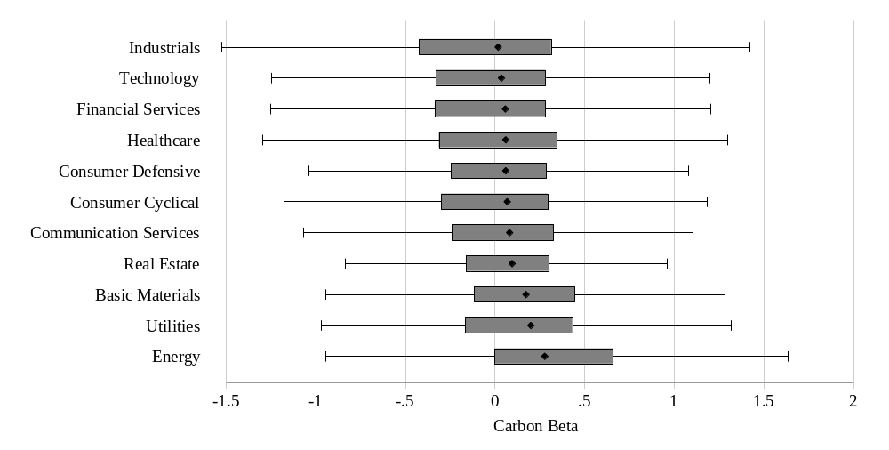
Carbon Beta industry breakdown
Carbon Betas are high in the Energy the Utilities and the Basic Materials sector and low in the Industrials, Technology and Financial Services sector

Slide 22
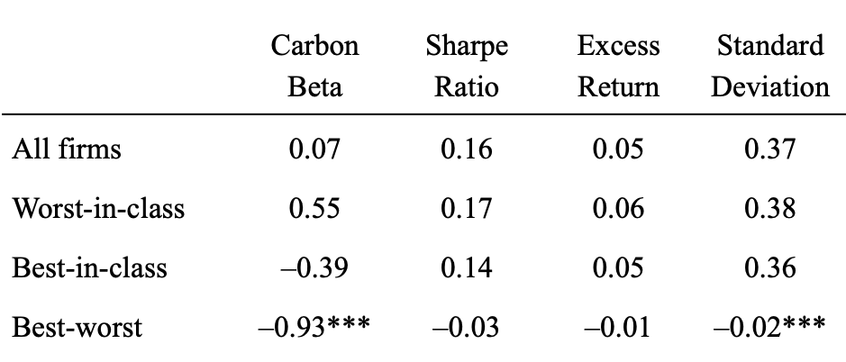
Managing Carbon Beta in industry portfolios
Portfolio manager can manage Carbon Beta exposures without sacrificing industry preferences or performance effects
11 Industry Portfolios

Slide 23
Explaining Carbon Betas in the full sample
Carbon Betas are related to fundamentals such as R&D and PPE
 | (1) | (2) | (3) | (4)
R&D expenditures | –0.020*** | –0.020*** | –0.021*** | –0.021***
PPE assets | 0.036*** | 0.0084** | 0.035*** | 0.036***
Leverage ratio | 0.015*** | –0.0075*** | 0.015*** | 0.015***
Book-to-market ratio | –0.16*** | –0.0037 | –0.16*** | –0.15***
Cash | –0.040*** | –0.0069*** | –0.040*** | –0.038***
Return on assets | –0.0033 | –0.011*** | –0.0043 | –0.00019
Net sales | –0.022*** | 0.0030 | –0.020*** | –0.021***
Country fixed effects | no | yes | no | no
Industry fixed effects | no | no | yes | no
Time fixed effects | no | no | no | yes
R² | 0.12 | 0.39 | 0.12 | 0.15
Within R² |  | 0.0071 | 0.12 | 0.11
N | 30,664 | 30,663 | 30,664 | 30,664

Slide 24
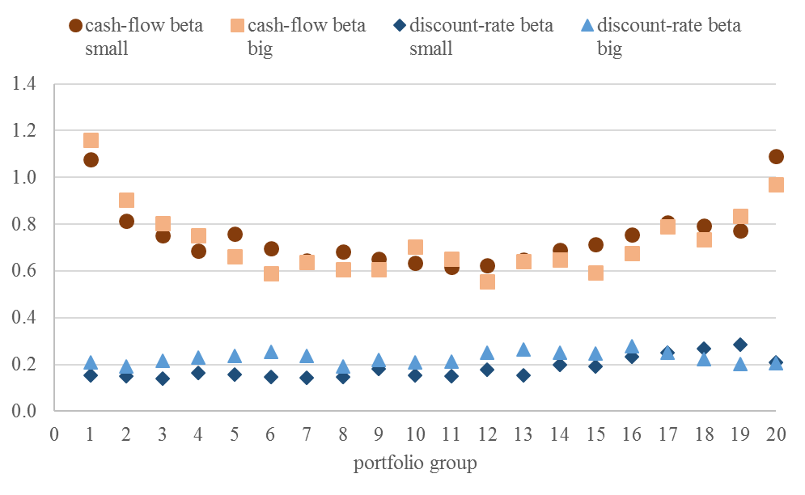
Beta decomposition of Carbon Beta portfolios
Cash-flow beta is distinctively higher than the discount-rate beta and extreme portfolios, i.e. green and brown firms, have higher cash-flow betas

Slide 25
Outline
Motivation
Carbon Risk Factor Construction
Applications of Carbon Beta
Summary

Slide 26
Main contribution
Constructing a Carbon Risk Factor and measure Carbon Risk
CRS is able to identify firms with high potential carbon risk
Carbon Risk Factor (BMG) enhances explanatory power of common factor models
Carbon Beta is an applicable measure for carbon risk
Applications of the Carbon Beta
Carbon Betas can be described over time, regions and industries
Portfolio managers and investors can directly manage carbon risk in their portfolios without neglecting preferences or having performance effects
Analysts and regulators can understand the carbon risk of firms

