Slide 1
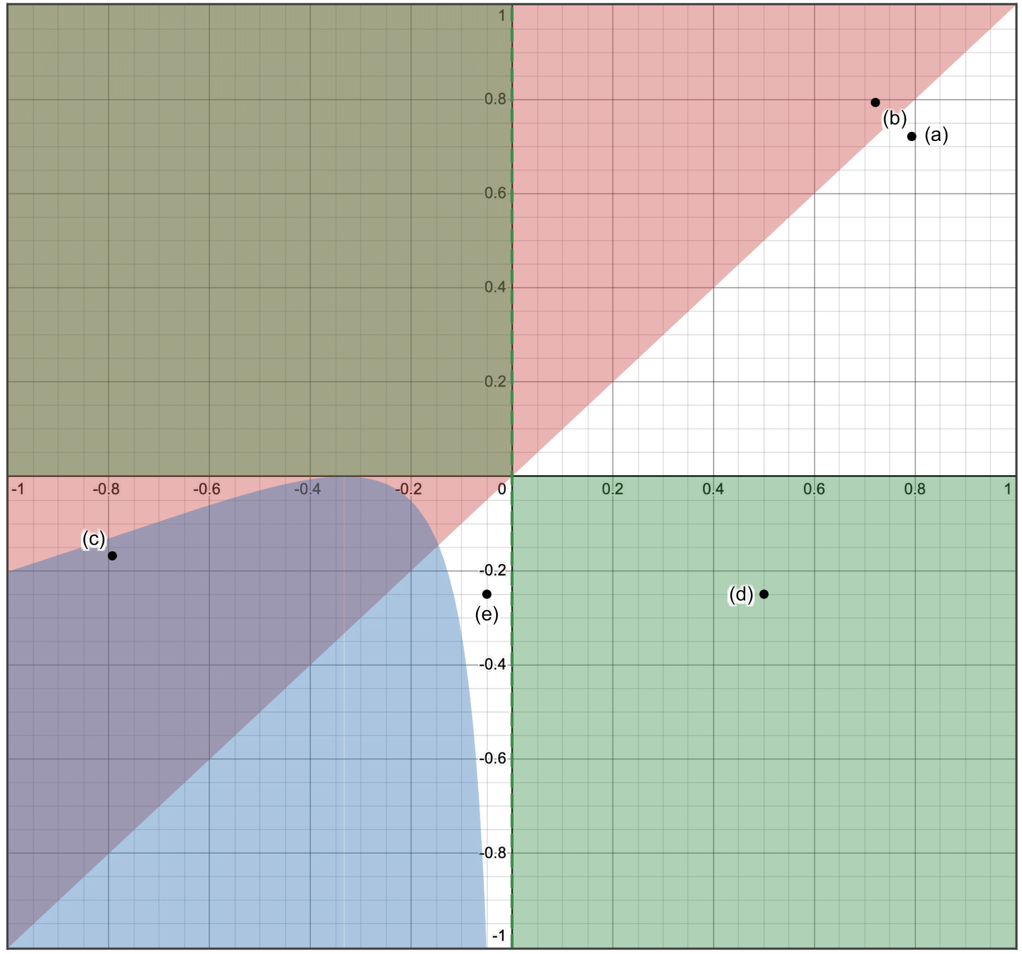
Yaw, Roll and Pitch Unstable
Pitch Unstable
Pitch Unstable
Yaw and Roll Unstable

